Slide 1
Zoo 103
Lab 6
By
lecturer: Jawahir ALGhamdi
Reem ALDosari

Slide 2
Fasciola
Classification
Kingdom :Animalia
Phylum: Platyhelminthes
Class :Trematoda
Genus: Fasciola

Slide 3
Causes the disease: Fascioliasis
Definitive host: Sheep, goat, cattle or man.
Intermediate hosts: Snails
Habitat: The adult worm lives in the bile duct of the liver of mammals.
Mode of infection: Humans can become infected by ingesting metacercariae-containing freshwater plants, especially watercress.
Infective stage: metacercaria

Slide 4
The characteristics of stages:
The adult worm:
It is leaf-like shape.
There are two suckers, the oral sucker and ventral sucker.
The alimentary canal begins with the month opening. This leads into a short muscular pharynx. is fol­lowed by the intestine which divides into two right and left branches.

Slide 5
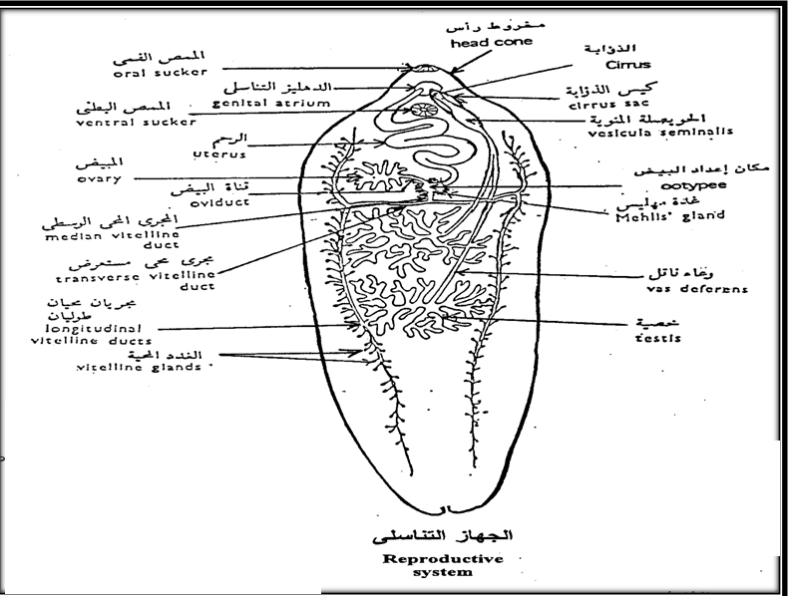
e) The male genital system consists of two testes lying approximately in the centre of the body branched and each gives off a vas deferens.
f) The female genital system consists of a single branched ovary.
.

Slide 6
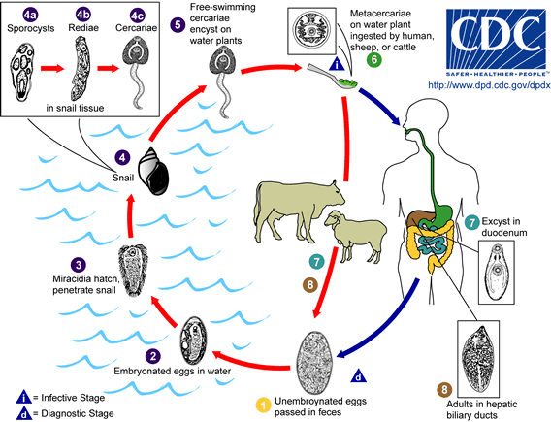
The Life cycle of Fasciola

Slide 7
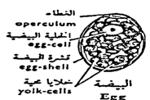
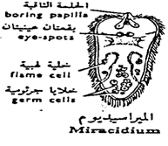
Stages in The Life ­cycle:-
The egg is Large, operculated, ovoid in shape, brownish yellow in colour (bile stained).
2. The miracidium is a free-living larva with an elongated body covered by cilia.

Slide 8
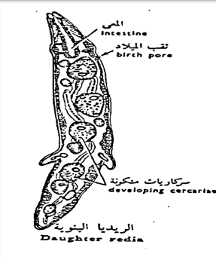
3. The sporocyst is sac­like.
4. The redia has an elongated body with many cercariae .

Slide 9
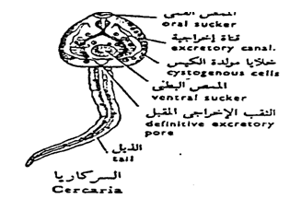
5. The cercaria has a heart-shaped body, a long simple tail, two suckers, and a pharynx.
6. The metacercaria or encysted cercaria is Round in shape, has lost the tail and is enclosed in a thick cyst.

Slide 10
Classification
Sponges
Kindom:Animalia
Sub kingdom :Parazoa
Phylum : Porifera
Genus: Sponges
Features:
Sponges are sessile with porous bodies and choanocytes.
Sponges lack nerves or muscles.
Most sponges are marine and some live in fresh water.
The body of a sponge consists of two cell layers separated by a gelatinous region, the mesohyl.
Most sponges are hermaphrodites.
The body of a simple sponge resembles a sac perforated with holes.
Nearly all sponges are suspension feeders, collecting food particles from water.

Slide 11
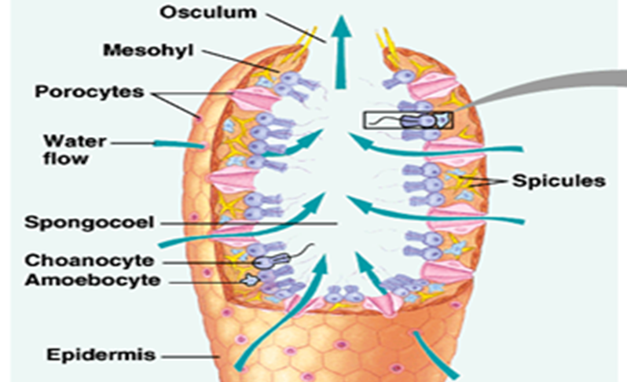

Slide 12
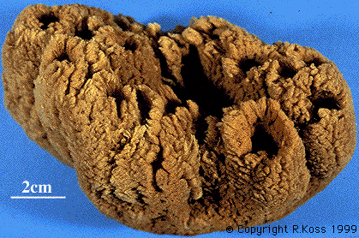
Euspongia

Slide 13
Classification
Kingdom: Animalia
Subkingdom: Metazoa
Division: Diplobiastic
Phylum: Coelenterata
Class: Hydrozoa
Ex.. Hydra
Hydra
They are radial symmetrical animals, mostly marine, solitary or colonial and sedentary or free-swim­, their body is built up of two cellular layers only, an outer ectoderm and an inner endo­derm.

Slide 14
External Features:
They have a relatively simple body construction.
The basic body plan is a sac with a central digestive compartment, the gastrovascular cavity.
Hydra exist only in the polyp form.
When environmental conditions are favourable, a hydra reproduces asexually by budding.
When condition deteriorate hydra can reproduce sexually Forming resistant zygote.
Hydra has testes at upper part and ovary at the lower part of the body.

Slide 15
Hydra
Reproduction way

Slide 17
Under The Microscope

Slide 18
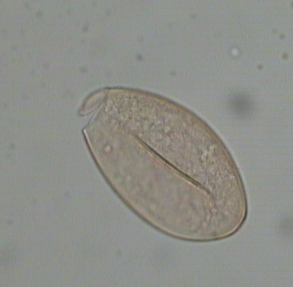
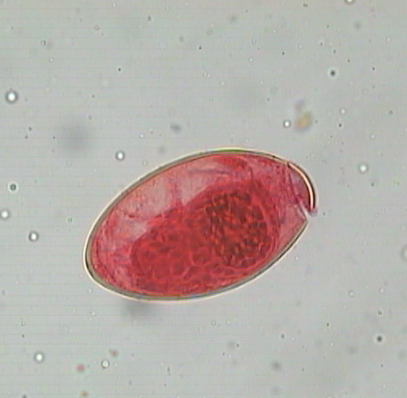
1
2
3
Fasciola egg
1-Operculum.
2-Developing miracidium.
3-Egg shell.

Slide 19
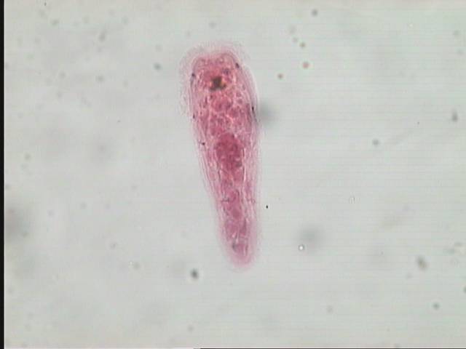
1
3
2
4
Miracidium of Fasciola
1-Boring papilla.
2-Cilia.
3-Eye Spots.
4-Germ celis.

Slide 20
1
2
Daughter radia of Fasciola
1- Developing radiae.
2- Sporocyst.

Slide 21
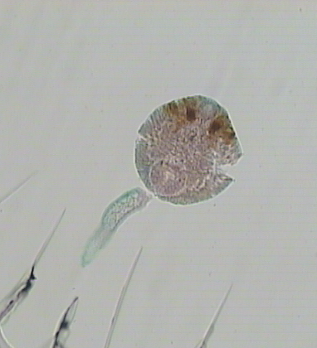
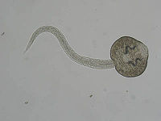
1
3
2
Cercaria of Fasciola
1- Head.
2-Tail.
3-Eye spot.

Slide 22
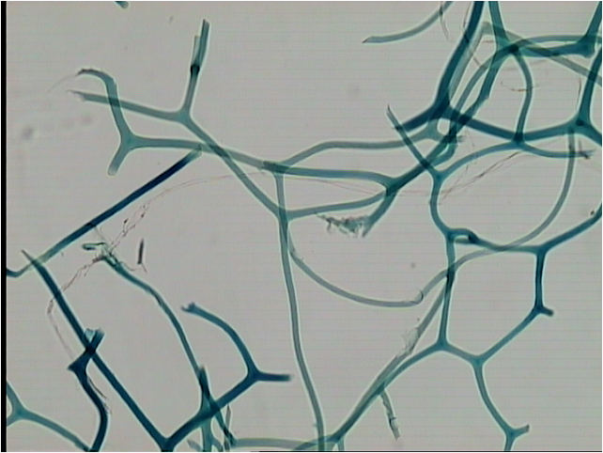
1-Spongia fibers from bath sponge.

Slide 23
3
2
1
Hydra - Male
1-Testes.
2-Oral cone.
3-Tentacles.
Notes:
23

Slide 24
3
2
1
Hydra - Female
1-Ovary.
2-Oral cone.
3-Tentacles.
Notes:
24

