Slide 1
GC201 Visual Programming
Installing Visual Studio 2010

Slide 2
Download Microsoft Visual Studio 2010
Open your browser and type the following address :
http://etc.ksu.edu.sa/ar
(you have to be in campus using the KSU network )
2-Click on

Slide 3
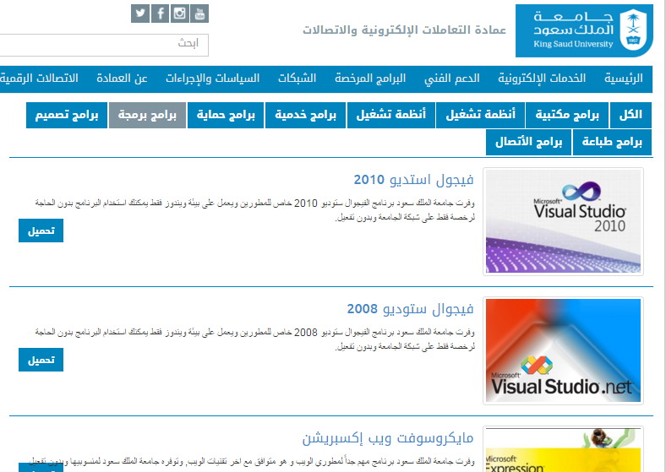
Click on

Slide 4
Installation
Microsoft Visual Studio 2010

Slide 5
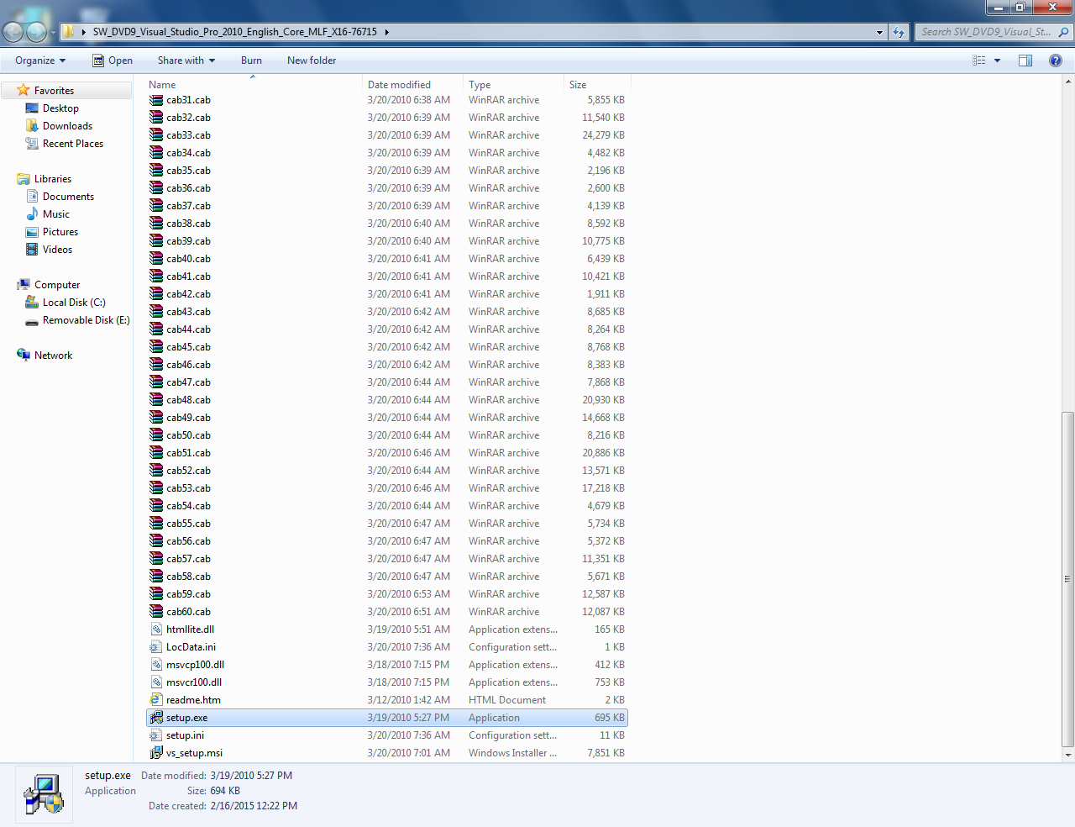
Setup.exe

Slide 6
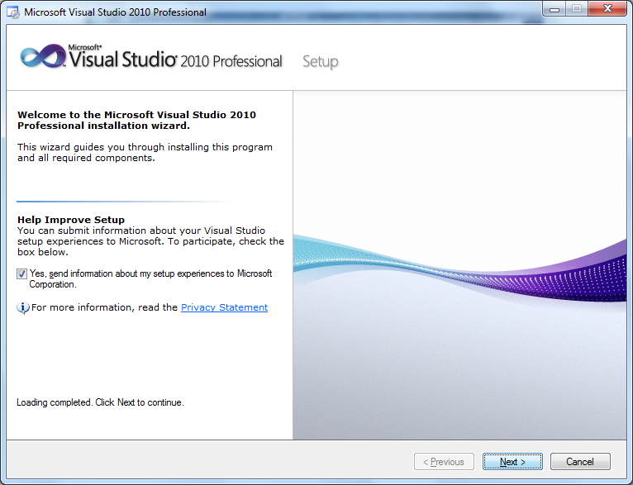

Slide 8
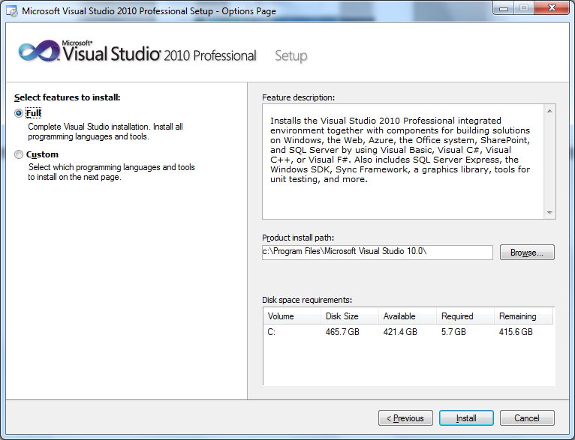

Slide 9
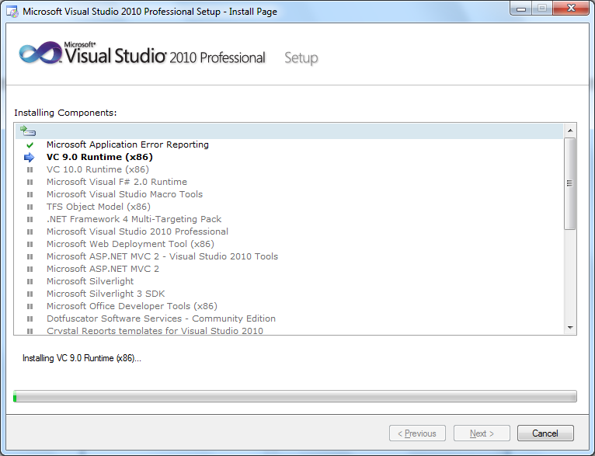
Now your installation is complete !

Slide 10
When you open the program for the first time

