Slide 1
Lab # 5 Dose Response Curve of Ach & The Effect of Different Drugs on Isolated Frog Rectus Abdominis

Slide 2
Nervous system
CNS
PNS
EFFERENT
AFFERENT
AUTONOMIC NERVOUS SYSTEM
SOMATIC NERVOUS SYSTEM
ENTERIC
SYMPATHETIC
PARA-SYMPATHETIC

Slide 3
Frog Rectus Abdominis:
Description:
It is a skeletal, voluntary, striated & transverse muscle .
It receives somatic motor innervations .
The transmission is mediated through release of Ach that acts on Nm Receptors present postsynaptically on the muscle .
Neuromuscular (myoneural)
junction
CNS
Voluntary motor nerve
Skeletal muscle
Nm -R

Slide 4
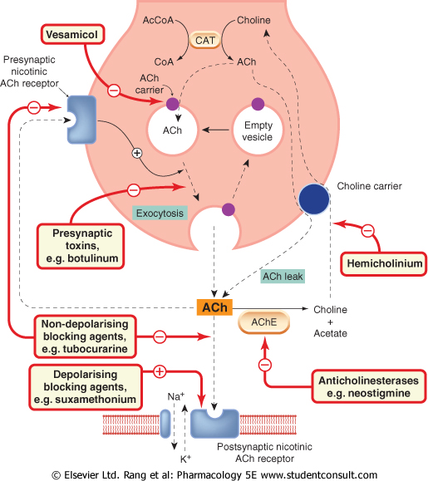

Slide 5
Neuromuscular transmission:
Action potential propagation through nerve fiber .
Calcium influx into the nerve ending .
Release of Ach from its vesicles (fusion with membrane & exocytosis) .
Release of Ach into synaptic cleft .
Ach binds to Nm-R postsynaptically .
Activation of Na+/K+ channels→ Na+ influx → contraction .
Ach action is terminated by cholinesterase enzyme .

Slide 6
Comparison between Nn & Nm:
Nn | Nm
smooth muscle | skeletal muscle
Located in ganglia | Located postsynaptically(MEP)

Slide 7
Drugs that act on skeletal muscles:
1- Centrally acting drugs:
e.g. Diazepam (skeletal muscle relaxant) .
2- Peripherally acting drugs:
a- Presynaptically .
b- Postsynaptically .

Slide 8
Drugs that act on skeletal muscles:
Presynaptically acting drugs :
1- ↓ AP propagation
e.g. local anesthetics
2- ↓ Ach synthesis
e.g. hemicholinium, vesamicol
3- ↓ Ach release
e.g. botulinum toxin
4- ↓ calcium conc.
e.g. Magnesium

Slide 9
Drugs that act on skeletal muscles:
Postsynaptically acting drugs:
A-Drugs that decrease transmission .
B-Drugs that increase transmission .

Slide 10
Drugs that act on skeletal muscles :
A- Drugs that decrease transmission
 | Non-depolarizing (Competitive) | Depolarizing (noncompetitive)
MOA | Competing with Ach at Nm-R . | They cause initial depolarization→ followed by persistent depolarization →transmission failure →receptor blockage .
Examples | Tubocurarine Gallamine | Succinylcholine Decamethonium
Type of paralysis produced | Flaccid | Spastic

Slide 11
Drugs that act on skeletal muscles :
B-Drugs that increase transmission:
Cholinesterase inhibitors:
1- Reversible:
e.g. neostigmine, physiostigmine
2- Irreversible:
e.g. organ phosphorus insecticides
* Both will lead to accumulation of Ach at myoneural junction .

Slide 12
Dose response curve of acetylcholine
The effect of different drugs on the
isolated frog rectus abdominis
PART 1
PART 2
A
N
B
W N
W+N
W+N
W+N
W+N
W+N
W+N
Ach
0.05ml
N
0.1ml
Ach
0.1ml
Ach
0.1ml
Ach
0.2ml
Ach
0.4ml
Ach
Ach 0.1ml
0.1ml
Ach
Physiostegmine
0.1ml
Curare 0.1ml
Height = A-B

