Slide 1
RIP

Slide 2
Static Routing

Slide 3
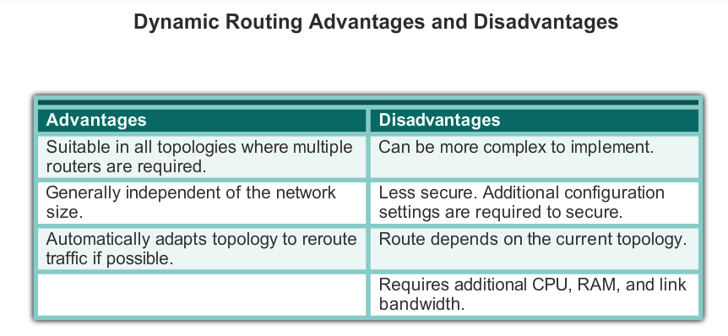
Dynamic Routing Protocols
Notes:
Dynamic routing protocols work well in any type of network consisting of several routers. They are scalable and automatically determine better routes if there is a change in the topology. Although there is more to the configuration of dynamic routing protocols, they are simpler to configure in a large network.
There are disadvantages to dynamic routing. Dynamic routing requires knowledge of additional commands. It is also less secure than static routing because the interfaces identified by the routing protocol send routing updates out. Routes taken may differ between packets. The routing algorithm uses additional CPU, RAM, and link bandwidth.
Notice how dynamic routing addresses the disadvantages of static routing.

Slide 4
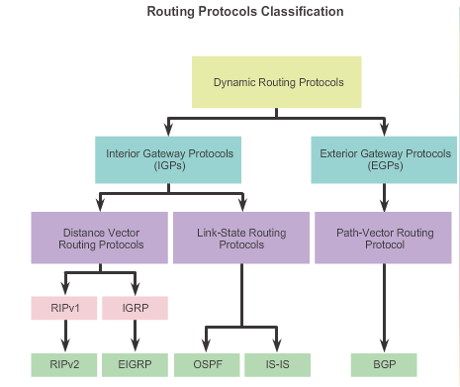
Classifying Routing Protocols

Slide 5
Classful Routing Protocols
Classful routing protocols do not send subnet mask information in their routing updates
Only RIPv1 and IGRP are classful
Created when network addresses were allocated based on classes (class A, B, or C)
Cannot provide variable length subnet masks (VLSMs) and classless interdomain routing (CIDR)
Notes:
5
7.1.4.5

Slide 6
Classless Routing Protocols
Classless routing protocols include subnet mask information in the routing updates
RIPv2, EIGRP, OSPF, and IS_IS
Support VLSM and CIDR
IPv6 routing protocols
Notes:
6
7.1.4.6

Slide 7
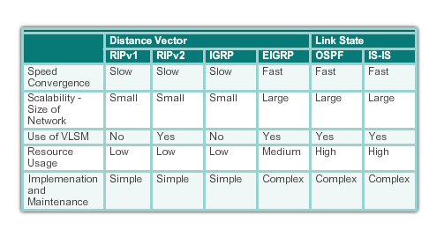
Routing Protocol Characteristics

Slide 8
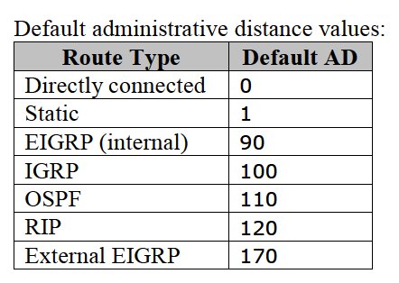
RIP Administrative Distance

Slide 9
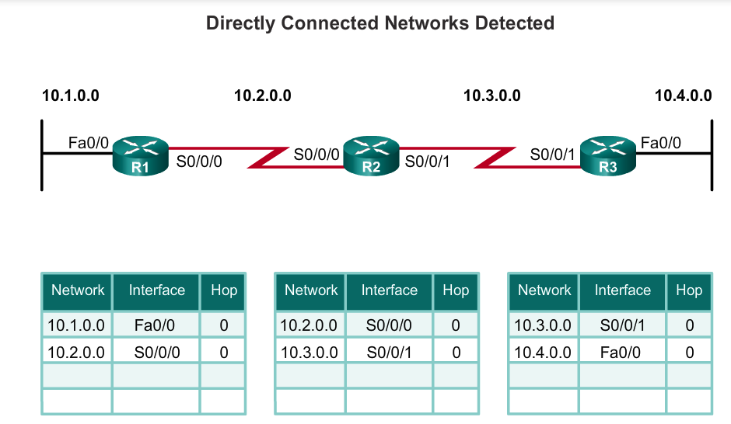
Cold Start
R1 adds the 10.1.0.0 network available through interface FastEthernet 0/0 and 10.2.0.0 is available through interface Serial 0/0/0.
R2 adds the 10.2.0.0 network available through interface Serial 0/0/0 and 10.3.0.0 is available through interface Serial 0/0/1.
R3 adds the 10.3.0.0 network available through interface Serial 0/0/1 and 10.4.0.0 is available through interface FastEthernet 0/0.
Notes:
When a router powers up, it knows nothing about the network topology. It does not even know that there are devices on the other end of its links. The only information that a router has is from its own saved configuration file stored in NVRAM. After a router boots successfully, it applies the saved configuration. If the IP addressing is configured correctly, then the router initially discovers its own directly connected networks.

Slide 10
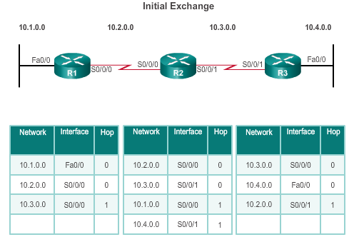
Network Discovery
R1:
Sends an update about network 10.1.0.0 out the Serial0/0/0 interface
Sends an update about network 10.2.0.0 out the FastEthernet0/0 interface
Receives update from R2 about network 10.3.0.0 with a metric of 0
Stores network 10.3.0.0 in the routing table with a metric of 1
Notes:
If a routing protocol is configured, the next step is for the router to begin exchanging routing updates to learn about any remote routes.
The router sends an update packet out all interfaces that are enabled on the router. The update contains the information in the routing table, which currently are all directly connected networks.
At the same time, the router also receives and processes similar updates from other connected routers. Upon receiving an update, the router checks it for new network information. Any networks that are not currently listed in the routing table are added.
After this first round of update exchanges, each router knows about the connected networks of their directly connected neighbors.

Slide 11
Network Discovery
R2:
Sends an update about network 10.3.0.0 out the Serial 0/0/0 interface
Sends an update about network 10.2.0.0 out the Serial 0/0/1 interface
Receives an update from R1 about network 10.1.0.0 with a metric of 0
Stores network 10.1.0.0 in the routing table with a metric of 1
Receives an update from R3 about network 10.4.0.0 with a metric of 0
Stores network 10.4.0.0 in the routing table with a metric of 1

Slide 12
Network Discovery
R3:
Sends an update about network 10.4.0.0 out the Serial 0/0/1 interface
Sends an update about network 10.3.0.0 out the FastEthernet0/0
Receives an update from R2 about network 10.2.0.0 with a metric of 0
Stores network 10.2.0.0 in the routing table with a metric of 1

Slide 13
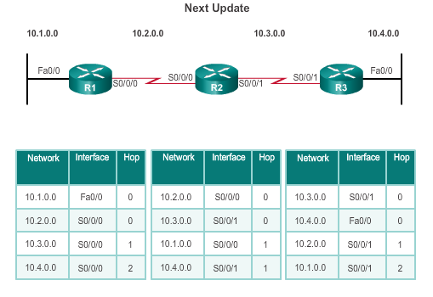
Network Discovery
R1:
Sends an update about network 10. 1. 0. 0 out the Serial 0/0/0 interface
Sends an update about networks 10. 2. 0. 0 and 10. 3. 0. 0 out the FastEthernet0/0 interface
Receives an update from R2 about network 10. 4. 0. 0 with a metric of 1
Stores network 10. 4. 0. 0 in the routing table with a metric of 2
Same update from R2 contains information about network 10. 3. 0. 0 with a metric of 0. There is no change; therefore, the routing information remains the same

Slide 14
Network Discovery
R2:
Sends an update about networks 10. 3. 0. 0 and 10. 4. 0. 0 out of Serial 0/0/0 interface
Sends an update about networks 10. 1. 0. 0 and 10. 2. 0. 0 out of Serial 0/0/1 interface
Receives an update from R1 about network 10. 1. 0. 0. There is no change; therefore, the routing information remains the same.
Receives an update from R3 about network 10. 4. 0. 0. There is no change; therefore, the routing information remains the same.

Slide 15
Network Discovery
R3:
Sends an update about network 10. 4. 0. 0 out the Serial 0/0/1 interface
Sends an update about networks 10. 2. 0. 0 and 10. 3. 0. 0 out the FastEthernet0/0 interface
Receives an update from R2 about network 10. 1. 0. 0 with a metric of 1
Stores network 10. 1. 0. 0 in the routing table with a metric of 2
Same update from R2 contains information about network 10. 2. 0. 0 with a metric of 0. There is no change; therefore, the routing information remains the same.

Slide 16
Configuring the RIP Protocol

Slide 17
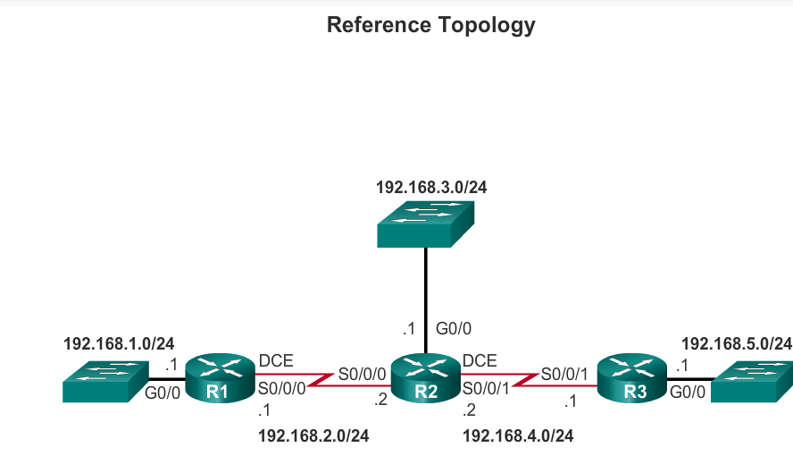
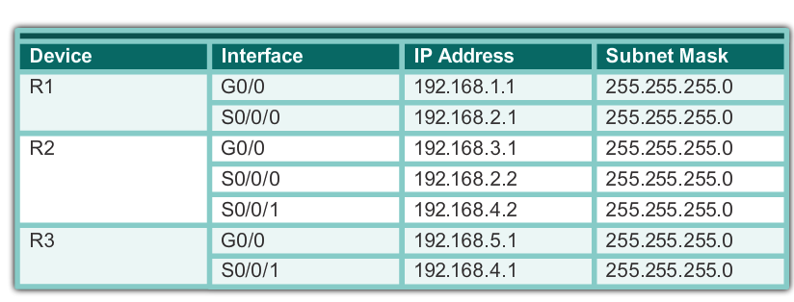
Reference Topology

Slide 18
Entering Routing Configuration Mode
Notes:
This command does not directly start the RIP process. Instead, it provides access to the router configuration mode where the RIP routing settings are configured.
To disable and eliminate RIP, use the no router rip global configuration command. This command stops the RIP process and erases all existing RIP configurations.

Slide 19
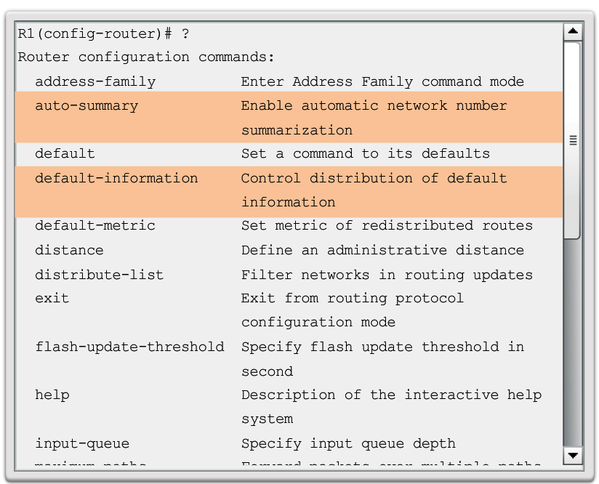
RIP Configuration Options

Slide 20
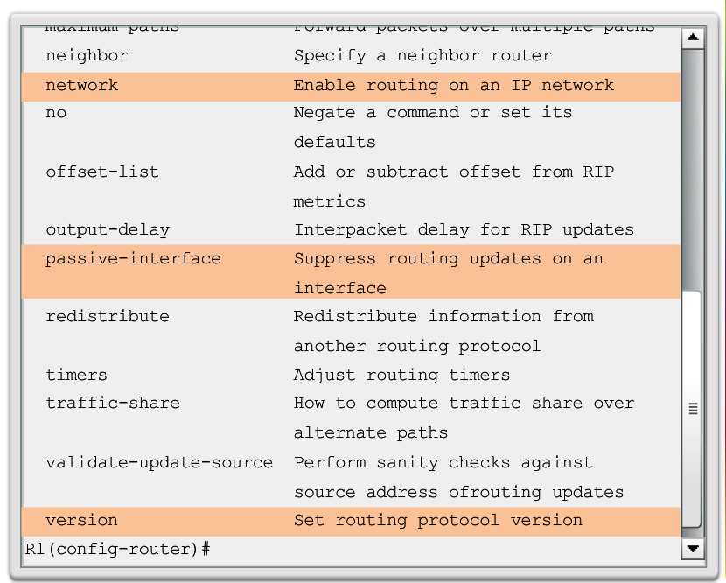
RIP Configuration Options

Slide 21
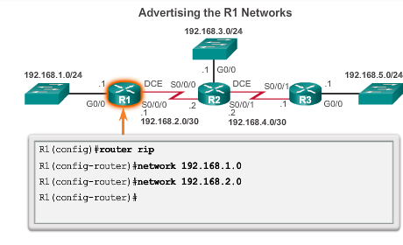
Advertising Networks
To enable RIP routing for a network
Enter the classful network address for each directly connected network.
Notes:
21
By entering the RIP router configuration mode, the router is instructed to run RIP. But the router still needs to know which local interfaces it should use for communication with other routers, as well as which locally connected networks it should advertise to those routers.
the network command is used to advertise the R1 directly connected networks.
To enable RIP routing for a network, use the network network-address router configuration mode command. Enter the classful network address for each directly connected network. This command:
Enables RIP on all interfaces that belong to a specific network. Associated interfaces now both send and receive RIP updates.
Advertises the specified network in RIP routing updates sent to other routers every 30 seconds.
Note: If a subnet address is entered, the IOS automatically converts it to the classful network address. Remember RIPv1 is a classful routing protocol for IPv4. For example, entering the network 192.168.1.32 command would automatically be converted to network 192.168.1.0 in the running configuration file. The IOS does not give an error message, but instead corrects the input and enters the classful network address.

Slide 22
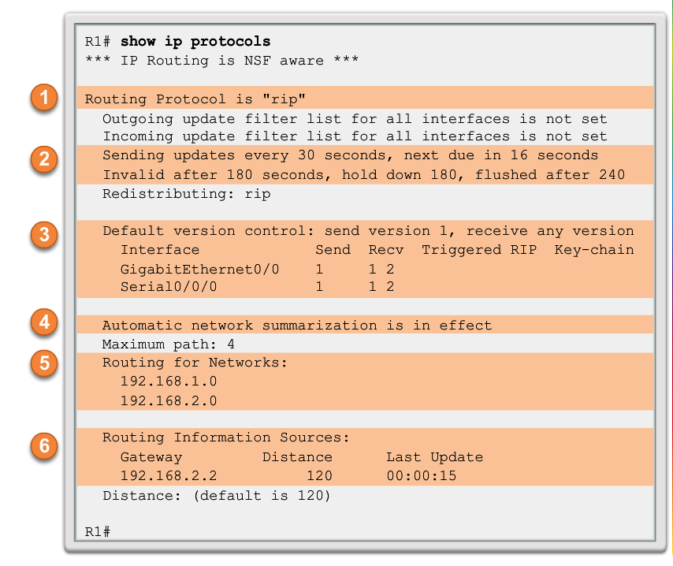
Verifying RIP Setting
Notes:
The show ip protocols command displays the IPv4 routing protocol settings currently configured on the router. This output displayed in Figure 1 confirms most RIP parameters including:
1. RIP routing is configured and running on router R1.
2. The values of various timers; for example, the next routing update, is sent by R1 in 16 seconds.
3. The version of RIP configured is currently RIPv1.
4. R1 is currently summarizing at the classful network boundary.
5. The classful networks are advertised by R1. These are the networks that R1 include in its RIP updates.
6. The RIP neighbors are listed including their next-hop IP address, the associated AD that R2 uses for updates sent by this neighbor and when the last update was received from this neighbor.

Slide 23
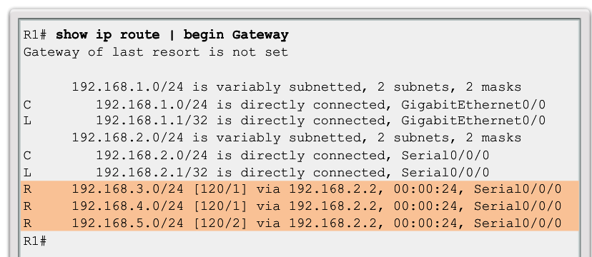
Verifying RIP Setting

Slide 24
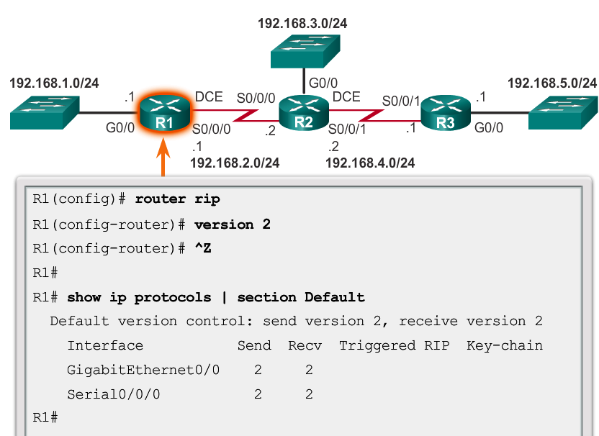
Enabling RIPv2
Notes:
By default, when a RIP process is configured on a Cisco router, it is running RIPv1, as shown in Figure 1. However, even though the router only sends RIPv1 messages, it can interpret both RIPv1 and RIPv2 messages. A RIPv1 router ignores the RIPv2 fields in the route entry.
Use the version 2 router configuration mode command to enable RIPv2, as shown in Figure 2. Notice how the show ip protocols command verifies that R2 is now configured to send and receive version 2 messages only. The RIP process now includes the subnet mask in all updates, making RIPv2 a classless routing protocol.
Note: Configuring version 1 enables RIPv1 only, while configuring no version returns the router to the default setting of sending version 1 updates but listening for version 1 or version 2 updates.

Slide 25
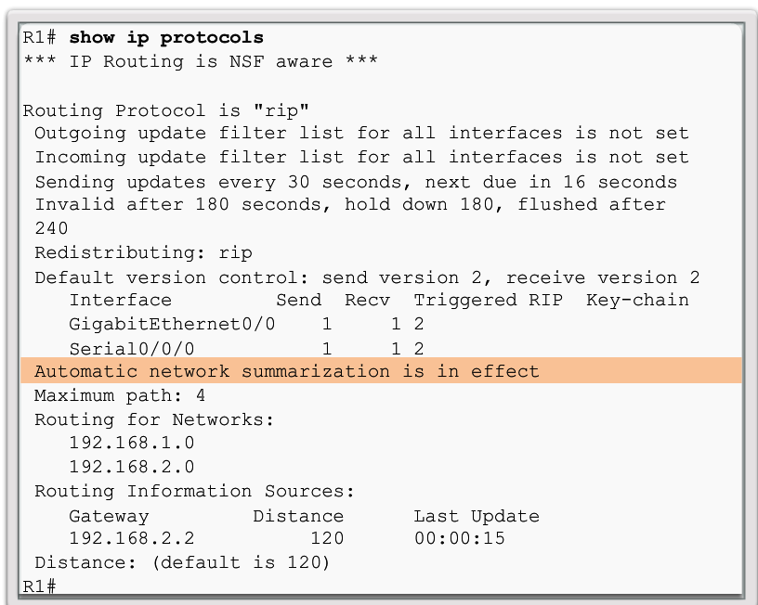
Automatic Summarization with RIPv2
Notes:
RIPv2 automatically summarizes networks at major network boundaries by default, just like RIPv1.

Slide 26
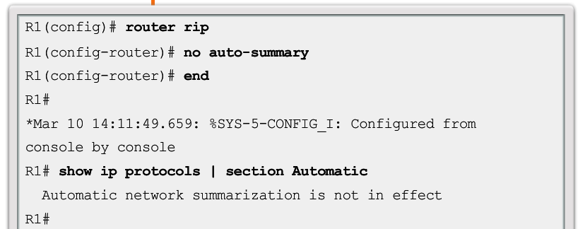
Disabling Auto Summarization
To modify the default RIPv2 behavior of automatic summarization
Notes:
This command has no effect when using RIPv1. When automatic summarization has been disabled, RIPv2 no longer summarizes networks to their classful address at boundary routers. RIPv2 now includes all subnets and their appropriate masks in its routing updates.
Note: RIPv2 must be enabled before automatic summarization is disabled.

Slide 27
Configuring Passive Interfaces
By default, RIP updates are forwarded out all RIP enabled interfaces.
However, RIP updates really only need to be sent out interfaces connecting to other RIP enabled routers.

Slide 28
Configuring Passive Interfaces
RIP sends updates out of its G0/0 interface even though no RIP device exists on that LAN.
R1 has no way of knowing this and, as a result, sends an update every 30 seconds.
Sending out unneeded updates on a LAN impacts the network in three ways:
Wasted Bandwidth
Wasted Resources
Security Risk
Notes:
Wasted Bandwidth - Bandwidth is used to transport unnecessary updates. Because RIP updates are either broadcasted or multicasted; therefore, switches also forward the updates out all ports.
Wasted Resources - All devices on the LAN must process the update up to the transport layers, at which point the devices will discard the update.
Security Risk - Advertising updates on a broadcast network is a security risk. RIP updates can be intercepted with packet sniffing software. Routing updates can be modified and sent back to the router, corrupting the routing table with false metrics that misdirect traffic.

Slide 29
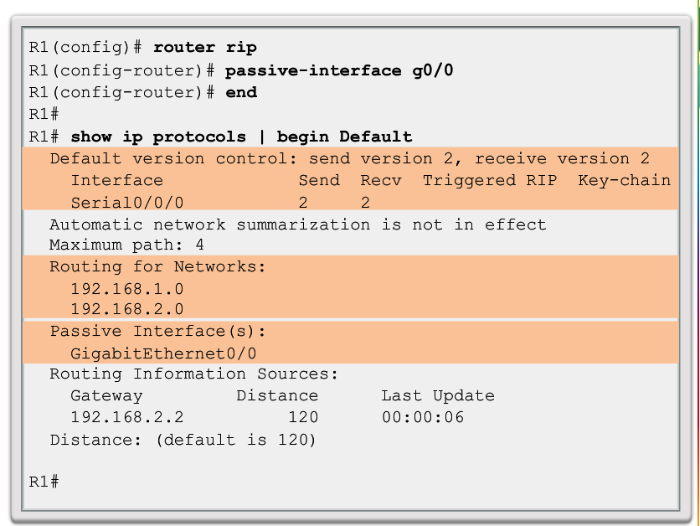
Configuring Passive Interfaces
Notes:
Use the passive-interface router configuration command to prevent the transmission of routing updates through a router interface, but still allow that network to be advertised to other routers. The command stops routing updates out the specified interface. However, the network that the specified interface belongs to is still advertised in routing updates that are sent out other interfaces.
As an alternative, all interfaces can be made passive using the passive-interface default command. Interfaces that should not be passive can be re-enabled using the no passive-interface command.

Slide 30
Propagating a Default Route
R1 has is a default static route going out of the Serial 0/0/1 interface
Similar default static routes could be configured on R2 and R3, but it is much more scalable to enter it one time on the edge router R1 and then have R1 propagate it to all other routers using RIP.

Slide 31
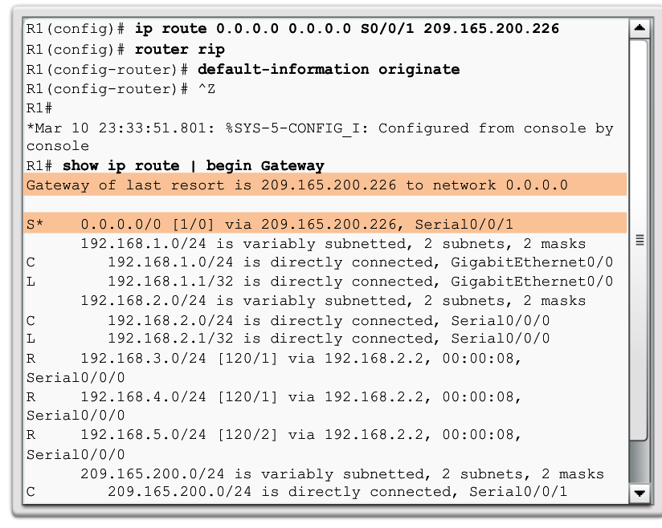
Propagating a Default Route

Slide 32
Propagating a Default Route

