Slide 1
Frame Relay

Slide 2
Outline
Why do we need Frame Relay?
Virtual Circuits
DLCI
Frame Relay Address Mapping
Building the network and configuring the cloud
Basic Frame Relay Configuration Steps
Frame Relay Encapsulation
Configuring a Static Frame Relay Map
Layer 3 Addressing with Frame Relay
One subnet containing all Frame Relay DTEs
One subnet per VC
A hybrid of the first two options
Frame Relay Subinterfaces
point-to-point
multipoint

Slide 3
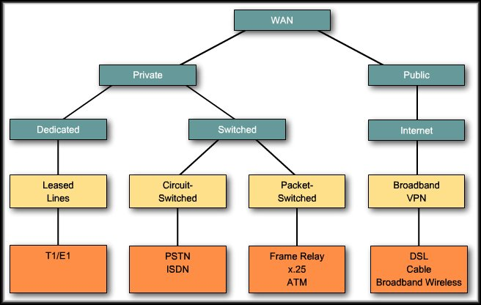
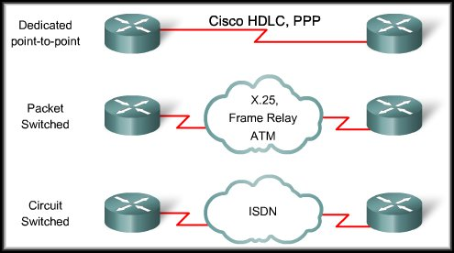

Slide 4
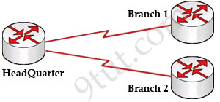
Why do we need Frame Relay?
Frame Relay is a more complex technology than point-to-point WAN links but also provides more features and benefits
Notes:
Let’s take a simple example. Suppose you are working in a big company and your company has just expanded to two new locations. The main site is connected to two branch offices, named Branch 1 & Branch 2 and your boss wants these two branches can communicate with the main site. The most simple solution is to connect them directly (called a leased line) as shown below
To connect to these two branches, the main site router, HeadQuarter, requires two serial interfaces which a router can provide. But what happens when the company expands to 10 branches, 50 branches? For each point-to-point line, HeadQuarter needs a separate physical serial interface (and maybe a separate CSU/DSU if it is not integrated into the WAN card). As you can imagine, it will need many routers with many interfaces and lots of rack space for the routers and CSU/DSUs. Maybe we should use another solution for this problem? Luckily, Frame Relay can do it!
By using Frame Relay we only need one serial interface at the HeadQuarter to connect to all branches. This is also true when we expand to 10 or 50 branches. Moreover, the cost is much lesser than using leased-lines.

Slide 5
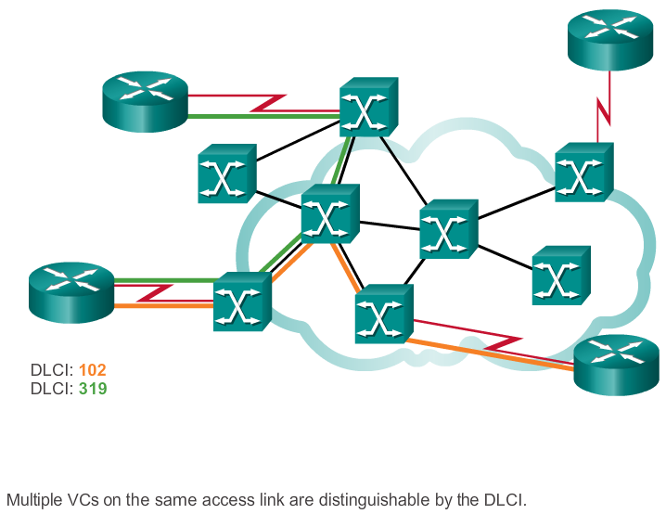
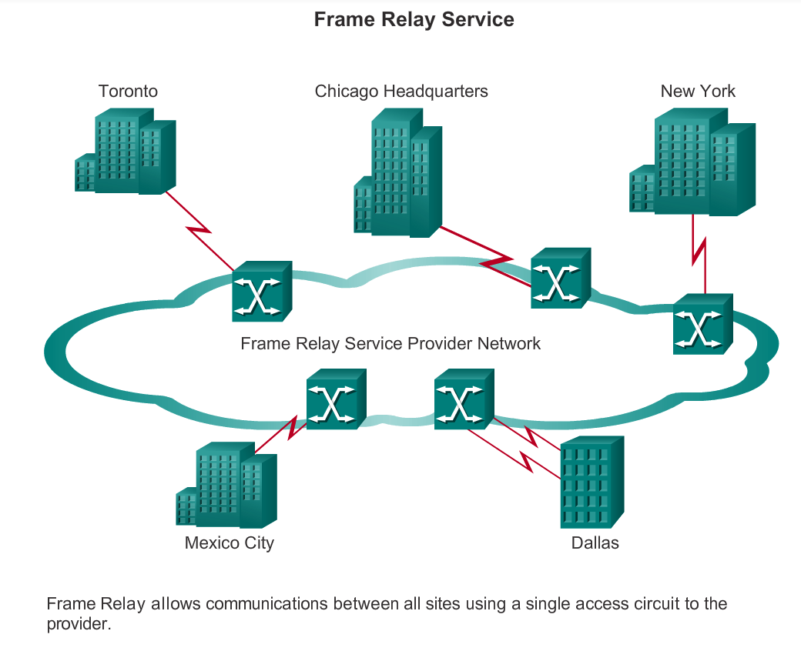
Virtual Circuits

Slide 6
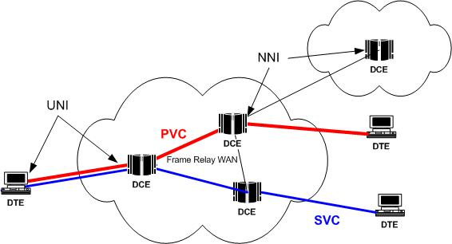
Virtual Circuits
The connection through a Frame Relay network between two DTEs is a virtual circuit (VC) .
VC is a means of transporting data over a packet switched network in such a way that it appears as though there is a dedicated physical layer link between the 2 DTEs.
There are two types of VCs:
Notes:
With VCs, Frame Relay shares the bandwidth among multiple users and any single site can communicate with any other single site without using multiple dedicated physical lines.

Slide 7
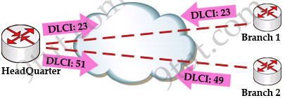
DLCI
The router , connected to the Frame Relay network, may have multiple VCs connecting it to various endpoints.
Multiple VCs on a single physical line are distinguished by assigning each VC an identifier called data-link connection identifiers (DLCI) .
DLCIs have local significance
Notes:
VCs are identified by DLCIs.
Frame Relay DLCIs have local significance, that means that their values are unique per router, but not necessarily in the other routers.
DLCI values typically are assigned by the Frame Relay service provider.

Slide 8
Frame Relay Address Mapping

Slide 9
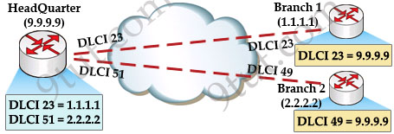
Frame Relay Address Mapping
Before DLCI can be used to route traffic, it must be associated with the IP address of its remote router

Slide 10
Mapping of DLCI
The mapping of DLCIs to Layer 3 addresses can be handled manually or dynamically.
Manually (static): the administrators can statically assign a DLCI to the remote IP address.
Dynamic: the router can send an Inverse ARP Request to the other end of the PVC for its Layer 3 address.
Notes:
We should use the “broadcast” keyword here because by default split-horizon will prevent routing updates from being sent back on the same interface it received. For example, if Branch 1 sends an update to HeadQuarter then HeadQuarter can’t send that update to Branch 2 because they are received and sent on the same interface. By using the “broadcast” keyword, we are telling the HeadQuarter to send a copy of any broadcast or multicast packet received on that interface to the virtual circuit specified by the DLCI value in the “frame-relay map” statement. In fact the copied packet will be sent via unicast (not broadcast) so sometimes it is called “pseudo-broadcast”.

Slide 11
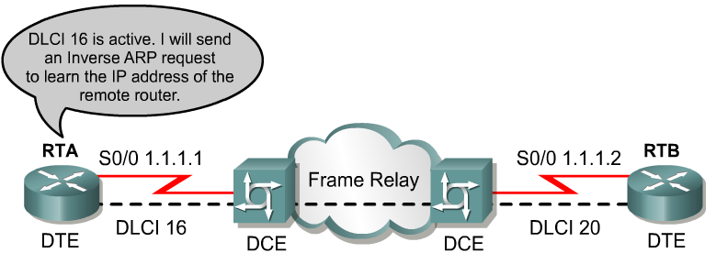
Inverse ARP
2
1
Once the router learns from the switch about available PVCs and their corresponding DLCIs, the router can send an Inverse ARP request to the other end of the PVC. (unless statically mapped )

Slide 12
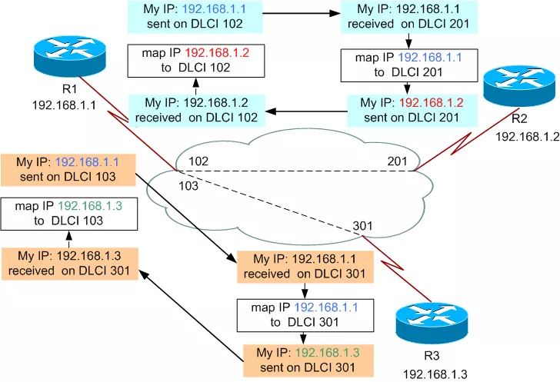
Now all the routers have a pair of DLCI & IP address of the router at the other end so data can be forwarded to the right destination.

Slide 13
Frame Relay Configuration

Slide 14
Outline
Why do we need Frame Relay?
Virtual Circuits
DLCI
Frame Relay Address Mapping
Building the network and configuring the cloud
Basic Frame Relay Configuration Steps
Frame Relay Encapsulation
Configuring a Static Frame Relay Map
Layer 3 Addressing with Frame Relay
One subnet containing all Frame Relay DTEs
One subnet per VC
A hybrid of the first two options
Frame Relay Subinterfaces
point-to-point
multipoint

Slide 15
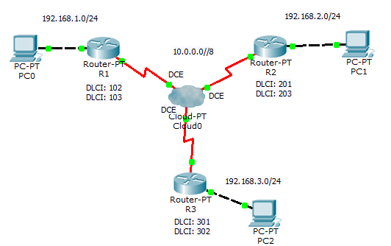
Building the Network

Slide 16
Evaluation

Slide 17
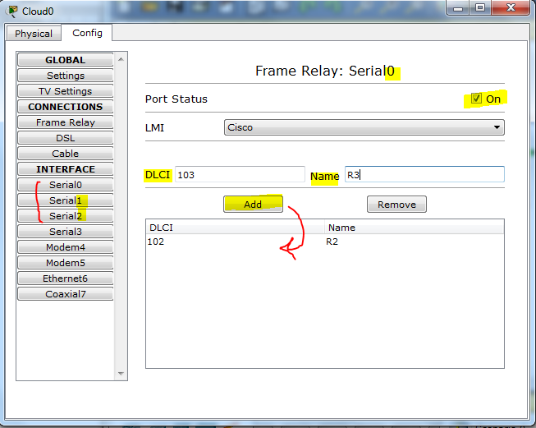
Configuring the cloud ( Frame Relay network)
Configure the DLCIs on the all the active serial interfaces of the cloud

Slide 18
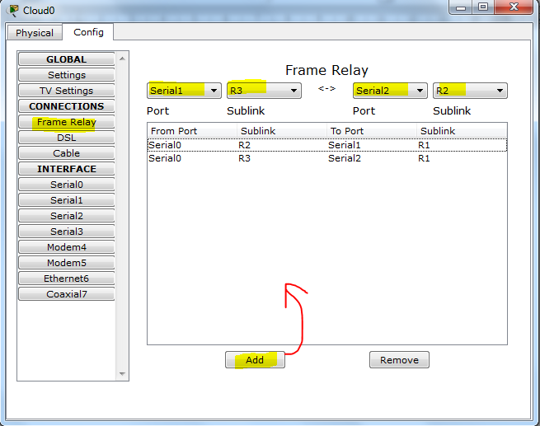
Configuring the cloud ( Frame Relay network)
Setup the VCs

Slide 19
Outline
Why do we need Frame Relay?
Virtual Circuits
DLCI
Frame Relay Address Mapping
Building the network and configuring the cloud
Basic Frame Relay Configuration Steps
Frame Relay Encapsulation
Configuring a Static Frame Relay Map
Layer 3 Addressing with Frame Relay
One subnet containing all Frame Relay DTEs
One subnet per VC
A hybrid of the first two options
Frame Relay Subinterfaces
point-to-point
multipoint

Slide 20
Basic Frame Relay Configuration Steps
Notes:
4.2.1.1 Basic Frame Relay Configuration Commands

Slide 21
Frame Relay Encapsulation
Router(config-if)#encapsulation frame-relay {cisco | ietf}
cisco - Default.
Use this if connecting to another Cisco router.
Ietf -
Select this if connecting to a non-Cisco router.

Slide 22
R1(config)# interface serial 2/0
R1(config-if)# ip address 10.0.0.1 255.0.0.0
R1(config-if)# encapsulation frame-relay
R2(config)# interface serial 2/0
R2(config-if)# ip address 10.0.0.2 255.0.0.0
R2(config-if)# encapsulation frame-relay

Slide 23
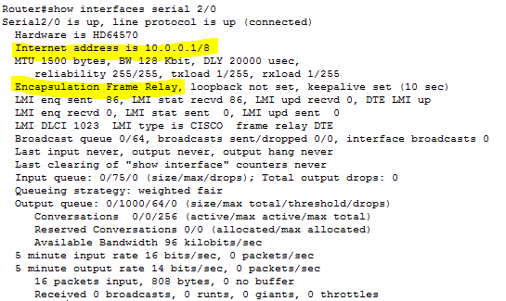
Verifies Frame Relay Configuration

Slide 24
Mapping of DLCI
The mapping of DLCIs to Layer 3 addresses can be handled manually or dynamically.
Manually (static): the administrators can statically assign a DLCI to the remote IP address.
Dynamic: the router can send an Inverse ARP Request to the other end of the PVC for its Layer 3 address.
Notes:
We should use the “broadcast” keyword here because by default split-horizon will prevent routing updates from being sent back on the same interface it received. For example, if Branch 1 sends an update to HeadQuarter then HeadQuarter can’t send that update to Branch 2 because they are received and sent on the same interface. By using the “broadcast” keyword, we are telling the HeadQuarter to send a copy of any broadcast or multicast packet received on that interface to the virtual circuit specified by the DLCI value in the “frame-relay map” statement. In fact the copied packet will be sent via unicast (not broadcast) so sometimes it is called “pseudo-broadcast”.

Slide 25
R1# show frame-relay map
Serial0 (up): ip 10.0.0.2 dlci 102, dynamic, broadcast, status defined, active
dynamic refers to the router learning the IP address via Inverse ARP

Slide 26
Configuring a Static Frame Relay Map
Notes:
4.2.1.2 Configuring a Static Frame Relay Map

Slide 27
Configuring a Static Frame Relay Map
Use the frame-relay map command to configure static address mapping.
Once a static map for a given DLCI is configured, Inverse ARP is disabled on that DLCI.
The broadcast keyword is commonly used with the frame-relay map command.
The broadcast keyword simplifies the configuration of OSPF for nonbroadcast networks that use Frame Relay.

Slide 28
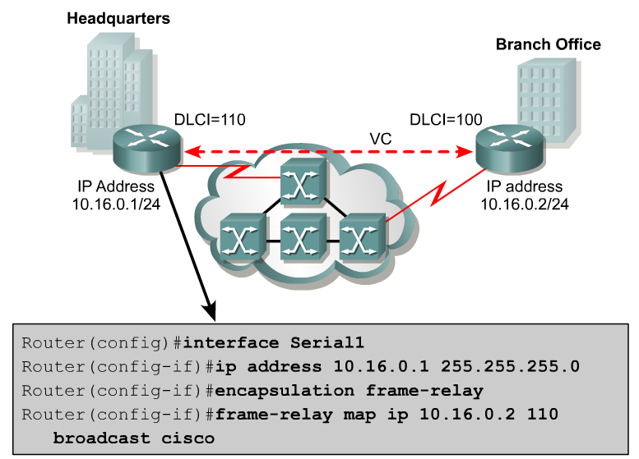
Remote IP Address
Local DLCI

Slide 29
Notes:
4.1.2.6 Frame Relay Address Mapping

Slide 30
Outline
Why do we need Frame Relay?
Virtual Circuits
DLCI
Frame Relay Address Mapping
Building the network and configuring the cloud
Basic Frame Relay Configuration Steps
Frame Relay Encapsulation
Configuring a Static Frame Relay Map
Layer 3 Addressing with Frame Relay
One subnet containing all Frame Relay DTEs
One subnet per VC
A hybrid of the first two options
Frame Relay Subinterfaces
point-to-point
multipoint

Slide 31
Layer 3 Addressing with Frame Relay
Cisco's Frame Relay implementation defines three different options for assigning subnets and IP addresses on Frame Relay interfaces:
One subnet containing all Frame Relay DTEs
One subnet per VC
A hybrid of the first two options

Slide 32
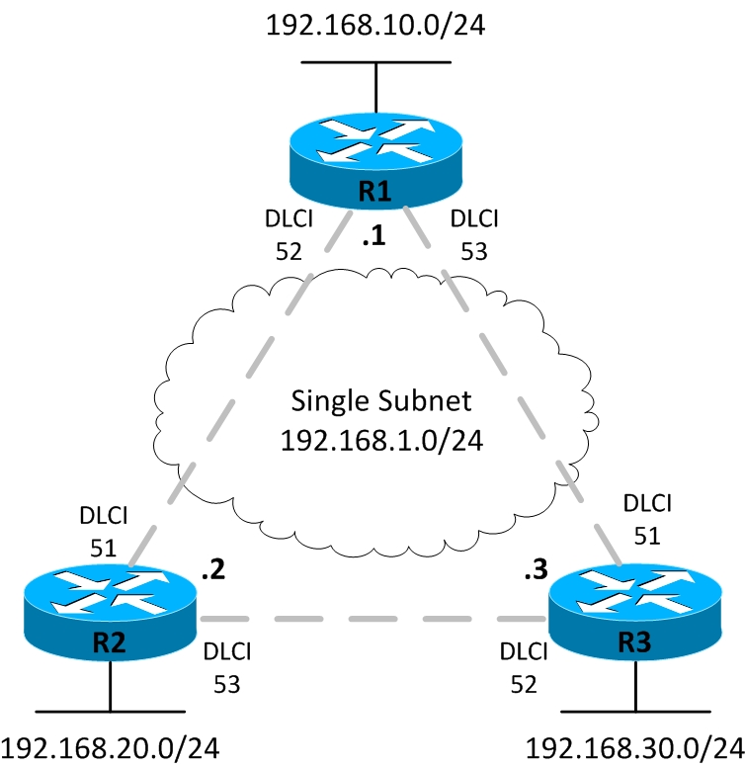
One Subnet Containing All Frame Relay DTEs
Is the using of a single subnet for the Frame Relay network.
The single-subnet option is typically used when a full mesh of VCs exists.
Notes:
https://www.youtube.com/watch?v=mjjWp5RjMX0
https://www.youtube.com/watch?v=mjjWp5RjMX0
https://www.youtube.com/watch?v=luEQzT__dAk
https://www.youtube.com/watch?v=JpUveApljiw

Slide 33
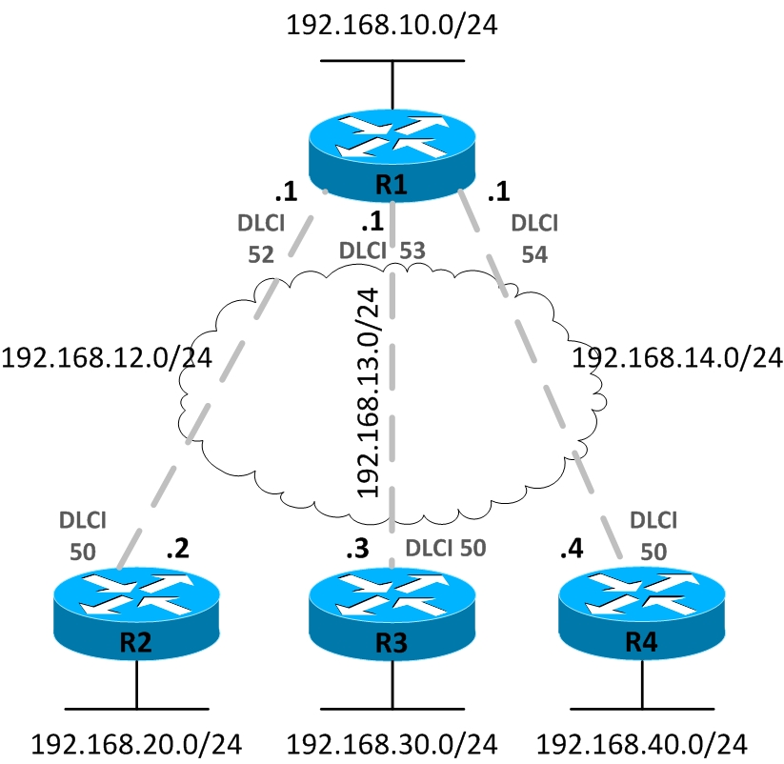
One Subnet Per VC

Slide 34
One Subnet Per VC
The single-subnet-per-VC works better with a partially meshed or star Frame Relay network.
The single-subnet-per-VC alternative matches the logic behind a set of point-to-point links.
Using multiple subnets instead of one larger subnet wastes some IP addresses, but it overcomes some issues with distance vector routing protocols.

Slide 35
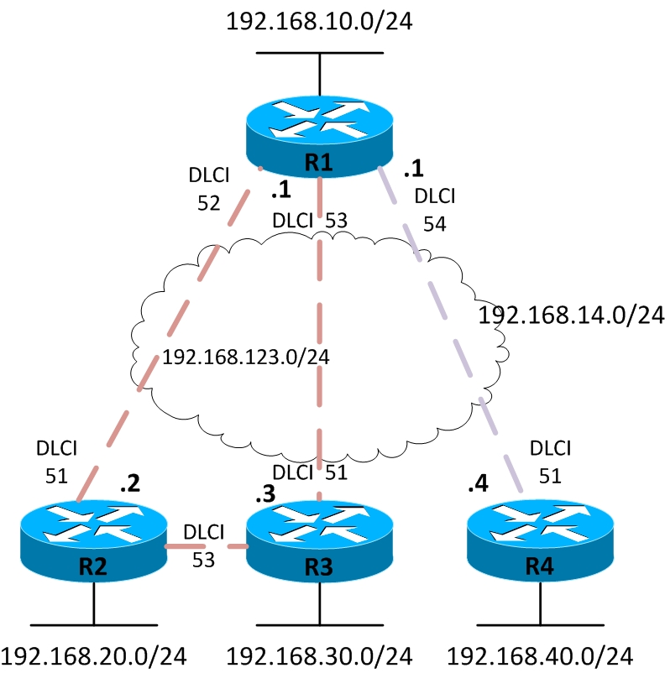
Hybrid Approach
Routers 1,2 , and 3 create a smaller full mesh between each other.
This allows Routers 1,2, and 3 to use one subnet.
Is treated as a separate subnet

Slide 36
Hybrid Approach
We are going to have both point-to-point and multipoint sub-interfaces.
Multipoint interfaces are logical Frame Relay sub-interfaces but they can terminate more than one PVCs just like physical serial interfaces.

Slide 37
Outline
Why do we need Frame Relay?
Virtual Circuits
DLCI
Frame Relay Address Mapping
Building the network and configuring the cloud
Basic Frame Relay Configuration Steps
Frame Relay Encapsulation
Configuring a Static Frame Relay Map
Layer 3 Addressing with Frame Relay
One subnet containing all Frame Relay DTEs
One subnet per VC
A hybrid of the first two options
Frame Relay Subinterfaces
point-to-point
multipoint

Slide 38
Frame Relay Subinterfaces
Frame Relay can partition a physical interface into multiple virtual interfaces called subinterfaces.
A subinterface is simply a logical interface that is directly associated with a physical interface.
Therefore, a Frame Relay subinterface can be configured for each of the PVCs coming into a physical serial interface.

Slide 39
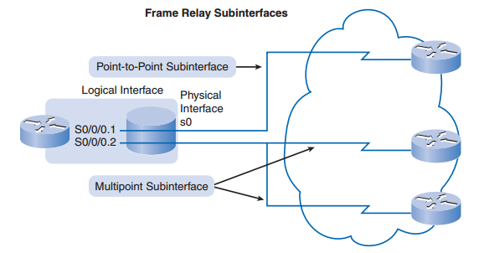
Frame Relay Subinterfaces
Frame Relay subinterfaces can be configured in either point-to-point or multipoint mode:

Slide 40
Point-to-Point Subinterface
A single point-to-point subinterface establishes one PVC connection to another physical interface or subinterface on a remote router.
In this case, each pair of the point-to-point routers is on its own subnet, and each point-to-point subinterface has a single DLCI.
In a point-to-point environment, each subinterface acts like a separate, conventional point-to-point interface.

Slide 41
Multipoint Subinterface
A single multipoint subinterface establishes multiple PVC connections to multiple physical interfaces or subinterfaces on remote routers.
All the participating interfaces are in the same subnet.

Slide 42
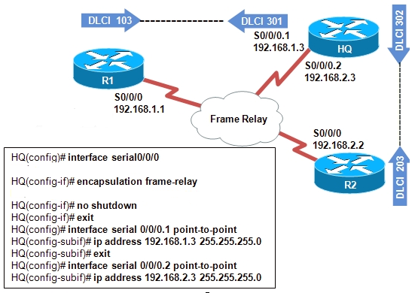
Assigning IP address to point-to-point subinterfacses

Slide 43
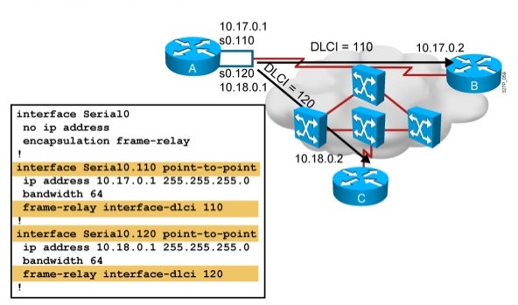
Mapping DLCI in point-to-point subinterfacses

Slide 44
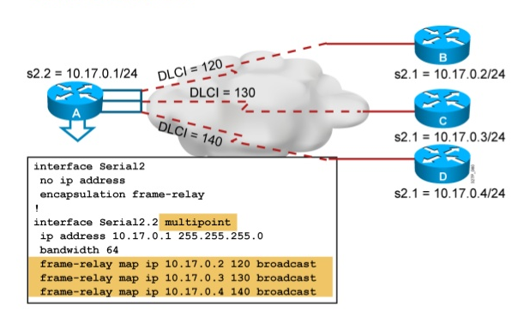
Multipoint subinterface

