Slide 1
LAB
(3)
ANEMIA

Slide 2
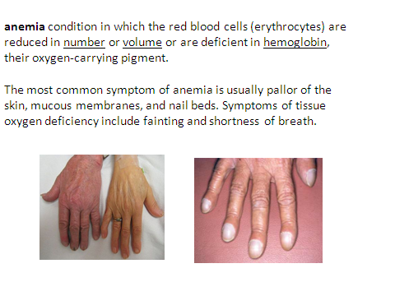

Slide 14
Case study 1
  30 years old female come to outpatient clinic suffering from easy fatigability & breathlessness on exertion .
  by clinical examination she was normal except for some
  pallor .
  on doing CBC the fallowing parameters were found.
  RBC count 4x106 /µL³
  HCT 30%
  HB% 9mg /dl
  MCV 70 fl
  MCH 28 pg
  MCHC 25 %

Slide 15
questions
1-What is the most probable diagnoses from the clinical picture?
microcytic hypochromic Anemia

Slide 16
questions
2-What type of anemia ?
Iron deficiency anemia

Slide 17
questions
3-Give causes for iron deficiency anemia ?
1.lack of iron in the diet (poor diet) as vegetarians
Examples of iron-rich foods include meat, eggs, and green vegetables.
2. chronic blood loss ; heavy periods , peptic ulcer, Gastrointestinal bleeding colorectal cancer ,parasitic infection (hook worm ) ..
3. An inability to absorb iron; intestinal disorder such as celiac disease and gastroctomy.
*tannate,phtate –present in tea -compete with iron in absorption
4.Increase the demand ; pregnancy .

Slide 18
Case study 2
2.65-year-old female reports about 2 months of tiredness, difficulty concentrating, fatigue and gastrointestinal discomfort with some decrease in appetite and numbness and tingling sensation in her hands and feet.

Slide 19
Case study 2
Clinical examination
by clinical examination she was normal except for some pallor and smooth, thick, red tongue
lab finding
RBC count 4x106 /µL³
HCT 34 %
HB% 8.5mg /dl
MCV 105 fl
MCH 25 pg
MCHC 23 %

Slide 20
Questions
1. What is the most probable diagnoses from the clinical picture?
a. Iron deficiency anemia
b. Sickle cell anemia
c. Pernicious anemia

Slide 21
Questions
2. The high MCV indicatefor;
a.Microcytic RBC
b.Macrocytic RBC
c.Normocytic RBC

Slide 22
questions
3.Pernicious cousd by :
a. Iron deficiency
b.vit b12 deficiency
c.folic acid deficiency

Slide 23
Thank you

