Slide 1
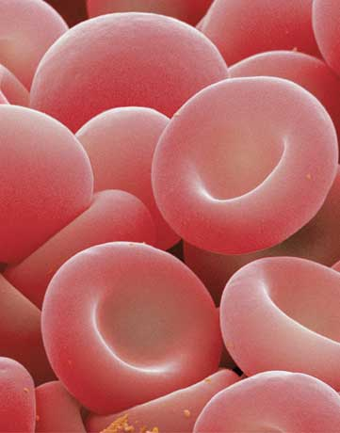
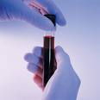
Introduction Determination of Serum Glucose Concentration
224 PHL
Lab#1

Slide 2
Introduction
Types of biochemical experiments
Chemical method
for a qualitative purposes “ to identify the presence or absence of a substance”
Colorimetric method
for a quantitative purposes “ to measure the concentration of a substance”

Slide 3
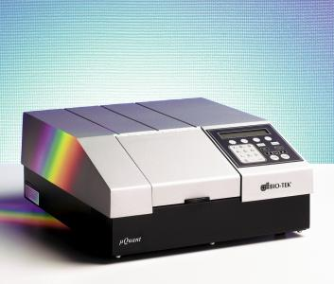
Instrument used in Colorimetric method:
Spectrophotometer

Slide 4
Types of Specimens used in the laboratory experiments:
Blood
Urine
Cerebrospinal fluid (CSF)
Saliva

Slide 5
Factors affects the results and validity of the specimen:
Diet.
Drugs.

Slide 6
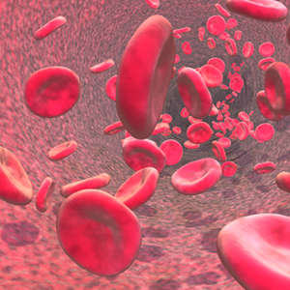
BLOOD Analysis
Blood is a tissue that circulates in the closed system of blood vessels.

Slide 7
Functions of Blood
Respiration.
Nutrition.
Excretion of waste products.
Defense mechanisms.
Regulation of body water.
Regulation of acid base balance.
Regulation of body temperature.

Slide 8
Compositions of Blood :
Blood
Cellular elements
RBCs, WBCs, Platelets
Plasma
Water
Solids
Non diffusible constituents
Diffusible constituents
Anabolic
Catabolic
e.g. albumin, globulin, fibrinogen.

Slide 9
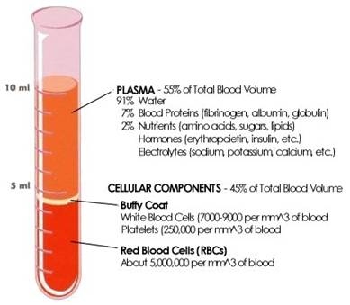

Slide 10
Purpose of blood analysis:
Diagnostic.
Prognostic (investigation).

Slide 11
Preparation of plasma and serum samples:
If whole blood is allowed to clot and the clot is removed, the remaining fluid is called Serum.
Serum = Plasma – Blood clotting factor.

Slide 12
Anti-coagulants :
1. Heparin:
Mode of action: Anti –thrombin i.e. :prevents the conversion of prothrombin to thrombin.
2. E.D.T.A :
Mode of action: Binds to Ca⁺⁺
3. Oxalates:
Mode of action: Forms insoluble salts with Ca⁺⁺
4. Na Fluoride:(enzyme poison)
It inhibits glycolysis; therefore it is used in determination of blood sugar.
It inhibits urease enzyme, therefore it is not used in determination of blood urea.
5. Tri Na Citrate: To determine E.S.R
6. Acid Citrate Dextrose Solution: Used mainly to study platelets and to preserve blood.

Slide 13
Deproteinization :
Purpose of deproteinization is to precipitate the proteins. This is necessary because:
proteins have a certain U-V absorption and could give false reading.
Proteins are colloids which make the solution turbid and difficult to read on the spectrophotometer.

Slide 14
Deproteinization Agents :
1. Trichloroacetic Acid &Tungestic Acid
Mode of action: Proteins at a pH lower than their isoelectric pH become cations and are precipitated as insoluble salts of the acids.
2. Zinc Hydroxide
Mode of action: Proteins at a pH higher than their isoelectric pH become anions and are precipitated as salts of the heavy metals.
3.Organic Substance : remove water and extract some blood constituents e.g. ethanol, ether precipitate proteins and extract fat and cholesterol.

Slide 15
Determination of Serum Glucose Concentration
Serum glucose is determined by two methods :
Oxidation method (Enzymatic method).
Alkaline copper reduction method (Asatoor and King method).

Slide 16
Determination of Serum Glucose Concentration (Oxidation method)
Principle:
Glucose + O2 + H2O gluconic acid + H2O2
2H2O2 + phenol + amino-4-antipyrine quinoneimine + 4H2O
Glucose oxidase
Peroxidase

Slide 17
Procedure:
 | Sample | Standard | Blank
Serum | 0.1 ml | - | -
Standard | - | 0.1 ml | -
Working reagent | 1 ml | 1 ml | 1 ml
1- Bring two dried test tubes (sample & standard).
2- Incubate for 10 minutes at 37ºC in water bath.
3- Measure the absorbance for the sample & standard against blank at ℷ= 546 nm.

Slide 18
Calculation:
Serum glucose (mg/dl)= Absorbance (sample)
Normal value: 75 – 110 mg/dl
Standard
Concentration
(100 mg/dl)
×
Absorbance (standard)

Slide 19
Clinical significance:
Hyperglycemia is blood glucose level › 110 mg/dl
Hypoglycemia is blood glucose level ‹ 75 mg/dl
Causes:
1. Diabetes mellitus.
2. Hyperactivity of thyroid, adrenal, pituitary gland.
3. ↑secretion of GH (Acromegaly)
4. Asphyxia causing acidosis and increased mobilization of glucose from glycogen in the liver.
5. Exercise or stress causing increased secretion of adrenaline.
6. Pancreatic carcinoma or acute pancreatitis.
Causes:
1. Overdose of insulin.
2. Hypoactivity of thyroid, adrenal, or pituitary gland.
3. Glycogen storage disease in which there is deficiency of G6P → inability to produce glucose from glycogen.

Slide 20
Renal Glucose Threshold :
Normally glucose present in the blood is filtered out in the renal glomeruli but reabsorbed back into the blood by the kidney tubules.
The limit to the ability of the tubules to reabsorb glucose is 180 mg/ dl.
If blood sugar level rises above this value glucose appears in the urine (Glucosurea).
The blood glucose level of 180 mg/dl is therefore called the renal glucose threshold.

