Slide 1
INTRODUCTION
Chromosomes are the structures that contain the genetic material
  They are complexes of DNA and proteins
The genome comprises all the genetic material that an organism possesses
  In bacteria, it is typically a single circular chromosome
  In eukaryotes, it refers to one complete set of nuclear chromosomes
The main function of the genetic material is to store information required to produce an organism
  The DNA molecule does that through its base sequence

Slide 2
Introduction
Normal human cells contain 23 pairs of chromosomes
This includes one pair of sex chromosome XX or XY
During cell division we can identify chromosomes
Haploid: set of 23 chromosomes
Diploid: normal number of 46 chromosomes
Chromosomes in eukaryotes found in the nucleus
Condensed and visible during cell division
At the beginning of mitosis they can be seen to consist of two threads (sister chromatids) joined by a centromere
The sister chromatids are identical copies
During mitosis the sister chromatids separate and are placed into two nuclei
Number of chromosome is constant for each cell in the body (except sex cells which only have half sets).

Slide 3
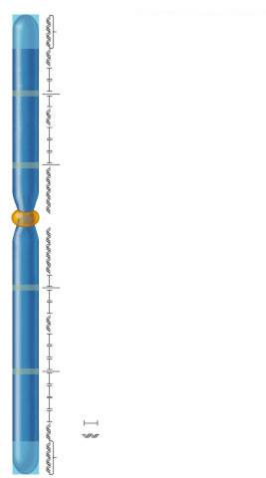
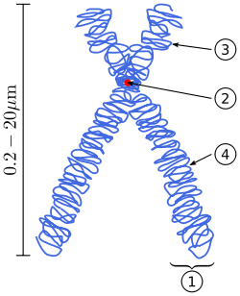
Diagram of a duplicated and condensed metaphase eukaryotic chromosome.
1. Chromatid– one of the two identical parts of the chromosome after S phase.
2. Centromere – the point where the two chromatids touch, and where the microtubules attach.
3. Short arm.
4 Long arm.
Telomere
Origin of replication
Origin of replication
Kinetochore proteins
Centromere
Origin of replication
Origin of replication
Genes
Repetitive sequences
Telomere

Slide 4
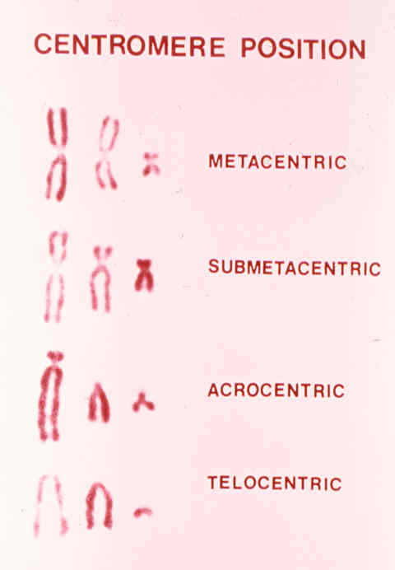
CHROMOSOME STRUCTURE
Chromosomes can vary considerably in size and shape
  Various features used for identification
    Size, Centromere location, Banding patterns
Centromere location differs between chromosomes
  At the middle in a metacentric chromosome
  Near the middle in a submetacentric chromosome
  Near an end in an acrocentric chromosome
  At an end in a telocentric chromosome

Slide 5
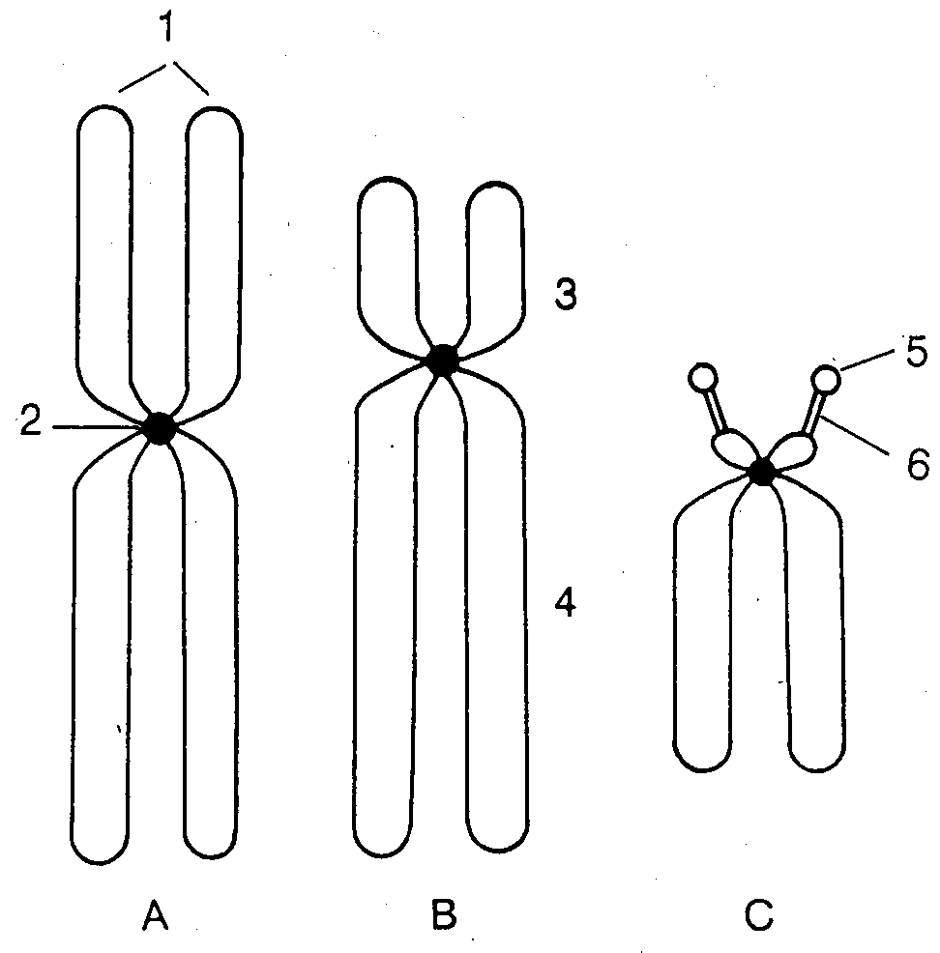
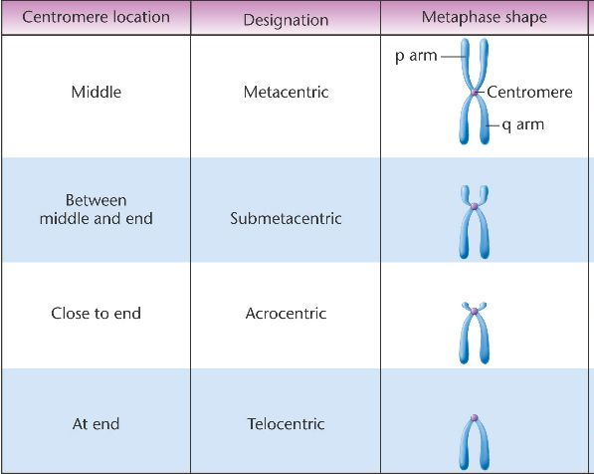
Shapes of chromosomes
1: sister chromatids,
2: centromere,
3: short arm,
4: long arm,
5: satellite,
6: secondary constriction
A: metacentric, B: submetacentric, C: acrocentric

Slide 6
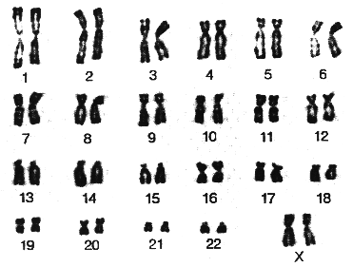
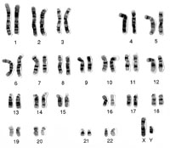
The chromosomes of human (male and female Karyotype)
Female
Male

Slide 7
Chromosome Groups
Group | Chromosomes | Description
A | 1–3 | Largest; 1 and 3 are metacentric but 2 is submetacentric
B | 4,5 | Large; submetacentric with two arms very different in size
C | 6–12,X | Medium size; submetacentric
D | 13–15 | Medium size; acrocentric with satellites
E | 16–18 | Small; 16 is metacentric but 17 and 18 are sub metacentric
F | 19,20 | Small; metacentric
G | 21,22,Y | Small; acrocentric, with satellites on 21 and 22 but not on the Y
Autosomes are numbered from largest to smallest, except that chromosome 21 is smaller than chromosome 22.

Slide 8
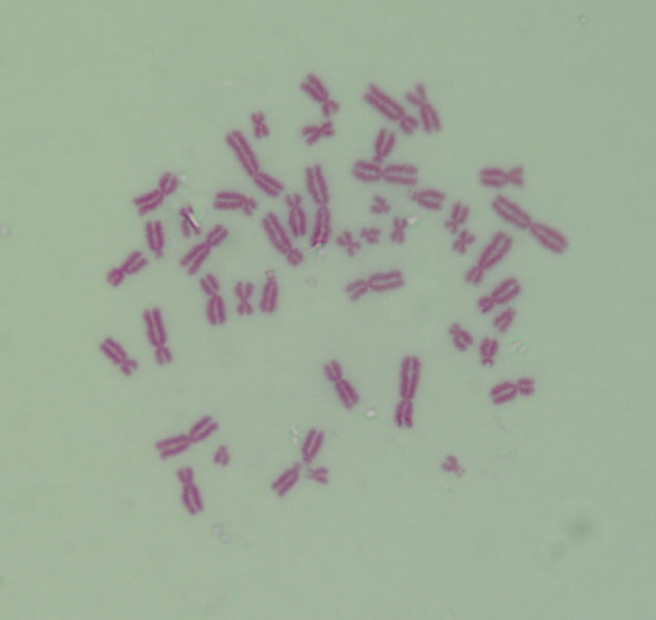
Human Chromosomes (44 + XY =46)

Slide 9
Mouse Chromosomes (38 + XY =40)

Slide 10
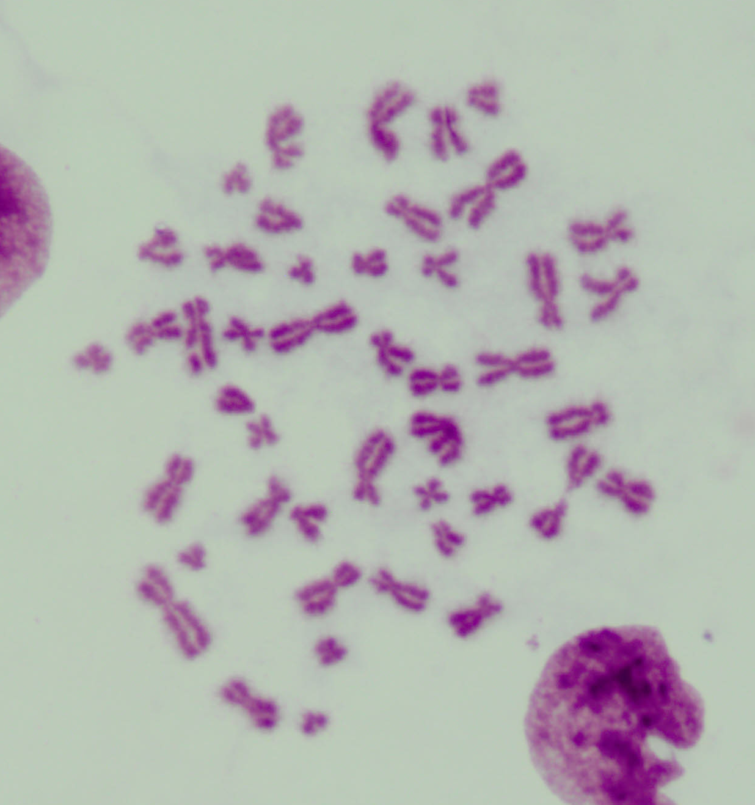
Frog Chromosomes (42 + XY =44)

Slide 11
Rat Chromosomes (40 + XY =42)

