Slide 1
2. Business Process Modelling
Aman Quadri
https://fac.ksu.edu.sa/aquadri
aquadri@ksu.edu.sa

Slide 2
Definitions
A Model is complete description textual/diagrammatic representation of a system from a particular perspective.

Slide 3
Definitions
A Business Process Model is an abstract representation of an organization:
  It can be conceptual / graphic Representation
  Represents the processes of an enterprise for analysis or improvements.
  Represents architectural, functional and financial arrangements that needs to be designed and implemented.
  Carried out by domain experts known as ‘Business Analysts’
  BPM is done mainly to enhance the speed and/or quality and reduce overheads

Slide 4
Why Business Modelling
Gap between Business Engineering descriptions and interpretation by Software Engineering.
Unclear inputs from Business Engineering in the software development.
RUP (Rational Unified Process) provides a common language for both engineering to model the business functions.
Enables seamless traceability between business and software processes.

Slide 5
Demonstration using RSA
Using RSA BPM perspective, model the Cash withdrawal process of XYZ Bank.
  Customer fills the check with details (Account #, name and amount)
  The bank verification unit rep, verifies the information and the amount presented for withdrawal
  If the amount in account is greater than the amount presented the check is marked cleared for teller else, an Overdraft is created for the customer and its presented to the teller for further processing.

Slide 6
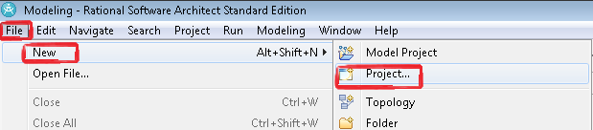
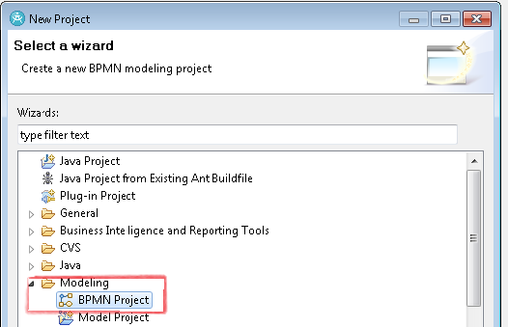
Start a fresh BPM Project

Slide 7
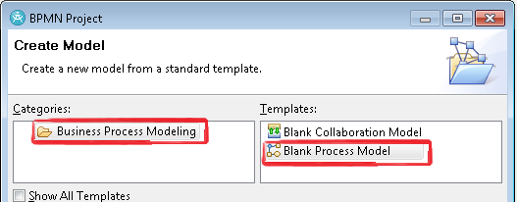
Contd.
Give the project a name.
Demo Using RSA

Slide 8
Lab Activity 1 - Hands on
Case Study: The True Aqua Distilled Water Company, sell distilled water for business and home use, following is a textual description of their water delivery process.
To order distilled water, 90% of the orders come from phone calls. The customer service assistant who receives the order will check whether the customer is an existing customer or a new one. If the customer has never ordered before, the customer service assistant will create a customer account for him or her before proceeding to water delivery.
The water delivery happens only on Wednesday, on every Wednesday, the Cx Service assistant forwards the orders to the logistics department for delivery. The logistics department manager approves and assigns delivery workers for different orders.

Slide 9
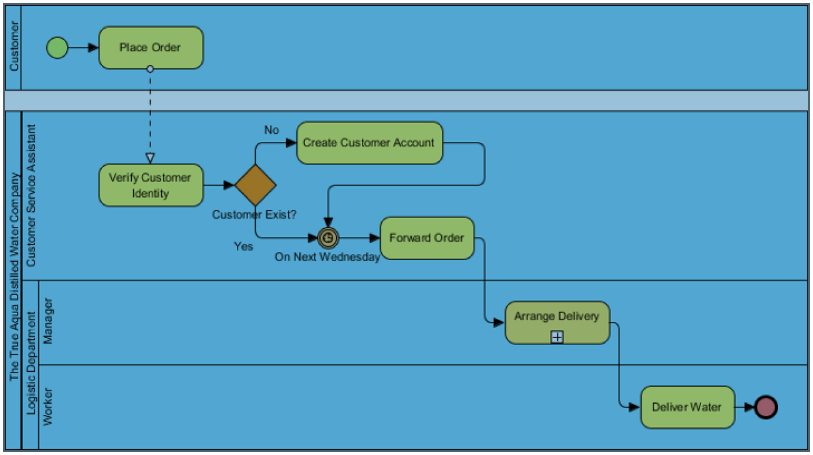
Rational Software Architect – Business Analysis Model

Slide 10
Business Use Case Model
Primary purpose of modeling business use cases and actors is to describe how the business is used by its customers and partners.
The model describes the business in terms of business use cases generally called "processes"
To create a use case model, right click on the BPM and add UML Model
Use the UML Model perspective to create the Use Case Model of the Business Model.

Slide 11
Lab Activity - 2
From the business model of the Aqua water, create the Business use case model in RSA.

