Slide 1
Introduction to MATLAB [Vectors and Matrices] Lab 2

Slide 2
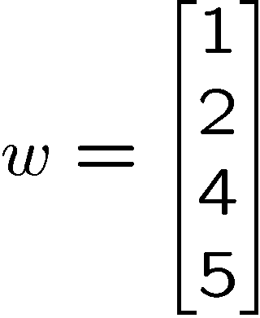
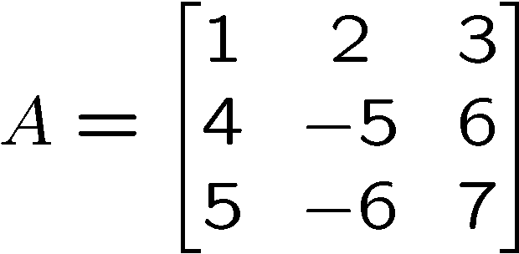
Vectors and Matrices
Vectors (arrays) are defined as
>> v = [1, 2, 4, 5]
>> w = [1; 2; 4; 5]
Matrices (2D arrays) defined similarly
>> A = [1,2,3;4,-5,6;5,-6,7]

Slide 3
Vectors and Matrices
a vector x = [1 2 5 1]
x =
1 2 5 1
a matrix x = [1 2 3; 5 1 4; 3 2 -1]
x =
1 2 3
5 1 4
3 2 -1
transpose y = x’
y =
1 5 3
2 1 2
3 4 -1

Slide 4
Vectors and Matrices
t =1:10
t =
1 2 3 4 5 6 7 8 9 10
k =2:-0.5:-1
k =
2 1.5 1 0.5 0 -0.5 -1
B = [1:4; 5:8]
x =
1 2 3 4
5 6 7 8

Slide 5
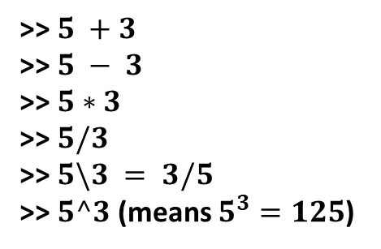
Arithmetic Operator & Their Precedence
Computing with MATLAB
Operations
Operators
Examples
Addition
Subtraction
Multiplication
Right Division
Left Division
Exponentiation
$$+$$
$$−$$
*
/
\
^
>> $5 +3$
>> $5 − 3$
>> $5∗3$
>> $5/3$
>> $5\backslash 3 = 3/5$
>> $5^3$ (means $5^{3}=125$)
Precedence Order
Operators
1
2
3
4
Parentheses ( ). For nested parentheses, the innermost
are executed first.
Exponentiation, ^
Multiplication, *; Division, /,\
Addition, +; Subtraction, -

Slide 6
Generating Vectors from functions
zeros(M,N) MxN matrix of zeros
>> zeros(5,1);
ones(M,N) MxN matrix of ones
rand(M,N) MxN matrix of uniformly distributed random
numbers on (0,1)
A=rand(5); B=rand(1,5); C=rand(5,1)
a=randn(5); b=randn(1,5); c=randn(5,1)
x = zeros(1,5)
x =
0 0 0 0 0
x = ones(1,3)
x =
1 1 1
x = rand(1,3)
x =
0.9501 0.2311 0.6068

Slide 7
Matrix Operators
All common operators are overloaded
>> v + 2
Common operators are available
>> B = A’
>> A*B
>> A+B
Note:
Matlab is case-sensitive
A and a are two different variables
Transponate conjugates complex entries; avoided by
>> B=A’

Slide 8
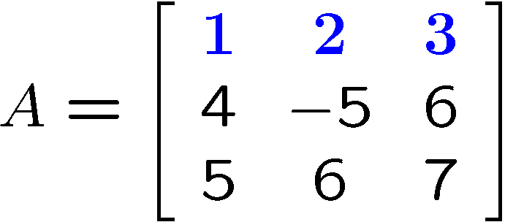
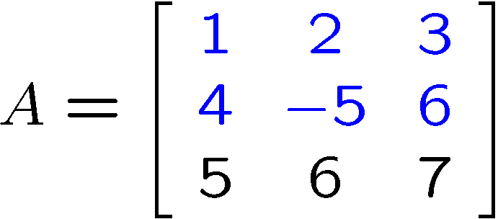
Indexing Matrices
Index complete row or column using the colon operator
>> A(1,:)
Can also add limit index range
>> A(1:2,:)
>> A([1 2],:)
General notation for colon operator
>> v=1:5
>> w=1:2:5

Slide 9
Indexing Matrices
Addressing
vector : (colon operator)
Addressing
matrix : (colon operator)
A(:,n)
Refers to the elements in all the rows of column n of the matrix A.
A(n,:)
Refers to the elements in all the columns of row n of the matrix A.
A(:,m:n)
Refers to the elements in all the rows between columns m and n of the matrix A.
A(m:n,:)
Refers to the elements in all the columns between rows m and n of the matrix A.
A(m:n,p:q)
Refers to the elements in rows m through n and columns p through q of the matrix A.

Slide 10
Matrix information commands
Try them…by typing
>> help size
>> help length
>> help ndims

Slide 11
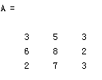
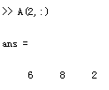
Matrix Index
The matrix indices begin from 1 (not 0 (as in C))
The matrix indices must be positive integer
Given:
A(-2), A(0)
Error: ??? Subscript indices must either be real positive integers or logicals.
A(4,2)
Error: ??? Index exceeds matrix dimensions.

Slide 12
Matrix Index
Address
3 11 6 5
4 7 10 2
13 9 0 8
MAT =
(1,1) (1,2) (1,3) (1,4)
(2,1) (2,2) (2,3) (2,4)
(3,1) (3,2) (3,3) (3,4)
11 6 5
4 7 10 2
9 0 8
MAT =

Slide 13
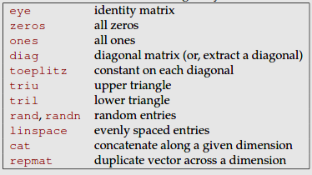
Commands for building arrays and Matrices

Slide 14
Concatenation of Matrices
x = [1 2], y = [4 5], z=[ 0 0]
A = [ x y]
1 2 4 5
B = [x ; y]
1 2
4 5
You can try ‘cat’ command as well… for concatenation
C = [x y ;z]
Error:
??? Error using ==> vertcat CAT arguments dimensions are not consistent.

Slide 15
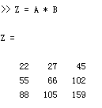
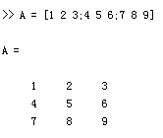
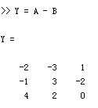
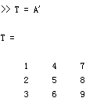
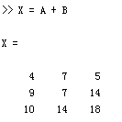
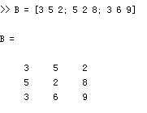
Matrices Operations
Given A and B:
Addition
Subtraction
Product
Transpose

Slide 16
Operation on Matrices

Slide 17
Operators (Element by Element)
.* element-by-element multiplication
./ element-by-element division
.^ element-by-element power

Slide 18
The use of “.” – “Element” Operation
A = [1 2 3; 5 1 4; 3 2 1]
A =
1 2 3
5 1 4
3 2 -1
b = x .* y
b=
3 8 -3
c = x . / y
c=
0.33 0.5 -3
d = x .^2
d=
1 4 9
x = A(1,:)
x=
1 2 3
y = A(:,3)
y=
3 4 -1
K= x^2
Erorr:
??? Error using ==> mpower Matrix must be square.
B=x*y
Erorr:
??? Error using ==> mtimes Inner matrix dimensions must agree.

Slide 19
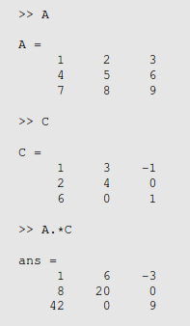
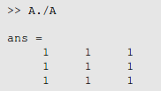
Example of element wise operation
Most elementary functions, such as sin, exp, etc. act as elementwise

Slide 20
Reducing functions….try them

Slide 21
Multi-dimensional matrices
5
7
4
5
5 7 4
Scalar of 1 X 1
Row Vector of 1 X 3
Column vector of 3 X 1
14 12 10 56
10 504 4 6
89 0
14 12 10 56
6
0
10 56
4 6
78 86
14 12 10 56
89
0
10 56 85 23
4 6 23 2
78 86 53 6
10 56 85 23
4 6 23 2
78 86 53 6
One Dimensional
Matrix of 3 X 3
Two Dimensional
Matrix of 3 X 5
Three Dimensional
Matrix of 3 X 5

