Slide 1
Introduction to Matlab LAB 4

Slide 2
Use of M-File
Click to create a new M-File
Extension “.m”
A text file containing script or function or program to run

Slide 3
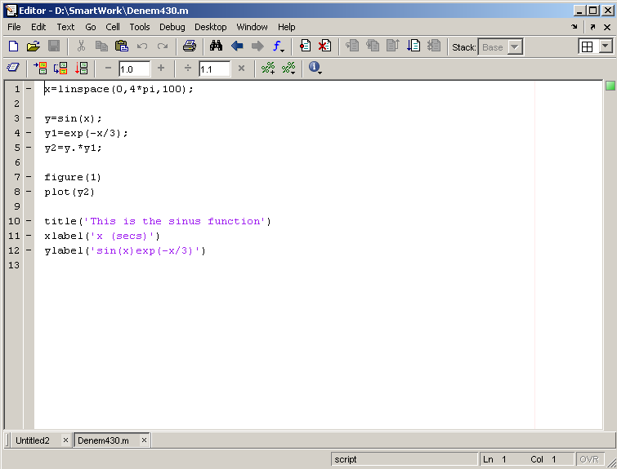
Use of M-File
Save file as Denem430.m
If you include “;” at the
end of each statement,
result will not be shown
immediately

Slide 4
Writing User Defined Functions
Functions are m-files which can be executed by specifying some inputs and supply some desired outputs.
The code telling the Matlab that an m-file is actually a function
You should write this command at the beginning of the m-file and you should save the m-file with a file name same as the function name
function out1=functionname(in1)
function out1=functionname(in1,in2,in3)
function [out1,out2]=functionname(in1,in2)

Slide 5
Writing Functions: Example
Here is a function that implements the quadratic formula.
function [x1,x2] = quadform(a,b,c)
d = sqrt(bˆ2 - 4*a*c);
x1 = (-b + d) / (2*a);
x2 = (-b - d) / (2*a);
From MATLAB you could call
>> [r1,r2] = quadform(1,-2,1)
r1 = 1
r2 =1

Slide 6
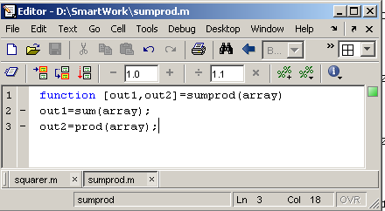
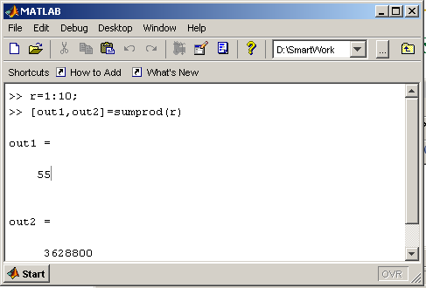
Writing Functions: Example
Another function which takes an input array and returns the sum and product of its elements as outputs
The function sumprod(.) can be called from command window or an m-file as

Slide 7
Operators (relational, logical)
== Equal to
~= Not equal to
< Strictly smaller
> Strictly greater
<= Smaller than or equal to
>= Greater than equal to
& And operator
| Or operator

Slide 8
IF statement

Slide 9
Control Structures
Some Dummy Examples
if ((a>3) & (b==5))
Some Matlab Commands;
end
if (a<3)
Some Matlab Commands;
elseif (b~=5)
Some Matlab Commands;
end
if (a<3)
Some Matlab Commands;
else
Some Matlab Commands;
end
If Statement Syntax
if (Condition_1)
Matlab Commands
elseif (Condition_2)
Matlab Commands
elseif (Condition_3)
Matlab Commands
else
Matlab Commands
end

Slide 10
The if Statement: Example
if x >= 0
y = sqrt(x)
end
z = 0;w = 0;
if (x >= 0)&(y >= 0)
z = sqrt(x) + sqrt(y)
w = sqrt(x*y)
end
10
The if statement’s basic form is
if logical expression
statements
end
Notes:
Whenever entering text as input to title, legend or labels use ‘’ to enclose the text
10

Slide 11
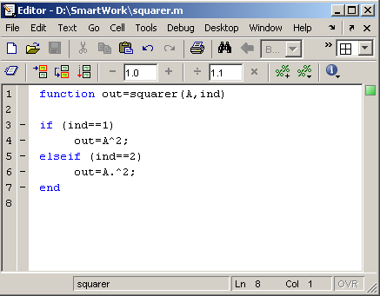
Writing Functions along with IF statement
Examples
Write a function : out=squarer (A, ind)
Which takes the square of the input matrix if the input indicator is equal to 1
And takes the element by element square of the input matrix if the input indicator is equal to 2
Same Name

Slide 12
The if Statement: Example
if logical expression 1
statement group 1
if logical expression 2
statement group 2
end
end
x = [4 -9 25];
12
Notes:
Whenever entering text as input to title, legend or labels use ‘’ to enclose the text
12

Slide 13
switch statement

Slide 14
Switch Statement
The if/elseif construct is ﬁne when only a few options are present.
When a large number of options are possible, it’s customary to use switch instead. e.g.
switch units
case ’length’
disp(’meters’)
case ’volume’
disp(’liters’)
case ’time’
disp(’seconds’)
otherwise
disp(’I give up’)
end
Units = input(‘put units you need to know, ‘S’);

Slide 15
Switch Statement: Example
month = input (‘Please input month (1-12)’);
switch month
case {1,3,5,7,8,10,12}
disp (‘31 days’)
case {4,6,9,11}
disp (‘30 days’)
case {2}
disp (‘28 days’)
end

Slide 16
Loop statement

Slide 17
Control Structures
Some Dummy Examples
for i=1:100
Some Matlab Commands;
end
for j=1:3:200
Some Matlab Commands;
end
for m=13:-0.2:-21
Some Matlab Commands;
end
for k=[0.1 0.3 -13 12 7 -9.3]
Some Matlab Commands;
end
For loop syntax
for i=Index_Array
Matlab Commands
end

Slide 18
for Loops
for loop variable m:s:n
statements
end
for k = 5:10:35
x = k^2
end
18
Notes:
Whenever entering text as input to title, legend or labels use ‘’ to enclose the text
18

Slide 19
for Loops
Write a script le to compute the sum of the rst 15 terms in the series 5 k²-2k, k = 1,2, 3, …, 15
total = 0;
for k = 1:15
total = 5*k^2 - 2*k + total;
end
disp (‘The sum for 15 terms is:’)
disp (total)
19
Notes:
Whenever entering text as input to title, legend or labels use ‘’ to enclose the text
19

Slide 20
for Loops
20
Notes:
Whenever entering text as input to title, legend or labels use ‘’ to enclose the text
20

Slide 21
for Loops
We choose a spacing dx 35/300 to obtain 301 points, which is sufcient to obtain a smooth plot. The script le is the following:
dx = 35/300;
x = -5:dx:30;
for k = 1:length(x)
if x(k) >= 9
y(k) = 15*sqrt(4*x(k)) + 10;
elseif x(k) >= 0
y(k) = 10*x(k) + 10;
else
y(k) = 10;
end
end
plot (x,y), xlabel(’x’), ylabel(‘y’)
21
Notes:
Whenever entering text as input to title, legend or labels use ‘’ to enclose the text
21

Slide 22
While statement

Slide 23
Control Structures
While Loop Syntax
while (condition)
Matlab Commands
end
Dummy Example
while ((a>3) & (b==5))
Some Matlab Commands;
end

