Slide 1
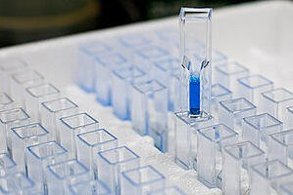
Detection and quantitative estimation of proteins by different methods II

Slide 2
Standard solution:
Protein concentration is determined by reference to a standard curve consisting of known concentrations of a purified reference protein.
Because proteins differ in their amino acid compositions, each one responds somewhat differently in each type of protein assay.

Slide 3
It is essential to include a standard curve each time the assay is performed.
Typically, standard curves are constructed using at least two replicates for each point on the curve.

Slide 4
Standard curve:
Notes:
Therefore, the best choice for a reference standard is a purified, known concentration of the most abundant protein in the samples.

Slide 5
Practical Part

Slide 6
Experiment (1). Quantitative estimation of proteins by Bradford assay:
Objective:
To determine the concentration of extracted protein by Bradford assay
Principle:
The Bradford reagent consists of the dye Brilliant Blue G.
This method relies on forming a complex by the binding of the dye Coomassie Brilliant Blue G-250 to the proteins. The absorption at 595 nm is proportional to the amount of protein present in the sample.
The dye reagent reacts primarily with arginine residues and less so with histidine, lysine, tyrosine, tryptophan, and phenylalanine residues.
The practical advantages of the method are that the reagent is simple to prepare and that the color develops rapidly and is stable
Notes:
(three or more amino acids).

Slide 7
Result
Notes:
تركيز ال BSAمعدل عليه صار 2

