Slide 1
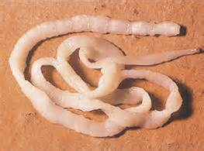
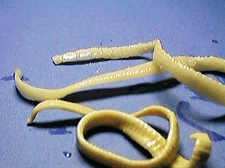
Taenia
By:
lecturer: Jawahir AL-Ghamdi

Slide 2
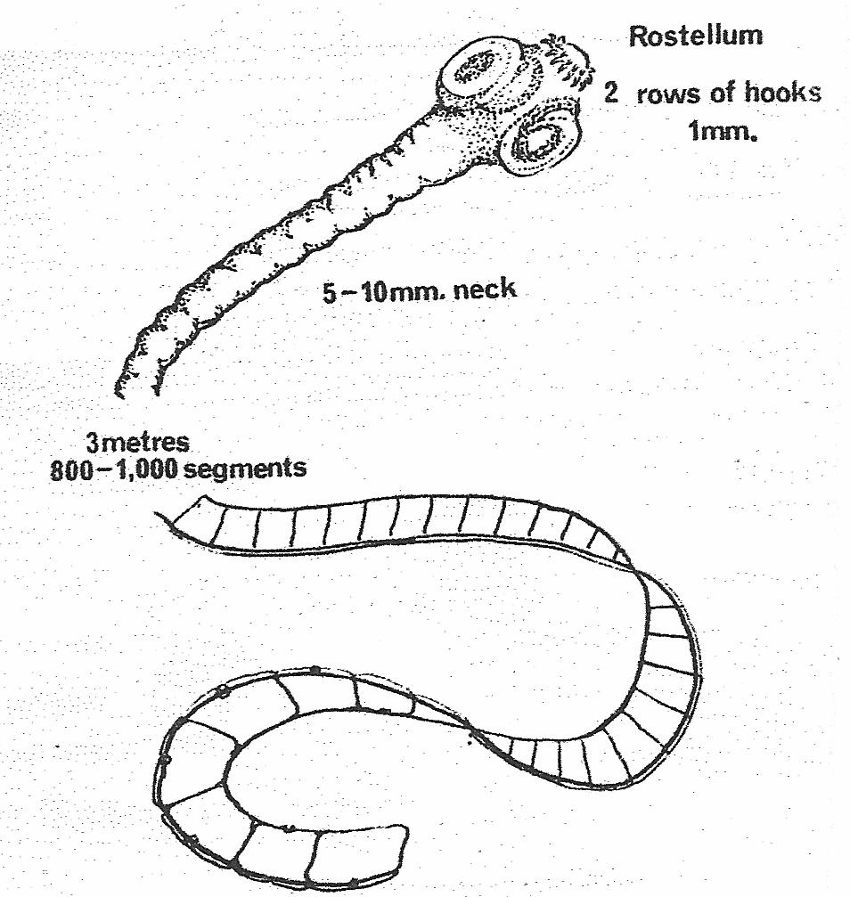
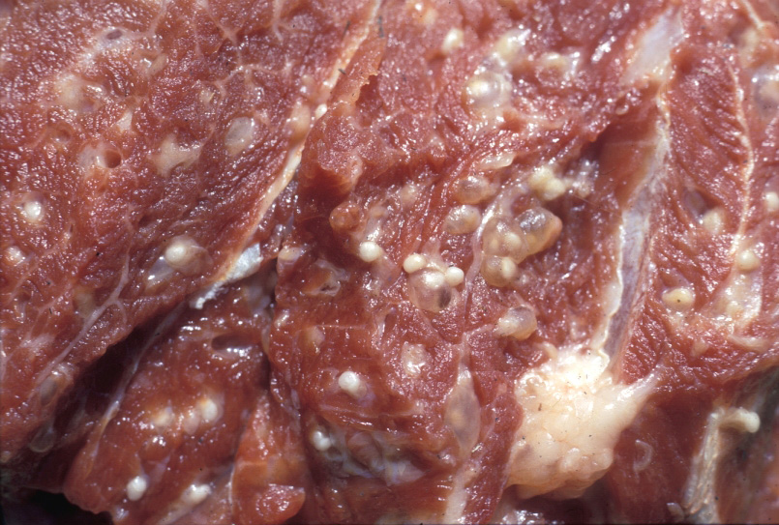
Taenia
Classification
Kingdom: Animalia
Subkingdom: Eumetazoa
Class: Cestoda
Order:Cyclophllidea
Genus:Taenia
Species: Taenia saginata (beef tape­worm)
Taenia solium
(pork tapeworm)
This class comprises the tapeworms, all of which are endoparasites and lack an alimentary canal throughout life.
They have a great power of reproduction, both asexual and sexual.
Infection acquired by
the ingestion of raw or
undercooked meat of
infected animals.

Slide 3
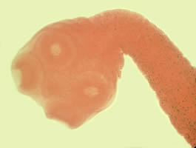
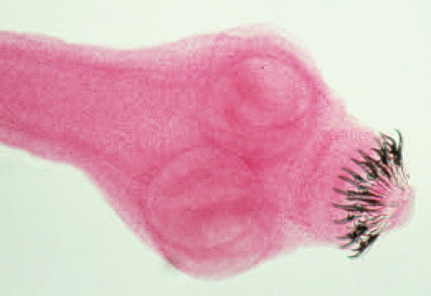
External Features
Taetnia saginata
Taenia solium
Scolex has four large muscular suckers;
No mouth or hooks exist.
Scolex is relatively smaller with a rounded rostellum with a double row of chitinous hooks.

Slide 4
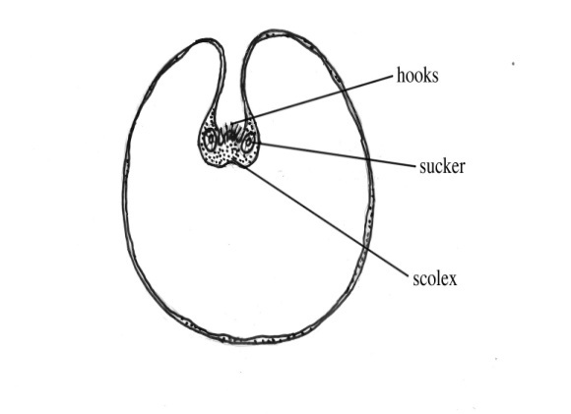
T. solium | T. saginata
human | human | Definitive host
Pig | Cattle | Intermediate host
Found encysted in the muscles or subcutaneous tissues of their intermediate host. | Found in encysted the cow after ingestion of the worm eggs. | Larvae

Slide 5
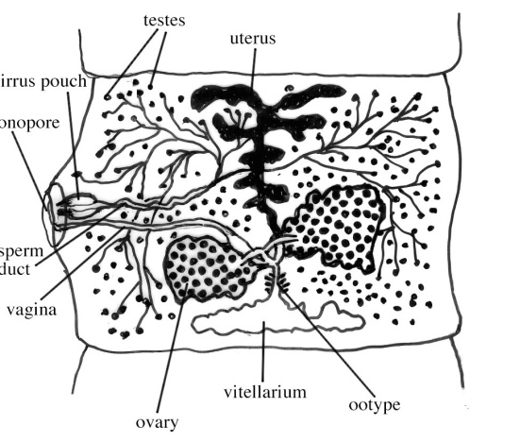
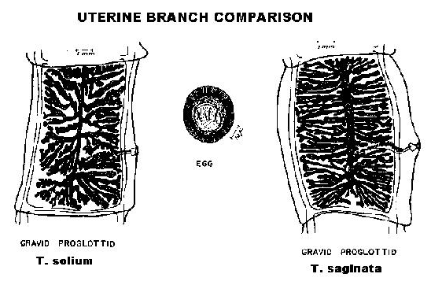
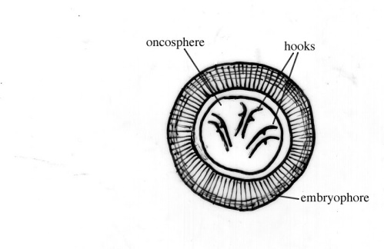
The Mature Proglottids: contains the uterus (unbranched), overy, genital pore, and testes
The Gravid Proglottids: the uterus in T. saginata is branched and is filled with eggs.
Egg is round in shape, enclosed by
a striated and thick shell, and contains
a mature hexacanth embryo

Slide 6
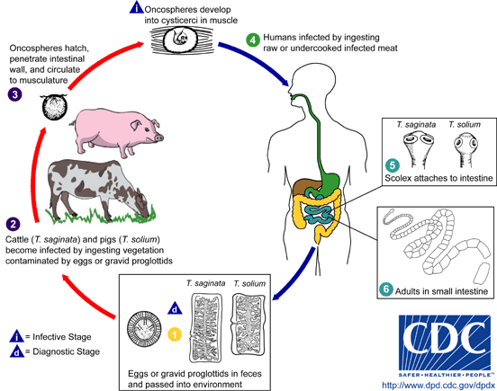
Life Cycle

Slide 7
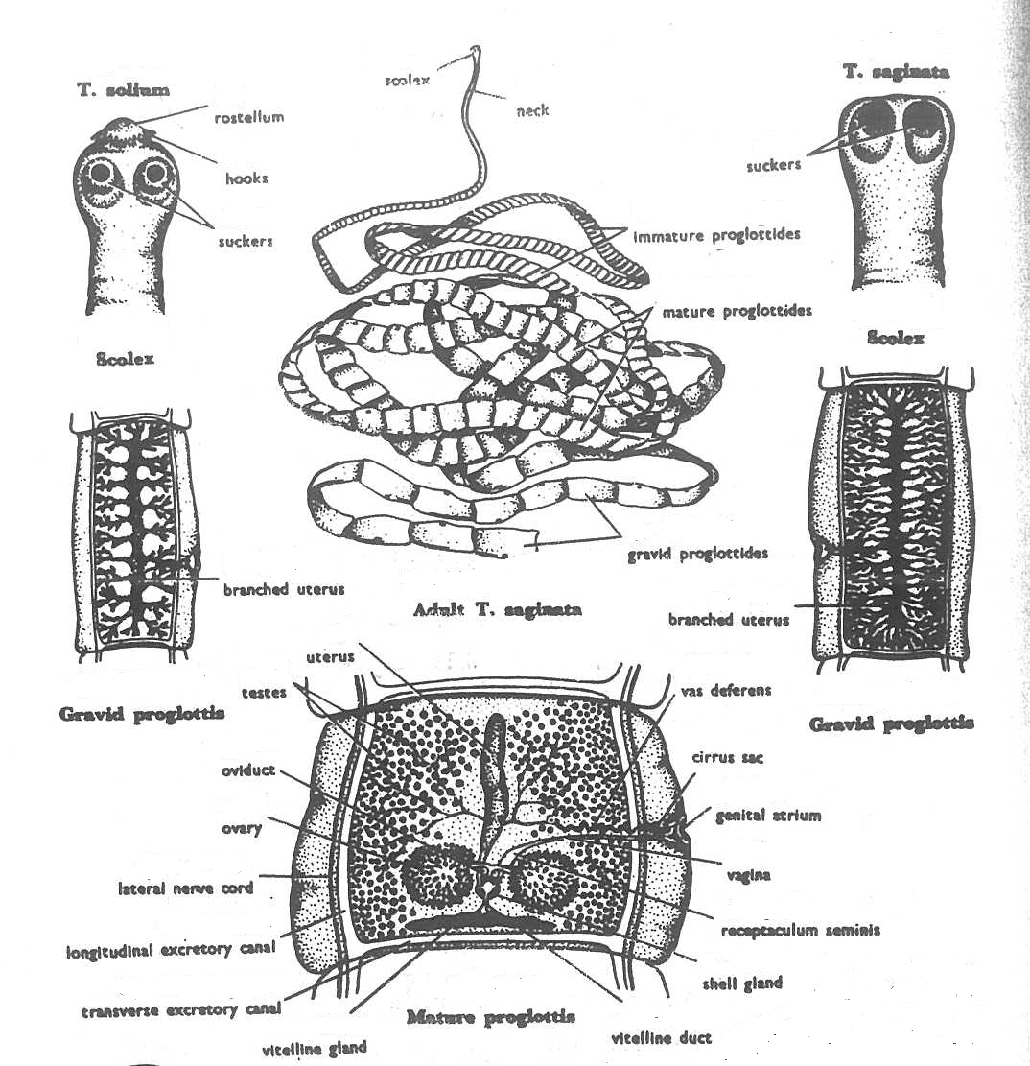

Slide 8
Under The microscope

Slide 9
Scolex of Taenia solium

Slide 10
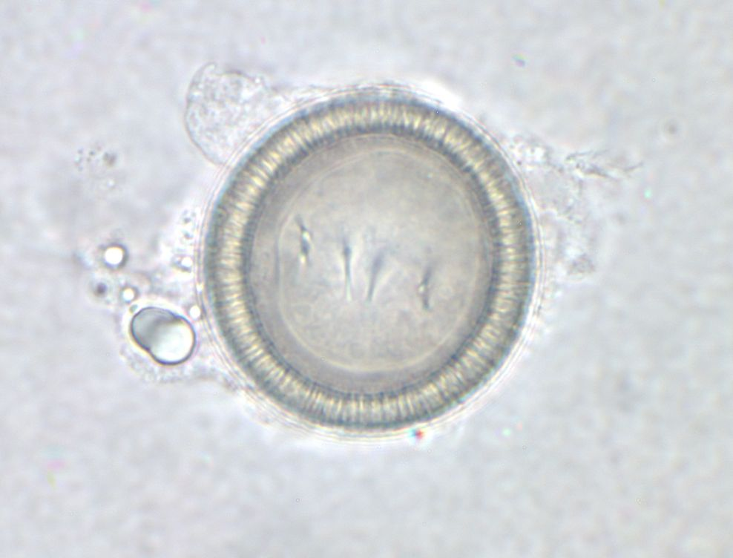
Egg of Taenia

Slide 11
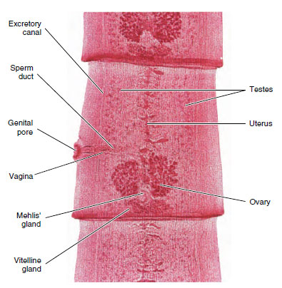
Mature segment Taenia spp.

Slide 12
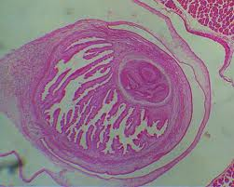
T.S. of muscle containing cysticercus larva

Slide 13
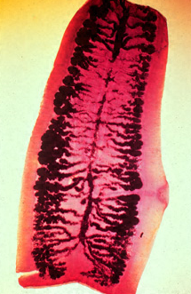
Gravid segment Taenia spp.

Slide 14
Thank you for attention

