Slide 1
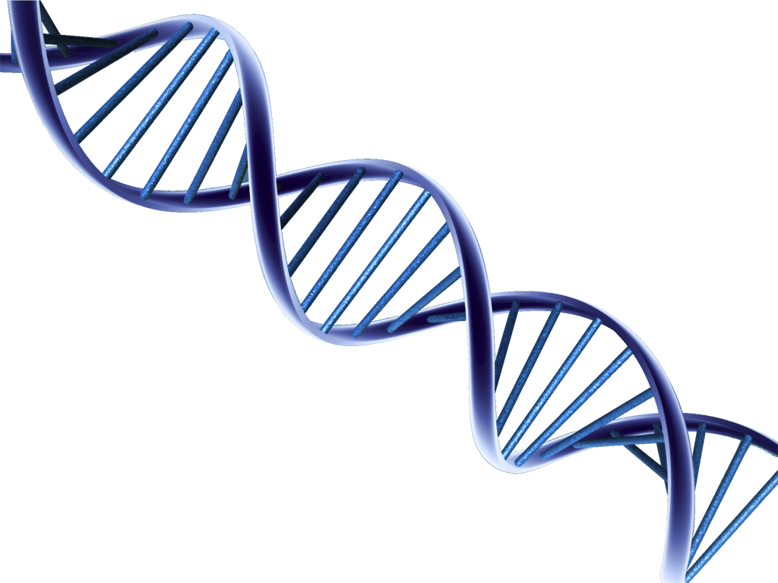
Spectral Characterization
of DNA

Slide 2
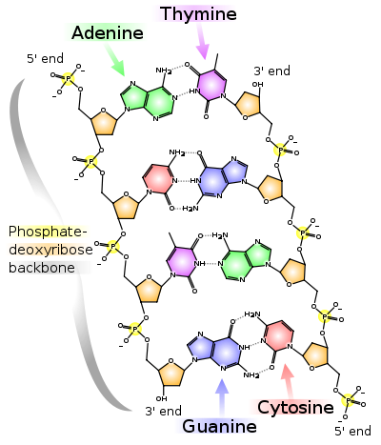
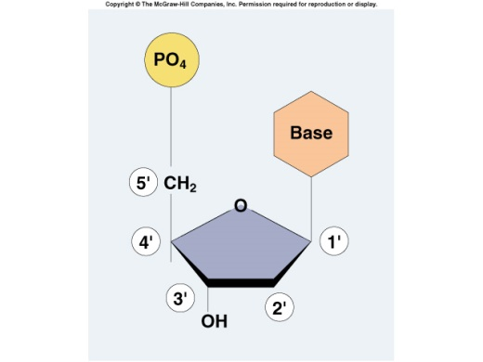
- DNA [Deoxyribonucleic acid] :
-DNA is made of two polynucleotide chains which run in opposite direction. [antiparallel]
-DNA has a double helical structure.
Each polynucleotide chain of DNA consists of monomer units of nucleotides.
-A monomer unit, [each nucleotide] consists of 3 main components that are:
1-sugar,
2-phosphate,
3-nitrogenous base.

Slide 3
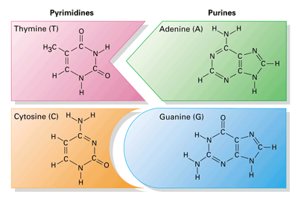
DNA Structure:
Deoxyribose sugar:
Is a monosaccharide 5-Carbon Sugar, Its name indicates that it is a deoxy sugar,
meaning that → [ it is derived from the sugar ribose by loss of an oxygen atom ].
2. Phosphate Group:
The sugars are joined together by phosphate groups that form phosphodiester bonds between the third and fifth carbon atoms of adjacent sugar rings.
Nitrogenous bases:
is a nitrogen-containing organic molecule having the chemical properties
of a base. They are classified as the derivatives of two parent compounds,
Purine. [ Adenine, Guanine ]
Pyrimidine. [ Cytosine, Thymine ]

Slide 4
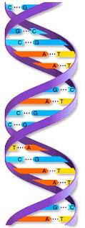
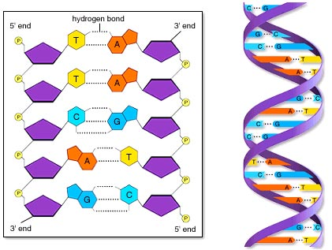
Hydrogen bond:
The H-bonds form between base pairs of the antiparallel strands.
The base in the first strand forms an H-bond only with a complementary base in the second strand.
Those two bases form a base-pair (H-bond interaction that keeps strands
together and form double helical structure).
Sugars and phosphates are located outside of the double helical structure.

Slide 5
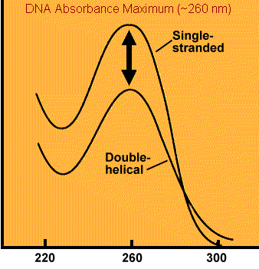
Optical density of DNA:
-Nucleic acid have maximum absorbance at 260nm, It absorbs at this wavelength because of the nitrogenous bases (A, G, C and T) of DNA.
In a spectrophotometer, a sample is exposed to ultraviolet light at 260 nm, and a photo-detector measures the light that passes through the sample.
Absorbance
Weave length [nm]

Slide 6
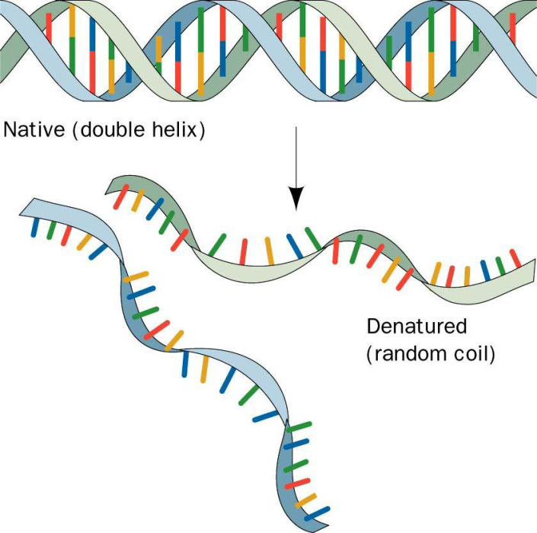
Denaturation of DNA:
Denaturation is a process by which nucleic acids, such as DNA, lose their three-dimensional structures and consequently their functions.
Many different substances or environmental conditions can denature nucleic acids, such as
-strong acids, organic solvent
-heating
-Exposure to Radiation/ UV light

Slide 7
Hyperchromicity :
The increase of absorbance (optical density) of DNA occurs when the DNA duplex is denatured.
- Due to denaturation of DNA the strands separate (become single strand) and bases become exposed to the surface and able to absorb more light at 260 nm (non-stacked bases). This action is calling the hyperchromic effect.
Note: The opposite, a decrease of absorbance is called hypochromicity

Slide 8
The effect of temperature on the absorbance of DNA:
Objectives:
1- To establish the effect of temperature on the absorbance of DNA or [hyperchromic effect].
2- To determine the optimum wave length for DNA.
Principle:
When DNA in solution is heated above its melting temperature (usually more than 80 °C), the double-stranded DNA unwinds to form single-stranded DNA. The bases become unstacked and can thus absorb more light.
Note: In their native state, the bases of DNA absorb light in the 260-nm wavelength region. When the bases become unstacked, the wavelength of maximum absorbance does not change, but the amount absorbed increases by 30-40%.
- a double strand DNA dissociating to single strands produces a sharp cooperative transition.
Notes:
The double helix of DNA are bound together mainly by thydrogen bonds and hydrophobic effect between the complementary bases.

Slide 9
Method:
1- Read the absorbance of the DNA solution at the following wave lengths:
(240, 245, 250, 255, 260, 265, 270, 275, 280)
using distilled water as a blank.
2- Then put the DNA solution in boiling water bath for 15 min
•Immediately measure the absorbance at the following wave lengths:
(240, 245, 250, 255, 260, 265, 270, 275, 280)

Slide 10
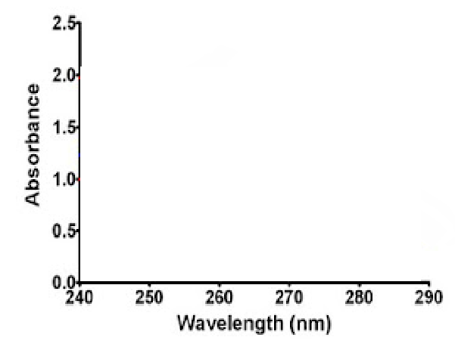
Results:
Plot The absorption spectra of the native DNA solution and the denatured DNA against wave lengths.
write your comment regarding the two graphs in the discussion. And determine the optimum wavelengh.
Absorbance of heated DNA | Absorbance of isolated DNA | Wave length (nm)
 |  | 240
 |  | 245
 |  | 250
 |  | 255
 |  | 260
 |  | 265
 |  | 270
 |  | 275
 |  | 280

Slide 12
Questions:
Can you quantify DNA using photometer?

