Slide 1
Modulation
Lab 2 – 2019/1440
By: Elham Sunbu

Slide 2
OUTLINE
Standard Amplitude Modulation (AM)
(Generating standard AM signal and show the effect of μ)
Frequency Modulation (FM)
Use the Simulink to implement the modulation process of FM.
Phase Modulation (PM)
Use the Simulink to view a PM modulated signal.

Slide 3
Standard Amplitude Modulation (AM)

Slide 4
Blocks Required:
- Signal Generator (carrier signal source and message signal source) - Constant block
- Product Block - Summer Block - Blocks for viewing the signals – Scope
We can find these blocks in the following locations of Simulink Library
Carrier, Message blocks:
Simulink → Sources → Signal Generator
View Block:
Simulink → Sink → Scope
Product and Summer Block
Simulink → Math Operations→ Product
Simulink → Math Operations→ Sum

Slide 5
Generating standard AM signal and the effects of μ values:
To generate standard AM modulated signal, we just have to implement the equation of AM in block level
S_{AM}(t) = A_{c} c(t) + m(t) c(t)
= [A_{c} + m(t) ] c(t)

Slide 6
Simulink

Slide 7
Let’s do AM modulation using the following signals:
m(t) = 2 sin(6πt) c(t) = 5 sin(100πt) What is the value of μ?
m(t) = 3 sin(4πt) c(t) = 3 sin(200πt) What is the value of μ?
m(t) = 3 sin(8πt) c(t) = 2 sin(200πt) What is the value of μ?

Slide 8
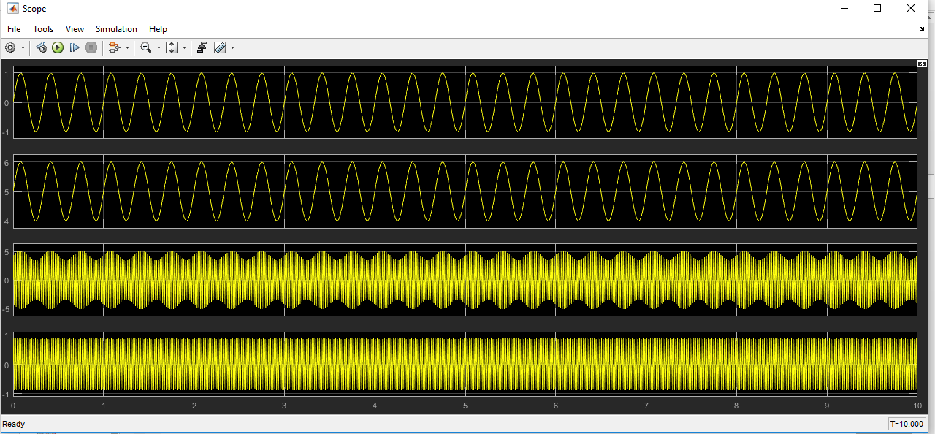
OUTPUT

Slide 9
Frequency Modulation (FM)

Slide 10
Blocks Required:
- Sin Wave Block (message signal source) - Integrator Block - Gain Blocks
- Trigonometric Function Block - Summer Block - Scope Block - Constant Block
We can find these blocks in the following locations of Simulink Library
Sin Wave and Constant Blocks:
Simulink → Sources → Sin Wave
Simulink → Math operation → Constant
Trigonometric Function, Gain, and Sum Block:
Simulink → Math operation → Trigonometric Function
Simulink → Math operation → Gain
Simulink → Math Operations→ Sum
Integrator Block:
Simulink → continuous → Integrator
View Block:
Simulink → Sink → Scope

Slide 11
Simulink

Slide 12
Generate an FM modulated signal where the
m(t)= sin (2π10t) c(t) = cos(2π100t) kf = 50Hz/v
m(t)= sin (2π5t) c(t) = cos(2π200t) kf = 70Hz/v
m(t)= sin (2πt) c(t) = cos(2π100t) kf = 30Hz /v

Slide 13
settings

Slide 14
OUTPUT

Slide 15
Phase Modulation (PM)

Slide 16
Blocks Required:
Sine Wave, in the signal processing Blockset → Signal Processing Sources library (not the Sine Wave block in the Simulink Sources library)

Slide 17
Simulink

Slide 18
Generate an PM modulated signal where the:
m(t) = 2 sin(7πt), carrier signal has frequency 50 Hz and the phase deviation is 100π
m(t) = sin(10πt), carrier signal has frequency 90Hz and the phase deviation is 70π
m(t) = sin(24πt), carrier signal has frequency 30Hz and the phase deviation is 120π

Slide 19
OUTPUT

Slide 20
Thank You

