Slide 1
Digital Modulation Basics
Lab 3 – 2019/1440
By: Elham Sunbu

Slide 2
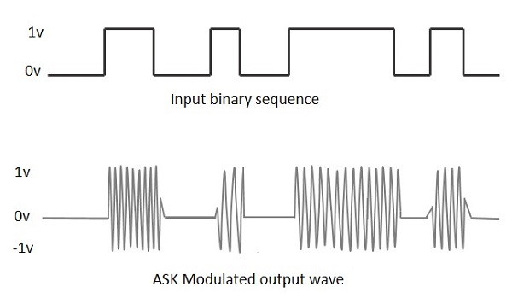
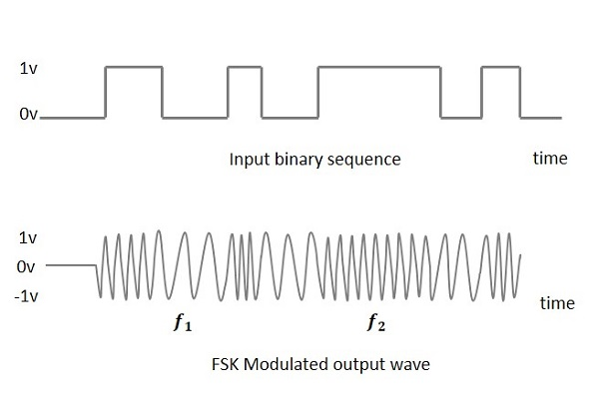
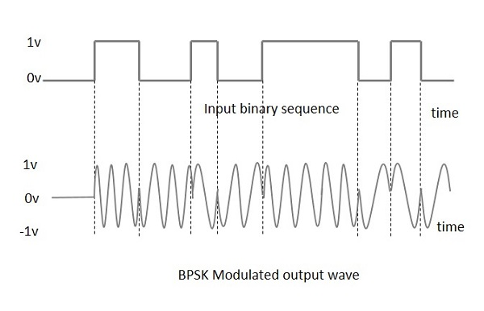
OUTLINE
Amplitude Shift Keying (ASK)
Frequency Shift Keying (FSK)
Phase Shift Keying (PSK)

Slide 3
Amplitude Shift Keying (ASK)

Slide 4
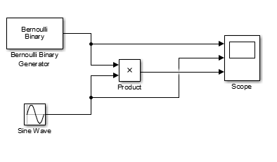
Simulink

Slide 5
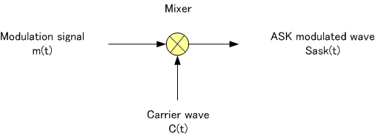
OOK Modulator
Apply a OOK for a random digital signal using the following carrier
2 sin (2π20t)
3 sin (2π30t) (Evaluation)

Slide 6
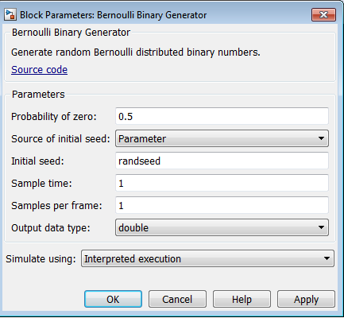
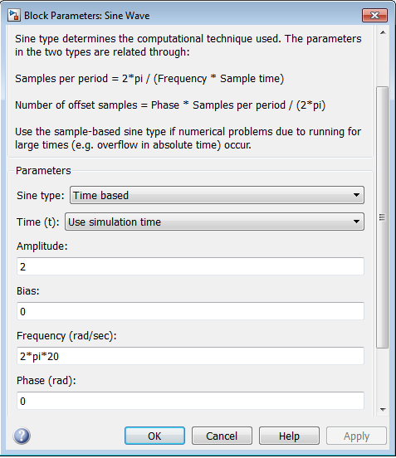
Settings

Slide 7
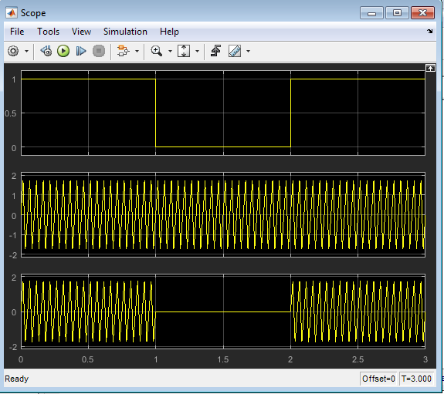
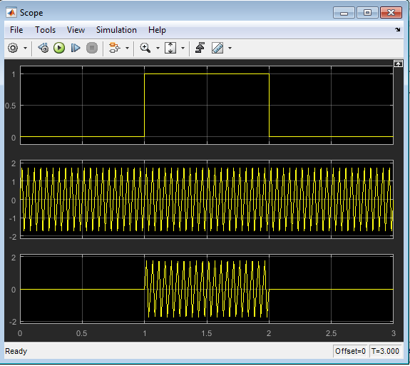
OUTPUT

Slide 8
Frequency Shift Keying (FSK)

Slide 9
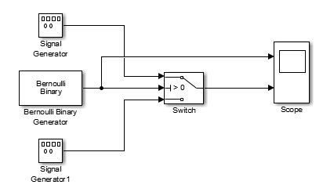
Simulink

Slide 10
FSK Modulator
Implement a BFSK modulation that use the following carriers:
f_{c1} = 100 Hz and f_{c2} = 20Hz

Slide 11
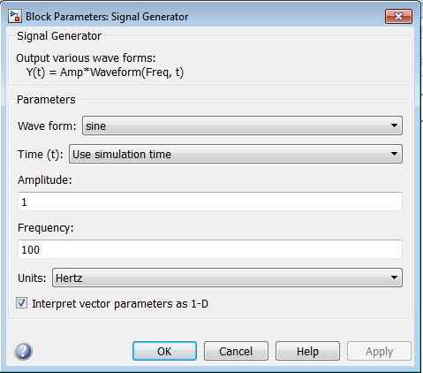
Settings

Slide 12
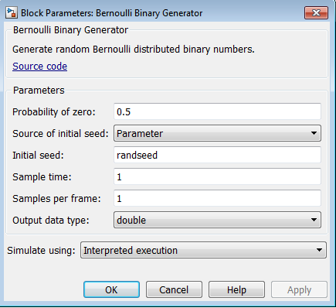
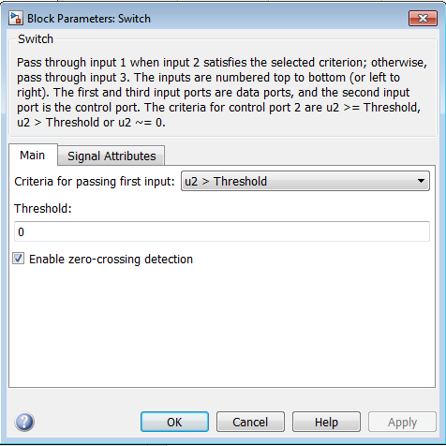
Settings

Slide 13
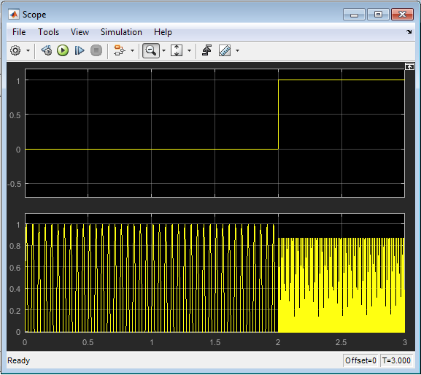
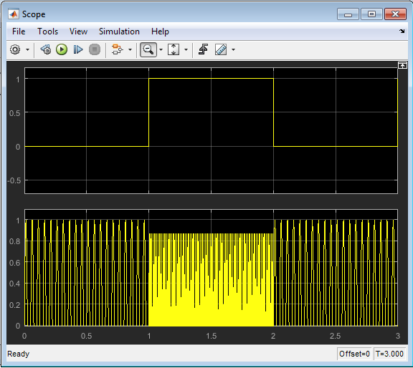
OUTPUT

Slide 14
Evaluation
f_{c1} = 180 Hz and f_{c2} = 50Hz

Slide 15
Phase Shift Keying (PSK)

Slide 16
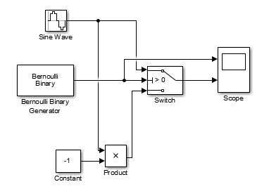
Simulink

Slide 17
Implement a BPSK modulation that use the following carriers:
1- f = 7 Hz
2- f = 4 Hz (Evaluation)
3- f = 5 Hz

Slide 18
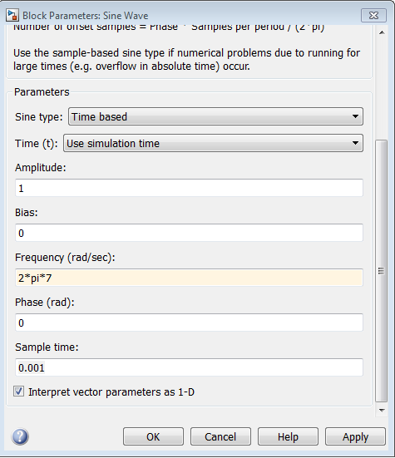
Settings

Slide 19
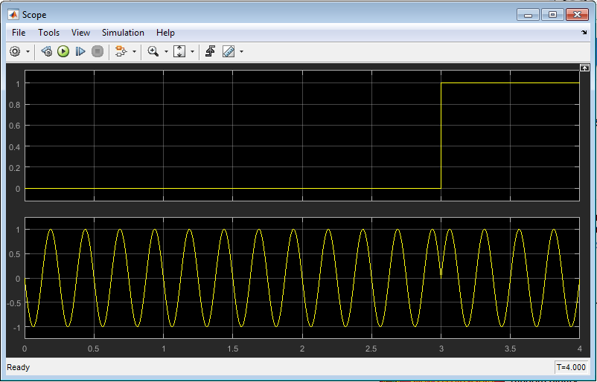
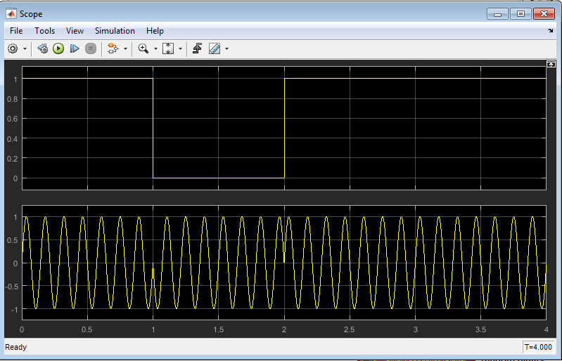
OUTPUT

Slide 20
Thank You

