Slide 1
Files and Streams

Slide 2
Objectives
Learn about the classes that support file input/output
Understand the concept of abstraction and how it related to the file I/O model
Connecting files and streams
Learn how to read sequential text files
Learn how to write sequential text files
Text files = streams of characters perhaps with special characters (often the end of line character) that mark the end of a line.

Slide 3
Data Hierarchy

Slide 4
The Directory Class
Common methods of the Directory class
Exists (path designation)
CreateDirectory (path designation)
Delete (path designation)
Code that uses some of the Directory methods
Dim dir As String = "C:\VB 2005\Files\"
If Not Directory.Exists(dir) Then
Directory.CreateDirectory(dir)
End If

Slide 5
The Directory Class

Slide 6
The Directory Class

Slide 7
The File Class
Common methods of the File class
Exists (path)
Delete (path)
Copy (source, dest)
Move (source, dest)
Code that uses some of the File methods
Dim path As String = dir & "Products.txt"
If File.Exists(path) Then
File.Delete(path)
End If

Slide 8
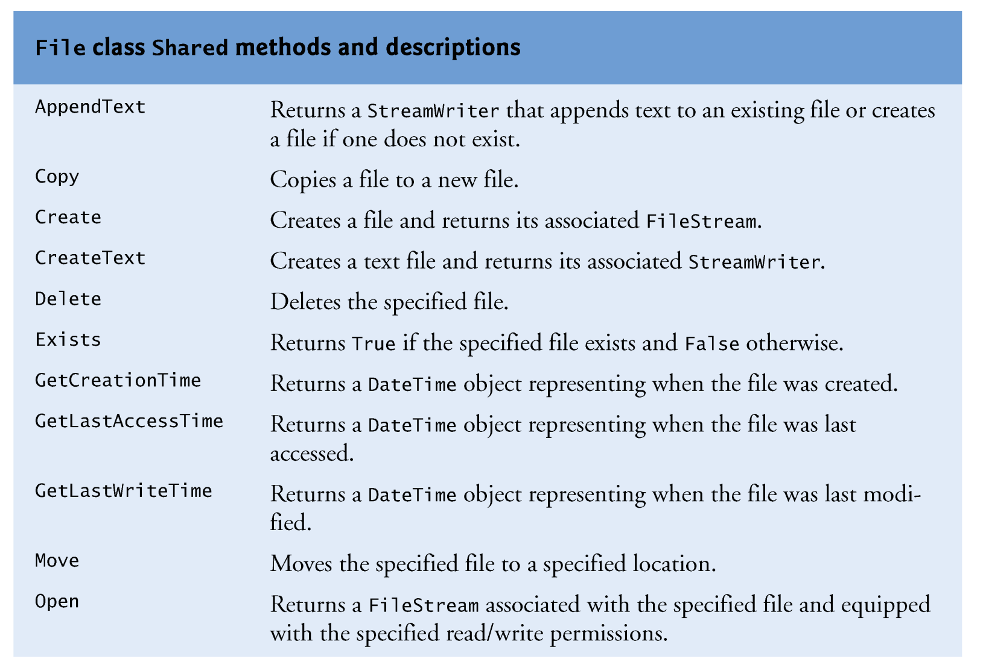
The File Class

Slide 9
The File Class

Slide 10
Introduction to Files and Streams
System.IO classes are used to work with files and streams
You can work with two kinds of files – text files (containing only characters) and binary files
In this Lecture Set, we discuss text files in detail – we present material on binary files later but will not discuss them in this course

Slide 11
Text vs Binary Files
A text file displayed in a text editor
A binary file displayed a text editor

Slide 12
Introduction to Processing Textual Data
One way to process textual files is from beginning to end using sequential access
This type of file is called a sequential file
Sequential files can be categorized into roughly three types
Free-form files have no particular format
Fields in a delimited file are separated with a special character called a delimiter
In a fixed-field file, each field occupies the same character positions in every record
There are other types of files in addition to sequential files: binary files; direct (random or indexed) access files

Slide 13
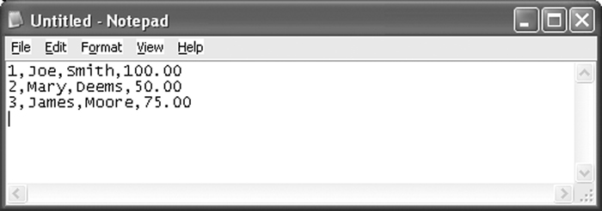
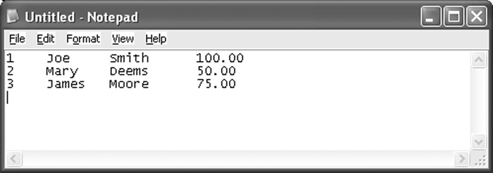
Introduction to Processing Textual Data
Delimited file
Fixed-field file

Slide 14
The Object Framework
For files, the object is an instance of a class that provides an abstract view of a file. This view is modeled by a Stream class (StreamReader or StreamWriter classes).
The stream abstraction (methods and data stores) of a file that you program against
(reading and writing an entire file, a line at a time, or a field at a time)
The actual, physical file to be manipulated
The connection – via creation of a streamReader or streamWriter object

Slide 15
The Stream-File Connection
When you program the manipulation of files, you are really programming “against” the stream abstraction:
FileStream
StreamReader
StreamWriter
BinaryReader
BinaryWriter

Slide 16
Establishing Connections
There are several different ways to establish file-stream connections
Create a FileStream object
Dim path as String = “C:\VB 2005\Files\Products.txt
Dim fs as New FileStream(path, FileMode.create, _
FileAccess.Write)
2. Create a StreamReader object
3. Create a StreamWriter object
The results of using these techniques are similar – they all result in the creation of (or opening of) a stream (fs) against which all subsequent file operations are written

Slide 17
The FileStream Class
The syntax for creating a FileStream object
New FileStream(path, FileMode, FileAccess, share]])
Members in the FileMode enumeration
Append – opens a file if it exists and place the write pointer at the end of the file
Create – Creates a new file. If file exists it is overwritten
CreateNew – Creates a new file. If file already exists an exception is thrown
Open – Opens an existing file. If file does not exist, an exception is thrown
OpenOrCreate – Opens a file if it exists or creates a new file if it does not exist
Truncate –Opens an existing file and truncates it to zero bytes (erases its contents)

Slide 18
The FileStream Class
Members in the FileAccess enumeration
Read
ReadWrite
Write
Members in the FileShare enumeration
None
Read
ReadWrite
Write
Common method of the FileStream class
Close()
Example
Dim path as String = “C:\VB 2005\Files\Products.txt
Dim fs as New FileStream(path, FileMode.create, FileAccess.Write)

Slide 19
The StreamReder Class
The StreamReader and StreamWriter classes belong to the System.IO namespace
Sequential files can be read one character at a time, one line at a time, or the entire file can be read at once
Sequential files are typically read into a string or an array
Closing a file disconnects the application from the file

Slide 20
The StreamReder Class
The StreamReader constructor accepts one argument – the path and filename of the sequential file to open.
Dim CurrentReader As StreamReader = _
New System.IO.StreamReader( _
"C:\Demo.txt")
The Close method closes a sequential file.
Always close files when processing is complete to prevent loss of data
Open files also consume system resources
Example:
CurrentReader.Close()

Slide 21
The StreamReder Class
The Close method closes an open file.
The Peek method gets the next character without actually reading the character. The method returns the Integer code point of the character that will be read. The method returns -1 if there are no more characters to read
The Read method reads a single character or many characters. Without arguments, the Read method returns the Integer code point of the character read
The ReadLine method reads a record. The carriage return at the end of the record is discarded. The method returns a String containing the characters read.
The ReadToEnd method reads from the current file position to the end of the file. The method returns a String containing the characters read

Slide 22
Reading Entire Content of File

Slide 23
Reading a Sequential File One Record at a Time
Dim CurrentReader As New _ System.IO.StreamReader("C:\Demo.txt")
Dim CurrentRecord As String
CurrentRecord = CurrentReader.ReadLine()
Do Until CurrentRecord = Nothing
' Statements to process the current record.
CurrentRecord = CurrentReader.ReadLine()
Loop
CurrentReader.Close()

Slide 24
The StreamWriter Class
The StreamWriter class of the System.IO namespace writes a sequential file
The constructor accepts one argument – the file to write
Example:
Dim CurrentWriter As New _
System.IO.StreamWriter("C:\Demo.txt")
' Statements to write the file.
CurrentWriter.Close()

Slide 25
The StreamWriter Class
The NewLine property contains the character(s) that mark the end of the line
The Close method closes the sequential file
It's imperative to close a sequential file once writing is complete to prevent loss of data
The Write method writes a character or array of characters
The WriteLine method writes data terminated by the character(s) stored in the NewLine property
If the data type passed to Write or WriteLine is not a string, these methods will call toString
Individual variables must be concatenated and separators must be used

Slide 26
StreamWriter Example
Code that writes data from a collection of Product objects to a text file
Dim textOut As New StreamWriter( _
New FileStream( path, _
FileMode.Create, FileAccess.Write))
For Each product As Product In products
textOut.Write(product.Code & "|")
textOut.Write(product.Description & "|")
textOut.WriteLine(product.Price)
Next
textOut.Close()

Slide 27
Writing a Freeform File
A freeform file can be written all at once as follows:
Dim StringData As String = "Freeform text"
Dim CurrentWriter As New _
System.IO.StreamWriter("C:\Demo.txt")
CurrentWriter.Write(StringData)
CurrentWriter.Close()

Slide 28
Writing a Delimited File
Write an array of Integers
Public Shared Sub WriteIntegerList( _
ByRef argArray() As Integer, _ ByVal argFile As String)
Dim CurrentStream As New StreamWriter(argFile)
Dim CurrentIndex As Integer
For CurrentIndex = 0 To argArray.GetUpperBound(0)
CurrentStream.Write(argArray(CurrentIndex))
If CurrentIndex <> _ argArray.GetUpperBound(0) Then
CurrentStream.Write(",")
End If
Next
CurrentStream.Close()
End Function

