Slide 1
Computer components

Slide 2
Computer Definition
computer is an electronic device, that can accept data (input), manipulate data (process), and produce information (output) ,and it is operating under the control of instructions (software).

Slide 3
Computer components
Software
Hardware

Slide 4
• Hardware:
- Pieces of equipment that make up a computer system.
- These are the parts you can touch (although many parts are contained within the computer’s case).

Slide 6
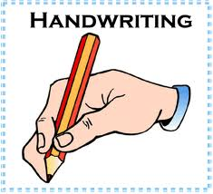
hardware
Brain
memory
3
1+2
1+2

Slide 7
hardware
CPU
Memory
3
1+2
1+2
Computer
Output devices
Input devices

Slide 8
Computer hardware
?
Output devices
Input devices
memory
Central Processing Unit
Cpu

Slide 9
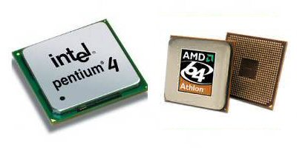
The Central Processing Unit(CPU):
is the brain of the computer All the "thinking", calculating and processing is done by the CPU.
The CPU also control the transfer of information between the secondary and main memory
The speed at witch a CPU can process information is Known as its Clock Speed

Slide 10
The Central Processing Unit(CPU):
The Central Processing Unit(CPU)
Arithmetic logic unit
(ALU)
Control Unit (CU)

Slide 11
hardware
CPU
Memory
3
1+2
1+2
Computer
Output devices
Input devices

Slide 12
The Central Processing Unit(CPU) :
The Central Processing Unit(CPU) Speed is measured in megahertz (MHz) or gigahertz (GHz).
KHZ=1000 HZ
MHZ=1000000 HZ =1000 KHZ
GHZ=1000000000 HZ = 1000 MHZ

Slide 13
The Central Processing Unit(CPU) :
The Central Processing Unit = (CPU) = processor

Slide 14
Computer hardware
?
Output devices
Input devices
memory
Central Processing Unit
Cpu

Slide 15
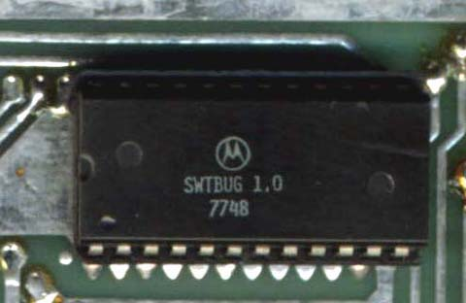
Memoty
(RAM)
(ROM)

Slide 16
ROM (Read Only Memory):
This is a special type of memory which contains all the
information the computer needs to switch itself on, check that all its systems are working and to tell the PC what things are plugged into it. It cannot be changed or overwritten by you, and stays the same even when the PC is switched off.

Slide 17
RAM (Random Access Memory) or main memory :
Random access memory is used in a PC to temporarily store data when you are using applications.
RAM is not permanent, when you switch off the PC (or shut down), the contents of RAM are lost or emptied This is known as volatile memory.

Slide 18
CPU
Memory
(RAM)
3
1+2
1+2
Computer
Output devices
Input devices

Slide 19
Computer hardware
?
Output devices
Input devices
memory
Central Processing Unit
Cpu

Slide 20
Storage measurement units

Slide 21
A
1
1
0
0
1
0
1
1
Bit
Byte

Slide 22
: the amount of storage space needed to hold either a 1 or a 0 in memory (binary numbering ) This is the smallest unit of computer memory | bit
Equal to 8 bits , this is the amount of storage space needed to hold one character | byte
bytes1024 | Kilobyte(KB)
1024KB | Megabyte(MB)
1024MB | Gigabyte(GB)
1024GB | Terabyte(TB)

Slide 23
Computer hardware
?
Output devices
Input devices
memory
Central Processing Unit
Cpu

Slide 24
Input devices:
An input device is any device that is used to supply information to a computer (as data or for the selection of commands/menus/icons etc)

Slide 25
Input devices.

Slide 26
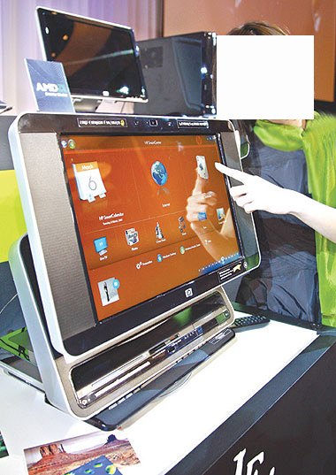
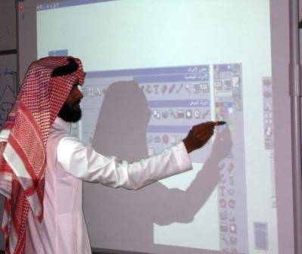
Touch screen
Electronic board

Slide 28
Computer hardware
?
Output devices
Input devices
memory
Central Processing Unit
Cpu

Slide 29
Output devices:
Any devices that allows the result of computer processing activity to be seen or heard

Slide 30
Output devices:

Slide 31
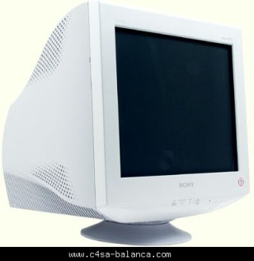
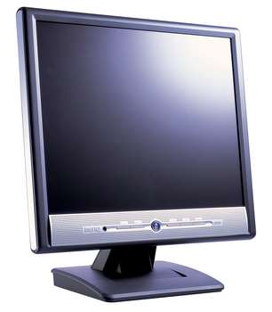
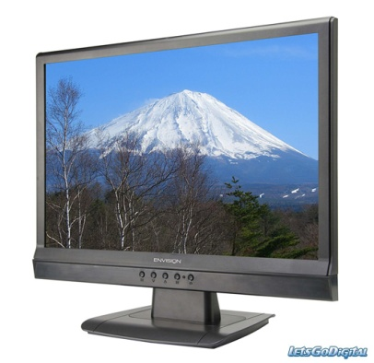
Output device:
The screen :
CRT
LCD
Plasma

Slide 32
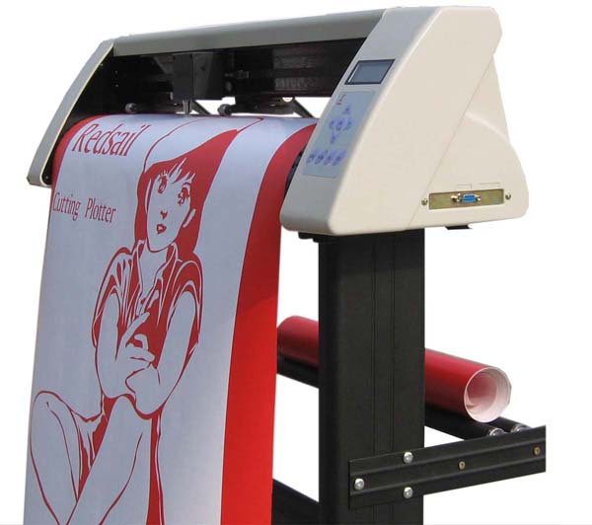
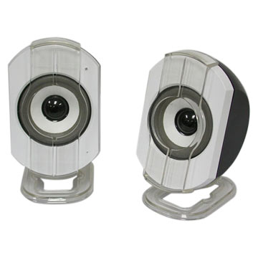
Plotter
Speakers

Slide 34
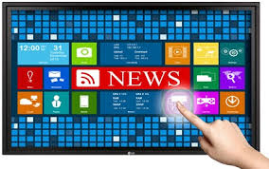
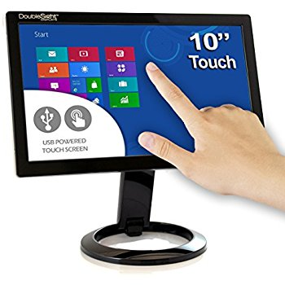
Devices used for input and output
Touch screen

Slide 35
Computer Hardware
?
Output Devices
Input Devices
Memory
Central Processing Unit
CPU
))

Slide 36
Storage drives
Storage drives are used to store and transfer data files. After data is entered into a computer, is must be saved as a file to preserve its contents after the computer is switched off.

Slide 37
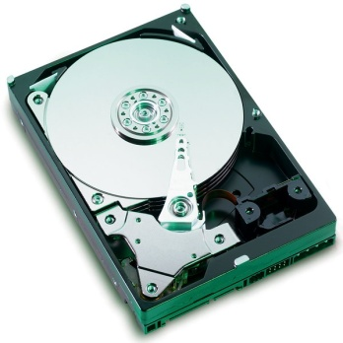
Hard disk:
drive HDD Usually fixed inside the computer and stores large volumes of data, which can be accessed and retrieved quickly. A software application must also install files onto the hard disk drive in order to run .

Slide 38
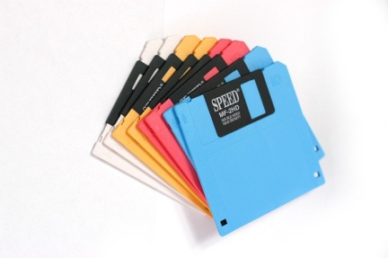
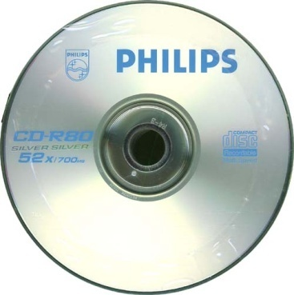
Floppy disk drive:
A floppy disk drive is like a hard disk, but with
removable disks called floppies, floppy disks or diskettes. Floppies
can be used to transfer small files from one PC to another (up to
1.4MB)
CD-ROM/DVD-ROM Drive:
CD-ROM
CD-R
CD-RW
DVD-ROM
DVD-R
DVD-RW

Slide 39
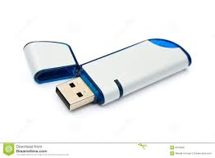
Flash Memory:

Slide 40
A
1
1
0
0
1
0
1
1
Bit
Byte

Slide 41
: the amount of storage space needed to hold either a 1 or a 0 in memory (binary numbering ) .This is the smallest unit of computer memory | bit
Equal to 8 bits , this is the amount of storage space needed to hold one character | byte
bytes1024 | Kilobyte(KB)
1024KB | Megabyte(MB)
1024MB | Gigabyte(GB)
1024GB | Terabyte

Slide 42
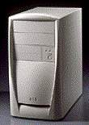
System Box –SYSTEM UNIT-case

Slide 43
MOTHERBOARD

Slide 44
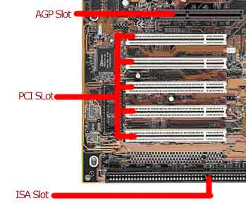

Slide 46
https://www.youtube.com/watch?v=75YluhFQyII

Slide 48
Computer components
Software
Hardware

Slide 49
Software:
- The instructions that a computer follows .
- Operating systems, office programs and games are examples of software.
- Software governs when and how various pieces of hardware can be put to a variety of uses

Slide 50
1-Operating Systems software :
is the software that runs the computer
Microsoft Windows is the operating system a lot of people use.
However, there are other forms of systems software such as Unix, Linux, (Mac OS) and so on

Slide 51
2- Applications Software
Word Processing: Example Microsoft Word
Spreadsheets:. Example Microsoft Excel
Database: Examples Microsoft Access
Presentation: Example Microsoft PowerPoint
Web browsing
Applications Software must be compatible with the Operating Systems

Slide 52
3- programming language :
Cin<<num1,num2
Sum=num1+num2
Cout >>sum

Slide 53
(Sheet 1)
Sara Turn on her computer and then open the word processor to write her homework :
What are the steps taken by the computer to do this task in order:
3
Load MS word into the RAM
1
Run the BIOS software from the ROM
2
read the OS files from HDD and copy them to the RAM
4
save the word file in the hard disk

