Slide 1
Physical Transmission

Slide 2
Computer Network Components
Components of a computer network:
Computer with NIC (PCs, laptops, handhelds)
routers & switches (IP router, Ethernet switch)
Links” Transmission media” (wired, wireless)
protocols (IP,TCP,CSMA/CD,CSMA/CA)
applications (network services) i.e. Network Operating System (NOS)
humans and service agents

Slide 4
Physical Transmission
Physical Transmission
Transmission Media
Wire (guided)
Coaxial cable
Twisted Pair
STP
Fiber Optic
Wireless (unguided)
Radio waves
Microwave
Infrared
Satellite
Laser
Signaling Techniques
Baseband
Transmission
Broadband
Transmission
UTP

Slide 5
Transmission Media
Anything that can carry information from a source to a destination.

Slide 6
Transmission Media
LANs can be connected together using a variety of transmission media types.
Each type has its own advantages and disadvantages which will be examined in this section

Slide 7
Transmission Media
Computers and telecommunication devices use signals to represent data.
These signals are transmitted from a device to another in the form of electromagnetic energy.
Electromagnetic energy is a form of energy that is reflected from objects in the form of electrical and magnetic waves that can travel through space
Examples of Electromagnetic energy:
power, radio waves, infrared light, visible light, ultraviolet light, and X and gamma rays.

Slide 8
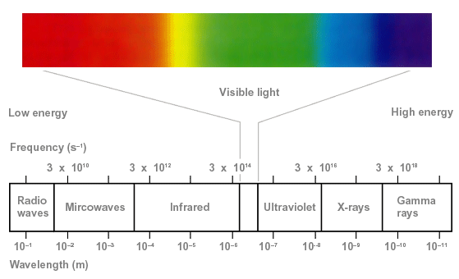
Transmission Media
Each of the previous examples constitutes a portion of the electromagnetic spectrum.
Not all portion of the spectrum are currently usable for telecommunications.
Each portion of the spectrum requires a particular transmission medium.

Slide 9
Transmission Media
There are two categories of Transmission media:
Wired (Guided) media
A signal traveling along guided media is directed and contained by the physical limits of the medium
Wireless (Unguided) media
Unguided media transport signals without using a physical conductor.

Slide 10
Overview
For Guided Medium
The medium is more important
For Unguided
The bandwidth produced by the antenna is more important

Slide 11
Design Factors for Transmission Media
Bandwidth: Communication capacity of a transmission media
All other factors remaining constant, the greater the bandwidth of a signal, the higher the data rate that can be achieved.
Transmission impairments: Limit the distance a signal can travel.
Interference: Competing signals in overlapping frequency bands can distort or wipe out a signal.
Number of receivers: Each attachment introduces some attenuation and distortion, limiting distance and/or data rate.

Slide 12
1. Wired (Guided) media

Slide 13
I. Wired (Guided) media:
There are three categories of guided media:
Twisted Pair :
Unshielded twisted pair (UTP)
Shielded twisted pair (STP)
Coaxial Cable
Fiber Optic Cable

Slide 14
Twisted Pair Wires
Consists of two insulated copper wires, each with its own plastic insulation, twisted together arranged in a regular spiral pattern to minimize the electromagnetic interference between adjacent pairs
Often used at over distances to carry voice as well as data communications
Low frequency transmission medium

Slide 15
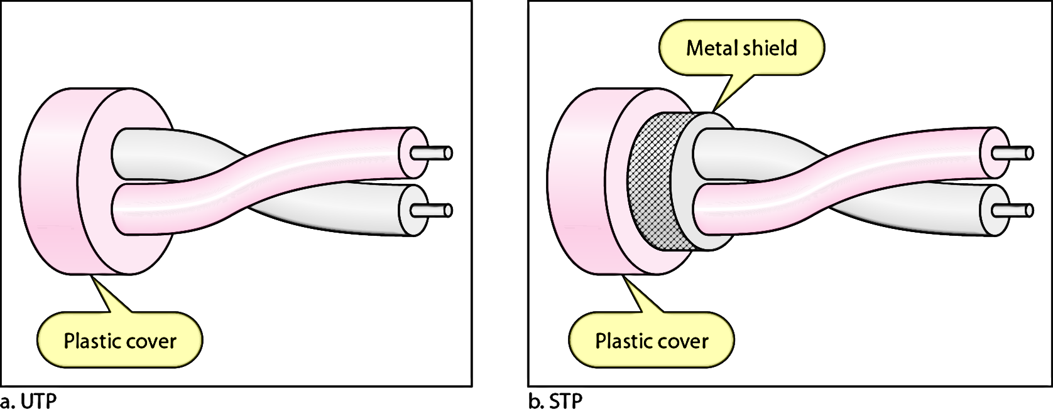
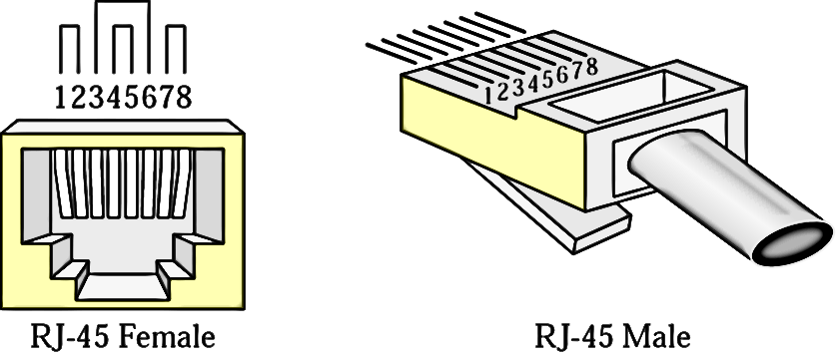
Types of Twisted Pair
STP (shielded twisted pair)
the pair is wrapped with metallic foil or braid to insulate the pair from electromagnetic interference
UTP (unshielded twisted pair)
each wire is insulated with plastic wrap, but the pair is encased in an outer covering

Slide 17
Advantages of UTP & STP
The characteristics of UTP are:
Cheap
Ease of use
flexible
easy to install.
The characteristics of STP:
less susceptible to noise
materials and manufacturing requirements make STP more expensive than UTP

Slide 18
Twisted Pair Advantages & Disadvantages
Advantages
Disadvantages
Inexpensive and available
Flexible and light weight
Easy to work with and install
Sensitivity to interference and noise
Relatively low bandwidth (3000Hz)

Slide 19
Coaxial Cable (or Coax)
Carries signals of higher frequency ranges than twisted pair cable.
Has an inner conductor enclosed in an insulator, which is in turn encased in an outer conductor of metal braided mesh.
Both conductors share a common center axial, hence the term “co-axial”
Used for cable television, LANs, telephony

Slide 20
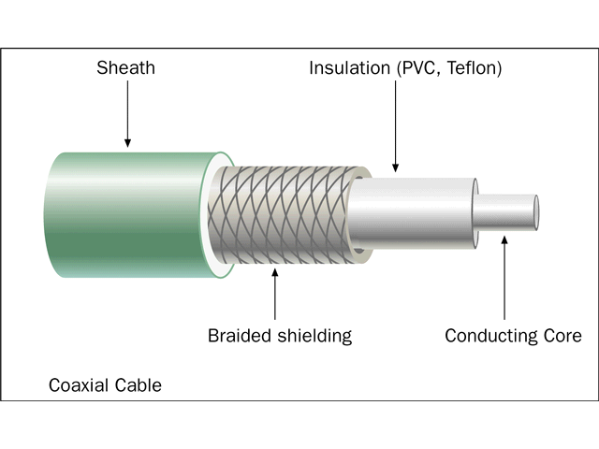
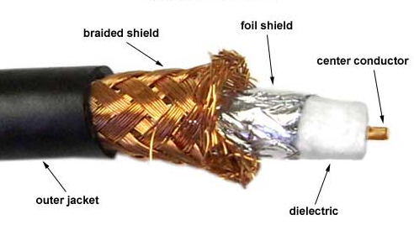
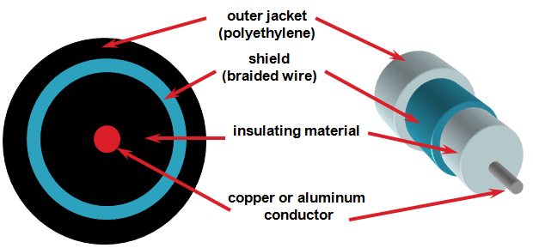
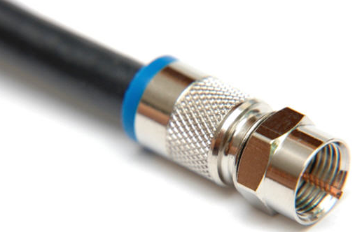

Slide 21
Coaxial Cable (or Coax)
Coaxial types:
Thicker used with large networks.
Thinner used with small networks.

Slide 22
Coax Advantages & Disadvantages
Advantages
Disadvantages
Higher bandwidth
400 to 600Mhz
Much less susceptible to interference than twisted pair
It will not cause a toxic gas when its burned. That’s why they use it in some buildings.
High attenuation rate makes it expensive over long distance
It’s not used anymore due to high cost and other technical factors.

Slide 23
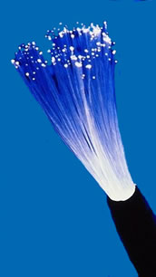
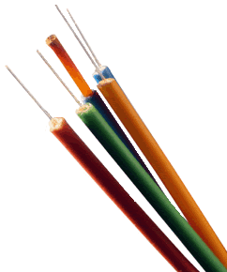
Fiber Optic Cable
Relatively new transmission medium used by telephone companies in place of long-distance trunk lines
Fiber Optic works on the properties of light. When light ray hits at critical angle it tends to refracts at 90 degree. This property has been used in fiber optic. The core of fiber optic cable is made of high quality glass or plastic. From one end of it light is emitted, it travels through it and at the other end light detector detects light stream and converts it to electric data form.
Fiber Optic provides the highest mode of speed.
Also used by private companies in implementing local data communications networks
Require a light source with injection laser diode (ILD) or light-emitting diodes (LED)

Slide 24
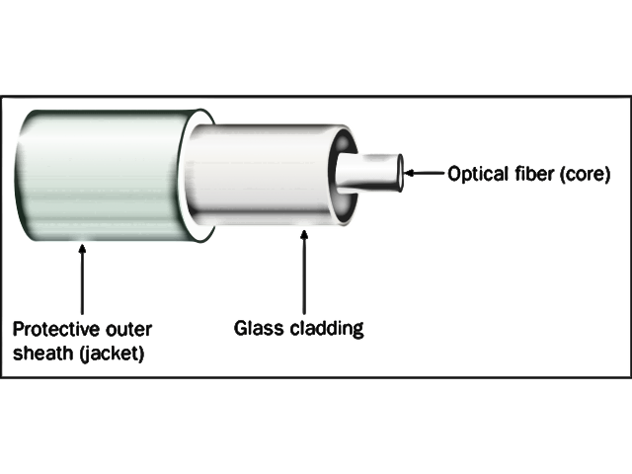
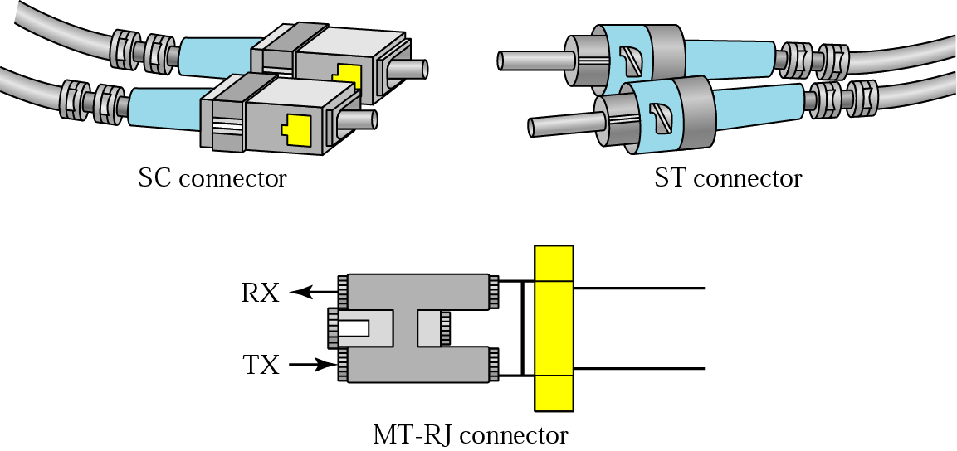
Fiber Optic Cable
Optical fiber is made of glass or plastic and transmits signals in the form of light.
The cable consists of a strand of glass (core) surrounded by a glass tube (cladding).
Its surrounded by a plastic isolation layer for protection .

Slide 25
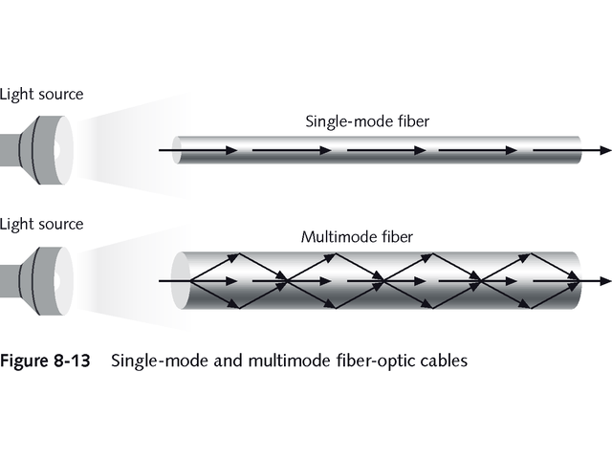
Fiber Optic Types
Digital data is converted to light
Single mode - one light source flashes a light down the cable.
can carries single ray of light
Multimode - supports many simultaneous light transmissions.
capable of carrying multiple beams of light.

Slide 26
fiber optic multimode
step-index
fiber optic multimode
graded-index
fiber optic single mode

Slide 27
Fiber Optic Advantages & Disadvantages
Advantages
Disadvantages
greater capacity (bandwidth of up to 2 Gbps)
Speed (100 - 500 mbps)
smaller size and lighter weight
lower attenuation
immunity to environmental interference
highly secure
expensive over short distance
requires highly skilled installers
adding additional nodes is difficult

Slide 28
Type of Cable depends on:
Transmission speed.
Maximum cable length.
Shielded requirements.
Price.

Slide 29
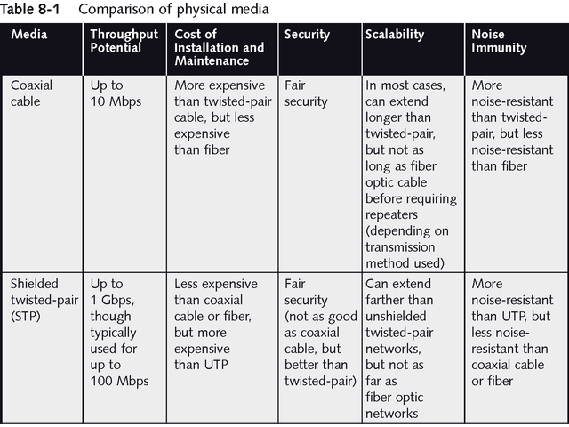
Comparison of Physical Media

Slide 30
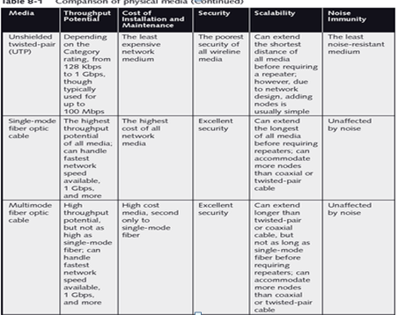
Comparison of Physical Media

