Slide 1
Digital Transmission Line coding
2nd semester 1438-1439
NET 205: Data Transmission and Digital Communication

Slide 2
205NET CLO
1-Introduction to Communication Systems and Networks architecture OSI Reference Model.
2- Data Transmission Principles
3- Transmission medias
4- Data modulation and encoding

Slide 3
Outline
Digital to Digital Conversion
Some Characteristics of Line Coding
Line Coding Schemes
Block Coding

Slide 4
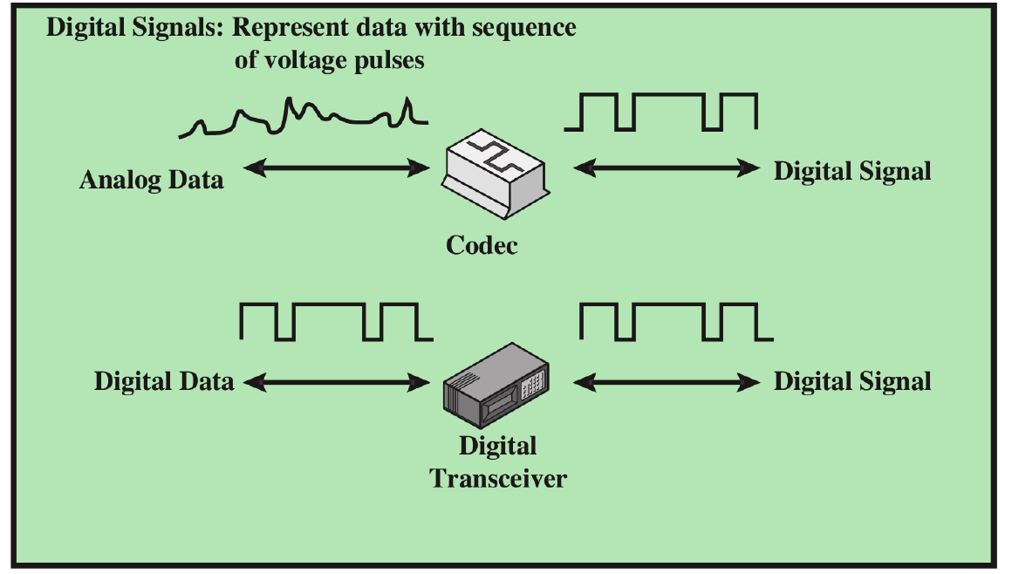
DIGITAL-TO-DIGITAL CONVERSION
The conversion involves three techniques: line coding, block coding, and scrambling.
Line coding is always needed; block coding and scrambling may or may not be needed ( used to improve the efficiency of line coding).

Slide 5
Line Coding
Line coding is the process of converting digital data to digital signals.
We assume that data, in the form of text, numbers, graphical images, audio, or video, are stored in computer memory as sequences of bits.
Notes:
Line coding is the process of converting digital data to digital signals. We assume that
data, in the form of text, numbers, graphical images, audio, or video, are stored in computer
memory as sequences of bits (see Chapter 1). Line coding converts a sequence of
bits to a digital signal. At the sender, digital data are encoded into a digital signal; at the
receiver, the digital data are recreated by decoding the digital signal

Slide 6
Outline
Digital to Digital Conversion
Some Characteristics of Line Coding
Data Elements versus Signal Elements
Data Rate and Signal rate
Bandwidth of a Digital Signal
Baseline Wandering
DC Components
Self-synchronization
Other Characteristics
Line Coding Schemes
Block Coding

Slide 7
Mapping Data Elements onto Signal levels
A data symbol (or element) can consist of a number of data bits:
1 , 0 or
11, 10, 01, ……
A data element can be coded into a single signal element ( level) or multiple signal elements
1 → +V, 0 → -V
1 → +V and -V, 0 →-V and +V
The ratio ‘r’ is the number of data elements carried by a signal element.
Notes:
Before discussing different line coding schemes, we address their common characteristics
In data communications, our goal is to send data elements. A
data element is the smallest entity that can represent a piece of information: this is the
bit. In digital data communications, a signal element carries data elements. A signal
element is the shortest unit (timewise) of a digital signal. In other words, data elements
are what we need to send; signal elements are what we can send. Data elements are
being carried; signal elements are the carriers.

Slide 8
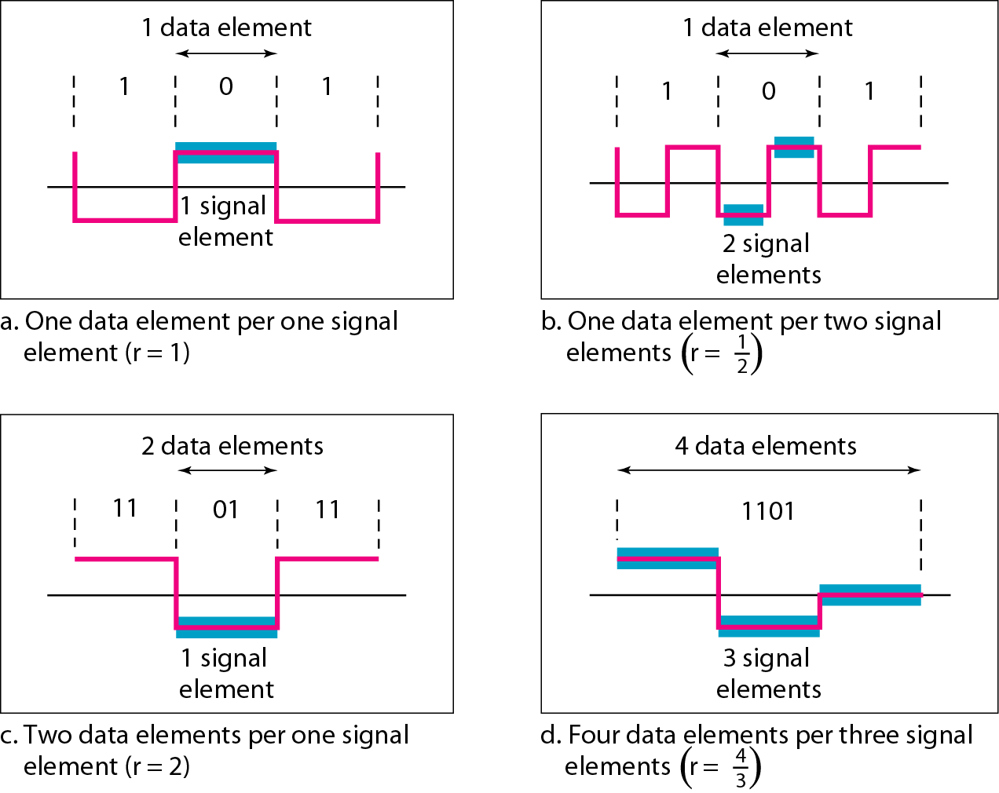

Slide 9
Relationship between data rate and signal rate
Goal is to increase the data rate while decreasing the signal rate.
S = c x N x 1/r bauds
where N is data rate
c is the case factor (worst, best & avg.)
r is the ratio between data element & signal element
Notes:
Increasing the data rate increases the speed of transmission; decreasing the
signal rate decreases the bandwidth requirement.
This relationship, of course, depends on the value of r. It also depends
on the data pattern. If we have a data pattern of all 1s or all Os, the signal rate may be
different from a data pattern of alternating Os and Is. To derive a formula for the relationship,
we need to define three cases: the worst, best, and average. The worst case is
when we need the maximum signal rate; the best case is when we need the minimum.
In data communications, we are usually interested in the average case.

Slide 10
Example
A signal is carrying data in which one data element is encoded as one signal element ( r = 1). If the bit rate is 100 kbps, what is the average value of the baud rate if c is between 0 and 1?
We assume that the average value of c is 1/2 . The baud rate is then

Slide 11
Bandwidth of a Digital Signal
Although the actual bandwidth of a digital signal is infinite, the effective bandwidth is finite.
the baud rate, not the bit rate, determines the required bandwidth for a digital signal.
The minimum bandwidth can be given as
B_{min} = c x N x 1/r
Notes:
We discussed in Chapter 3 that a digital signal that carries infonnation is
nonperiodic. We also showed that the bandwidth of a nonperiodic signal is continuous
with an infinite range. However, most digital signals we encounter in real life have a bandwidth with finite values. In other words, the bandwidth is theoretically infinite, but
many of the components have such a small amplitude that they can be ignored. The
effective bandwidth is finite. From now on, when we talk about the bandwidth of a digital
signal, we need to remember that we are talking about this effective bandwidth.

Slide 12
Baseline Wandering
In decoding digital signal, the receiver calculate the average power of the received signal.
This average called the baseline.
The incoming signal power is evaluated against this baseline to determine the value of the incoming data elements.
A long string of 0s and 1s can cause a drift in the baseline ( baseline wandering) and make it difficult for a receiver to decode correctly.
A good line encoding scheme will prevent long runs of fixed amplitude
Notes:
If the incoming signal does not vary over a long period of time, the baseline will drift and thus cause errors in detection of incoming data elements.

Slide 13
DC Components
When the voltage level in a digital signal remains constant for long periods of time, there is an increase in the low frequencies of the signal.
These frequencies around zero, called DC (direct-current) components.
Most channels are band-pass and may not support the low frequencies.
This will require the removal of the dc component of a transmitted signal.
Notes:
When the voltage level in a digital signal is constant for a while,
the spectrum creates very low frequencies (results of Fourier analysis). These frequencies
around zero, called DC (direct-current) components, present problems for a
system that cannot pass low frequencies or a system that uses electrical coupling
(via a transformer). For example, a telephone line cannot pass frequencies below
200 Hz. Also a long-distance link may use one or more transformers to isolate
different parts of the line electrically. For these systems, we need a scheme with no
DC component.

Slide 14
Self-synchronization
The receiver's bit intervals must correspond exactly to the sender's bit intervals, to correctly interpret the received signals.
If the receiver clock is faster or slower, the bit intervals are not matched and the receiver might misinterpret the signals.
A self-synchronizing digital signal includes timing information in the data being transmitted. (transitions in the signal that alert the receiver to the beginning, middle, or end of the pulse).
Notes:
To correctly interpret the signals received from the sender,
the receiver's bit intervals must correspond exactly to the sender's bit intervals. If the
receiver clock is faster or slower, the bit intervals are not matched and the receiver might
misinterpret the signals.
A self-synchronizing digital signal includes timing information in the data being
transmitted. This can be achieved if there are transitions in the signal that alert the
receiver to the beginning, middle, or end of the pulse. If the receiver's clock is out of
synchronization, these points can reset the clock.

Slide 15
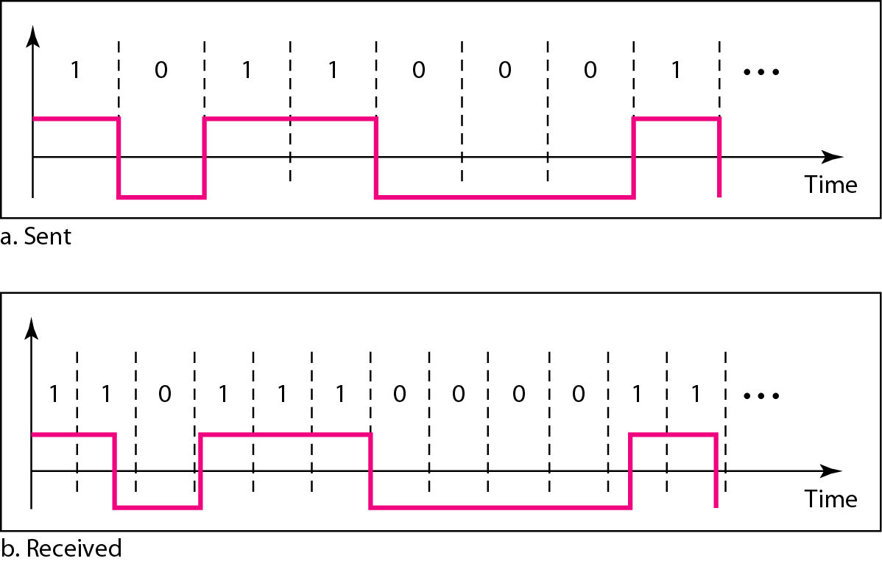

Slide 16
Other Characteristics
Built-in Error Detection It is desirable to have a built-in error-detecting capability in the generated code to detect some of or all the errors that occurred during transmission.
Complexity: A complex scheme is more costly to implement than a simple one.
Immunity to Noise and Interference: Another desirable code characteristic
Notes:
It is desirable to have a built-in error-detecting capability
in the generated code to detect some of or all the errors that occurred during transmission.
Some encoding schemes that we will discuss have this capability to some extent.
A complex scheme is more costly to implement than a simple one. For
example, a scheme that uses four signal levels is more difficult to interpret than one that
uses only two levels

Slide 17
Outline
Digital to Digital Conversion
Some Characteristics of Line Coding
Line Coding Schemes
Block Coding

Slide 18
Line Coding Schemes

Slide 19
Unipolar Scheme
It is very simple and very primitive.
Unipolar encoding is so named because it uses only one polarity.
This polarity is assigned to one of the two binary states, usually the 1.
The other state, usually the 0, is represented by zero voltage.
all the signal levels are on one side of the time axis, either above or below.
Notes:
NRZ (Non-Return-to-Zero) Traditionally, a unipolar scheme was designed as a
non-return-to-zero (NRZ) scheme in which the positive voltage defines bit I and the
zero voltage defines bit O. It is called NRZ because the signal does not return to zero at
the middle of the bit.

Slide 20
Unipolar Scheme
Scheme is prone to baseline wandering and DC components. It has no synchronization or any error detection. It is simple but costly in power consumption.

Slide 21
Polar Schemes
Use two voltage levels.
The voltage level for 0 can be positive and the voltage level for 1 can be negative.
The voltages are on both sides of the time axis.
There are two versions:
NZR - Level (NRZ-L) - positive voltage for one symbol and negative for the other
NRZ - Inversion (NRZ-I) - the change or lack of change in polarity determines the value of a symbol. E.g. a “1” symbol inverts the polarity a “0” does not.

Slide 22
NRZ-L and NRZ-I both have an average signal rate of N/2 Bd.
NRZ-L and NRZ-I both have a DC component problem and baseline wandering, it is worse for NRZ-L.
Both have no self synchronization &no error detection.
Both are relatively simple to implement.
Notes:
Let us discuss the bandwidth. Figure 4.6 also shows the normalized bandwidth for
both variations. The vertical axis shows the power density (the power for each I Hz of
bandwidth); the horizontal axis shows the frequency. The bandwidth reveals a very
serious problem for this type of encoding. The value of the power density is velY high
around frequencies close to zero. This means that there are DC components that carry a
high level of energy. As a matter of fact, most of the energy is concentrated in frequencies
between a and NIl. This means that although the average of the signal rate is N12,
the energy is not distributed evenly between the two halves.
Let us compare these two schemes based on the criteria we previously defined.
Although baseline wandering is a problem for both variations, it is twice as severe in
NRZ-L. If there is a long sequence of Os or Is in NRZ-L, the average signal power becomes skewed. The receiver might have difficulty discerning the bit value. In NRZ-I
this problem occurs only for a long sequence of as. If somehow we can eliminate the
long sequence of as, we can avoid baseline wandering. We will see shortly how this can
be done.
The synchronization problem (sender and receiver clocks are not synchronized)
also exists in both schemes. Again, this problem is more serious in NRZ-L than in
NRZ-I. While a long sequence of as can cause a problem in both schemes, a long
sequence of 1s affects only NRZ-L.
Another problem with NRZ-L occurs when there is a sudden change of polarity in
the system. For example, if twisted-pair cable is the medium, a change in the polarity of
the wire results in all as interpreted as I s and all I s interpreted as as. NRZ-I does not
have this problem. Both schemes have an average signal rate of NI2 Bd.

Slide 23
Example
A system is using NRZ-I to transfer 1-Mbps data. What are the average signal rate and minimum bandwidth?
Solution
The average signal rate is S= c x N x R = 1/2 x N x 1 = 500 kbaud. The minimum bandwidth for this average baud rate is Bmin = S = 500 kHz.
Note c = 1/2 for the avg. case as worst case is 1 and best case is 0

Slide 24
Return to Zero (RZ)
It uses three values: positive, negative, and zero.
Each symbol has a transition in the middle. Either from high to zero or from low to zero.
the signal changes not between bits but during the bit.
Notes:
The main problem with NRZ encoding occurs when the sender
and receiver clocks are not synchronized. The receiver does not know when one bit has
ended and the next bit is starting. One solution is the return-to-zero (RZ) scheme,
which uses three values: positive, negative, and zero. In RZ, the signal changes not
between bits but during the bit.
In Figure 4.7 we see that the signal goes to 0 in the middle
of each bit. It remains there until the beginning of the next bit.

Slide 25
Return to Zero (RZ)
This scheme has more signal transitions (two per symbol) and therefore requires a wider bandwidth.
No DC components or baseline wandering.
Self synchronization .
More complex as it uses three voltage level. It has no error detection capability.
Notes:
As a result of all
these deficiencies, the scheme is not used today. Instead, it has been replaced by the
better-performing Manchester and differential Manchester schemes (discussed next).

Slide 26
Manchester and Differential Manchester
Manchester coding consists of combining the NRZ-L and RZ schemes.
Every symbol has a level transition in the middle: from high to low or low to high. Uses only two voltage levels.
Differential Manchester coding consists of combining the NRZ-I and RZ schemes.
Every symbol has a level transition in the middle. But the level at the beginning of the symbol is determined by the symbol value. One symbol causes a level change the other does not.

Slide 27
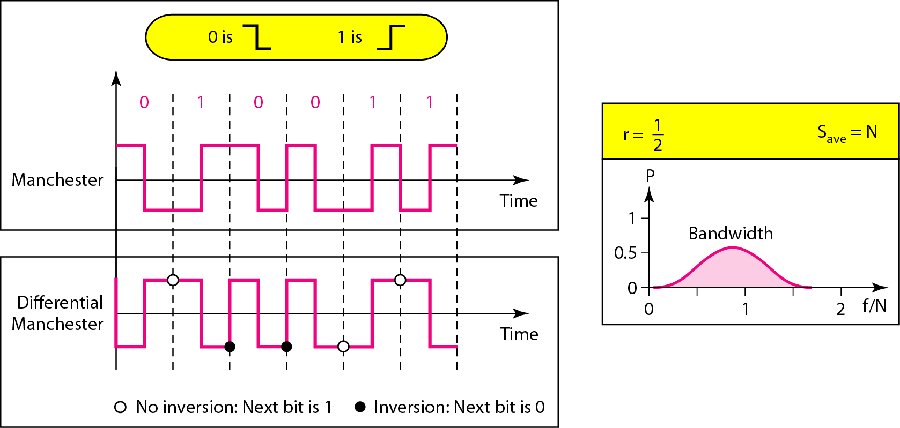

Slide 28
Manchester and Differential Manchester
In Manchester and differential Manchester encoding, the transition at the middle of the bit is used for synchronization
The minimum bandwidth of Manchester and differential Manchester is 2 times that of NRZ.
The is no DC component and no baseline wandering.
None of these codes has error detection
Notes:
The Manchester scheme overcomes several problems associated with NRZ-L, and
differential Manchester overcomes several problems associated with NRZ-I. First, there
is no baseline wandering. There is no DC component because each bit has a positive andnegative voltage contribution. The only drawback is the signal rate. The signal rate for
Manchester and differential Manchester is double that for NRZ. The reason is that there is
always one transition at the middle of the bit and maybe one transition at the end of each
bit. Figure 4.8 shows both Manchester and differential Manchester encoding schemes.
Note that Manchester and differential Manchester schemes are also called biphase
schemes.

Slide 29
Bipolar
In bipolar encoding (sometimes called multilevel binary), there are three voltage levels: positive, negative, and zero.
The voltage level for one data element is at zero, while the voltage level for the other element alternates between positive and negative.
Alternate mark inversion (AMI)and Pseudoternary are two variations of bipolar encoding.
Notes:
So AMI means alternate I inversion. A neutral zero voltage
represents binary O. Binary Is are represented by alternating positive and negative
voltages. A variation of AMI encoding is called pseudoternary in which the 1 bit is
encoded as a zero voltage and the 0 bit is encoded as alternating positive and negative
voltages.

Slide 30
It is a better alternative to NRZ.
Has no DC component or baseline wandering.
Has no self synchronization because long runs of “0”s results in no signal transitions.
No error detection
Notes:
So AMI means alternate I inversion. A neutral zero voltage
represents binary O. Binary Is are represented by alternating positive and negative
voltages. A variation of AMI encoding is called pseudoternary in which the 1 bit is
encoded as a zero voltage and the 0 bit is encoded as alternating positive and negative
voltages.
The bipolar scheme was developed as an alternative to NRZ. The bipolar scheme
has the same signal rate as NRZ, but there is no DC component. The NRZ scheme has
most of its energy concentrated near zero frequency, which makes it unsuitable for
transmission over channels with poor performance around this frequency. The concentration
of the energy in bipolar encoding is around frequency N12. Figure 4.9 shows the
typical energy concentration for a bipolar scheme.
One may ask why we do not have DC component in bipolar encoding. We can
answer this question by using the Fourier transform, but we can also think about it intuitively.
If we have a long sequence of 1s, the voltage level alternates between positive
and negative; it is not constant. Therefore, there is no DC component. For a long
sequence of Os, the voltage remains constant, but its amplitude is zero, which is the
same as having no DC component. In other words, a sequence that creates a constant
zero voltage does not have a DC component.
AMI is commonly used for long-distance communication, but it has a synchronization
problem when a long sequence of Os is present in the data. Later in the chapter, we
will see how a scrambling technique can solve this problem.

Slide 31
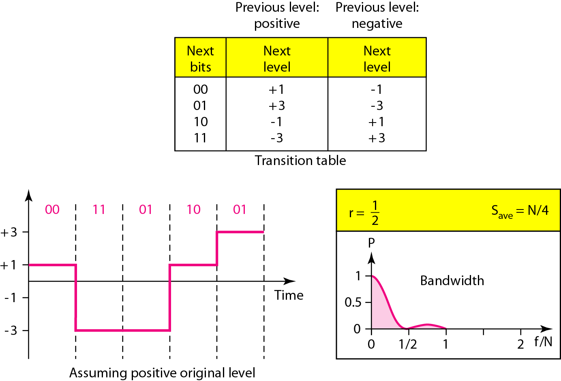
Some Other Schemes
2B1Q ( two binary, one quaternary)
Use four voltage levels, each pulse can then represent 2 bits.

Slide 32
Outline
Digital to Digital Conversion
Some Characteristics of Line Coding
Line Coding Schemes
Block Coding

Slide 33
Block Coding
Two improve the performance of line coding, block coding was introduced.
Adding redundancy (extra bits to the data bits) help to ensure synchronization and to provide some kind of inherent error detecting.
In general, block coding changes a block of m bits into a block of n bits, where n is larger than m.
Block coding is referred to as an mB/nB encoding technique.
Block coding normally involves three steps: division, substitution, and combination

Slide 34
Block Coding
In the division step, a sequence of bits is divided into groups of m bits. For example, in 4B/5B encoding, the original bit sequence is divided into 4-bit groups.
In the substitution step: we substitute an m-bit group for an n-bit group. For example, in 4B/5B encoding we substitute a 4-bit code for a 5-bit group.
Finally, the n-bit groups are combined together to form a stream. The new stream has more bits than the original bits.

Slide 35
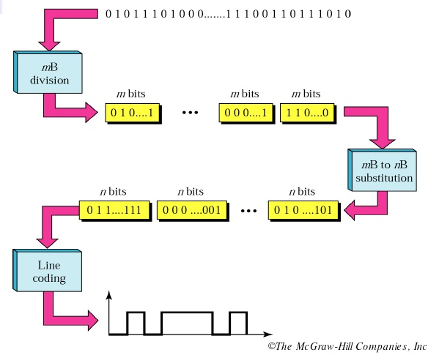

Slide 36
4B/5B
The four binary/five binary (4B/5B) coding scheme was designed to be used in combination with NRZ-I.
In 4B/5B, the 5-bit output that replaces the 4-bit input has no more than one leading zero (left bit) and no more than two trailing zeros (right bits). So after combination there are never more than three consecutive 0s.
Notes:
Recall that NRZ-I has a good signal rate, one-half that of the
biphase, but it has a synchronization problem. A long sequence of as can make the
receiver clock lose synchronization. One solution is to change the bit stream, prior to
encoding with NRZ-I, so that it does not have a long stream of as. The 4B/5B scheme
achieves this goal. The block-coded stream does not have more that three consecutive
as, as we will see later. At the receiver, the NRZ-I encoded digital signal is first
decoded into a stream of bits and then decoded to remove the redundancy. Figure 4.15
shows the idea.

Slide 37
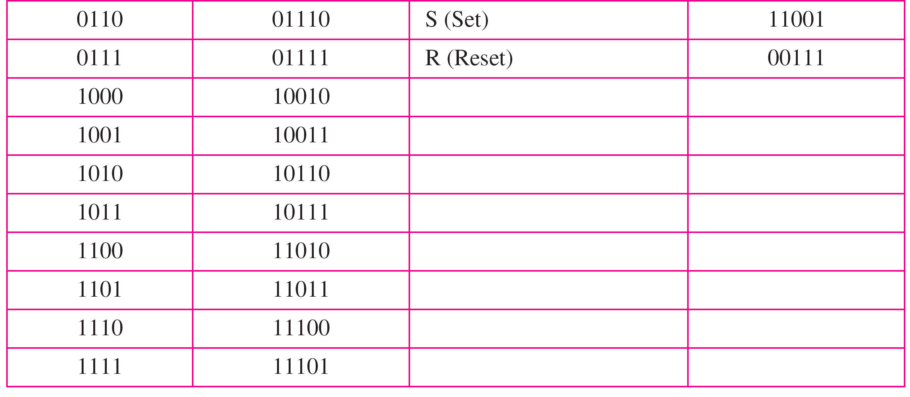
Substitution in 4B/5B block coding

Slide 38
Redundancy
A 4 bit can have 16 combinations.
A 5 bit can have 32 combinations.
We therefore have 32 - 16 = 16 extra groups that are not used for 4B/5B encoding.
Some of the extra groups are used for control/signalling purposes.
Error detection: If a 5-bit group arrives that belongs to the unused portion of the table, the receiver knows that there is an error in the transmission.
Notes:
Figure 4.16 shows an example of substitution in 4B/5B coding. 4B/5B encoding
solves the problem of synchronization and overcomes one of the deficiencies of NRZ-1.
However, we need to remember that it increases the signal rate of NRZ-1. The redundant
bits add 20 percent more baud. Still, the result is less than the biphase scheme
which has a signal rate of 2 times that of NRZ-1. However, 4B/5B block encoding does
not solve the DC component problem of NRZ-1. If a DC component is unacceptable, we
need to use biphase or bipolar encoding.

Slide 39
Any Questions ?

