Slide 1
Network Hardware for
Expanding Network

Slide 2
Expanding Networks
When do we need expansion:
Network cable is full of data movements
Printing tasks needs longer time
Applications response is low
How? :
Dividing a large network into smaller groups of networks
Connecting separate networks together with a certain hardware.

Slide 3
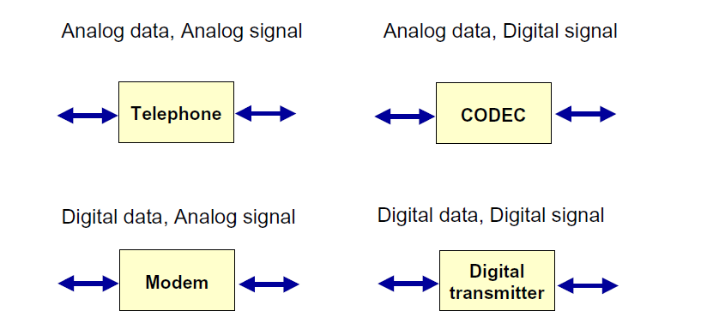
Encoding Schemes

Slide 4
Encoding Schemes
Analog Data to Analog Signal
  Converting analog data to analog signal to be transmitted over the medium
  e.g: When you talk in the telephone analog data (voice) is converted to analog signal to be sent through medium.
Analog Data to Digital Signal
    Converting analog data to digital signal to be transmitted over the medium.
    e.g: converting the received analog voice from the medium to digital signals to store it in the computer.

Slide 5
Encoding Schemes
Digital Data to Analog Signal
    Converting digital data to analog signal to be transmitted over the medium
    e.g: Converting digital data such as (Text) to analog signal using the modem to be transmitted over the medium
Digital Data to Digital Signal
    Converting digital data to digital signal to be transmitted over the medium
    e.g: Converting digital data such as (Text) to digital signal using the digital transmitter to be transmitted over the medium

Slide 6
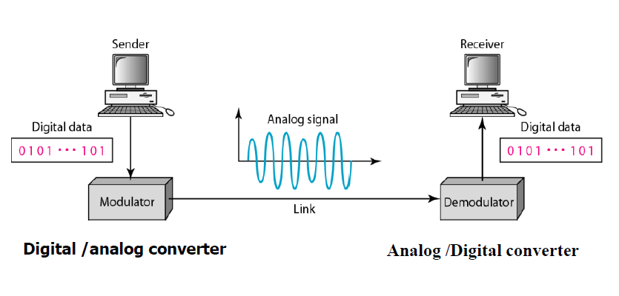
MODEM (Modulator Demodulator)

Slide 7
1 Modems
When computers are far to be connected with a network cable, we use telephone lines connection.
Computer uses electronic digital signals(0,1)
Telephone lines uses analog signals
We need to convert the signals by using a Modem ( Modulator , Demodulator)

Slide 8
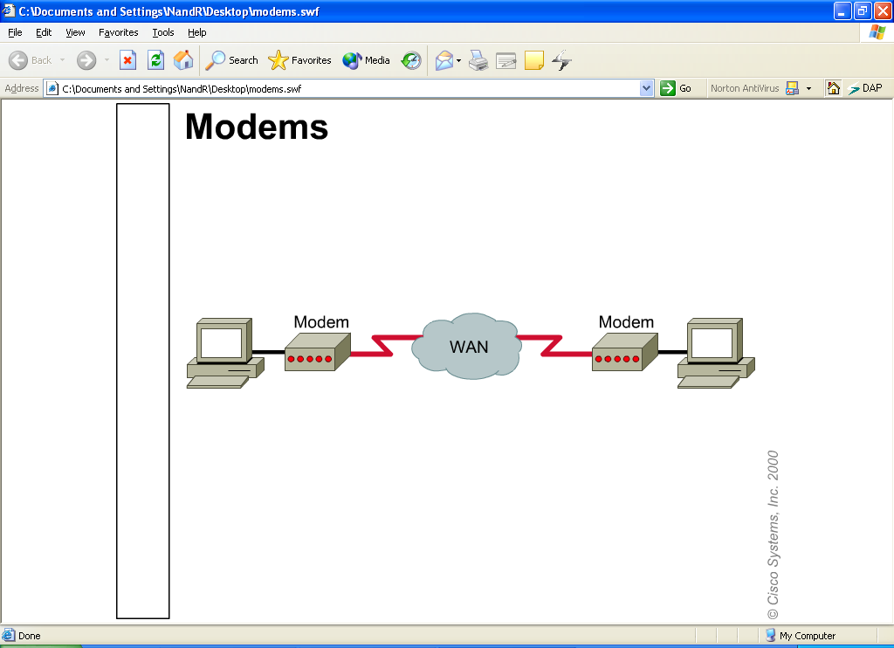
Modems
Types of modems :
  internal
  external
Types of telephone lines that uses modems:
  Dial-up Network lines
  (connect each time you want to use the modem, slow, max 56kbps )
  Leased Lines (ready 24 hours, high quality, 64 kbps- 45 Mbps)

Slide 9
Modems
Modem Transmission Techniques:
Asynchronous:
  A current of signals, convert each character to a chain of bits, between each chain of bits there is a start bit and a stop bit.
  Both modems ( sender and receiver) must agree on the flow of start and end.
  Called asynchronous because there is no timing system of sending and receiving.
  A parity bit is added to check the data.
Synchronous:
  Uses a timing system , a group of bits are called frames, there is no need of start and end bits.
  When error occurs data is sent again.
  This transmission is more reliable.

Slide 10
How does a modem work?
1
2
3
4
Sender sends digital information to modem.
Modem converts digital signals to analog signals.
These signals transmitted through telephone lines.
Receiver modem does the opposite conversion , analog signal converted to digital data.

Slide 11
2 Bridges
A hardware device used to connect LANs so that they can exchange data.
It joins two or more LAN segments to form what appears to be a single network.
Bridges can work with networks that use:
  Different wiring
  Different network protocols
  Different topologies (Ethernet , Token ring) special bridge called a translation bridge will allow that.
It divides networks and manages data transmission.
Regenerates data.

Slide 12
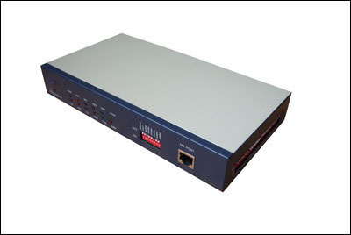
2- Bridges

Slide 13
How does a bridge work?
A bridge reads the outermost section of data on the data packet, to tell where the message is going.
It reduces the traffic on other network segments, since it does not send all packets.
Bridges can be programmed to reject packets from particular networks.
Bridges forward all broadcast messages.

Slide 14
How does a bridge work?
Bridging occurs at the data link layer of the OSI model, which means the bridge cannot read IP addresses, but only the outermost hardware address of the packet.

Slide 15
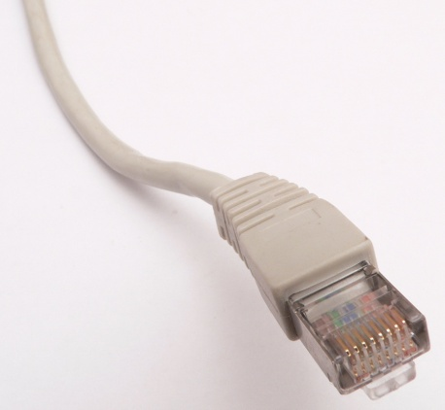
3 Hubs
A hub is a small, simple, inexpensive network device that joins multiple computers together.
Most hubs support the Ethernet standard.
To join a group of computers with an Ethernet hub:
  connects an Ethernet cable (that has an RJ-45 connector attached) into the hub,
  connect the other end of the cable to the computer's network interface card (NIC),
  and do that for all computers.

Slide 16
3 Hubs
Hubs also require external power and can be connected to other hubs, switches, or routers.
One good way to differentiate between Ethernet hubs is by :
  the speed (data rate) they support.
  the number of ports they have
In a large networks, multiple hubs can be bridged together.

Slide 17
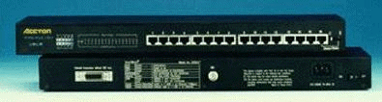
3 Hubs

Slide 18
3 Hub
Types of Hubs:
  Active Hubs
    Regenerate & Retransmit the Signals
    Usually 8 - 12 Ports
    Require Electricity
    Also Called ‘Multiport Repeaters’
  Passive Hubs
    No Regeneration of Signals
    No Electricity Required
  Hybrid Hubs
    Can Connect Different Cable Types

Slide 19
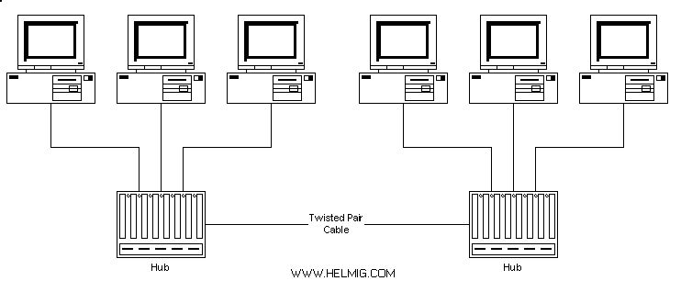
3 Hubs

Slide 20
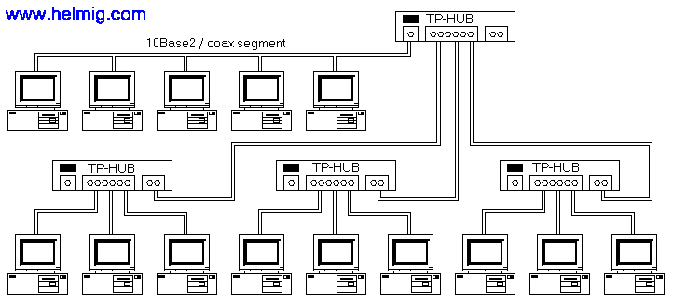
3 Hubs

Slide 21
4 Repeater
A network device used to strengthen the signals on the cables over its maximum length.
A repeater connects two segments of your network cable.
What does it do?
  It retransmit the signals
  regenerates the signals to proper amplitudes
  sends signals to the other segments.

Slide 22
4 Repeater
Repeaters require a small amount of time to regenerate the signal. What is the result?
It can cause a propagation delay which can affect network communication when there are several repeaters in a row.
Many network architectures limit the number of repeaters that can be used in a row.
Repeaters work on the physical layer of the OSI model.

Slide 23
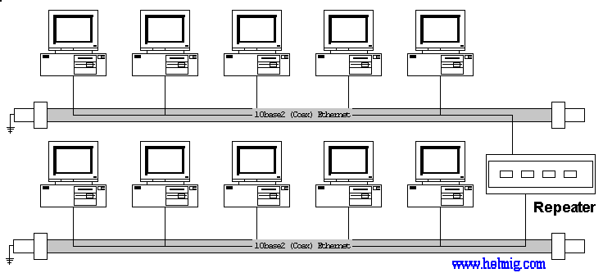
4 Repeater

Slide 24
5 Switch
A network switch is a small hardware device that joins multiple computers together within one LAN.
Network switches appear nearly identical to network hubs, but a switch generally contains more "intelligence" (and a slightly higher price tag) than a hub.

Slide 25
5 Switch
Unlike hubs, network switches are:
capable of inspecting data packets as they are received, determining the source and destination device of that packet, and forwarding it appropriately.
By delivering each message only to the connected device it was intended for, a network switch:
  conserves network bandwidth
  offers generally better performance than a hub.

Slide 26
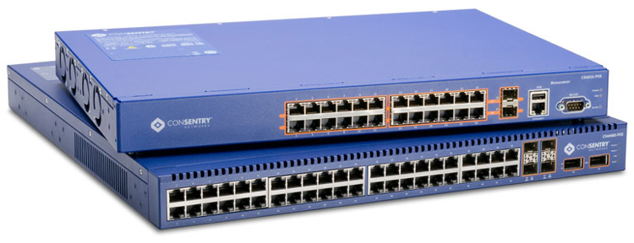
5 Switch
As with hubs, Ethernet implementations of network switches are the most common.
switches operate at layer two (Data Link Layer) of the OSI model.

Slide 27
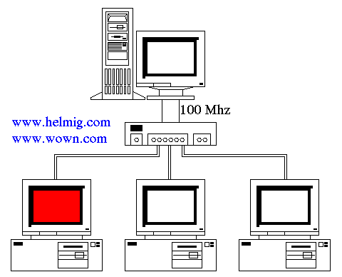
5 Switch

Slide 28
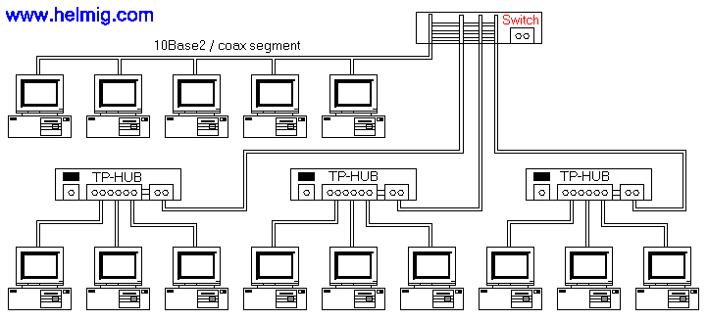
5 Switch

Slide 29
6 Router
A Router is a network device that forwards packets from one network to another.
They use internal routing tables.
Routers read each incoming packet and decide how to forward it. To which interface on the router outgoing packets are sent may be determined by any combination of:
source + destination address + current traffic conditions (load, line costs, bad lines, etc.).

Slide 30
6 Router
Routers are used to:
Separate LANs into sub networks in order to:
  balance traffic within workgroups
  filter traffic for security purposes and policy management.
Routers are also used at the edge of the network to connect remote offices or to an ISP for Internet access.
They can connect networks with different architectures such as Token Ring and Ethernet.

Slide 31
6 Router
Because routers have to inspect the network address in the packet, they do more processing and add more overhead than a bridge or switch.
Routers do not send broadcast packets or corrupted packets. If the routing table does not indicate the proper address of a packet, the packet is discarded.
Routers work at the network layer (layer 3) of the OSI model.

Slide 32
6 Routers
Operate in a Mesh
  Many possible alternative routes between two stations
Packet
Only One of Many
Possible Alternative Routes

Slide 33
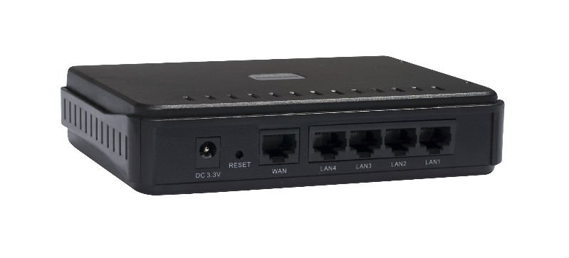
6 Routers

Slide 34
How does routers work?
A router is used to route data packets between two networks.
It reads the information in each packet to tell where it is going.
If it is destined for an immediate network it has access to, it will strip the outer packet, readdress the packet to the proper Ethernet address, and transmit it on that network.
If it is destined for another network and must be sent to another router, it will re-package the outer packet to be received by the next router and send it to the next router.

Slide 35
Routers Vs Switches
Switch | Router
connects different computers within one network. | connects two or more different networks.
is a Datalink Layer device. | is a Network Layer device.
are less sophisticated and less intelligent. | are sophisticated and intelligent network devices
A switch does not perform any such activities. | router compute the best possible path for routing data packets across different computer networks.

Slide 36
Switches Vs Hub
Hub | Switch
a hub is a Physical Layer device | network switches are classified as Data Link Layer devices
A hub is a very primitive device and is comparatively much cheaper. | A switch is a more sophisticated network device and is more expensive than a hub.
hub is a 'dumb' device to say the least. It broadcasts the data packets to each and every networked computer. | A switch is an intelligent device, it transmits the data packets from the source computer to only those network computers to which the data packets are originally intended.
Thanks to its broadcast mechanism, network security becomes a big issue and a loophole in the case of a hub. | Network security is much better with the use of a switch, as compared to a hub.

Slide 37
Bridges VS Switches
Bridges:
single processing
Process one communication, the other will be late.
2 to 4 ports
  Switches:
  Basically bridges with parallel processing
  Can process two or more pairs of communicating ports simultaneously
  Allows large numbers of ports
Bridge
Switch
Send
Send
Wait
Send
LAN 1
LAN 4
LAN 1
LAN 2
LAN 3
LAN 4
LAN 2
LAN 3

Slide 38
Large Networks
Broadcast address type ,is the address to all computers in a network.
When network are large, packets need to go through routers.
Switches are the ones to determine what is the suitable router.
Two tasks are used to make sure that data is sent correctly :
  Packet forwarding ( forward packets using shortest path)
  Packet filtering ( computer picks the packet with the same address, and ignore other packets)

