Slide 1
Ethernet and Token Ring LAN Networks

Slide 2
Local Area Network
local area network (LAN) is a computer network that is designed for a limited geographic area such as a building or a campus.
Although a LAN can be used as an isolated network, most LANs today are also linked to a wide area network (WAN) or the Internet.
A computer connected via a LAN to the Internet needs all the 5 layers of the TCP/IP model.
The three upper layers are common to all LANs.
The LANs differ in the 2 lower layers.

Slide 3
IEEE Project 802
In 1985, the Computer Society of the IEEE started a project, called Project 802, to set standards to enable intercommunication among equipment from a variety of manufacturers.
Project 802 does not seek to replace any part of the OSI or the TCP/IP model.
Instead, it is a way of specifying functions of the physical layer and the data link layer of major LAN protocols.
The IEEE has subdivided the data link layer into two sublayers:
logical link control (LLC) and media access control (MAC).

Slide 4
IEEE Project 802 cont.
IEEE has also created several physical layer standards for different LAN protocols.
Flow control and error control duties are collected into the LLC sublayer.
MAC sublayer governs the operation of access method.
Framing is handled in both the LLC sublayer and the MAC sublayer.
The LLC sublayer is the same for all LANs.
The LANs differ in their MAC sublayer and in their physical layer.

Slide 5
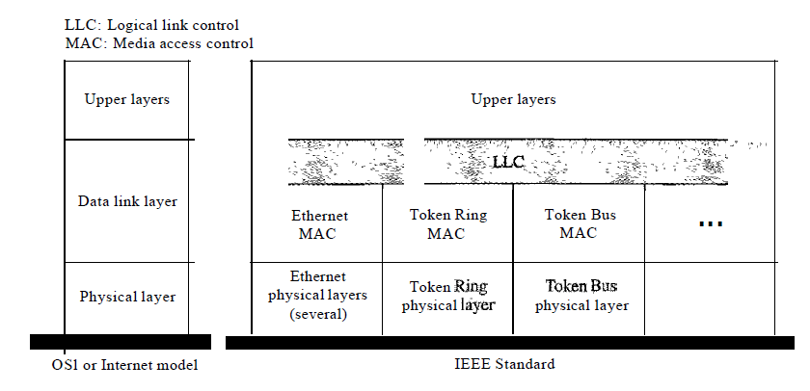

Slide 6
LANs
The LAN market has seen several technologies such as Ethernet, Token Ring, Token Bus, FDDI, and ATM LAN.
Some of these technologies survived for a while, but Ethernet is by far the dominant technology.

Slide 7
Ethernet

Slide 8
Ethernet
Ethernet is the most popular LAN.
Ethernet use CSMA/CD as an access method.
Traditional Ethernet is designed to operate at 10 Mbps.
For a higher data rate, Fast Ethernet is designed to operate at 100 Mbps.
For an even higher data rate, Gigabit Ethernet is designed to operate at 1000 Mbps.
There are four different implementations for baseband (digital), Traditional Ethernet :
10 Base 5
10 Base 2
10 Base-T
10 Base-FL

Slide 9
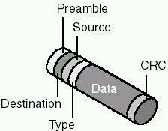
The Ethernet Frame Format
The Ethernet frame include the following fields:
Description | Frame field
Marks the start of the frame | Preamble
The origin and destination physical addresses | Destination and source addresses
Used to identify the network layer protocol | Type
The data encapsulated from the upper layer protocol. | Data
Error-checking field to determine if the frame arrived without being corrupted | Cyclical redundancy check (CRC)

Slide 10
10 Base5: Thick Ethernet
It is sometimes called thick Ethernet, or Thicknet.
This Ethernet LAN makes use of thick coaxial cable.
It uses a bus topology with an external transceiver (transmitter/receiver) connected via a tap to the thick coaxial cable.
The transceiver is responsible for transmitting, receiving, and detecting collisions.
The maximum length of the coaxial cable must not exceed 500 m.
Can support as many as 100 nodes (stations, repeaters, and so on) per backbone segment.

Slide 11
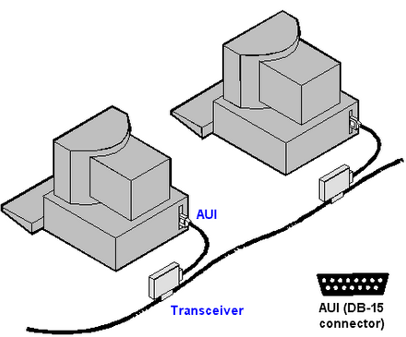
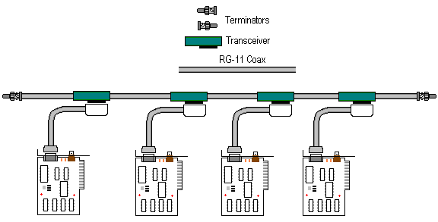
Transceiver cables or drop cable that connects the transceiver to the NIC.

Slide 12
10Base2: Thin Ethernet
It is called thin Ethernet, or Cheapernet.
The size of the coaxial cable is much thinner and more flexible than the 10Base5.
It also uses a bus topology applied as a daisy chain.
In this Ethernet, the transceiver is normally part of the network interface card (NIC), which is installed inside the station.
Note that the collision here occurs in the thin coaxial cable.
This implementation is more cost effective than 10Base5 because thin coaxial cable is less expensive than thick coaxial.
The length of each segment cannot exceed 200 m.
Can support up to 30 nodes per backbone segment.

Slide 13
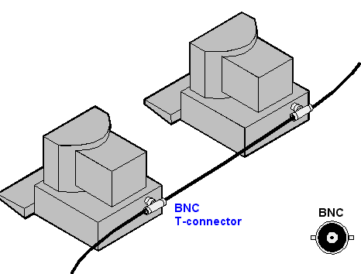

Slide 14
10BaseT
It uses twisted-pair cable to connect computers.
It use a physical star topology, but internally they use a bus signaling system like other Ethernet configurations.
The stations are connected to a hub via two pairs of twisted cable, one pair is used to receive data and one pair is used to transmit data.
Any collision here happens in the hub.
The maximum length of a 10BaseT segment is 100m.
Can support up to 1024 nodes.

Slide 15
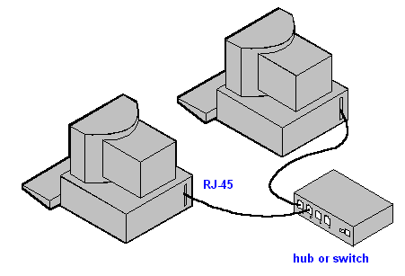
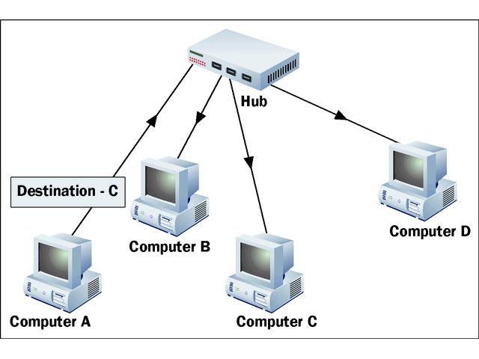

Slide 16
10Base-F
10 Base-F uses a star topology to connect stations to a hub.
The stations are connected to the hub using two fiber-optic cables.
The segment length is 2,000 m.

Slide 17
Token Ring

Slide 18
Token Ring
The Token Ring architecture was developed in the mid-1980s by IBM.
Token Ring specifications are governed by the IEEE 802.5 standards.
It use the token-passing access method.
It can be implemented with a physical ring, or can be a logical ring with a physical star topology.
The logical ring represents the token's path between computers. The actual physical ring of cable is in the hub.

Slide 19
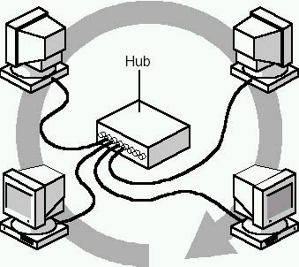
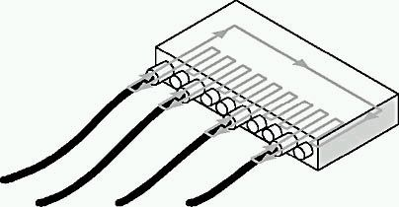
Token Ring
A Token Ring network includes the following features:
Star-wired ring topology
Token-passing access method
Shielded and unshielded twisted-pair cabling
Transfer rates of 4 and 16 Mbps
Baseband transmission

Slide 20
Token Ring
In a pure token-passing network ( with ring topology), a computer that fails, stops the token from continuing. This in turn brings down the network.
In the logical ring , a hub is designed to detect a failed NIC, and to disconnect from it.
This procedure bypasses the failed computer so that the token can continue on.
Therefore, a faulty computer or connection will not affect the rest of the Token Ring network.

Slide 21
Token Ring
The hub in the Token Ring networks does not function like a shared Ethernet hub.
The Token Ring method is more deterministic and ensures that all users get regular turns at transmitting their data.
With Ethernet, all users compete to get onto the network.

Slide 22
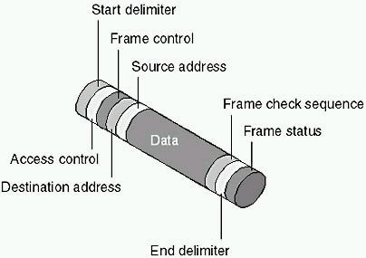
Token Ring Frame Formats
The Token Ring frame include the following fields:

Slide 23
Description | Frame field
Indicates start of the frame | Start delimiter
Indicates the frame's priority and whether it is a token or a data frame | Access control
Contains either Media Access Control information for all computers or "end station" information for only one computer | Frame control
The address of receiver | Destination address
The address of source | Source address
Contains the data being sent | Information, or data
Contains CRC error-checking information | Frame check sequence
Indicates the end of the frame | End delimiter
Tells whether the frame was recognized, copied, or whether the destination address was available | Frame status

Slide 24
How Token Ring Networking Works
When the first Token Ring computer comes online, the network generates a token.
The token is a predetermined formation of bits (a stream of data) that permits a computer to put data on the cables.
The token travels around the ring polling each computer until one of the computers signals that it wants to transmit data and takes control of the token.
A computer cannot transmit unless it has possession of the token; while the token is in use by a computer, no other computer can transmit data.
After the computer captures the token, it sends a data out on the network.

Slide 25
Cont.
The frame proceeds around the ring until it reaches the computer with the address that matches the destination address in the frame.
The destination computer copies the frame into its receive buffer and marks the frame in the frame status field to indicate that the information was received.
The frame continues around the ring until it arrives at the sending computer, where the transmission is acknowledged as successful.
The sending computer then removes the frame from the ring and transmits a new token back on the ring.
Only one token at a time can be active on the network, and the token can travel in only one direction around the ring.

Slide 26
Monitoring the System
The first computer to come online is assigned by the Token Ring system to monitor network activity.
The monitoring computer makes sure that frames are being delivered and received correctly. It does this by checking for frames that have circulated the ring more than once and ensuring that only one token is on the network at a time.
Also the process of monitoring called beaconing. The active monitor sends out a beacon announcement every seven seconds. The beacon is passed from computer to computer throughout the entire ring.

Slide 27
Cont.
If a station does not receive an expected announcement from its upstream neighbor, it attempts to notify the network of the lack of contact.
It sends a message that includes its address, the address of the neighbor that did not announce, and the type of beacon.
From this information, the ring attempts to diagnose the problem and make a repair without disrupting the entire network.
If it is unable to complete the reconfiguration automatically, manual intervention is required.

