Slide 1
Network Protocols

Slide 2
Protocols
Protocols are rules and procedures for communication.
Tasks:
Define how to interpret signals
Identify individual computers
Initiate and end networked communication
Manage information exchange across network medium
Determine the type of error checking to be used
Determine data compression method

Slide 3
Protocols
Keep three points in mind when you think about protocols in a network environment:
1) There are many protocols.
While each protocol facilitates basic communications, each has different purposes and accomplishes different tasks.
Each protocol has its own advantages and restrictions.
A protocol can be implemented either in hardware or in software.

Slide 4
Protocols
2) Some protocols work only at particular OSI layers.
The layer at which a protocol works describes its function. For example, a protocol that works at the physical layer ensures that the data packet passes through the network interface card (NIC) and out onto the network cable.
3 ) Protocols can also work together in a protocol stack, or suite.
A protocol stack or protocol suite is a combination of protocols.
Just as a network incorporates functions at every layer of the OSI reference model, different protocols also work together at different levels in a single protocol stack.

Slide 5
How Protocols Work
As learned before, the entire technical operation by which data is transmitted over the network has to be broken down into discrete, systematic steps.
At each step, certain actions take place that cannot take place at any other step. Each step includes its own rules and procedures, or protocol.
The protocol steps must be carried out in a consistent order that is the same on every computer in the network.
In the sending computer, these steps must be executed from the top down. In the receiving computer, these steps must be carried out from the bottom up.
Both sending and receiving computers need to perform each step in the same way so that the data will have the same structure when it is received as it did when it was sent.

Slide 6
Protocol Types
Connectionless Protocol
Connection-oriented Protocol

Slide 7
Protocol Types
A connectionless protocol:
Refers to network protocols in which a host can send a message without establishing a connection with the recipient. That is, the host simply puts the message onto the network with the destination address and hopes that it arrives. Examples: Ethernet, UDP.
A connection-oriented protocol:
Protocols require a channel to be established between the sender and receiver before any messages are transmitted.
Examples: TCP, SMTP

Slide 8
Standard Stacks
The computer industry has designated several kinds of stacks as standard protocol models. Hardware and software manufacturers can develop their products to meet any one or a combination of these protocols. The most important models include:
The ISO/OSI protocol suite.
The IBM Systems Network Architecture (SNA).
Apple's AppleTalk.
The Internet protocol suite, TCP/IP.

Slide 9
TCP/IP
Transmission Control Protocol /Internet Protocol (TCP/IP)
It is the most common protocol suite used today for LANs as well as the Internet.
It is composed of several different protocols.
IP
DNS
FTP
Telnet
RIP
NNTP
ARP
whois
IGMP
TCP/IP protocol suite
SMTP
TFTP
UDP
OSPF
TCP
RARP
SNMP
NTP
and many more...
BOOTP
finger
ICMP

Slide 10
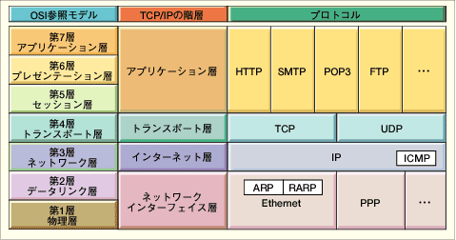
OSI Model
TCP/IP Hierarchy
Protocols
7th
Application Layer
6th
Presentation Layer
Application Layer
5th
Session Layer
4th
Transport Layer
Transport Layer
3rd
Network Layer
Network Layer
2nd
Link Layer
Link Layer
1st
Physical Layer
Link Layer : includes device driver and network interface card
Network Layer : handles the movement of packets, i.e. Routing
Transport Layer : provides a reliable flow of data between two hosts
Application Layer : handles the details of the particular application

Slide 11
1- Application Protocols
Application protocols work at the uppermost layer. They provide application-to-application interaction and data exchange. Popular application protocols are :
Telnet
FTP
SMTP
HTTP
As well as many other protocols.

Slide 12
a) Telnet
TErminaL NETwork.
The Telnet protocol is a standard of TCP/IP protocols, simply provide a facility for remote logins to computer via the Internet.
With Telnet, you log on as a regular user with whatever privileges you may have been granted to the specific application and data on that computer.
A Telnet command request looks like this
telnet the.libraryat.whatis.edu
The result of this request would be an invitation to log on with a userid and a prompt for a password.
If accepted, you would be logged on like any user who used this computer every day.

Slide 13
b) FTP (File Transfer Protocol)
File Transfer Protocol (FTP) is a standard Internet protocol for transmitting files between computers on the Internet.
FTP is an application protocol that uses the Internet's TCP/IP protocols.
FTP is a the protocol for exchanging files over the Internet.
FTP is built on a client-server architecture.
The files are saved on servers, compressed to save space.
Files can be free software, upgrading files, multimedia files and other types.

Slide 14
FTP
As a user, you can use FTP with a simple command line interface (for example, from the Windows MS-DOS Prompt window) or with a commercial program that offers a graphical user interface.
Your Web browser can also make FTP requests to download programs you select from a Web page.
Using FTP, you can also update (delete, rename, move, and copy) files at a server. You need to logon to an FTP server.

Slide 15
c) SMTP (Simple Mail Transfer Protocol)
SMTP (Simple Mail Transfer Protocol) is a TCP/IP protocol used in sending and receiving e-mail.
It is limited in its ability to queue messages at the receiving end, it is usually used with one of two other protocols, POP3 or IMAP, that let the user save messages in a server mailbox and download them periodically from the server.
In other words, users typically use a program that uses SMTP for sending e-mail and either POP3 or IMAP for receiving e-mail.

Slide 16
d) HTTP (HyperText Transfer Protocol)
Protocol used for communication between web browsers and web servers.
HTTP is the set of rules for transferring files (text, graphic images, sound, video, and other multimedia files) on the World Wide Web. As soon as a Web user opens their Web browser, the user is indirectly making use of HTTP.

Slide 17
2-Transport Protocols
Transport protocols facilitate communication sessions between computers and ensure that data is able to move reliably between computers. Popular transport protocols are :
TCP
UDP
DNS

Slide 18
a) TCP (Transmission Control Protocol)
TCP is a connection-oriented transport protocol that sends data as an unstructured stream of bytes.
Is a standard that defines how to establish and maintain a network conversation via which application programs can exchange data.
TCP works with the Internet Protocol (IP), which defines how computers send packets of data to each other. Together, TCP and IP are the basic rules defining the Internet.
TCP is a connection-oriented protocol, which means a connection is established and maintained until the application programs at each end have finished exchanging messages.

Slide 19
a) TCP (Transmission Control Protocol)
It determines how to break application data into packets that networks can deliver, sends packets to and accepts packets from the network layer, manages flow control, and—because it is meant to provide error-free data transmission—handles retransmission of dropped or garbled packets as well as acknowledgement of all packets that arrive.
In the Open Systems Interconnection (OSI) communication model, TCP is in Layer 4, the Transport Layer.

Slide 20
b) UDP (User Datagram Protocol )
UDP (User Datagram Protocol) is a communications protocol that offers a limited amount of service when messages are exchanged between computers in a network that uses the Internet Protocol (IP).
UDP is an alternative to the TCPand, together with IP, is sometimes referred to as UDP/IP.
Like the TCP, UDP uses the Internet Protocol to actually get a data unit (called a datagram) from one computer to another.

Slide 21
b) UDP (User Datagram Protocol )
Unlike TCP, however, UDP does not provide the service of dividing a message into packets (datagrams) and reassembling it at the other end. Specifically, UDP doesn't provide sequencing of the packets that the data arrives in. The application program that uses UDP must be able to make sure that the entire message has arrived and is in the right order.
It's used primarily for broadcasting messages over a network.
In the Open Systems Interconnection (OSI) communication model, UDP, like TCP, is in layer 4, the Transport Layer.

Slide 22
(c) DNS (Domain Name System) Protocol
On the Internet, the DNS associates various sorts of information with domain names.
A domain name is a meaningful and easy-to-remember "handle" for an Internet address.
The Domain Name System protocol translates domain names into IP addresses.
When a client wants to open a webpage at www.google.com, a query is sent to a DNS server (name server) to fetch the corresponding IP address.

Slide 23
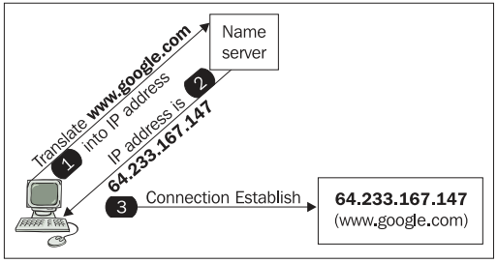
DNS (Domain Name System) Protocol
The IP returned by the name server is used to contact the Google web server – the server that hosts the actual website contents.

Slide 24
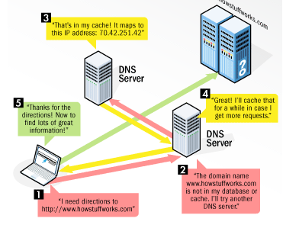
DNS (Domain Name System) Protocol
Each DNS server includes a database of network domain names/addresses of other Internet hosts.
Instead of being on only one server, the DNS database is divided and distributed to many different
servers on the Internet, each being
responsible for different areas of the
Internet.

Slide 25
DNS (Domain Name System) Protocol
The master DNS servers, known as root servers, store the whole database of the Internet domain names and their corresponding IP addresses. They are owned by various independent agencies based in the United States, Japan, the UK and Sweden.
The other lower-level DNS servers maintain only parts of the total database of the domains/addresses and are owned by businesses or ISPs (Internet Server Providers).

Slide 26
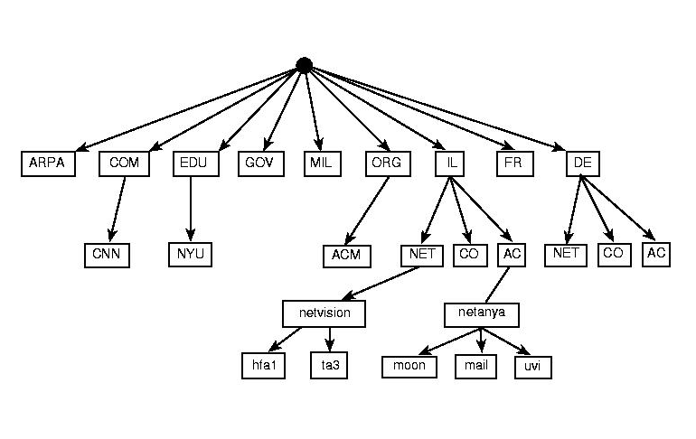
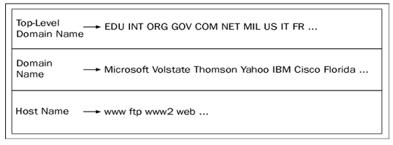

Slide 27
3- Internet Layer Protocols
Responsible for addressing , packaging and routing the data to be transmitted , it contains several protocols such as:
IP
DHCP
ARP

Slide 28
a) IP (Internet Protocol)
Responsible for addressing the data to be transmitted and getting it to its destination.
The hosts on a TCP/IP network use a logical address.
This logical address, called the IP address, is assigned to each host.
IP is responsible for the addressing of packets.

Slide 29
a) IP (Internet Protocol)
Is responsible for moving packet of data from node to node.
IP forwards each packet based on a four byte destination address (the IP number).
The Internet authorities assign ranges of numbers to different organizations. The organizations assign groups of their numbers to departments.

Slide 30
a) IP (Internet Protocol)
It’s Job: get some data
from source IP address
to destination IP address
Data
destination: 196.57.3.201
source: 140.117.34.7
= hosts/routers on a network
Data

Slide 31
b) DHCP (Dynamic Host Configuration Protocol)
The DHCP is an automatic configuration protocol used on IP networks.
Allows a computer to join an IP-based network without having a pre-configured IP address. DHCP is a protocol that assigns unique IP addresses to devices, then releases and renews these addresses as devices leave and re-join the network.
With dynamic addressing, a host can have a different IP address every time it connects to the network.
A major advantage is that it eliminates the need to manually assign each host a static IP address.

Slide 32
c) ARP (Address Resolution Protocol )
The ARP is a protocol for mapping an IP address to a physical address (MAC address) that is recognized in the local network.
A table, usually called the ARP cache, is used to maintain a correlation between each MAC address and its corresponding IP address. ARP provides the protocol rules for making this correlation and providing address conversion in both directions.

Slide 33
c) ARP (Address Resolution Protocol )
When an incoming packet destined for a host machine on a particular local area network arrives at a gateway (router) , the gateway asks the ARP program to find a physical or MAC address that matches the IP address.
The ARP program looks in the ARP cache and, if it finds the address, provides it so that the packet can be converted to the right packet length and format and sent to the machine.

Slide 34
c) ARP (Address Resolution Protocol )
If no entry is found for the IP address, ARP broadcasts a request packet in a special format to all the machines on the LAN to see if one machine knows that it has that IP address associated with it.
A machine that recognizes the IP address as its own returns a reply so indicating. ARP updates the ARP cache for future reference and then sends the packet to the MAC address that replied.

Slide 35
4- Network Interface Layer
Responsible for placing data on the network medium and receiving data off the network medium.
Contains :
Network Cables
Network Adapters
It does not contain any software-based protocol, but it contains protocols that defines how data is transmitted on the network like :
Ethernet
Asynchronous Transfer Mode (ATM)

Slide 36
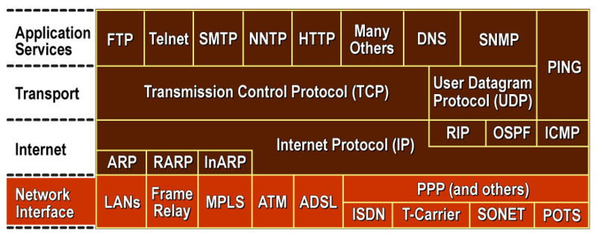
More Comprehensive Diagram

