Slide 1
(Digital Modulation Basics)
Data Transmission And Digital Communication
Lecture 3– 2019/1440
By: Elham Sunbu

Slide 2
OUTLINE
Digital Introduction to digital modulation
Relevant modulation schemes
Geometric representations
Coherent & Non-Coherent Detection
Modulation spectra

Slide 3
Digital To Analog Conversion
Digital-to-analog conversion is the process of changing one of the characteristics of an analog signal based on the information in digital data.
Topics discussed in this section:
Aspects of Digital-to-Analog Conversion
Amplitude Shift Keying
Frequency Shift Keying
Phase Shift Keying
Quadrature Amplitude Modulation

Slide 4
Digital-to-analog conversion
Digital-to-analog conversion is the process of changing one of the characteristics of an analog signal (carrier signal) based on the information in digital data.
Digital /Analog converter
Analog /Digital converter

Slide 5
Why we need digital modulation
Digital modulation is required if digital data has to be transmitted over a medium that only allows analog transmission.
Modems in wired networks.
Wireless must use analogue sine waves.

Slide 6
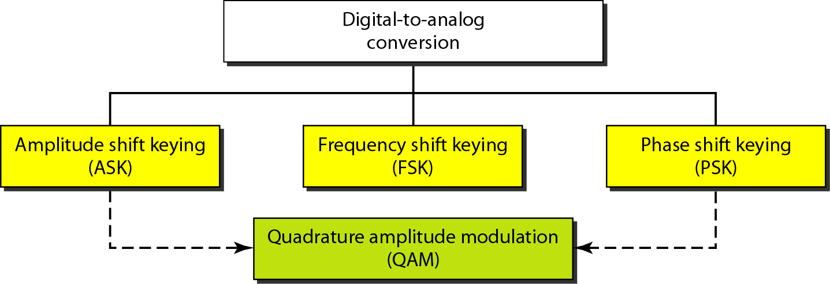
Types of digital-to-analog conversion

Slide 7
Modulation & Demodulation
Radio Channel
Carrier
Carrier
Baseband Modulation
Synchronization/ Detection/ Decision
Data in
Data out

Slide 8
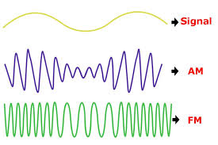
Modulation
Modulation :
process (or result of the process) of translation the baseband message signal to bandpass (modulated carrier) signal at frequencies that are very high compared to the baseband frequencies.
Demodulation is the process of extracting the baseband message back the modulated carrier.
An information-bearing signal is non- deterministic, i.e. it changes in an unpredictable manner.

Slide 9
Why Carrier?
Effective radiation of EM waves requires antenna dimensions comparable with the wavelength:
Antenna for 3 kHz would be ~100 km long
Antenna for 3 GHz carrier is 10 cm long
Sharing the access to the telecommunication channel resources

Slide 10
NOTE:
Bit rate, N, is the number of bits per second (bps).
Baud rate is the number of signal
elements per second (bauds).
In the analog transmission of digital data, the signal or baud rate is less than or equal to the bit rate.
S=Nx1/r bauds
Where r is the number of data bits per signal element.

Slide 11
Example 1:
An analog signal carries 4 bits per signal element. If 1000 signal elements are sent per second, find the bit rate.
Solution:
In this case, r = 4, S = 1000, and N is unknown. We can find the value of N from

Slide 12
Example 2:
An analog signal has a bit rate of 8000 bps and a baud rate of 1000 baud. How many data elements are carried by each signal element? How many signal elements do we need?
Solution:
In this example, S = 1000, N = 8000, and r and L are unknown. We find first the value of r and then the value of L.

Slide 13
Modulation Process
f = f (a₁ , a₂ , a₃ ,...a_{n} , t ) (= carrier)
a₁ , a₂ , a₃ ,...a_{n} (= modulation parameters)
t (= time)
Modulation implies varying one or more characteristics (modulation parameters a₁, a₂, … a_{n}) of a carrier f in accordance with the information-bearing (modulating) baseband signal.
Sinusoidal waves, pulse train, square wave, etc. can be used as carriers

Slide 14
Amplitude Shift Keying (ASK)
Baseband Data
1
0
0
1
ASK
modulated signal
Acos(ωt)
Acos(ωt)
Pulse shaping can be employed to remove spectral spreading
ASK demonstrates poor performance, as it is heavily affected by noise, fading, and interference

Slide 15
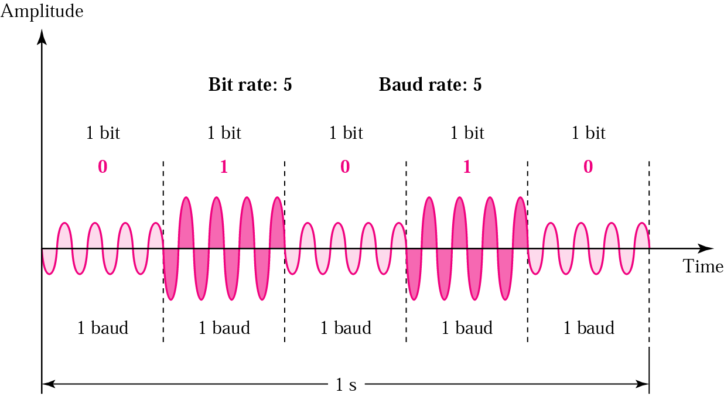
Amplitude Shift Keying (ASK)
In ASK the amplitude of the carrier signal is varied to represent binary 1 or 0.
Carrier signal is a high frequency signal that acts as a basis for the information signal.
Both frequency and phase remain constant while the amplitude changes.
The peak amplitude of the signal during each bit duration is constant, and its value depends on the bit (0 or 1).

Slide 16
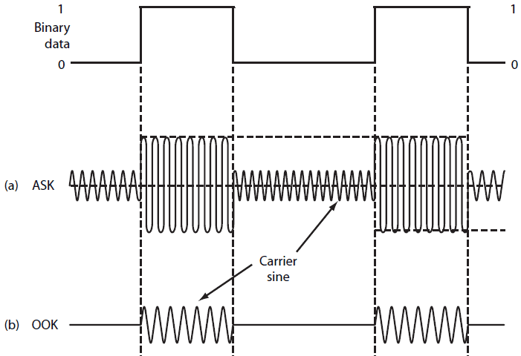
Binary ASK (BASK) or On Off Keying (OOK)
- Although we can have several levels of signal elements, each with a different amplitude, ASK is normally implemented using only two levels. This is referred to as binary amplitude shift keying.
- In ON OFF Keying: bit 0 is represented by the absence of a carrier and bit 1 is represented by the presence of a carrier .

Slide 17
Pros and Cons
- Pros:
ASK transmitter and receiver are simple to design.
ASK needs less bandwidth than FSK.
- Cons:
ASK transmission can be easily corrupted by noise.
- Application:
Early telephone modem (AFSK).
ASK is used to transmit digital data over optical fiber.

Slide 18
Frequency Shift Keying (FSK)
Baseband Data
1
0
0
1
BFSK
modulated signal
f₁ f₀ f₀ f₁
where f₀ =Acos(ω_{c}-Δω)t and f₁ =Acos(ω_{c}+Δω)t
Example: The ITU-T V.21 modem standard uses FSK
FSK can be expanded to a M-ary scheme, employing multiple frequencies as different states

Slide 19
FSK (Frequency Shift Keying)
The frequency of the carrier signal is varied to represent binary 1 or 0.
Both peak amplitude and phase remain constant while the frequency changes.
The frequency of the signal during each bit duration is constant, and its value depends on the bit (0 or 1).

Slide 20
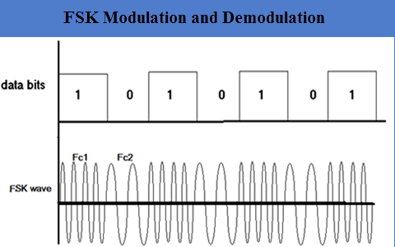
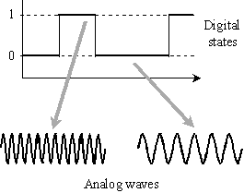
FSK Modulator
- One way to think about binary FSK (or BFSK) is to consider two carrier frequencies
Switch between two oscillators accordingly

Slide 21
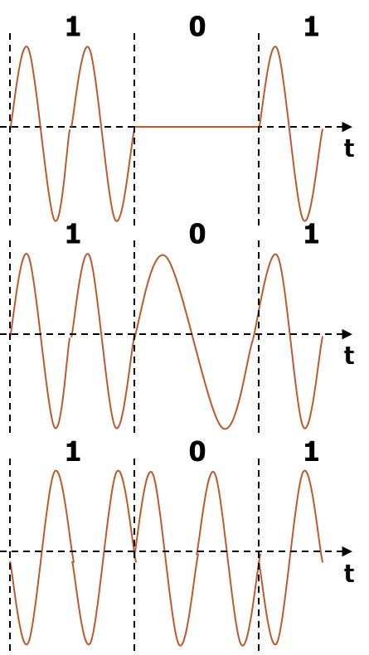
ASK and FSK
Amplitude Shift Keying (ASK) | Frequency Shift Keying (FSK)
Very simple. | Needs larger bandwidth.
Low bandwidth requirements. | More error resilience than AM.
Very susceptible to interference

Slide 22
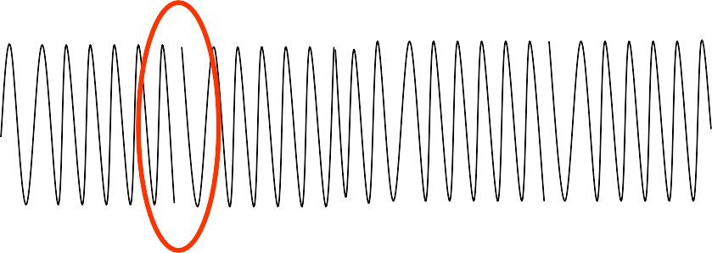
Phase Shift Keying (PSK)
Baseband Data
1
0
0
1
BPSK
modulated signal
s₁ s₀ s₀ s₁
where s₀ =-Acos(ω_{c}t) and s₁ =Acos(ω_{c}t)
Major drawback – rapid amplitude change between symbols due to phase discontinuity, which requires infinite bandwidth. Binary Phase Shift Keying (BPSK) demonstrates better performance than ASK and BFSK
BPSK can be expanded to a M-ary scheme, employing multiple phases and amplitudes as different states

Slide 23
Phase Shift Keying
In phase shift keying, the phase of the carrier is varied to represent two or more different signal elements (Both peak amplitude and frequency remain constant).
In binary PSK, we have only two signal elements: one with a phase of 0°, and the other with a phase of 180°.

Slide 24
Bandwidth of Binary PSK
PSK is less susceptible to noise than ASK.
PSK is superior to FSK because we do not need two carrier signals.
The implementation of BPSK :
the signal element with phase 180° can be seen as the complement of the signal element with phase 0°.
Notes:
. No bandwidth is wasted for
separating two carrier signals.
PSK is limited by the ability of the equipment to distinguish small differences in phase.
This factor limits its potential bit rate.

Slide 25
Digital Modulation Summary
Amplitude Shift Keying (ASK) | Frequency Shift Keying (FSK) | Phase Shift Keying (PSK)
Very simple. | Needs larger bandwidth. | More complex.
Low bandwidth requirements | More error resilience than AM. | Robust against interference.
Very susceptible to interference

Slide 26
Digital Modulation Summary

Slide 27
Thank You

