Slide 1
Ginzburg Landau phenomenological Theory
The superconducting state and the normal metallic state are separate thermodynamic phases of matter in just the same way as gas, liquid and solid are different phases.
Similarly, the normal Bose gas and BEC, or normal liquid He⁴ and super-fluid He II are separated by a thermodynamic phase transitions.
Each such phase transition can be characterized by the nature of the singularities in specific heat and other thermodynamic variables at the transition Tc.
The problems of superfluidity and superconductivity were examined from the point of view of the thermodynamics of phase transitions.

Slide 2
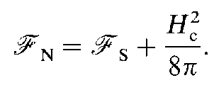
Ginzburg Landau phenomenological Theory
The theory of superconductivity introduced by Ginzburg and Landau in 1950 describes the superconducting phase transition from this thermodynamic point of view.
It was originally introduced as a phenomenological theory, but later Gor’kov showed that it can be derived from full the mi- croscopic BCS theory in a suitable limit.
Condensation Energy

Slide 3
Ginzburg Landau phenomenological Theory
The quantity μ₀H²_{c} /2 is the condensation energy in SI unit.
It is a measure of the gain in free energy per unit volume in the superconducting state compared to the normal state at the same temperature.
As an example lets consider niobium. Here T_{c} = 9K, and H_{c} = 160kA/m (B_{c} = μ₀Hc = 0.2T). The condensation energy μ₀H²_{c} /2 = 16.5kJ/m3.
Given that Nb has a bcc crystal structure with a 0.33nm lattice constant
we can work out the volume per atom and find that the condensation energy is only around 2μeV/atom!
Such tiny energies were a mystery until the BCS theory, which shows that the condensation energy is of order (k_{B}T_{c})2g(E_{F} ), where g(E_{F} ) is the density of states at the Fermi level.
The energy is so small because k_{B}T_{c} is many orders of magnitude smaller than the Fermi energy, ε_{F} .

Slide 4
Ginzburg Landau phenomenological Theory
The Ginzburg-Landau theory of superconductivity is built upon a general approach to the theory of second order phase transitions which Landau had developed in the 1930’s.
Landau had noticed that typically second order phase transitions, such as the Curie temperature in a ferromagnet, involve some change in symmetry of the system. For example a magnet above the Curie temperature, T_{C}, has no magnetic moment.
But below T_{C} a spontaneous magnetic moment develops. In principle could point in any one of a number of different directions, each with an equal energy, but the system spontaneously chooses one particular direction.
In Landau’s theory such phase transitions are characterized by an order parameter which is zero in the disordered state above Tc, but becomes non-zero below T_{C}.
In the case of a magnet the magnetization, M(r), is a suitable order parameter.

Slide 5
Ginzburg Landau phenomenological Theory
For superconductivity Ginzburg and Landau (GL) postulated the existence of an order parameter denoted by ψ . This characterizes the supercon-ducting state, in the same way as the magnetization does in a ferromagnet.
The order parameter is assumed to be some (unspecified) physical quantity which characterizes the state of the system.
In the normal metallic state above the critical temperature Tc of the superconductor it is zero. While in the superconducting state below Tc it is non-zero.

Slide 6
Ginzburg Landau phenomenological Theory
Therefore it is assumed to obey:
Ginzburg and Landau postulated that the order parameter should be a complex number, thinking of it as a macroscopic wave function for the superconductor in analogy with superfluid ⁴He.
At the time of their original work the physical significance of this complex in superconductors was not at all clear.
But, in the microscopic BCS theory of superconductivity there appears a parameter, Δ, which is also complex.
Gor’kov was able to derive the Ginzburg-Landau theory from BCS theory, and show that ψ is essentially the same as Δ , except for some constant.
numerical factors. In fact, we can even identify |ψ|² as the density of BCS “Cooper pairs” present in the sample.

Slide 7
Ginzburg Landau phenomenological Theory
Ginzburg and Landau assumed that the free energy of the superconductor must depend smoothly on the parameter ψ .
Since ψ is complex and the free energy must be real, the free energy can only depend on |ψ|. Furthermore, ψ since goes to zero at the critical temperature, T_{C}, we can Tailor expand the free energy in powers of |ψ|. For temperatures close to T_{C} only the first two terms in the expansion should be necessary, and so the free energy density (F) must be of the form:

Slide 8
Ginzburg Landau phenomenological Theory
Here fs(T) and fn(T) are the superconducting state and
Clearly above Eq. is the only possible function which is real for any complex ψ near ψ = 0 and which is a differentiable function of ψ and ψ* near to ψ = 0.
The parameters α(T) and β(T) are, in general, temperature dependent pheonomenological parameters of the theory.
However it is assumed that they must be smooth functions of temperature. We must also assume that β(T) is positive, since otherwise the free energy density would have no minimum, which would be unphysical (or we would have to extend the expansion to include higher powers such as |ψ|⁶).

Slide 10
Ginzburg Landau phenomenological Theory
Plotting F_{s} − F_{n} as a function of ψ is easy to see that there are two possible curves, depending on the sign of the parameter α(T), as shown in Fig. In the case α(T) > 0, the curve has one minimum at ψ = 0. On the other hand, for α(T) < 0 there are minima wherever | ψ |² = −α(T)/2β(T).
Landau and Ginzburg assumed that at high temperatures, above T_{C}, we have α(T) positive, and hence the minimum free energy solution is one with ψ = 0, i.e. the normal state.
But if α(T) gradually decreases as the temperature T is reduced, then the state of the system will change suddenly when we reach the point α(T) = 0. Below this temperature the minimum free energy solution changes to one with ψ ≠ 0. Therefore we can identify temperature ,where , α(T) becomes zero as the critical Temperature T_{C}.

Slide 11
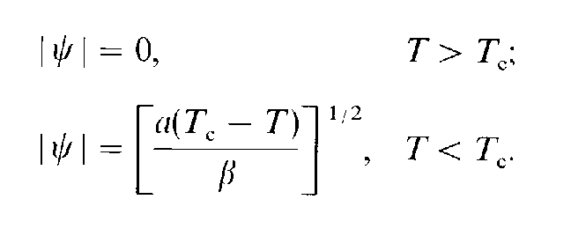
Ginzburg Landau phenomenological Theory
Near to this critical temperature, Tc, assuming that the coefficients α(T) and β(T) change smoothly with temperature, we can make a Taylor expansion,
α(T) ≈ α’ × (T − Tc) + . . .
β(T) ≈ β + . . . ,

Slide 12
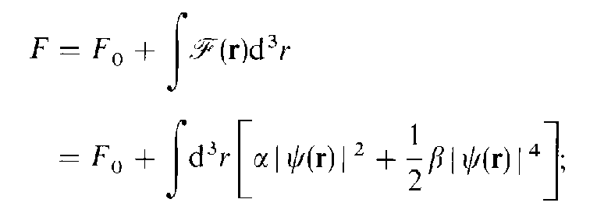
Ginzburg Landau phenomenological Theory
(1)
F is now the total free energy. Eq. (1) in its present form does not model the increase in energy associated with a spatial distortion of the order parameter, i.e., effects associated with a coherence length, ξ. To account for such effects Ginzburg and Landau added a 'gradient energy' term to (1) 0f the form

Slide 13
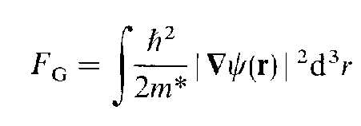
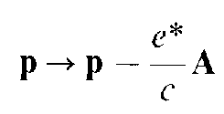
Ginzburg Landau phenomenological Theory

Slide 14
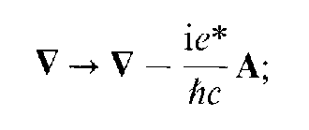
Ginzburg Landau phenomenological Theory
Hence
Finally we must add the contribution of the magnetic field to the energy density

Slide 15
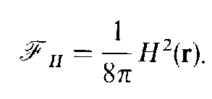
Ginzburg Landau phenomenological Theory
Combining the above
(2)
(2)

Slide 16
variation with respect to ψ, which is an independent Variable, yields the complex conjugate of (2). To minimize , we set the integrand of the of above to zero; this yields the first G-L equation.

Slide 17
Ginzburg Landau Equation
Variation of Eq. (2) w.r.t A where

Slide 18
Provided we identify J(r) as
Or equivalently
This is the 2nd Ginzburg landau equation which is same as the current density in quantum Mechanics

Slide 19
Boundaries and boundary conditions
We first examine a simple case involving an inhomogeneous order parameter generated by the presence of a boundary, in the absence of a magnetic field.
Assume we have a superconducting half space occupying the region x > 0.
We further assume that the order parameter is driven to zero at this interface.
Experimentally this can be accomplished by coating the surface of the superconductor with a film of ferromagnetic material.

Slide 20
continue
G L equation
In one dimension becomes

Slide 21
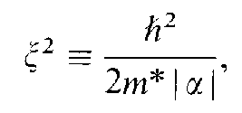
continue
α is negative in the superconducting state
Substituting
The above diff. equation becomes

Slide 22
continue
Multiplying by ƒ’ the diff. Eqn. can be written as
This means that the quantity in bracket is constant.
= C

Slide 23
continue
Far from the boundary the ψ and hence f is constant. This employs that f’=0 and
Then the above diff. equation becomes
Which has the solution

Slide 24
continue
or
Thus we see that the ξ is the measure of distance over which it responds to perturbation.
Since

Slide 25
continue
we have
We see that the G L coherence length diverges as
this divergence is a general property of the coherence length at all second order phase transitions (although the exponent differs in general from this 'mean field' value of 1/2 close to T_{C}).

Slide 26
continue
we have
We see that the G L coherence length diverges as
this divergence is a general property of the coherence length at all second order phase transitions (although the exponent differs in general from this 'mean field' value of 1/2 close to T_{C}).

Slide 27
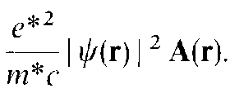
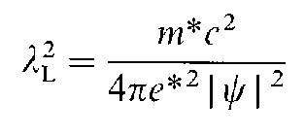
London equation from GL equation
2nd GL equation
In the limit when the two first term is negligible then the equation is nothing but London equation
J(r) =
Provided

Slide 28
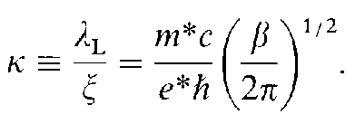
London equation from GL equation
Or,
Thus we see that in G-L theory λ_{L} and ξ both diverges as
The ratio, called G-L parameter
is independent of temperature and constant.

Slide 29
Surface energy at phase boundary
At phase boundary
By definition
Or,

Slide 30
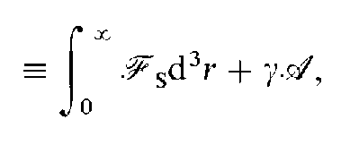
London equation from GL equation
Inserting for F in G
And
and using definition of
G

Slide 31
Surface energy at phase boundary
We obtain for ,
The vanishing of the cross term in both in above equation and the first G-L equation allows us to choose ψ real; it then follows from 2nd G-L that

Slide 32
Surface energy at phase boundary continue
And
To compute γ we must simultaneously solve the first and second G-L equations, for ψ(x) and B(x) = -(dA(x)/dx)), subject to boundary conditions and substitute in the equation for γ.

Slide 33
Surface energy at phase boundary
To simplify the calculation we rewrite in scaled var-iable
The GL eqn becomes
and

Slide 34
Surface energy at phase boundary
The solution for arbitrary κ must be obtained numerically. The appropriate boundary condition
And
To obtain the first integral of GL 1st , multiply by ψ’

Slide 35
Surface energy at phase boundary
Multiplying 2nd by A’
Combining the above two eqn.
The value of constant was fixed by boundary condition

Slide 36
Surface energy at phase boundary
Using and scaled variables
Combining this eqn. with the earlier eqn

Slide 37
Surface energy at phase boundary
In general the soln of
Can be computed if A’(x) and y’(x) are given.
For A=0

Slide 38
