Slide 1
Thermodynamics of a Type I superconductor
We restrict the geometry of the supercon- ductor to a form for which the external field, H, is not distorted by the presence of the superconductor.
Examples being an infinitely long cylinder with H parallel to the axis or a plane slab of infinite extent with H parallel to its surface.
Far inside the superconductor (i.e., several London depths from the surface) the magnetic field essentially vanishes in the superconducting state and is equal to H in the normal state.
In the thermodynamic identities that follow we identify this interior field as B, the flux density. The H field will be taken as the applied external field. The relation between B and H is shown in Fig. 1. .

Slide 2
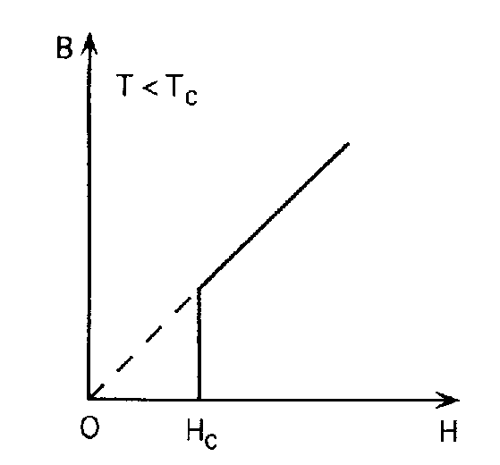
Thermodynamics of a Type I superconductor
We recall the thermodynamic identity for the response of a system in a magnetic field
Figure .1 B vs H curve for a Type 1 superconductor.

Slide 3
Thermodynamics of a Type I superconductor
When T and B are the independent variables we use the Helmholtz free energy density,
and when T and H are the independent variables we use the Gibbs free energy density,
taking the differential of these two quantities and using (1) yields

Slide 4
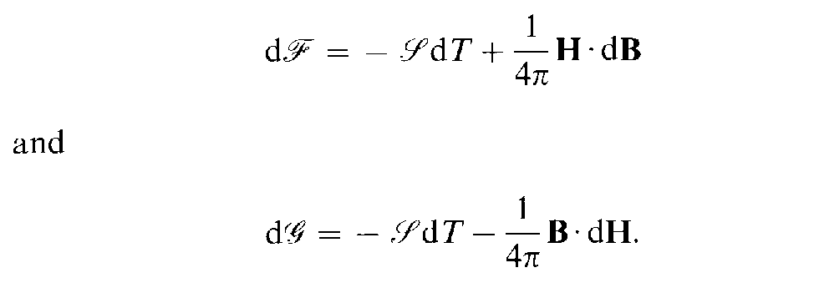
Thermodynamics of a Type I superconductor

Slide 5
Thermodynamics of a Type I superconductor

Slide 7
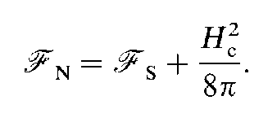
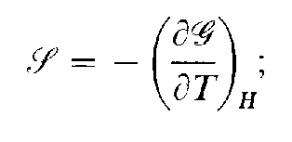

Slide 8
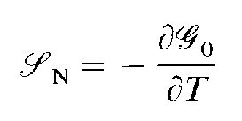

Slide 9
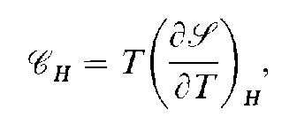

Slide 11
The intermediate state
If a superconducting body of an arbitrary shape is placed in a magnetic field, the flux the magnetic field. Exceptions are an infinite cylinder with the field parallel to the axis, or a sheet or half space with H₀ parallel to the plane of symmetry.
For situations involving lower symmetry the local magnetic field can vary over the surface, being both higher and lower than the applied field, H_{o}.
As a simple example consider the case of a spherical superconductor shown in Fig. 5.1. From magnetostatics, the field will be highest at the equator (on the circle C in Fig. 5.1) where it is . Hence flux enters the sample, not at the thermodynamic critical field, H_{c}, but at a value For magnetic fields
H_{c} > H₀ > 2/3H_{c} the sample consists of alternating domains of normal metal and superconductor. A superconductor in such a regime is said to be in the intermediate state.

Slide 12
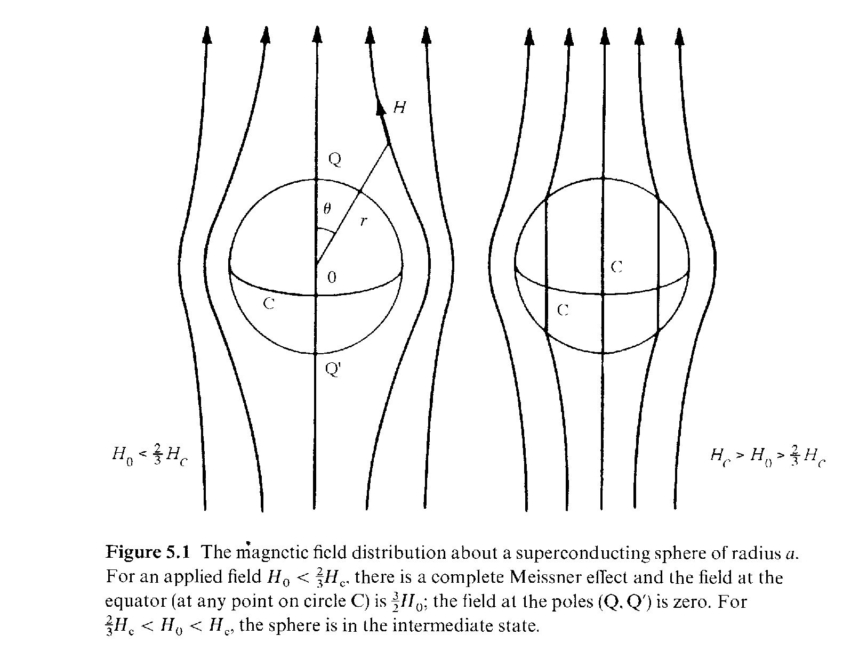

Slide 13
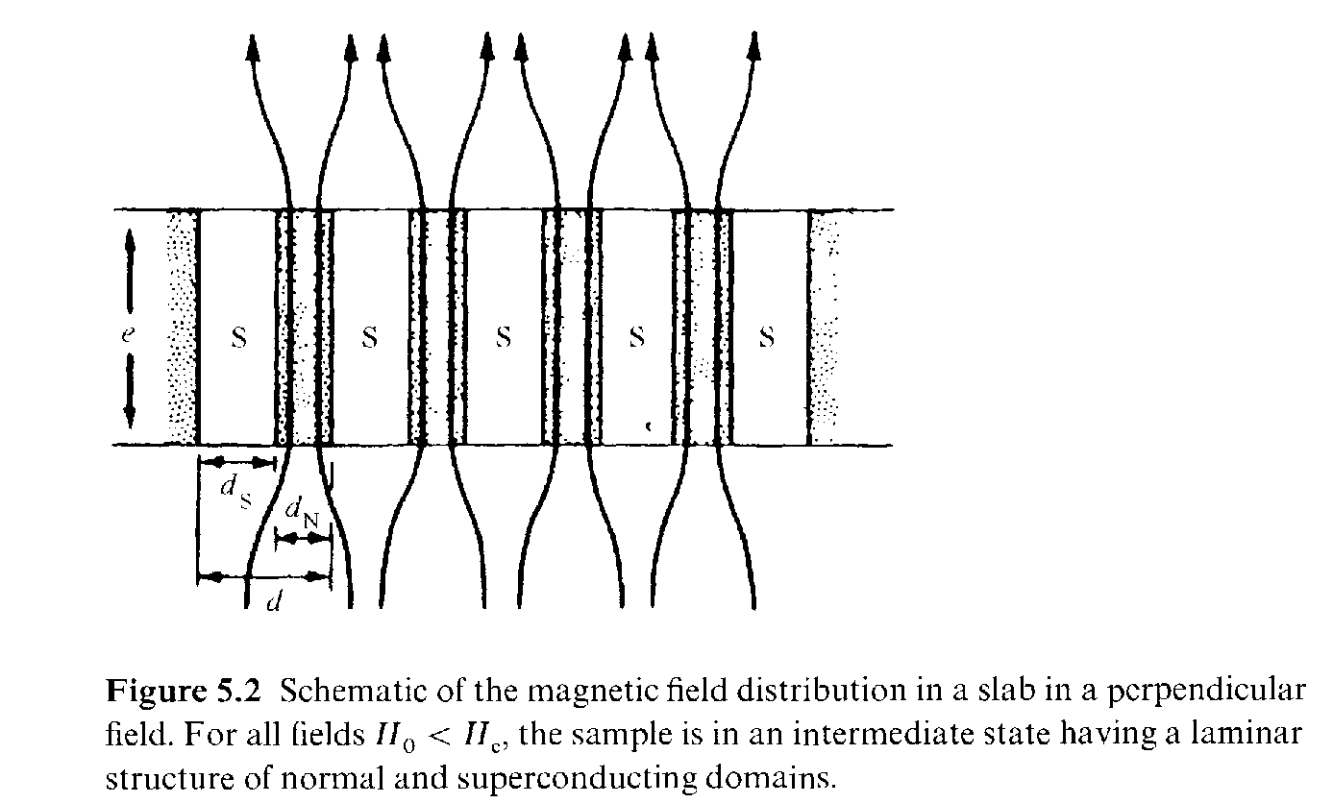

Slide 14
The intermediate state
We will limit our discussion to the simple case of a plane superconducting sheet with H₀ parallel to the surface normal.
From our earlier discussion we know that a superconductor cannot sustain a field component perpendicular to its surface. The field behavior is shown qualitatively in Fig. 5.2. It has the following features.

Slide 16
Surface energy between a normal and a superconducting metal
Consider a slab parallel to the x-y plane in a perpendicular magnetic field parallel to z. Assume we have a phase boundary perpendicular to the x axis with the superconductor occupying the region x > 0. The total free energy, F, in the London model is:
(6.1)
Where is the interface area, is the condensation energy density, , and the second and third terms are the magnetic field energy density and the super fluid electron-kinetic energy density, respectively.

Slide 17
Surface energy between a normal and a superconducting metal
At our phase boundary in the intermediate state, where H = H_{c} for x < 0, we have
(6.2)
(6.3)

Slide 18
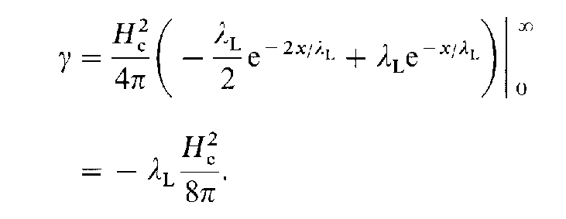
Surface energy between a normal and a superconducting metal

Slide 19
Surface energy between a normal and a superconducting metal
Note this surface energy is negative. This suggests the system can lower its energy by maximizing the interfacial area (i.e., the system is unstable to the formation of multiple domains with associated interfaces).

