Slide 1
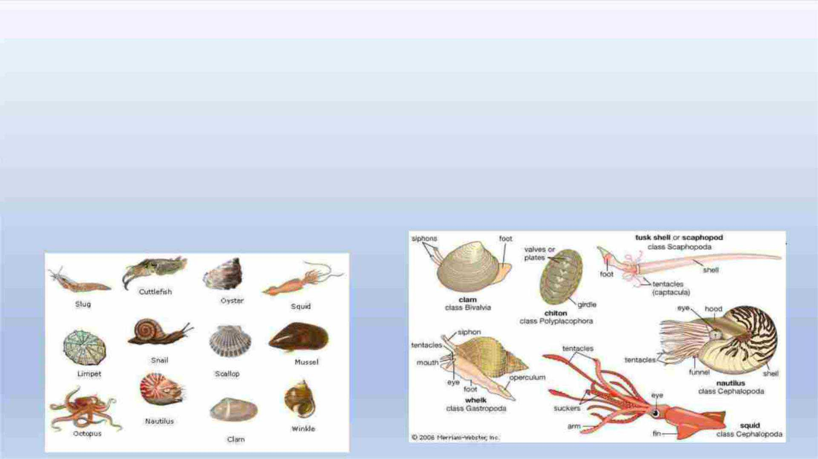
Mollusks
mollusks
ﺖﺍﻠﺮﺨﻮﻴﺎ
any soft-bodied invertebrate of the phylum Mollusca, usually
wholly or partlyenclosed in a calcium carbonate shell secreted by a
soft mantle covering the body. Along withthe insects and
vertebrates , it is one of the most diverse groups in the animal
kingdom, withnearly 100,000 (possibly as many as 150,000)
described species. Each group includes anecologically and
structurally immense variety of forms: the shell-less
Caudofoveata; thenarrow-footed gliders (Solenogastres); the
serially valved chitons (Placophora orPolyplacophora); the cap-
shaped neopilinids (Monoplacophora); the limpets, snails, and
slugs(Gastropoda); the clams ,mussels, scallops, oysters,
shipworms and cockles (Bivalvia); thetubiform to barrel-shaped
tusk shells (Scaphopoda); and the nautiluses , cuttlefishes , squids,
and octopuses (Cephalopoda).
ﻛﻠﺎ
ﺖﻻﻔﻘﺎﺮﻴﺎ ﺖﺫﺎ ﺟﺴﻢ ﺭﺨﻮ ﻣﻦ ﺷﻌﺒﺔ ﺖﺍﻠﺮﺨﻮﻴﺎ، ﻭﻌﺎﺪﺔ ﻣﺎ ﺗﻜﻮﻦ ﻣﺤﺎﻄﺔ
ﺃﻲ
ﺃﻮ
ﺇﻠﻰ ﺟﺎﻨﺐ .ﺟﺰﺌﺎ ﺑﻘﺸﺮﺔ ﻣﻦ ﺖﻛﺮﺒﻮﻨﺎ ﺍﻠﻜﺎﻠﺴﻴﻮﻢ ﻳﻔﺮﺰﻬﺎ ﻏﻄﺎﺀ ﻧﺎﻌﻢ ﻳﻐﻄﻲ ﺍﻠﺠﺴﻢ
ﺗﻨﻮﺎ ﻓﻲ ﺍﻠﻤﻤﻠﻜﺔ ﺍﻠﺤﻴﻮﺎﻨﻴﺔ،
ﺗﺘﻀﻤﻦ ﻛﻞ .) ﻧﻮﻊ ﻣﻮﺼﻮﻒ150000 (ﺭﺒﻤﺎ ﻳﺼﻞ ﺇﻠﻰ 100000ﺣﻴﺚ ﻳﻮﺠﺪ ﻣﺎ ﻳﻘﺮﺐ ﻣﻦ
ﺖﺍﻠﺤﺸﺮﺎ ﺖﻭﺎﻠﻔﻘﺎﺮﻴﺎ، ﻓﻬﻲ ﻭﺎﺤﺪﺔ ﻣﻦ ﺃﻜﺜﺮ ﺖﺍﻠﻤﺠﻤﻮﻌﺎ
:ﺍﻷﺸﻜﺎﻞ ﻣﻦ ﺍﻠﻨﺎﺤﻴﺔ ﺍﻠﺒﻴﺌﻴﺔ ﻭﺎﻠﻬﻴﻜﻠﻴﺔ
Caudofoveata ﺍﻷﻘﺪﺎﻢ ﺍﻠﻀﻴﻘﺔ
ﻣﺠﻤﻮﻌﺔ ﻣﺠﻤﻮﻌﺔ ﻣﺘﻨﻮﻌﺔ ﻫﺎﺌﻠﺔ ﻣﻦ
ﺑﺪﻮﻦ ﺻﺪﻔﺔ؛ ﺛﻢ ﺖﺍﻠﻄﺎﺌﺮﺎ ﺍﻠﺸﺮﺎﻌﻴﺔ ﺖﺫﺎ
)Solenogastres)) ؛ ﺖﺍﻠﻜﻴﺘﻮﻨﺎ ﺖﺫﺎ ﺖﺍﻠﺼﻤﺎﻤﺎ ﺍﻠﺘﺴﻠﺴﻠﻴﺔPlacophora
ﺃﻮPolyplacophora)) ؛ ﺖﺍﻠﻨﻴﻮﺒﻴﻠﻴﻨﻴﺪﺎ ﻋﻠﻰ ﺷﻜﻞ ﻏﻄﺎﺀMonoplacophora)؛
ﺍﻷﻘﺪﺎﻢ) ؛ ﺍﻠﻤﺤﺎﺮ ﻭﺒﻠﺢ ﺍﻠﺒﺤﺮ
ﺲﺍﻠﺒﻄﻠﻴﻨﻮ ﻭﺎﻠﻘﻮﺎﻘﻊ ﺖﻭﺎﻠﺮﺨﻮﻴﺎ (ﺖﺑﻄﻨﻴﺎ
ﻭﺎﻻﺴﻜﺎﻠﻮﺐ ﻭﺎﻠﻤﺤﺎﺮ ﻭﺪﻴﺪﺎﻦ ﺍﻠﺴﻔﻦ ﻭ ﺍﻠﻘﻮﺎﻘﻊ (ﺑﻴﻔﺎﻠﻔﻴﺎ) ؛ ﺃﻨﺒﻮﺒﻲ ﺍﻠﺸﻜﻞ ﺇﻠﻰ ﻗﺬﺎﺌﻒ
) ﺖﺫﺎ ﺃﻨﻴﺎﺐ ﺑﺮﻤﻴﻠﻴﺔ ﺍﻠﺸﻜﻞScaphopoda)؛ ﺲﻭﺎﻠﻨﻮﺘﻴﻠﻮ ﻭﺎﻠﺤﺒﺎﺮ ﻭﺎﻠﺤﺒﺎﺮ
ﺖﻭﺎﻷﺨﻄﺒﻮﻄﺎ
ﺴﻲﺄﺭ)

Slide 2
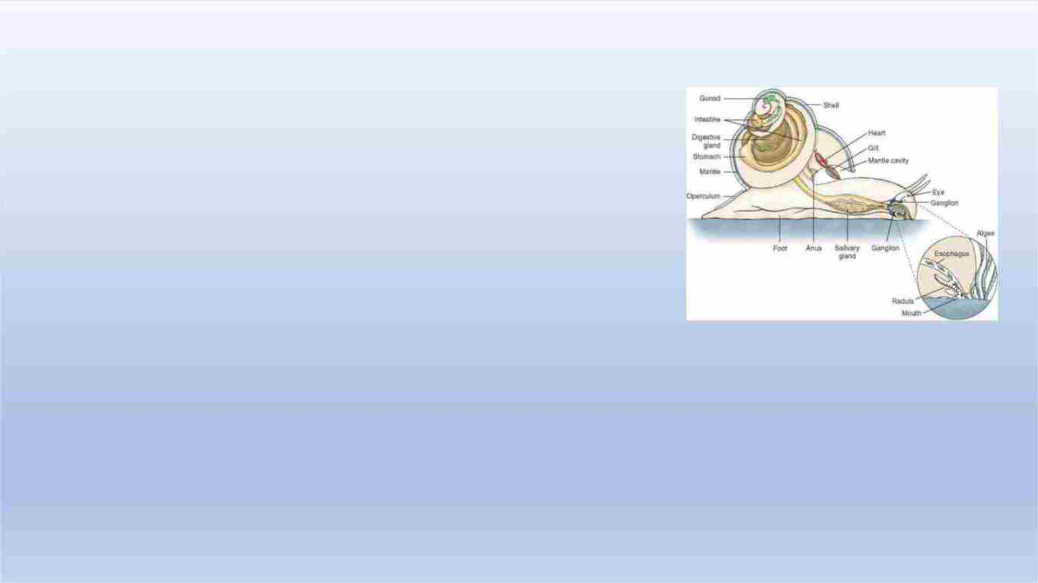
Phylum Mollusca
• 200,000ꢀspecies
• Moreꢀspeciesꢀinꢀoceanꢀthanꢀanyꢀotherꢀanimalꢀgroup
• Softꢀbodyꢀenclosedꢀbyꢀcalciumꢀcarbonateꢀshell
• Bodyꢀcoveredꢀbyꢀmantle
• Thinꢀlayerꢀofꢀtissueꢀthatꢀsecretesꢀtheꢀshell
• DisplaysꢀBilateralꢀSymmetry
• Ventralꢀmuscularꢀfootꢀusedꢀforꢀlocomotion
• Mostꢀhadꢀhaveꢀthatꢀincludesꢀeyesꢀandꢀotherꢀsensoryꢀorgans

Slide 3
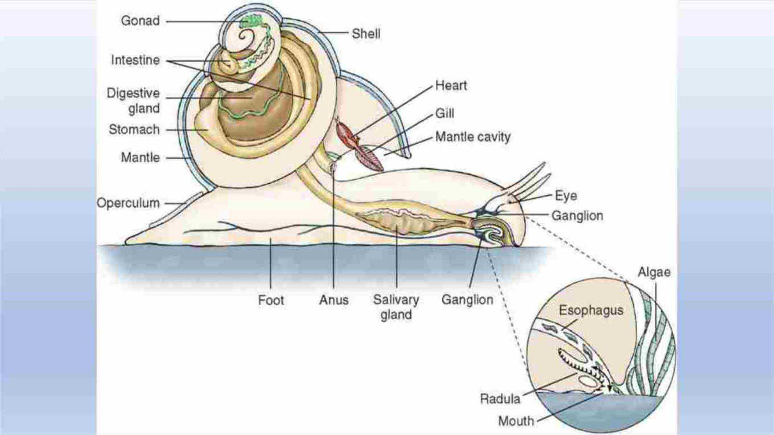
Essentially,ꢀaꢀmolluscꢀisꢀaꢀcoiledꢀmassꢀofꢀvital
organsꢀwrapped
inꢀaꢀdorsalꢀshell.

Slide 4
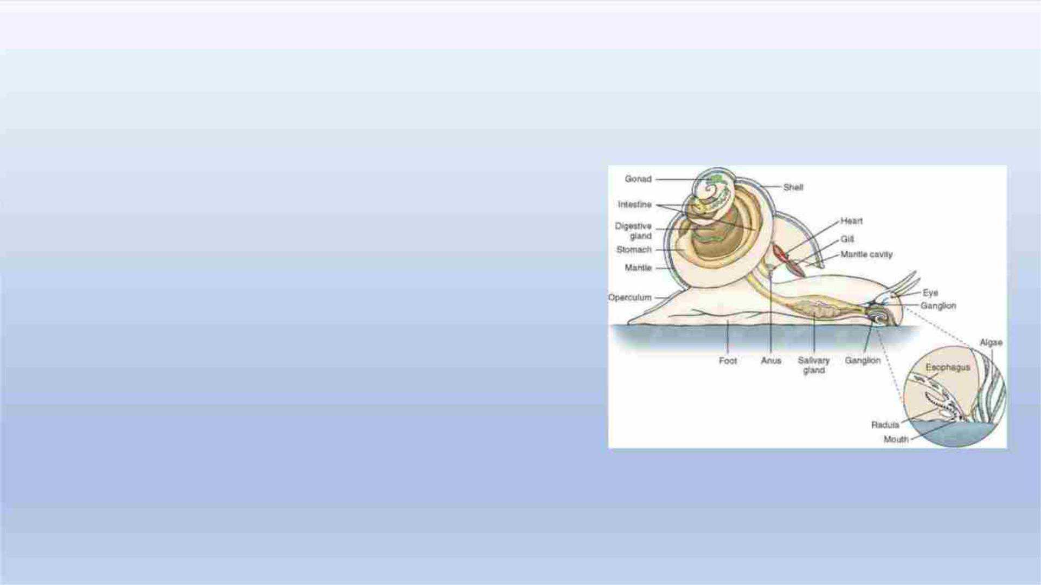
Phylum Mollusca
• Someꢀhaveꢀradula
• Ribbonꢀofꢀsmallꢀteethꢀusedꢀtoꢀraspꢀfood
• fromꢀsurfaces
• Madeꢀofꢀchitin
• Haveꢀpairedꢀgills
• Portionꢀofꢀbodyꢀmayꢀbeꢀcoiledꢀandꢀasymetrical
• Occupyꢀallꢀmarineꢀenvironmentsꢀ–ꢀrockyꢀshoresꢀtoꢀhydrothermalꢀvents

Slide 5
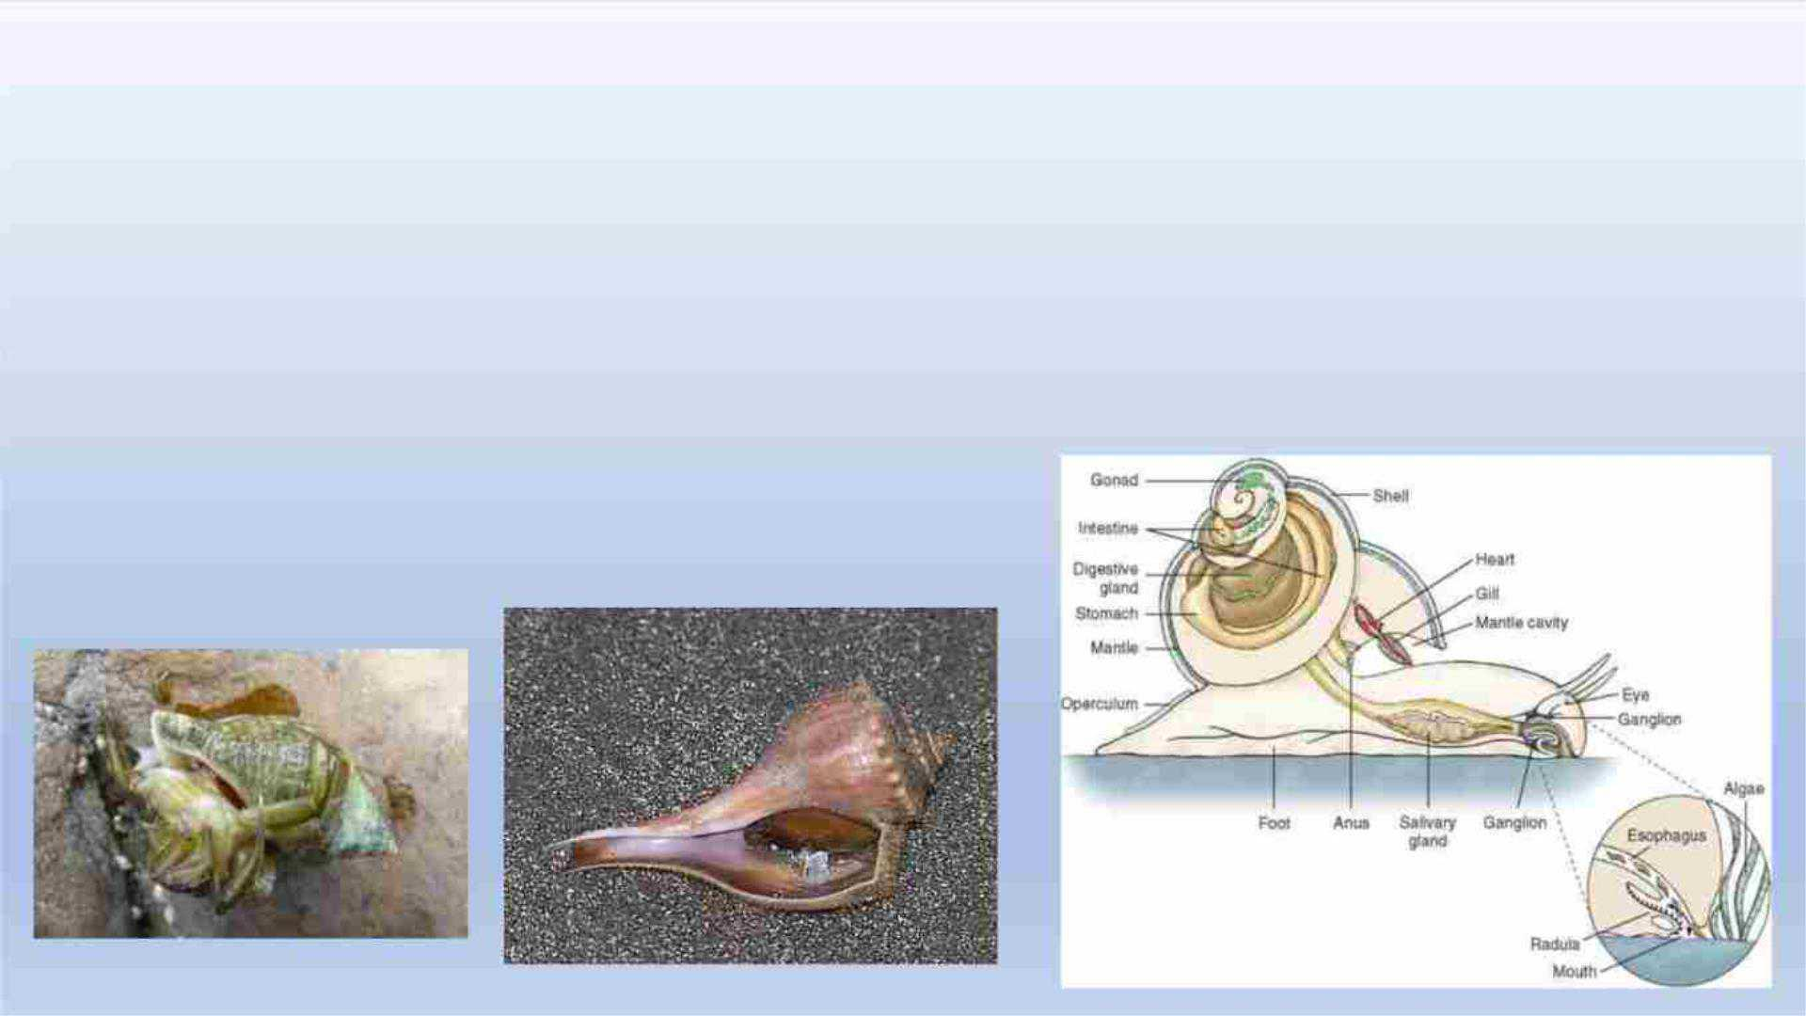
Class Gastropod – Stomach Footed
• Coiledꢀmassꢀofꢀvitalꢀorgansꢀenclosedꢀbyꢀaꢀdorsalꢀshellꢀrestingꢀonꢀaꢀfoot
• Mostꢀuseꢀradulaꢀtoꢀscrapeꢀalgae
• Mudꢀsnailsꢀareꢀdepositꢀfeeders
• Whelks,ꢀoysterꢀdrills,ꢀandꢀconeꢀshellsꢀareꢀcarnivoresꢀthatꢀpreyꢀonꢀclams,ꢀoysters,ꢀworms,
andꢀsmallꢀfishes
• ModifiedꢀRadulaꢀtoꢀdrillꢀandꢀraspꢀprey

Slide 6
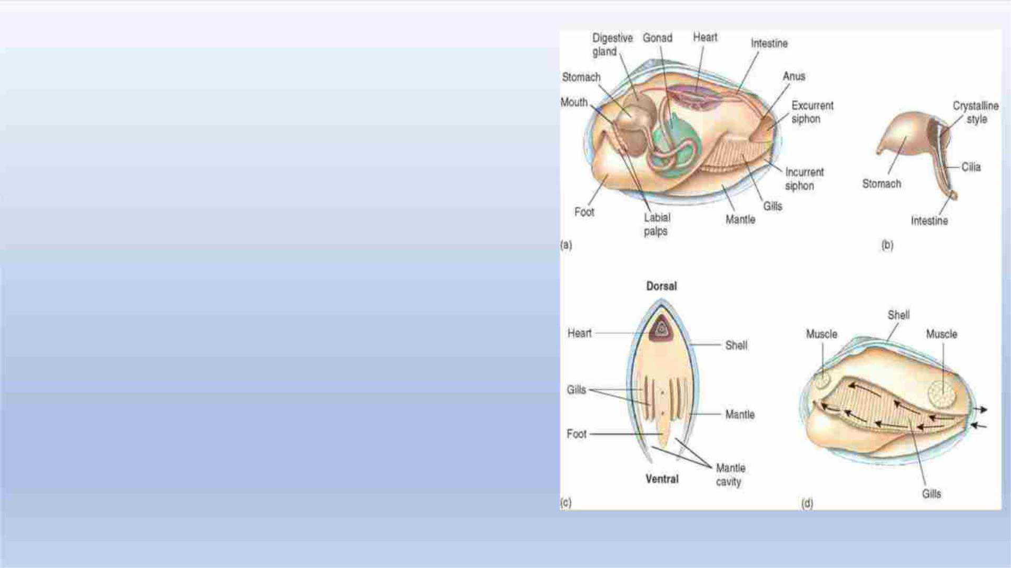
Class Bivalvia
• Clams,ꢀmussels,ꢀandꢀoysters
• Bodyꢀlaterallyꢀcompressedꢀandꢀenclosed
• withꢀtwoꢀpartsꢀ(valves)
• Noꢀheadꢀorꢀradula
• Gillsꢀexpandedꢀandꢀfoldedꢀusedꢀtoꢀobtain
oxygen,
• andꢀfilterꢀandꢀsortꢀfoodꢀparticlesꢀfromꢀwater

Slide 7
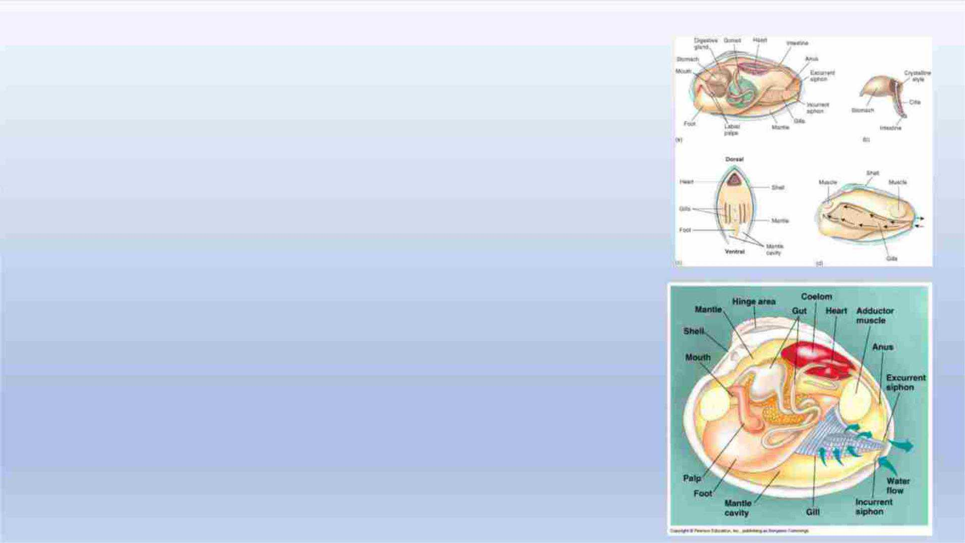
Class Bivalvia
• Innerꢀsurfaceꢀofꢀshellꢀlinedꢀw/ꢀmantleꢀso
• wholeꢀbodyꢀliesꢀinꢀmantleꢀcavity
• Strongꢀmusclesꢀusedꢀtoꢀcloseꢀvalves
• Clamsꢀburrowꢀinꢀsandꢀorꢀmudꢀandꢀwaterꢀdrawn
• inꢀandꢀoutꢀofꢀmantleꢀbyꢀsiphons
• Allowꢀclamꢀtoꢀfeedꢀandꢀobtainꢀoxygenꢀwhileꢀburied

Slide 8
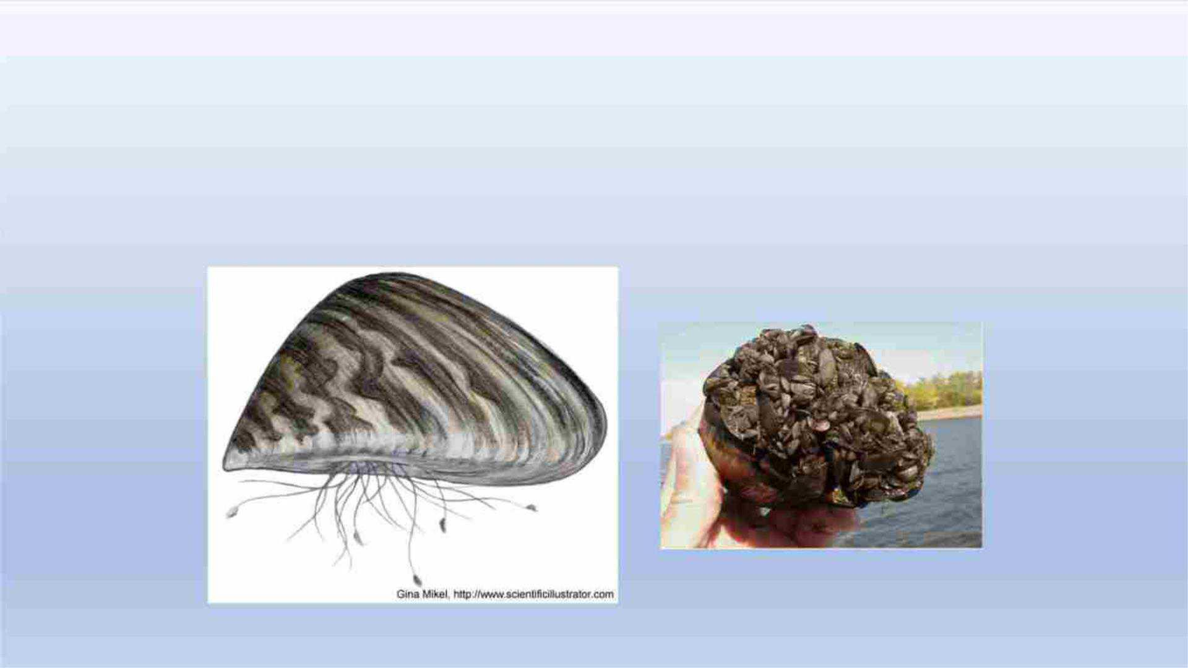
Class Bivalvia
• Musselsꢀsecreteꢀbyssalꢀthreadsꢀthatꢀattachꢀthemꢀtoꢀrocksꢀandꢀother
surfaces

Slide 9
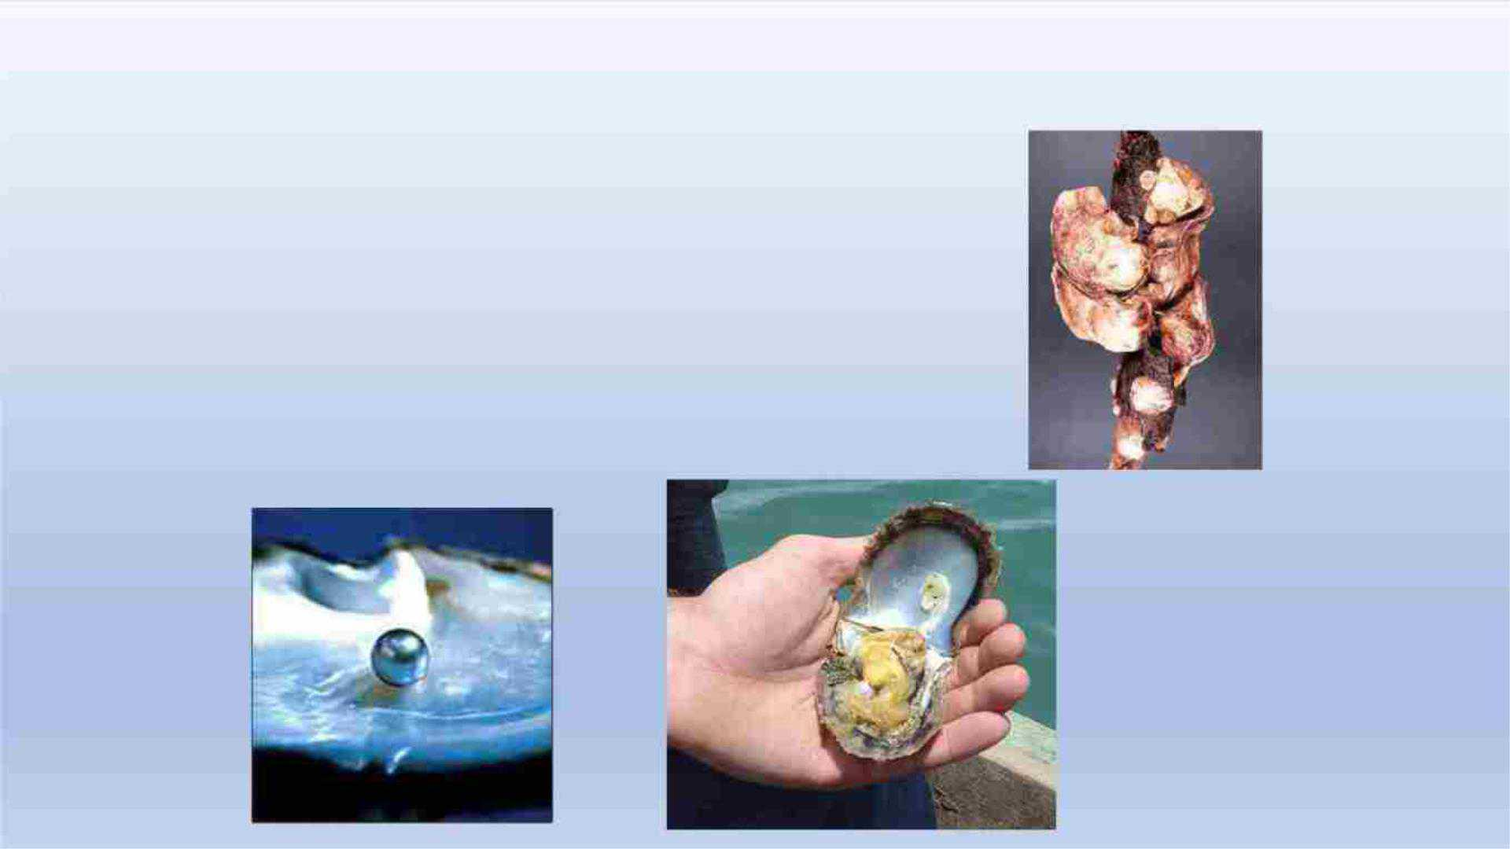
Class Bivalvia
• Oystersꢀcementꢀtheirꢀleftꢀshellꢀtoꢀhard
surfaceꢀandꢀotherꢀtoꢀanotherꢀoyster
• Pearlsꢀoccurꢀwhenꢀirritatingꢀparticlesꢀare
lodgedꢀwithinꢀtheꢀmantleꢀcavityꢀand
coveredꢀbyꢀsecretionsꢀ(CaCO₃)ꢀfromꢀoyster

Slide 10

Class Bivalvia
• Someꢀscallopsꢀcanꢀswimꢀbyꢀrapidlyꢀejectingꢀwaterꢀfromꢀmantleꢀcavity
withꢀsiphon
• Shipwormꢀboresꢀinꢀmangroves,ꢀdriftwood,ꢀandꢀpilings
• Haveꢀsymbioticꢀrelationshipꢀw/ꢀbacteriaꢀinꢀtheꢀgutꢀthatꢀdigestsꢀwood
• Valvesꢀlieꢀatꢀtheꢀinnerꢀendꢀofꢀtunnelꢀlinedꢀw/ꢀcalciumꢀcarbonateꢀandꢀsiphon
protrudesꢀfromꢀentrance
• Foulingꢀorganismꢀ=ꢀsettlesꢀonꢀbottomsꢀofꢀboats,ꢀpilings,ꢀandꢀotherꢀsubmerged
surfaces

