Slide 1


Slide 2



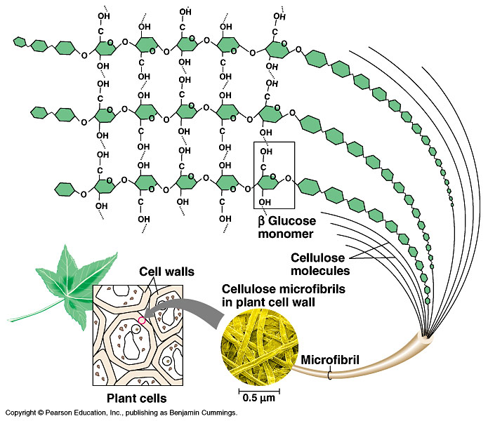
Macromolecules
Continuo….
Copyright © 2002 Pearson Education, Inc., publishing as Benjamin Cummings

Slide 3
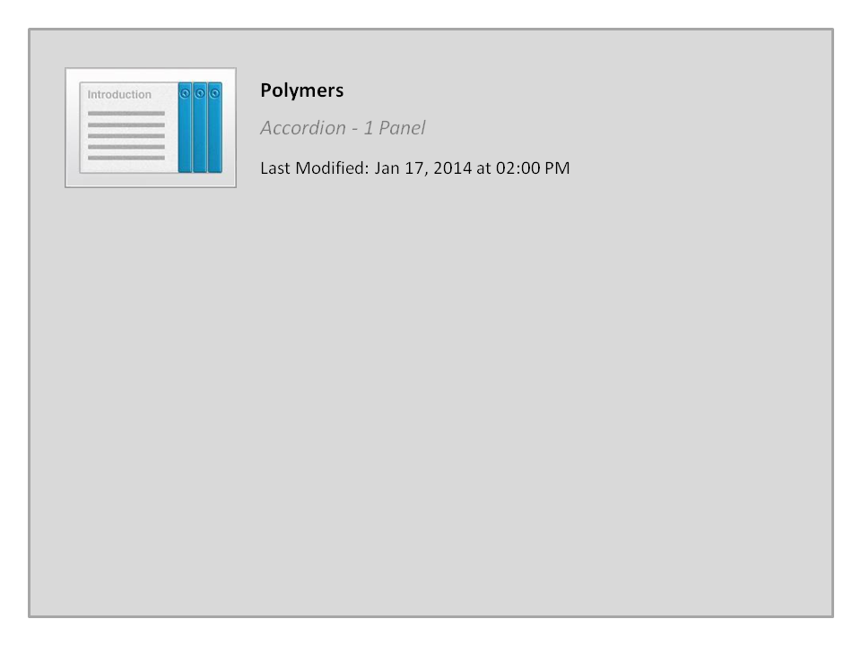



Polymers

Slide 4


2-Proteins (Polypeptides)
Proteins are polymer of amino acids (constructed from 20 amino acids) (to form Polypeptides).
There are six functions of proteins:
1. Storage: albumin (egg white)
2. Transport: hemoglobin
3. Regulatory: some hormones
4. Movement: muscles
5. Structural: membranes, hair, nails
6. Enzymes: cellular reactions
Copyright © 2002 Pearson Education, Inc., publishing as Benjamin Cummings

Slide 5
- The components of proteins include a hydrogen atom, a carboxyl group, an amino group, and a variable متغيرة R group (or side chain).
H
H
O
General Formula of the Amino Acid:
N
C
C
H
OH
Amino group
R
Carboxyl group
Side chain
- Differences in R groups produce the 20 different amino acids.
Amino acids الأحماض الأمينية
Hydrophobic: the amino acids that have hydrophobic R groups (non-polar).
Hydrophilic: the amino acids that have polar R groups, making them hydrophilic.
Ionized: the amino acids with functional groups that are charged (ionized) at cellular pH (7). So, some R groups are bases, others are acids.

Slide 6
The Peptide Bondالرابطة البيبتيدية
Peptide bond formed between the carboxyl group of one amino acid and the amino group of the other by dehydration.
H
O
H
H
H
O
N
C
C
N
C
C
H
OH
H
OH
R
R
Dehydrationنزع الماء
Peptide bond
Amino acids Peptide
Polypeptide (Protein)

Slide 7
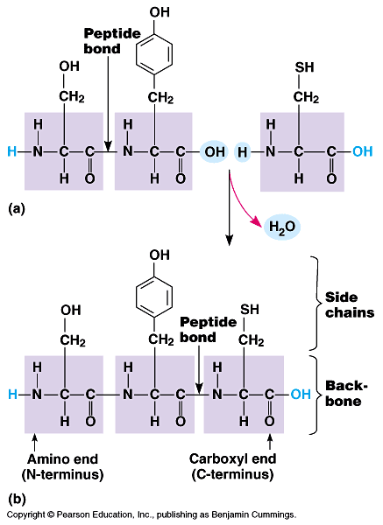
The Peptide Bond
Amino acids are joined together when a dehydration reaction removes a hydroxyl group from the carboxyl end of one amino acid and a hydrogen from the amino group of another. The resulting covalent bond is called a peptide bond.
The repeated sequence (N-C-C) is the polypeptide backbone.
Attached to the backbone are the various R groups.
Polypeptides range in size from a few monomers to thousands.

Slide 8
Hydrophobic (non-polar R group)
Amino acids
Hydrophilic (polar R group)
Ionized (charged functional groups)
Peptide bonds
Summary
Dehydration
Peptides
Polypeptides
Proteins
There are four levels of protein structure:
Primary Structure أولي (بسيط)
Secondary Structure ثنائي
Tertiary Structure ثلاثي
Quaternary Structure رباعي

Slide 9


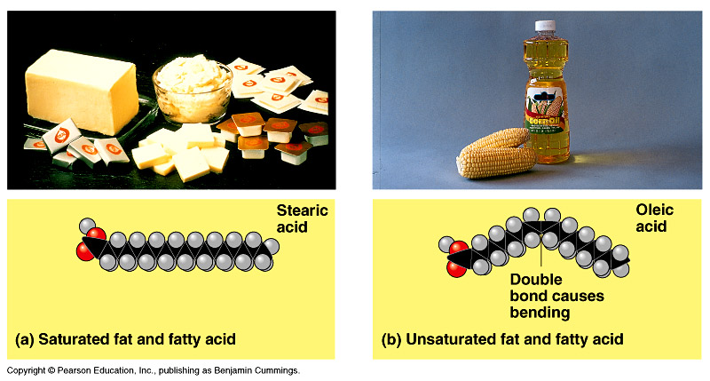
3-Lipids
It is the general term for compounds which are not soluble in water.
1. Fats store large amounts of energy
Phospholipids are major components of cell membranes
Steroids include cholesterol and certain hormones

Slide 10
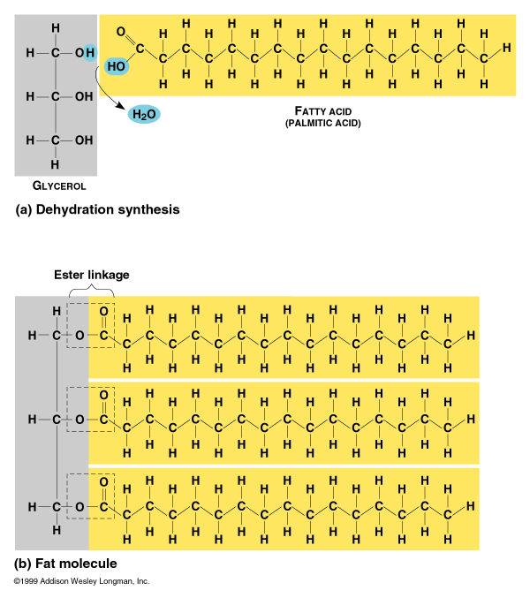
Functions of lipids:
1. Long term energy storage
2. Protection against heat loss (insulation)
3. Protection against physical shock
4. Protection against water loss
5. Chemical messengers (hormones)
6. Major component of membranes (phospholipids)
Structure of Fatty Acids
Long chains of mostly carbon and hydrogen atoms with a -COOH group at one end.
When they are part of lipids, the fatty acids resemble long flexible tails.
Notes:
10

Slide 11
Structure of Fat molecule
Glycerol
H
H
Fatty Acid
O
H
H
H
H
C
C
H
C
C
C
C
H
C
O
H
OH
H
H
H
Ester link
H
H
H
C
OH
H
C
OH
Dehydration
H
In a fat, three fatty acids are joined to a single glycerol by an ester linkage, رابطة إستيرية creating a triacylglycerol.

Slide 12
1)- Saturated Fats الدهون المشبعة
Types of fats
The Fatty acid components are saturated when there is no double bond between the carbons. All Carbn are linked with Hydrogen .
  The Fatty acid components are saturated (there is no double bonds between the carbons. All C are linked with H.
  have only single C-C bonds in fatty acid tails
  solid at room temp
  Include most animal fats
Most animal fats are saturated.
The double bonds are formed by the removal of H atoms.
2)- Un-saturated Fats الدهون الغير مشبعة
  liquid at room temp
  one or more double bonds between carbons in the fatty acids allows for “kinks” in the tails
  Include most plant fats
Most plant fats are unsaturated.
They can be synthetically converted to saturated (solid) by adding H (Hydrogenation الهَدْرَﭽـَة).

Slide 13
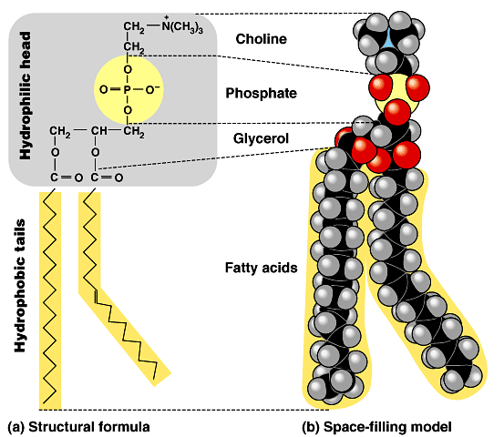
1- Phospholipids: are the major components of cell membranes
Other lipids have structural, hormonal, or protective functions
Phospholipids have two fatty acids attached to glycerol and a phosphate group at the third position.
  The phosphate group carries a negative charge.
The fatty acid tails are hydrophobic, but the phosphate group and its attachments form a hydrophilic head.
Thus, it is amphipathic
Steroids: are hydrophobic molecules that pass through plasma membranes (Sex Hormones)
Waxes: are hydrophobic molecules used for waterproofing

Slide 14
Summary
F a t s
(Composed of Lipids)
Saturated
Unsaturated
Phospholipids
Steroids
Waxes
Animal Fats
Vegetable Fats
Bi-layer of cell membrane
Sex Hormones & Cholesterol
Hydrogenation
هَـدْرَﭽـَــــــــة

Slide 15



Quiz1

Slide 16




College of Science,
Zoology Department
General Animal Biology
(Zoo-145)
Prof. Ashraf M. Ahmed
aalii@ksu.edu.sa

