Slide 1
AJAX Calendar Control
Rehab AlFallaj

Slide 2
The Calendar control enables you to display a date picker when focus is moved to an input element. Calendar is an ASP.NET AJAX extender that can be attached to any ASP.NET TextBox control. It provides client-side date-picking functionality with customizable date format and UI in a popup control. You can interact with the calendar by clicking on a day to set the date, or the "Today" link to set the current date. In addition, the left and right arrows can be used to move forward or back a month. By clicking on the title of the calendar you can change the view from Days in the current month, to Months in the current year. Another click will switch to Years in the current Decade. This action allows you to easily jump to dates in the past or the future from within the calendar control.

Slide 3
First:
Add a ToolkitScriptManager
<asp:ToolkitScriptManager ID="ToolkitScriptManager1" runat="server">
</asp:ToolkitScriptManager>

Slide 4
Second:
Add a TextBox Control
The CalendarExtender works with a standard ASP.NET TextBox control. In Design view, drag a TextBox control from under the Standard tab in the Toolbox onto your page.

Slide 5
Third:
Add a CalendarExtender
The next step is to apply a CalendarExtender control to the TextBox. Add the following CalendarExtender control to your page:
<asp:CalendarExtender ID="CalendarExtender1"
TargetControlID="txtStartDate" runat="server"> </asp:CalendarExtender>

Slide 6
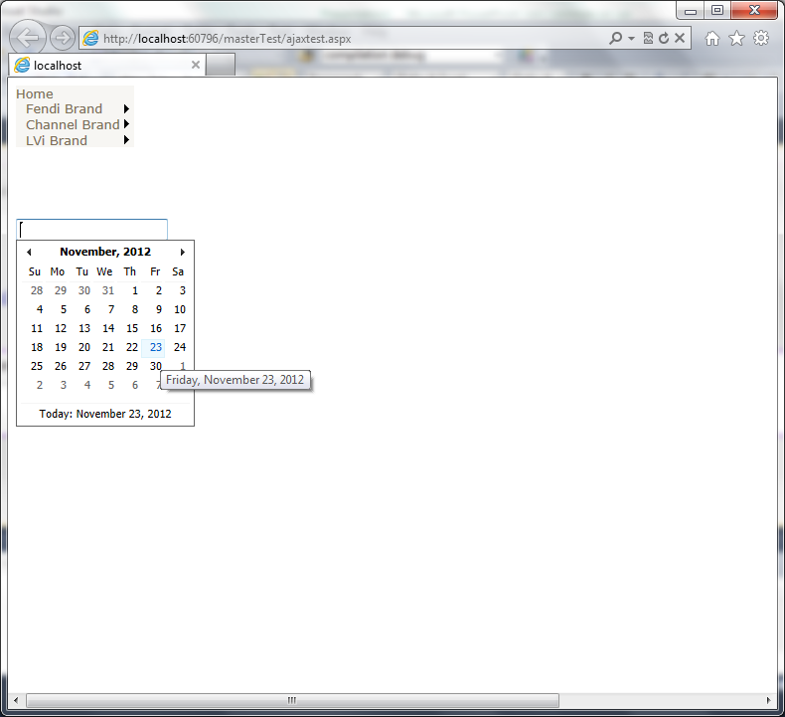
Result:

Slide 7
OR:
You can add am Image button so the Calendar Extendar works after
clicking the ImageButton:

Slide 8
In the CalendarExtendar Property window:
popUpButtonID = ID of the ImageButton
TargetControlID = ID of the TextBox

