Slide 1
Dynamic Routing Protocols part2

Slide 2
CH2 Outline
Dynamic Routing Protocols
Distance Vector Dynamic Routing
Link-State Dynamic Routing
RIP
OSPF

Slide 3
CH2 p2 Outline
Distance Vector Routing Protocols
Routing Protocol Metrics
Classful and Classless Routing Protocols
Routing Protocol Characteristics
RIP Routing
  Routing table
  Hop count
  Initialization
  Sharing
  Updating
  Message Format
  Timers
  Two-Node Loop Instability and solutions

Slide 4
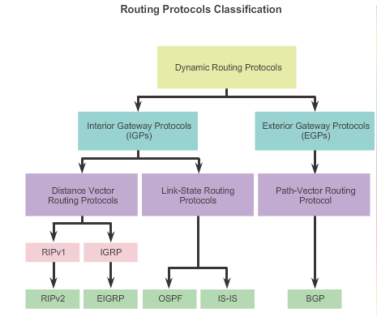
Types of Routing Protocols
Notes:
4
7.1.4.1

Slide 5
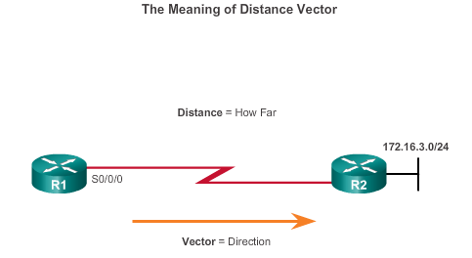
Distance Vector Routing Protocols
For R1, 172.16.3.0/24 is one hop away (distance) it can be reached through R2 (vector)
Notes:
5
7.1.4.3

Slide 6
Distance Vector Routing Protocols
Distance vector means that routes are advertised by providing two characteristics:
Distance: Identifies how far it is to the destination network and is based on a metric such as the hop count, cost, bandwidth, delay, and more
Vector: Specifies the direction: the next-hop router or exit interface to reach the destination

Slide 7
Routing Protocol Metrics
A metric is a measurable value that is assigned by the routing protocol to different routes based on the usefulness of that route
Used to determine the overall “cost” of a path from source to destination
Routing protocols determine the best path based on the route with the lowest cost
Notes:
7
7.1.4.8

Slide 8
Distance Vector Routing Protocols
A router using a distance vector routing protocol does not have the knowledge of the entire path to a destination network.
The only information a router knows about a remote network is the distance or metric to reach that network and which path or interface to use to get there.
Distance vector protocols use routers as sign posts along the path to the final destination.
Distance vector routing protocols do not have an actual map of the network topology.

Slide 9
Types of Routing Protocols
Classful routing protocol
Classless routing protocol
Notes:
9
7.1.4.1

Slide 10
Classful and Classless Routing Protocols
Classful routing protocols do not send subnet mask information in their routing updates
  Only RIPv1 and IGRP are classful
  Created when network addresses were allocated based on classes (class A, B, or C)
Classless routing protocols include subnet mask information in the routing updates
  RIPv2, EIGRP, OSPF, and IS_IS
  Support VLSM and CIDR

Slide 11
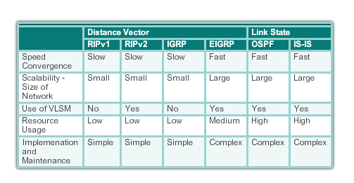
Routing Protocol Characteristics
RIP uses the Bellman-Ford algorithm as its routing algorithm
IGRP and EIGRP use the Diffusing Update Algorithm (DUAL) routing algorithm developed by Cisco

Slide 12
Distance Vector Technologies
Distance vector routing protocols
Share updates between neighbors
Not aware of the network topology
Some send periodic updates even if topology has not changed e.g RIP ( consume bandwidth and resources)
Some only send an update when topology has changed e.g. EIGRP
Notes:
12
Some send periodic updates to broadcast IP 255.255.255.255 even if topology has not changed

Slide 13
RIP Routing Protocol
RIP
Routing table
Hop count
Initialization
Sharing
Updating
Message Format
Timers

Slide 14
RIP
RIP is an IGP routing protocol for exchanging routing table information between routers.
It is a very simple protocol based on distance vector routing.
It uses a hop count as a path selection metric.
RIP routes have an administrative distance (AD) of 120.
RIP has a maximum hop count of 15 hops , with “16” equal to “”.
It uses a three types of timers.

Slide 15
Distance Vector Routing
In distance vector routing, each router shares its routing table with its immediate neighbors periodically and when there is a change.
The three features:
  Each router sends all or part of its routing table in routing updates
  Sharing only with neighbors
  Sharing at regular intervals and when there is a change
Notes:
The whole idea of distance vector routing is the sharing of information between neighbors
Although router A does not know about router C, router B does. So if router B shares its routing table with A, node A can also know how to reach node C

Slide 16
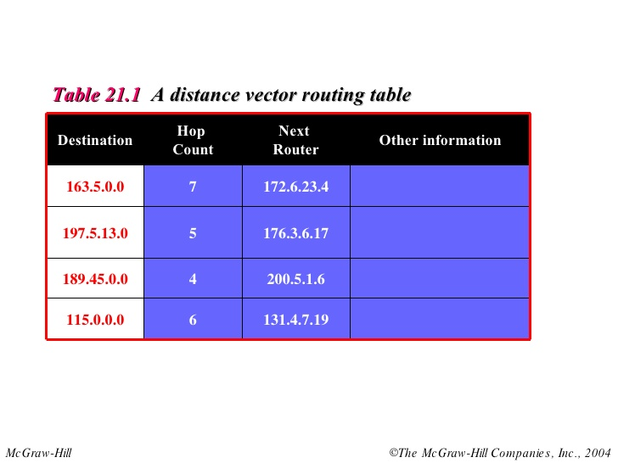
Routing Table
Every router keeps a routing table.
The routing table has one entry for each destination network of which the router is aware.

Slide 17
Routing Table
The entry consists of:
  the destination network address,
  the shortest path to reach the destination in hop count,
  and the next router to which the packet should be delivered.
The table may contain other information.

Slide 18
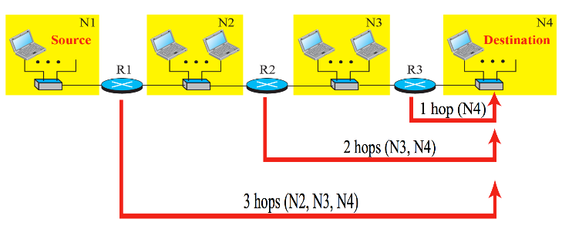
Hop Count
The hop count is the number of networks that a packet encounters to reach its final destination.
After 15 hops, the packet is discarded

Slide 19
RIP
Initialization
Sharing
update

Slide 20
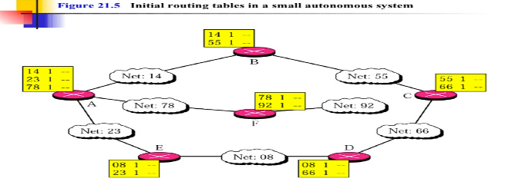
Initialization
When a router is added to a network, it initializes a routing table for itself, using its configuration file.
The table contains only the directly attached networks and hop counts, which are initialized to 1.
The next-hop field is empty.

Slide 21
Sharing
Each router sent its routing table to its immediate neighbors periodically and when there is a change in the table.

Slide 22
Updating
When a router receives a 2-column table from a neighbor, it needs to update its routing table.
Updating takes 3 steps:
  The receiving router needs to add one hop count to each value in the hop count column
  The receiving router needs to add the name of the sending router to each row as the 3rd column if the receiving router uses information from any row. The sending router is the next node in the route

Slide 23
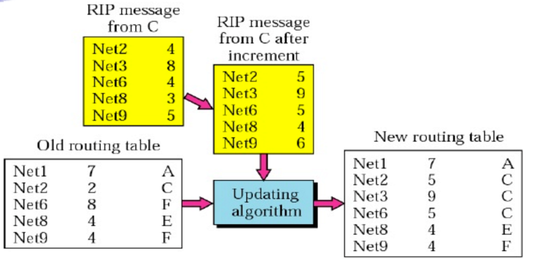
Updating
3- The receiving router needs to compare each row of its old table with the corresponding row of the modified version of the received table.

Slide 24
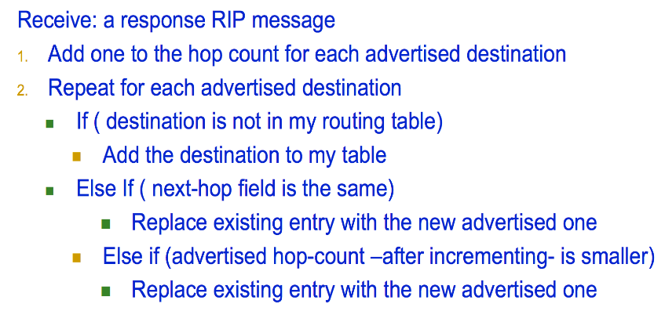
Updating Algorithm

Slide 25
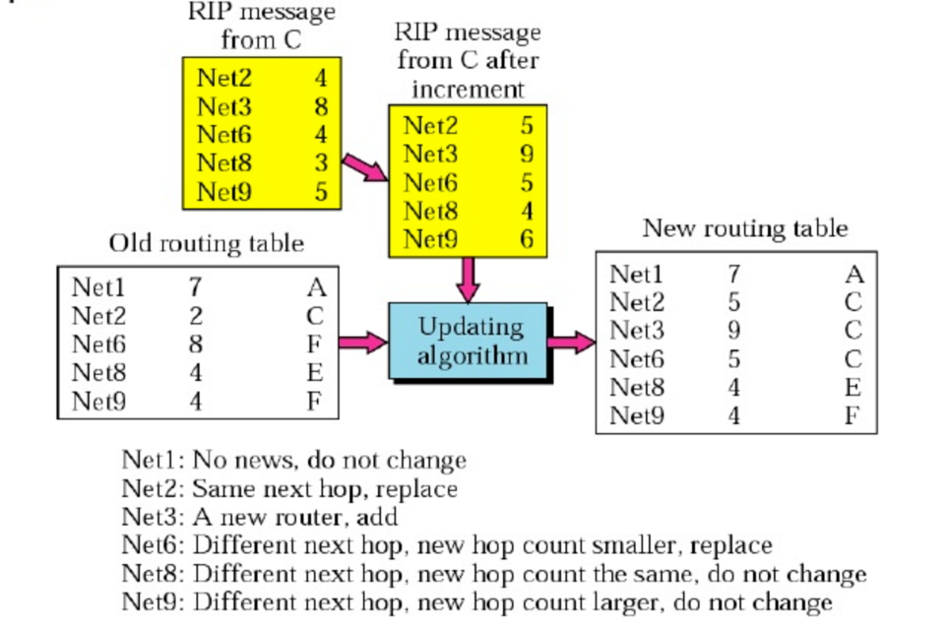

Slide 26
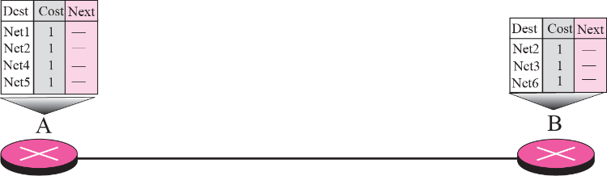

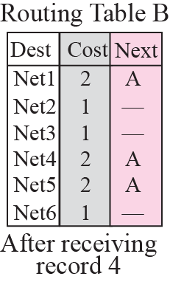
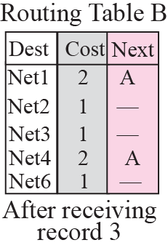
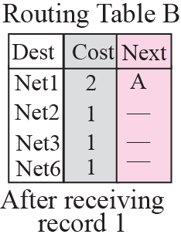
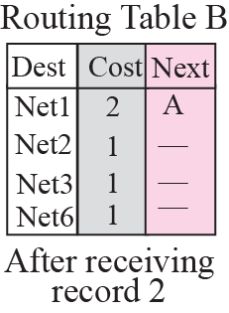

Slide 27
When to Share
Periodic Update:
A router sends its routing table, normally every 30 seconds, in a periodic update.
Triggered Update:
A router sends its 2-column routing table to its neighbors any time there is a change in its routing table. The change can result from the following.
  A router receive a table from a neighbor resulting in changes in its own table after updating
  A router detects some failure in the neighboring links which results in a distance change to infinity
Notes:
Triggered Updates: If a metric changes on a link, a router immediately sends out an update without waiting for the end of the update period.

Slide 28
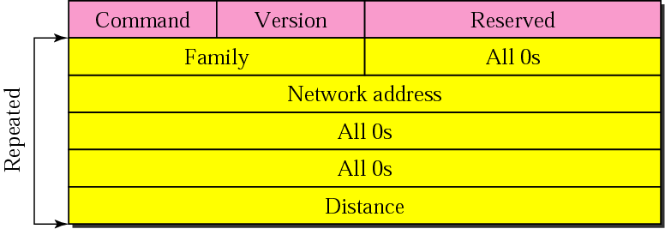
RIP Message Format

Slide 29
RIP Message Format (cont.)
Command. This 8-bit field specifies the type of message: request (1) or response (2)
Version. This 8-bit defines the RIP version.
Family. This 16-bit field defines the family of the protocol used. For TCP/IP the value is 2.
Network address. RIP has allocated 14 bytes for this field to be applicable to any protocol.
Distance. This 32-bit field defines the hop count from the advertising router to the destination network
Notes:
Family: Indicates type of address being specified (IP, IPX, etc)

Slide 30
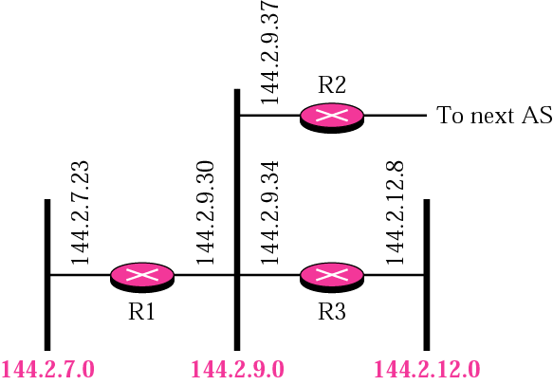
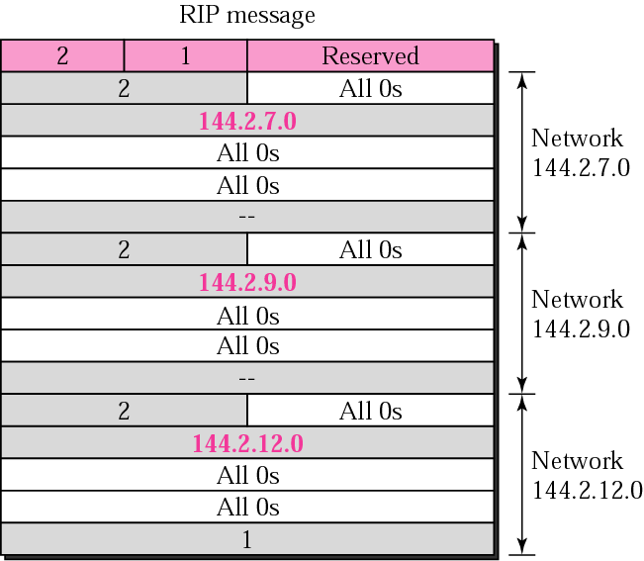
Example

Slide 31
Request and Response
Request:
A request message is sent by a router that has just come up or by a router that has some time-out entries. A request can ask about specific entries or all entries
Response:
A solicited response is sent only in answer to a request. It contains information about the destination specified in the corresponding request.
An unsolicited response is sent periodically, every 30 s or when there is a change in the routing table
Notes:
Two types of messages:
Request messages
used to ask neighboring nodes for an update
Response messages
contains an update

Slide 32
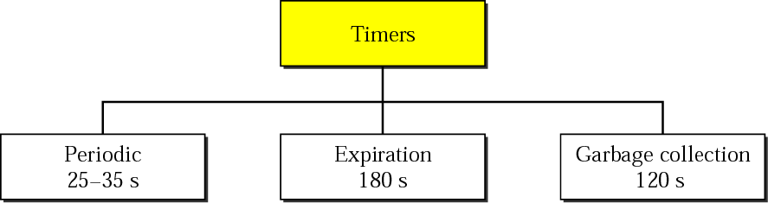
Timers in RIP
RIP uses 3 timers:
The periodic timer controls the sending of messages
the expiration timer governs the validity of a route
the garbage collection timer advertises the failure of a route

Slide 33
Periodic Timer
The periodic timer controls the advertising of regular update messages
The working model uses a random number between 25 and 30 s
This is to prevent any possible synchronization and therefore overload on an network if routers update simultaneously

Slide 34
Expiration Timer
The expiration timer governs the validity of a route
When a router receives update information for a route, the expiration timer is set to 180 s for that particular route
Every time a new update for the route is received, the timer is reset
If the timer is expired, the hop count of the route is set to 16, which means the destination is unreachable
Notes:
Routes are timeout (set to 16) after 3 minutes if they are not updated

Slide 35
Garbage Collection Timer
When the information about a route becomes invalid, the router does not immediately purge that route from its table
Instead, it continues to advertise the route with a metric value of 16
At the same time, the garbage collection timer is set to 120 s for that route
When the count reaches zero, the route is purged from the table

Slide 36
Example
A routing table has 20 entries. It does not receive information about five routes for 200 s. How many timers are running at this time?
Solution
The 21 timers are listed below:
Periodic timer: 1
Expiration timer: 20 − 5 = 15
Garbage collection timer: 5

Slide 37
RIP v1 Drawbacks
RIP version 1 does not recognize subnets.
This feature was added in RIP version 2.
Because RIP only uses hop count as a metric, packets may be forced to take a slower route with less hops over a faster route with more hops.
  Other routing protocols use a combination of different metrics to calculate a route.

Slide 38
RIPv2
RIPv2 is an extends RIPv1:
  Subnet masks are carried in the route information
  Authentication of routing messages
  Exploits IP multicasting
Extensions of RIPv2 are carried in unused fields of RIPv1 messages
Notes:
Classless Addressing
Authentication
Multicasting
RIPv1 uses broadcasting to send RIP messages to every neighbors. Routers as well as hosts receive the packets
RIPv2 uses the all-router multicast address to send the RIP messages only to RIP routers in the network

Slide 39
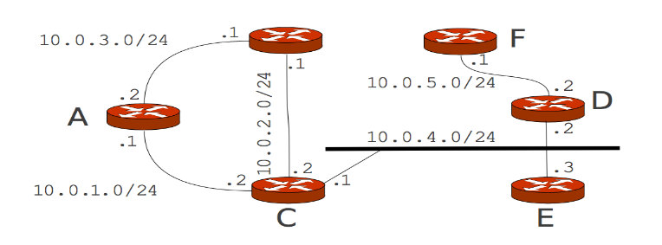
Exercise
In the network above, all routers run RIPv2.
What is the initial routing table state of A?
Assume C is the first router that sends a RIP update to all its neighbors. What is now the state of A's routing table?

Slide 40
Two-Node Loop Instability
A problem with distance vector routing is instability, which means that a network using this protocol can become unstable.

Slide 41
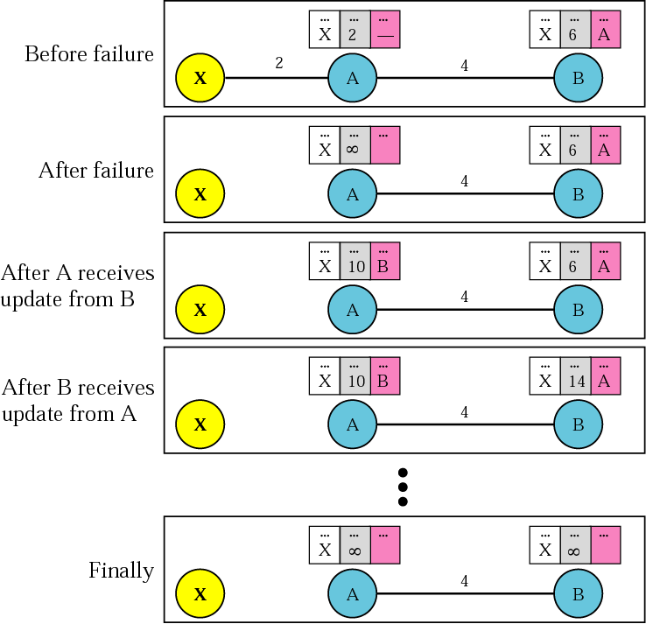
Both A and B know how to reach X.
A changes its table.
If A send its table to B immediately ✔
If B send its table to A before receiving A's
routing table !!
B sends its routing table to A
Based on the triggered update strategy,
A sends its new update to B.
The cost of reaching X increases
gradually until it reaches infinity
Notes:
If A can send its table to B immediately, everything is fine. However, the system
becomes unstable if B sends its routing table to A before receiving A's routing table.
A before receiving A's routing table.
Node A receives the update and, assuming that B has found a way to reach X, immediately
updates its routing table.
Based on the triggered update strategy, A sends its new update to B.

Slide 42
Two-Node Loop Instability
The cost of reaching X reaches infinity, both A and B know that X cannot be reached.
However, during the time of increasing cost the system is not stable.
Node A thinks that the route to X is via B; node B thinks that the route to X is via A.
If there is a packet to X, Packet bounces between A and B, creating a two-node loop problem.
Notes:
If A receives a packet destined for X, it goes to B and then comes back to A. Similarly, if B receives a packet destined for X, it goes to A and comes back to B.

Slide 43
Solutions
A few solutions have been proposed for instability of this kind (routing loops).
  Defining Infinity
  Holddown timers
  Split Horizon
  Split Horizon and Poison Reverse

Slide 44
Defining Infinity
Setting a maximum
Distance Vector routing protocols set a specified metric value to indicate infinity
Once a router “counts to infinity” it marks the route as unreachableThe solution is redefining infinity to a small number so the system will be stable in less updates.
Most implementation of the distance vector protocol define the distance between each router to be 1 and define 16 as infinity.
Therefore, the distance vector cannot be used in large systems

Slide 45
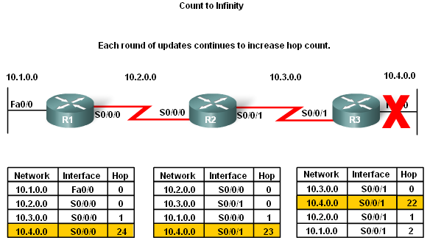
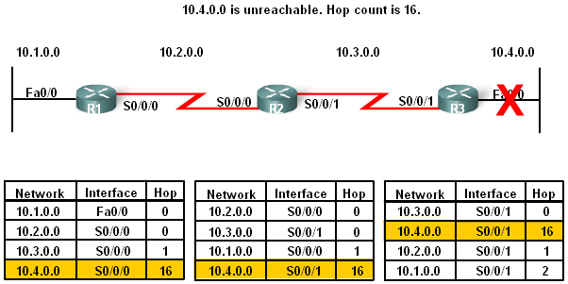
Defining Infinity- example
This is a routing loop whereby packets bounce infinitely around a network

Slide 46
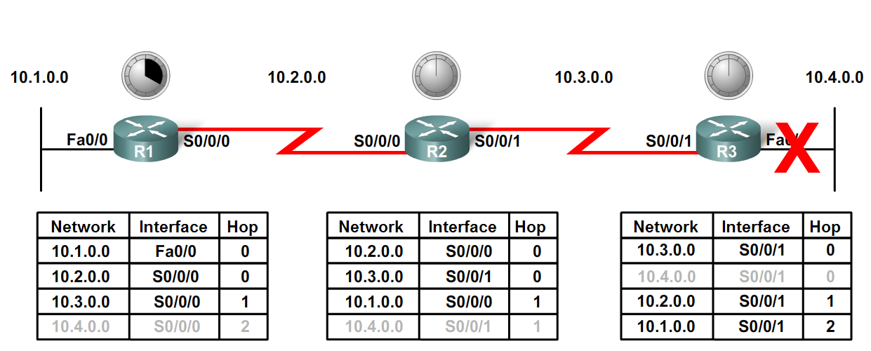
Holddown timers
Preventing loops with holddown timers
  Holddown timers allow a router to not accept any changes to a route for a specified period of time
  Point of using holddown timers
    Allows routing updates to propagate through network with the most current information

Slide 47
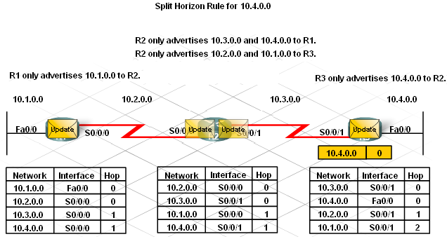
Split Horizon
The Split Horizon Rule is used to prevent routing loops
Split Horizon rule:
  A router should not advertise a network through the interface from which the update came

Slide 48
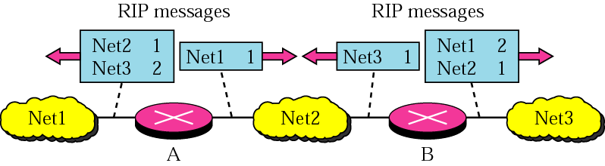
Split Horizon

Slide 49
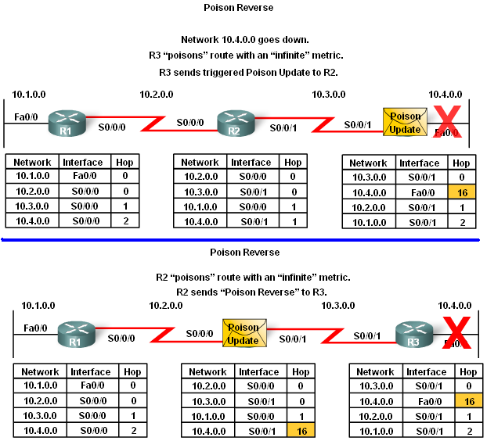
Split horizon with poison reverse
Split horizon with poison reverse
This strategy is a combination between split horizon and poison reverse
The rule states that once a router learns of an unreachable route through an interface, advertise it as unreachable back through the same interface

Slide 50
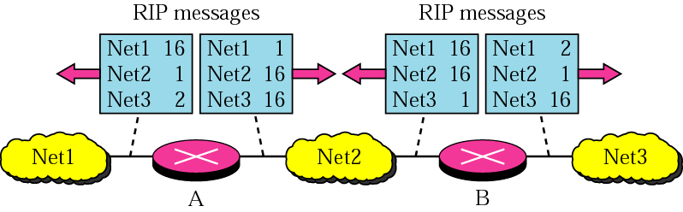
Split Horizon and Poison Reverse
Router B can still advertise the value of X, but if the source of information is A, it can replace the distance with infinity as a warning: “Don’t use this value; what I know about this route comes from you.”
Notes:
Using the split horizon strategy has one drawback.
Normally, the distance vector protocol uses a timer, and if there is no news about
a route, the node deletes the route from its table. When node B in the previous scenario
eliminates the route to X from its advertisement to A, node A cannot guess that this is
due to the split horizon strategy (the source of information was A) or because B has not
received any news about X recently.

Slide 51

Exercise
After convergence of RIP in the network, how many entries in the RIP update message does C send on 10.0.4.0/24 if RIP is configured to run:
  split horizon and poison reverse?
  only split horizon?
  neither split horizon nor poison reverse?

