Slide 1
CT301
lecture7

Slide 2
LAN MAC protocols
Protocol:
Set of rules that governs data communications.
Represent agreements between sender and receiver.
Defines what is communicated, how it is communicated, and when it is communicated.
Without a protocol, two devices may be connected but NOT communicating.
Key elements of protocol are:
Syntax
Semantics
timing

Slide 3
LAN MAC protocols
Syntax:
Refers to the structure or format of the data, the order in which they are presented.
Semantics:
Refers to the meaning of each section of bits.
How is a particular pattern to be interpreted.
Timing:
When data should be sent.
How fast they can be sent

Slide 4
LAN MAC protocols
Fixed assignment protocols:
Frequency division multiple access.
Time division multiple access.
Wavelength division multiple access.
Code division multiple access.
Dynamic MAC protocols:
Round robin protocols:
Contention protocols
Reservation protocols

Slide 5
LAN MAC protocols: Fixed assignment protocols
each node is allocated a predetermined fixed amount of the channel resources :
Frequency-division Multiple Access (FDMA)
Time-division Multiple access (TDMA)
Wavelength-division Multiple Access (WDMA)
Code-division multiple Access (CDMA)

Slide 6
LAN MAC protocols: Frequency-division Multiple Access
The available bandwidth is divided into sub-channels.
Multiple channel access is achieved by allocating communicating nodes with different carrier frequencies of the spectrum.
The bandwidth of each node’s carrier is constrained within certain limits such that no interference, or overlap, occurs between different nodes.

Slide 7
LAN MAC protocols: Frequency-division Multiple Access
C = n. w
C: bandwidth of channel Hz
w.: bandwidth of each sub-channels Hz
n: number of connected nodes to the channel.
Example:
Channel with 48 kHz bandwidth, its frequency 60 kHz- 108 kHz. If each node needs 4 kHz.
Then 48÷4= 12 sub-channels needed.
Therefore; 12 devices or nodes can use the channel at the same time.

Slide 8
LAN MAC protocols: FDMA

Slide 9
LAN MAC protocols: FDMA

Slide 10
LAN MAC protocols: Time-division multiple access
In TDMA, a radio spectrum is divided into time slots. These time slots are allocated for each user to transmit and receive information.
The number of time slots is called a frame.
Information is transferred and received in form of frame.
A frame is consists of a preamble, an information message and trial bits.

Slide 11
LAN MAC protocols: TDMA

Slide 12
LAN MAC protocols: TDMA

Slide 13
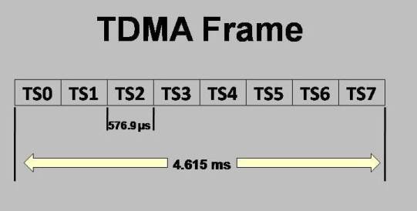
LAN MAC protocols

Slide 14
LAN MAC protocols: wavelength-division multiple access
Mostly used in fiber optics because fiber optics have a very wide frequency bandwidth.
The available bandwidth is divided into sub-channels.
It achieved by allocating communicating nodes with different wavelength of signals.
each node’s carrier is constrained within certain limits of wavelength such that no interference, or overlap, occurs between different nodes.

Slide 15
LAN MAC protocols: wavelength-division multiple access

Slide 16
LAN MAC protocols: Code-Division Multiple Access
all users transmit information simultaneously by using the same carrier frequency.
Each user has its own CodeWord, which is orthogonal to other users. To detect the message, the receiver should know the codeword used by the transmitter.
many users share the same frequency.

Slide 17
LAN MAC protocols: CDMA
In CDMA unlike FDMA and TDMA the number of users is not limited. It has a soft capacity. But due to large number of users its performance degrades.
In CDMA, each user operates independently with no knowledge of the other users.

Slide 18
LAN MAC protocols: CDMA: FHSS
Frequency Hopping spread spectrum (FHSS):
Used mostly in wireless networks.
It overcomes noise and interference due to its widely frequency bandwidth.
a transmitter "hops" between available frequencies according to a specified algorithm, which can be either random or preplanned

Slide 19
LAN MAC protocols: CDMA: DSSS
Direct Sequence Spread Spectrum (DSSS):
chops the data into small pieces and spreads them across the frequency domain.
FH-CDMA devices use less power and are generally cheaper, but the performance of DS-CDMA systems is usually better and more reliable.
The biggest advantage of frequency hopping lies in the coexistence of several access points in the same area, something not possible with direct sequence.

Slide 20
LAN MAC protocols: CDMA: DSSS

Slide 21
Fixed Assignment protocols
Advantages:
Effective usage of the channel
Channel Multiple access with no overlaps, collisions.
Effective if the channel capabilities is great; frequency bandwidth, wavelength, transmit rate.
Disadvantages:
In computer networks, channel resources may not be used at the optimal level.

