Slide 1
Lecture 7: Mobile Computing
By D. Najla Al-Nabhan

Slide 2
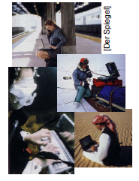
Overview
What is it?
Who needs it?
History
Future

Slide 3
A computer in 2014?
Advances in technology
– More computing power in smaller devices
– Flat, lightweight displays with low power consumption
– New user interfaces due to small dimensions
– More bandwidth (per second? per space?)
– Multiple wireless techniques
Technology in the background of mobile computing
– Device location awareness: computers adapt to their environment
– User location awareness: computers recognize the location of the user and react appropriately (call forwarding, service allocation)
• “Computers” evolve
– Small, cheap, portable, replaceable
– Integration or disintegration?

Slide 4
What is Mobile Computing?
Aspects of mobility
User mobility: users communicate “anytime, anywhere, with anyone”
(example: read/write email on web browser)
Device portability: devices can be connected anytime, anywhere to the network
Wireless vs. mobile Examples
× × Stationary computer
× √ Notebook in a hotel
√ √ mobile phone
√ √ Personal Digital Assistant (PDA)

Slide 5
What is Mobile Computing?
• The demand for mobile communication creates the need for integration of wireless networks and existing fixed networks, such as
– Local area networks
– Wide area networks
– Internet: Mobile IP extension of the Internet protocol IP

Slide 6
Application Scenarios
• Vehicles
• Smart mobile phone
• Invisible computing
• Wearable computing
• Intelligent house or office
• Meeting room/conference
• Taxi/Police/Fire squad fleet
• Service worker
• Disaster relief and Disaster alarm
• Games
• Military / Security
What is important?

Slide 7
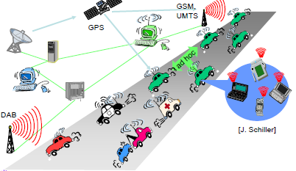
Vehicles

Slide 8
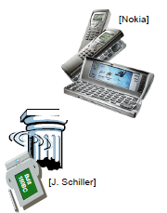
Smart mobile phone
• Mobile phones get smarter
• Converge with PDA?
• Voice calls, video calls
• Email or instant messaging
• Play games
• Up-to-date localized information
Map
Finding Services
( Ask: Find the next Pizzeria, answer: “Hey, we have great Pizza!”)
• Stock/weather/sports info
• Ticketing

Slide 9
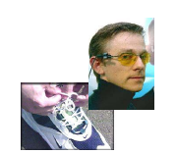
Invisible/ubiquitous/pervasive and wearable computing
• Tiny embedded “computers”
• Everywhere

Slide 10
Intelligent Office and Intelligent House
• Bluetooth replaces cables
• Plug and play, without the “plug”
• Again: Find the local printer
• House recognizes resident
• House regulates temperature according to person in a room
• Home without cables looks better
• LAN in historic buildings

Slide 11
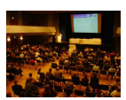
Meeting room or Conference
• Share data instantly
• Send a message to someone else in the room
• Secretly vote on controversial issue
• Find person with similar interests
• Broadcast last minute changes
• Ad-Hoc Network

Slide 12
Taxi / Police / Fire squad / Service fleet
• Connect
• Control
• Communicate
Service Worker Example..

Slide 13
Disaster relief
• After earthquake, tsunami, volcano, etc:
• You cannot rely on infrastructure but you need to
orchestrate disaster relief
• Early transmission of patient
data to hospital
• Satellite
• Ad-Hoc network

Slide 14
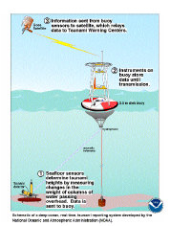
Disaster alarm
• With sensors you might be able to alarm early
• Example: Tsunami
• Example: Cooling room
• Or simpler: Weather station
•Satellite
• Ad-Hoc network

Slide 15
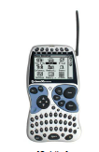
Games
• Nintendo Gameboy [Advance]: Industry standard mobile game station
• Connectable to other Gameboys
• Can be used as game pad for Nintendo GameCube

Slide 16
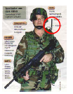
Military / Security
• From a technology standpoint this is similar to disaster relief
• “US army is the best costumer”

Slide 17
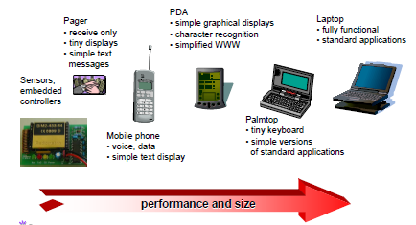
Mobile devices

Slide 18
Effect of Device Portability: Challenges
• Energy consumption
– limited computing power, low quality displays, small disks
– Limited memory (no moving parts)
– Radio transmission has a high energy consumption
– CPU: power consumption = CV²f
• C: total capacitance, reduced by integration
• V: supply voltage, can be reduced to a certain limit
• f: clock frequency, can be reduced temporally

Slide 19
Effect of Device Portability: Challenges
• Limited user interfaces
– compromise between size of fingers and portability
– integration of character/voice recognition, abstract symbols
• Loss of data
– higher probability (e.g., defects, theft)

Slide 20
Wireless networks in comparison to fixed networks
Wireless networks has :
• Higher loss-rates due to interference
• Restrictive regulations of frequencies
• Low transmission rates
. Higher delays, more jitter
• Lower security, simpler active attacking
• Always shared medium

