Slide 1
Edited by : Noor Al-Hareqi

Slide 2
Objectives Overview
Discuss the purpose of the components required for successful communications and identify various sending and receiving devices
Describe the uses of computer communications
Differentiate between client/server and peer-to-peer networks, and describe how a P2P network works
Differentiate among a star network, bus network, and ring network
Describe the various network communications standards
List advantages of using a network, and differentiate among LANs, MANs, and WANs
See Page 459
for Detailed Objectives

Slide 3
Objectives Overview
Explain the purpose of communications software
Describe various types of lines for communications over the telephone network
Describe various physical and wireless transmission media
Describe commonly used communications devices
Discuss different ways to set up a home network
See Page 459
for Detailed Objectives

Slide 4
Communications
Computer communications describes a process in which two or more computers or devices transfer data, instructions, and information
Sending device
Communications channel
Receiving device
Page 460

Slide 5
Communications
What are needed for successful communications?
Sending device — initiates instruction to transmit data, instructions, or information
Communications device — connects the sending device to the communications channel
Communications channel — media on which data, instructions, or information travel
Communications device — connects the communications channel to the receiving device
Receiving device — accepts transmission of data, instructions, or information

Slide 6
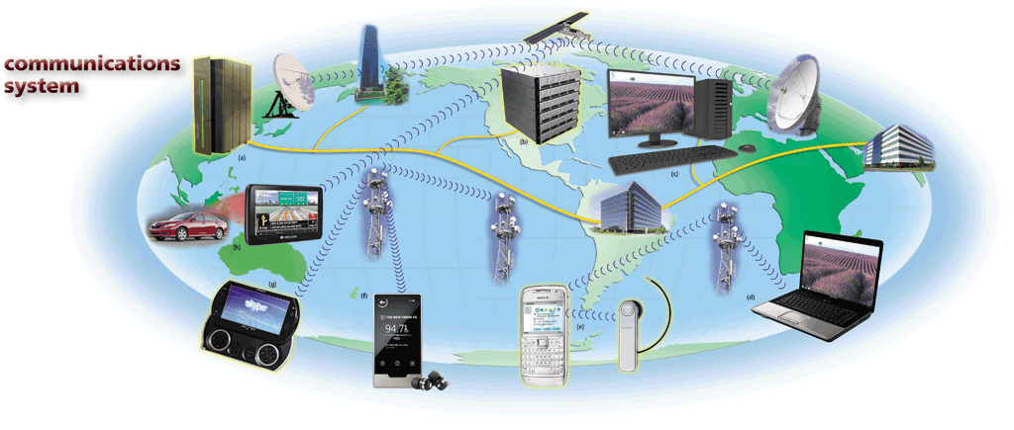
Communications
Pages 460 – 461
Figure 9-1

Slide 7
Uses of Computer Communications
Blogs
Chat rooms
E-mail
Fax
FTP
Instant messaging
Internet
Newsgroups
RSS
Video conferencing
VoIP
Web
Web 2.0
Web folders
Wikis
Page 462

Slide 8
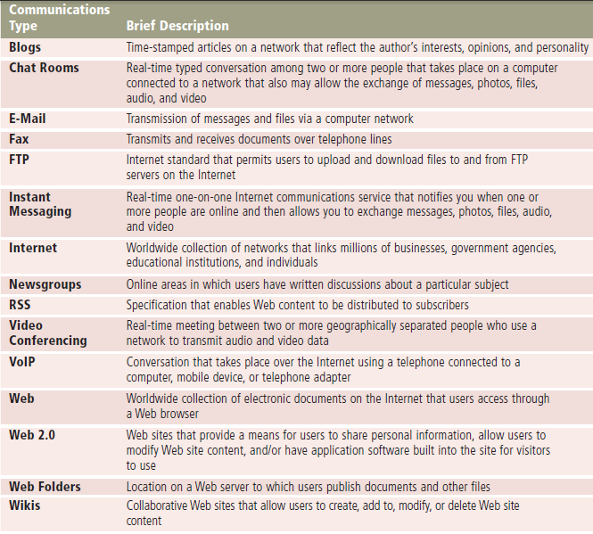

Slide 9
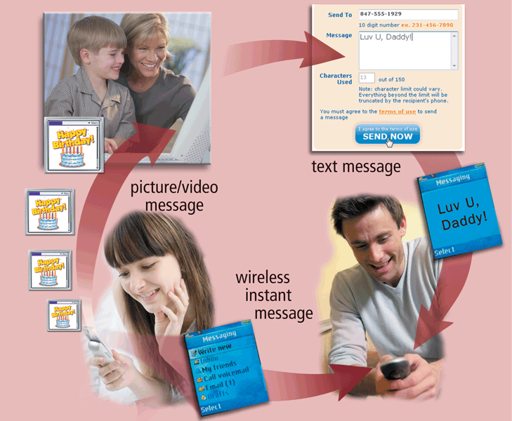
Uses of Computer Communications
Wireless Messaging Services :Users can send and receive wireless messages using wireless messaging services
Pages 462 – 463
Figure 9-3

Slide 10
Uses of Computer Communications
What are wireless messaging services?
Text messaging (SMS) allows users to send and receive short text messages on a phone or other mobile device or computer
Picture messaging allows users to send pictures and sound files
Video messaging allows users to send short video clips
Wireless instant messaging allows wireless users to exchange real-time messages with one or more other users
Pages 463 - 464

Slide 11
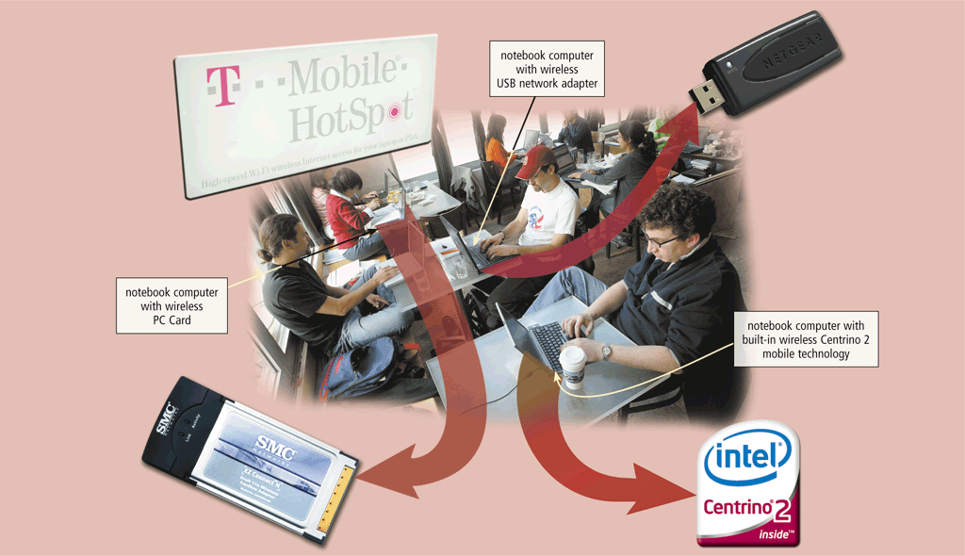
Uses of Computer Communications
Wireless Internet access points allow people to connect wirelessly to the Internet from home, work, school, and in many public locations
Pages 464 – 465
Figure 9-4

Slide 12
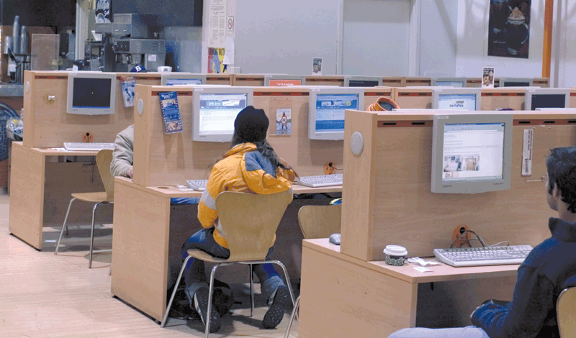
Uses of Computer Communications
A cybercafé is a coffeehouse, restaurant, or other location that provides personal computers with Internet access to its customers
Page 466
Figure 9-5

Slide 13
Uses of Computer Communications
A global positioning system (GPS) is a navigation system that consists of one or more earth-based receivers that accept and analyze signals sent by satellites in order to determine the GPS receiver’s geographic location
GPS receivers are:
Built into many mobile devices
Available as a handheld device
Available with new vehicles
Page 466

Slide 14
Uses of Computer Communications
Groupware
Helps groups of people work together on projects and share information over a network
Component of workgroup computing
Major feature is group scheduling
Voice mail
Allows someone to leave a voice message for one or more people
Computer in voice mail system converts an analog voice message into digital form
A voice mailbox is a storage location on a hard disk in the voice mail system
Page 467

Slide 15
Uses of Computer Communications
Many programs provide a means to collaborate, or work online, with other users connected to a server
Collaboration software includes tools that enable users to share documents via online meetings and communicate with other connected users
Online meetings
Web conferences
Document management systems
Page 468

Slide 16
Uses of Computer Communications
Page 468
Figure 9-7

Slide 17
Uses of Computer Communications
Web services enable programmers to create applications that communicate with other remote computers over the Internet or on an internal business network
A mashup is a Web application that combines services from two or more sources
Page 469
Figure 9-8

Slide 18
Networks
A network is a collection of computers and devices connected together via communications devices and transmission media
Advantages of a network include:
Facilitating communications
Sharing hardware
Sharing data and information
Sharing software
Transferring funds
Pages 470 - 471

Slide 19
Networks
Page 470
Figure 9-9

Slide 20
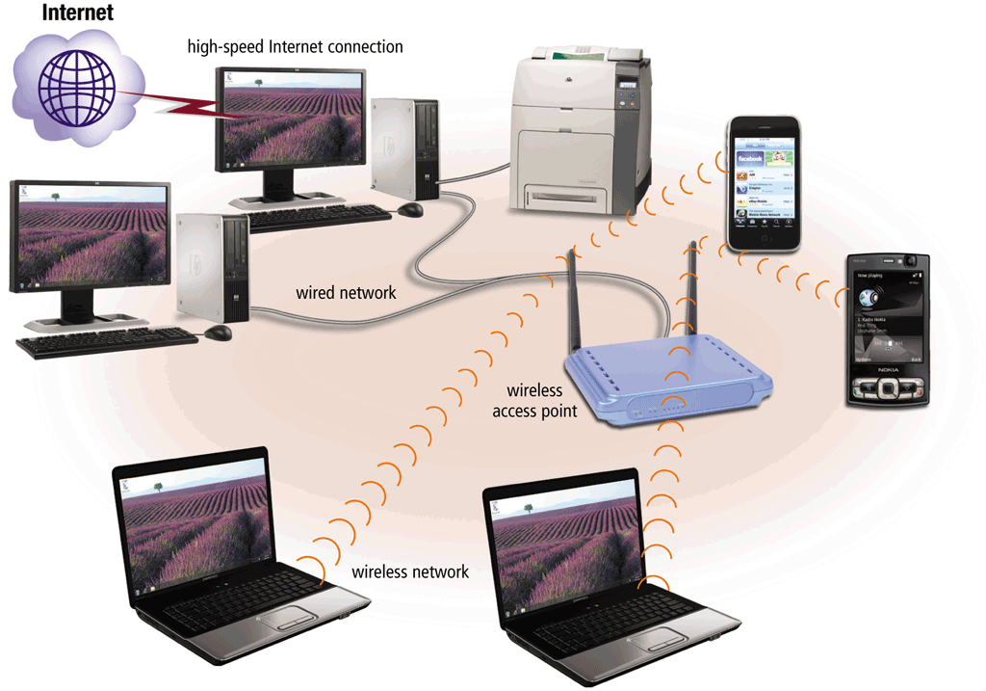
Networks
A local area network (LAN) is a network that connects computers and devices in a limited geographical area
A wireless LAN (WLAN) is a LAN that uses no physical wires
Page 472
Figures 9-10 – 9-11

Slide 21
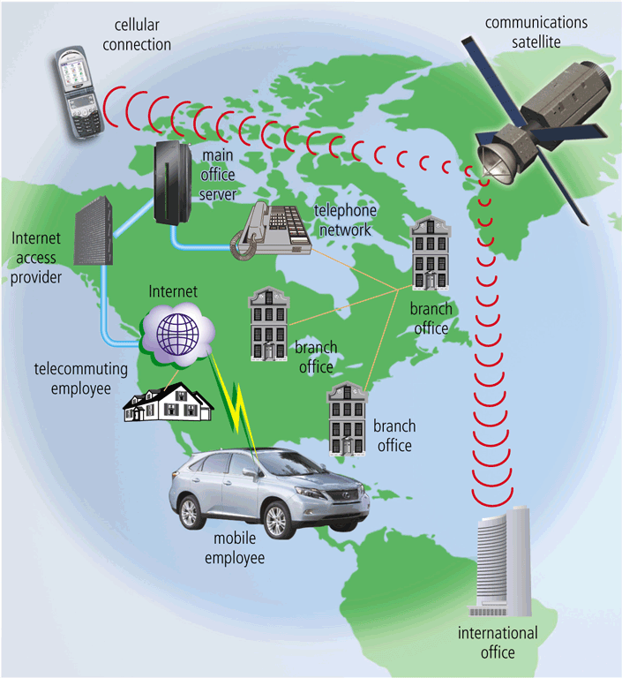
Networks
A metropolitan area network (MAN) connects LANs in a metropolitan area
A wide area network (WAN) is a network that covers a large geographical area
Page 473
Figure 9-12

Slide 22
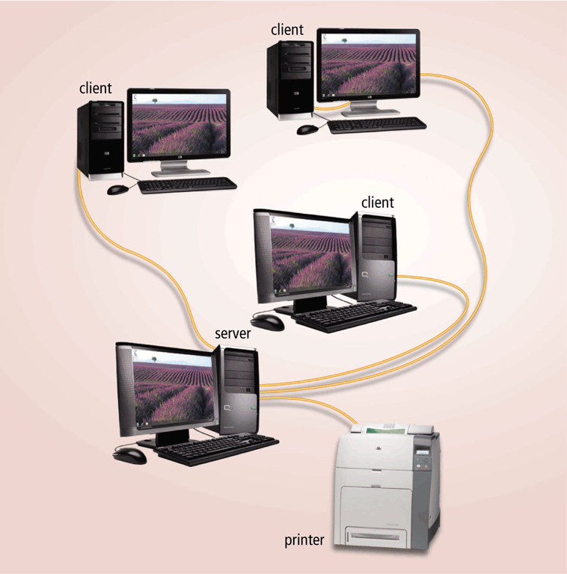
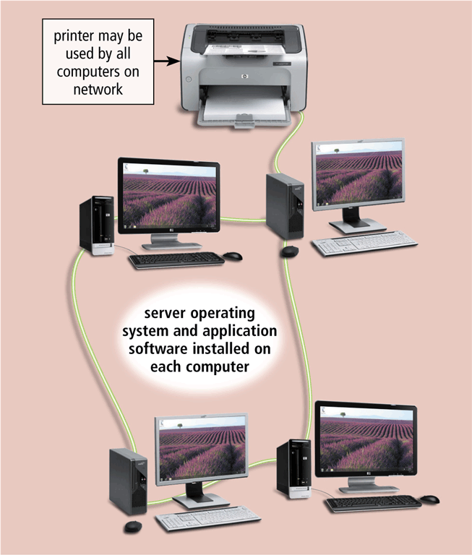
Networks
The design of computers, devices, and media on a network is sometimes called the network architecture
Client/server network
Peer-to-peer network
Pages 473 – 474
Figures 9-13 – 9-14

Slide 23
Networks
On a client/server network one or more computers act as a server, and the other computers on the network request services from the server.
peer-to-peer network is a simple, inexpensive network that typically connects fewer than 10 computers. Each computer, called a peer, has equal responsibilities and capabilities.

Slide 24
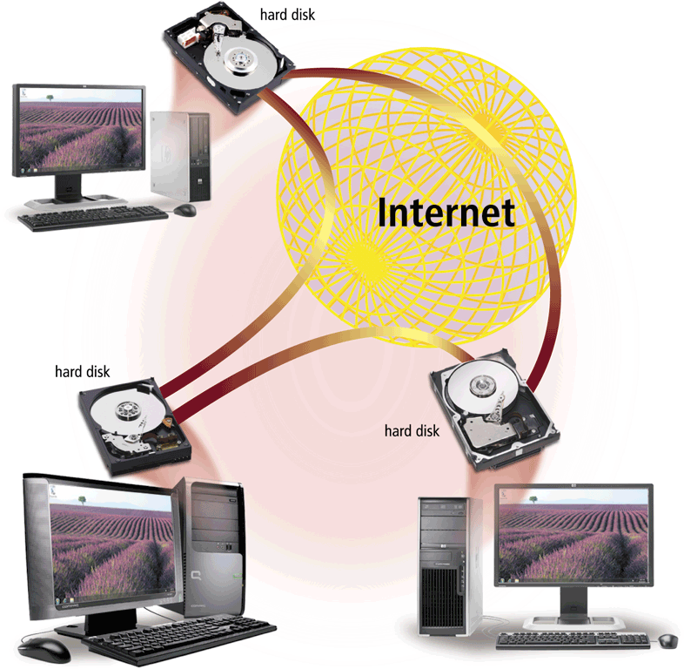
Networks
Internet Peer-to-Peer : another type of peer-to-peer, called P2P, describes an Internet network on which users access each other’s hard disks and exchange files directly over the Internet
Page 475
Figure 9-15

Slide 25
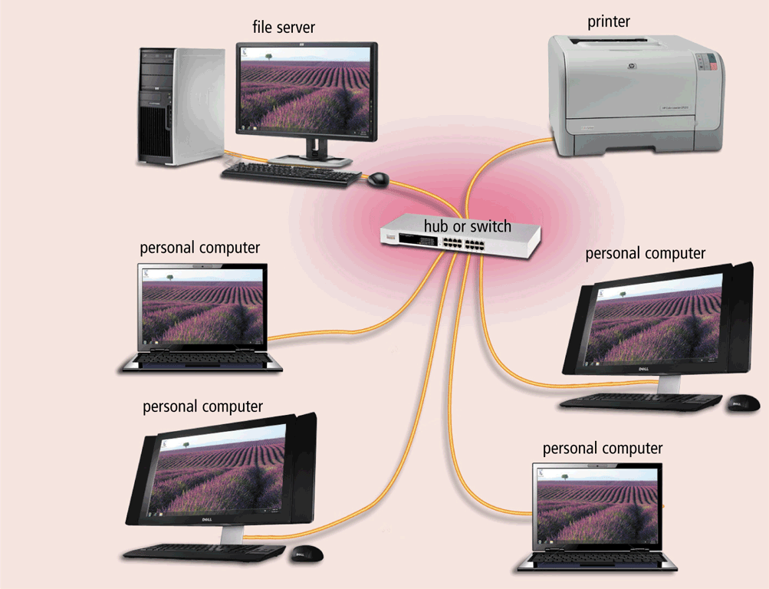
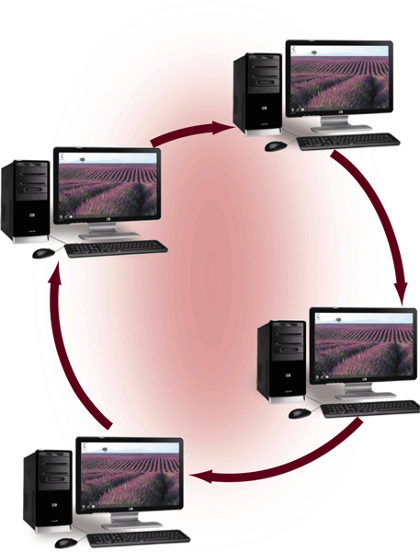
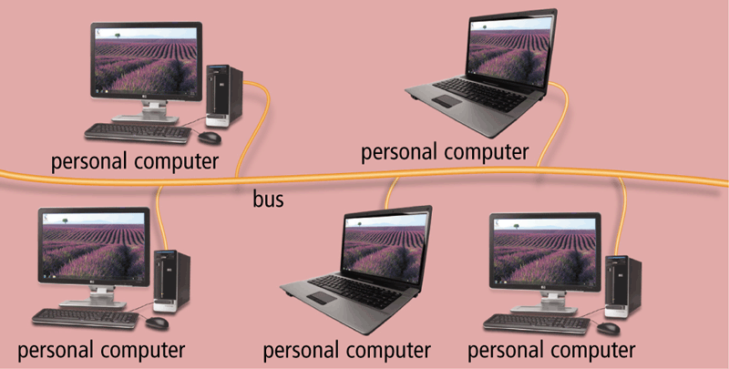
Networks
A network topology refers to the layout of the computers and devices in a communications network
Star network
Bus network
Ring network
Pages 475 – 477
Figures 9-16 – 9-18

Slide 26
Networks
Bus topology: All computers and devices connect to central cable or bus.
Star topology: All devices connect to a central device (hub or switch).
All data transferred from one computer to another passes through hub or switch.
Ring topology: Cable forms closed ring, or loop, with all computers and devices arranged along ring
Data travels from device to device around entire ring, in one direction

Slide 27
Networks
An intranet is an internal network that uses Internet technologies
An extranet allows customers or suppliers to access part of its intranet
Page 477

