Slide 1
DBMS
Lec-1: Advanced relational data modeling
By: Boshra AlQureashi
Notes:
Introduce ER model and how to model data requirements of a database using ER model

Slide 2
What is a database?
A database represents some aspect of the real world, i.e. a mini world.
A database consists of a logical coherent collection of data with an underlying meaning.
A database is designed, built and filled with data with respect to an underlying purpose.

Slide 3
Basic Definitions
Database:
  A collection of related data.
Data:
  Known facts that can be recorded and have an implicit meaning.
Mini-world:
  Some part of the real world about which data is stored in a database. For example, student grades and transcripts at a university.
Database Management System (DBMS):
  A software package/ system to facilitate the creation and maintenance of a computerized database.
Database System:
  The DBMS software together with the data itself. Sometimes, the applications are also included.

Slide 4
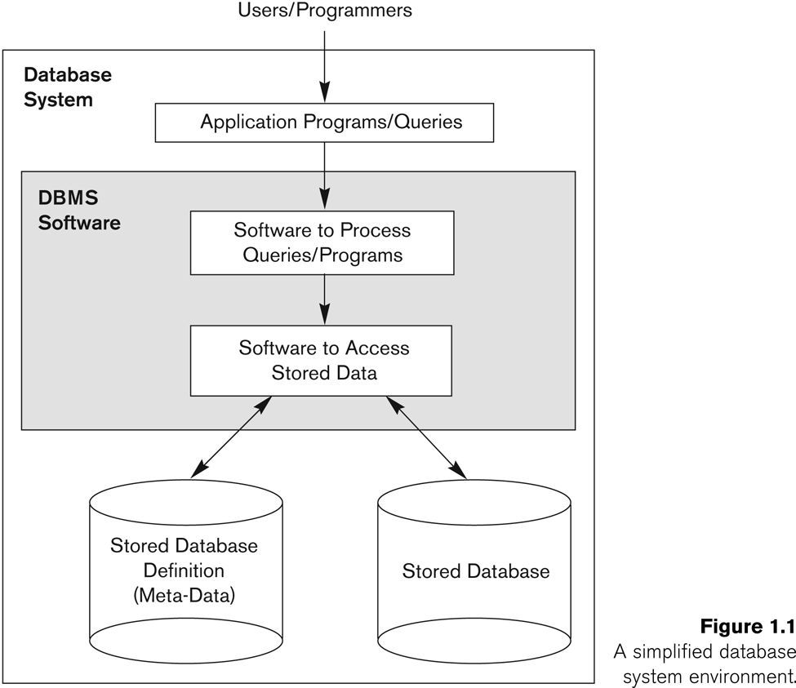
Database System Environment

Slide 5
Typical DBMS Functionality
Define a particular database in terms of its data types, structures, and constraints
Construct or load the initial database contents on a secondary storage medium
Manipulate the database:
  Retrieval: Querying, generating reports
  Modification: Insertions, deletions and updates to its content
  Accessing the database through Web applications
Process and share by a set of concurrent users and application programs – yet, keeping all data valid and consistent

Slide 6
Example of a Database
Mini-world for the example:
  Part of a UNIVERSITY environment.
Some mini-world entities:
  STUDENTs
  COURSEs
  SECTIONs (of COURSEs)
  (academic) DEPARTMENTs
  INSTRUCTORs
Some mini-world relationships:
  SECTIONs are of specific COURSEs
  STUDENTs take SECTIONs
  COURSEs have prerequisite COURSEs
  INSTRUCTORs teach SECTIONs
  COURSEs are offered by DEPARTMENTs
  STUDENTs major in DEPARTMENTs

Slide 7
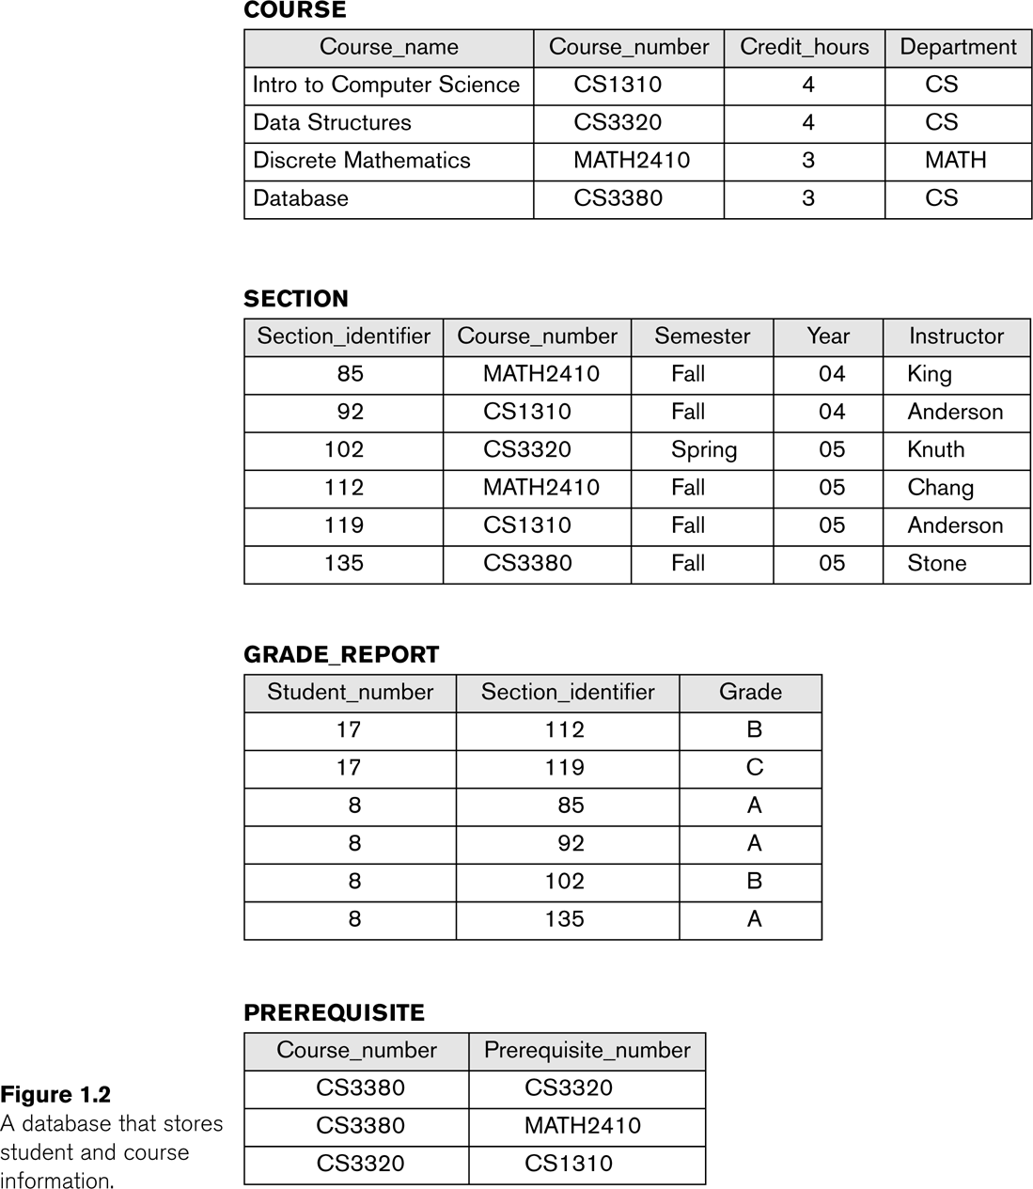

Slide 8
Main Characteristics of the Database Approach
Self-describing nature of a database system:
  A DBMS catalog stores the description of a particular database (e.g. data structures, types, and constraints)
  The description is called meta-data.
  This allows the DBMS software to work with different database applications.
Insulation between programs and data:
  Called program-data independence.
  Allows changing data structures and storage organization without having to change the DBMS access programs.
Data Abstraction:
  A data model is used to hide storage details and present the users with a conceptual view of the database.
  Programs refer to the data model constructs rather than data storage details
Support of multiple views of the data:
  Each user may see a different view of the database, which describes only the data of interest to that user.

Slide 9
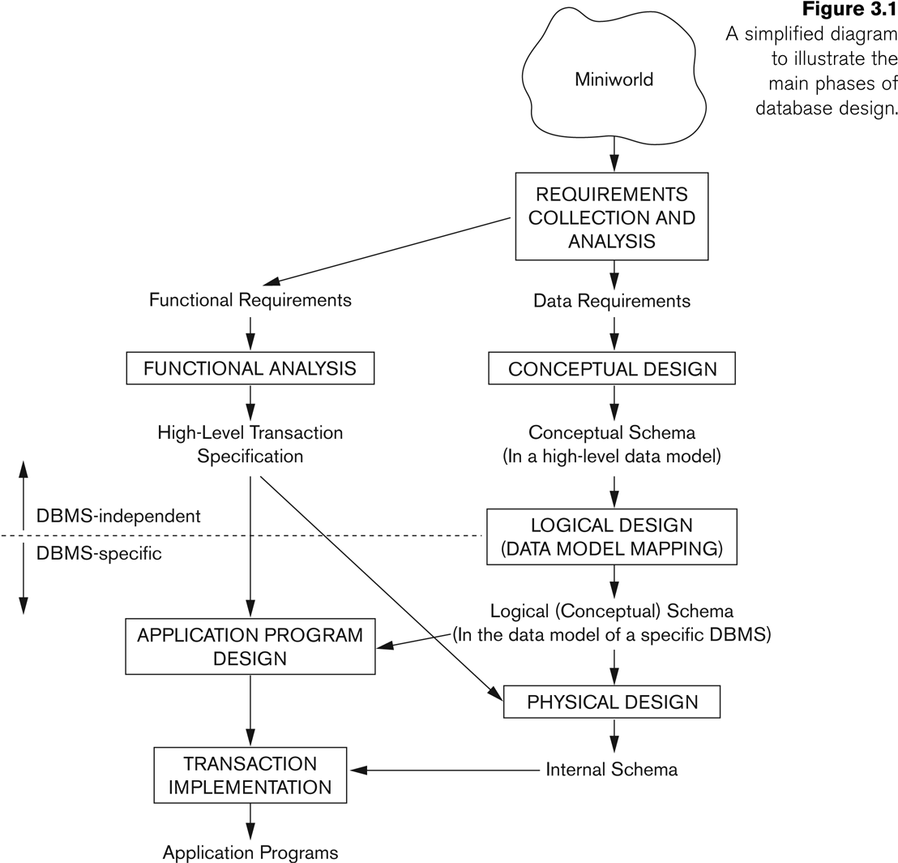
Database Design Process

Slide 10
Overview
Real world
Query
Answer
Model
Database
Processing of
queries and updates
DBMS
Access to stored data
Physical
database
Notes:
Now imagine that you and your group get a task. It is to design and implement a database application for company. What you need to do in the first?
When we design a database, the first step is to collect and analyze user’s requirements. We interview the database users to understand and document their data requirments. Like what are the data must be included in the database, data types, relationships between data, and constraints must be hold for data, and functions they need in the database application.
We describe the requirments using A high-level conceptual data model.
Then in the next step of the database design, this high-level conceptual data model is transformed into implementation data model supported by DBMS, like relational model we introduced in the last lecture.
The data model is in high level model. We do not need consider any implementation and storage details. With high level model, it is much easier to communicate with users, since usually they do not have technology backgroud. And also database designer can concentrate on the data requirments.

Slide 11
Entity-Relationship (ER) Model
High-level conceptual data model
  An overview of the database
  Easy to discuss with non-database experts
  Easy to translate to data model of DBMS
Notes:
In this lecture we introduce a popular high-level conceptual data model, ER model, and their use in modelling
The data model describes data requirements of a database on conceptual level, does not includes implementation details.
It is easy to discuss with non-database experts using the model
It is easy to translate it to data model of DBMS
There are graphical notation associates with the ER model.
A model can be displayed by a ER diagram.
-------------------------------------------------------------------------------------
Model defines concepts that can be used to define a particular domain
ER model: data structuring concepts and constraints.
Conceptual design of database applications.
Graphical model

Slide 12
Entity and entity type
Entity – a ”thing” in the real world with an independent existence
Attributes – properties that describes an entity
Entity type – a collection of entities that have the same set of attributes
Model
RegNumber
Year
PersonalNumber
Name
Car
Owner
Notes:
ER model describes data as entities, relationships and attributes.
An entity represents a particular ”thing” in the real world. e.g. a particular car.
An each entity has attributes. The attributes describe an entity. E.g. a car can be decribed by its model, year and registration number.
Entity type – a collection of entities that have the same set of attributes. E.g. car. It is described by its names and attributes.
In ER diagram, Entity types are shown in rectangular boxes.
Attributes are shown in a ovals. An attribute is attached to its entity type by a straight line.
e.g. the entity type car. A collection of cars have three attributes.

Slide 13
Attributes
Simple vs composite
Single-valued vs multivalued
Stored vs derived
Street
City
Name
Address
PersonalNumber
Owner
PhoneNumber
Age
Notes:
In ER model there are different types of attributes .
Composite attributes can be divided into smaller subparts (attributes with independent meaning). E.g. address, divided into street and city.
Simple attributes can not be divided into smaller subparts.
A single-valued attribute has a single value for an entity.
Multivalued – attributes can have a number of values for an entity. E.g. A person may have several phonenumbers.
Derived – The value of a derived attribute can be derived from other attributes or related entities. Otherwise a attribute is a stored attribute. E.g. Age can be derived from the current date and the value of that person’s birthday.

Slide 14
Constraints on attributes
Value sets (domains) of attributes
Key attributes
Street
City
Name
Address
PersonalNumber
Owner
PhoneNumber
Age
Notes:
A database appllication has constraints on values of attributes
They are specified by domains. A domain is specified by data type, such as real number, string and so on.
For each entity type, there must be a set of attributes can be used to identify each entity uniquely. Such set of attributes is called a key of the entity type. E.g. the attribute ”personalNumber” can be a key of the entity type ”OWNER”. The value of a key is unique for each entity. So it can be used to uniquely identify entites.
In ER diagram, each key attribute has its name underlined.
Notice: The set of attributes in a key is minimal. It means that we can not remove any attribute from a key and still have the uniqueness condition hold.

Slide 15
Relationship type
Relationship type – association among entity types
Model
RegNumber
PersonalNumber
Name
Year
1
owns
N
Owner
Car
Notes:
There are relationships between entity types. E.g. Owner owns car.
Relationships are shown in diamonsds. Connected to entity types by straight lines.

Slide 16
Constraints on relationship types
Cardinality ratio – maximum number of relationship instances that an entity can participate in
  possible cardinality ratio: 1:1, 1: N, N:1, N:M
1
owns
N
Owner
Car
N
owns
1
Owner
Car
N
owns
M
Owner
Car
Notes:
A database application has constraints on relationship types.
Relationship types have certains constraints, (that limit the possible combinations of entities that may participate in relationships.)
Cardinality ratio specifies maximum number of …
The relationship type has candinality ratio 1:N, meaning that an owner can be related to many cars. So a owner can owns any number of car, but a car can only be related to one owner.
Owner, car is of cardinality ratio N:M, meaning that each owner can owns any number of car, and a car can be related to any number of owner.
In ER diagram, cardinality ratio is displayed by the number.

Slide 17
Constraints on relationship types
Participant constraint
  Total participation – an entity must exist related to another entity
”Every car must be owned by at least one owner.”
PersonalNumber
RegNumber
N
owns
M
Owner
Car
Notes:
Users may have a requirment that Every car must be owned by at least one owner.
So each car must exist related to an owner in the database..
So all cars in the database participant in the relationship ”owns”. It is called total participant.
It is showen by double straight line in ER diagram.
Total participation is also called existence dependency.
If a car does not have to have an owner, the participation of ”car” is partial participation.
---------------------------------------------------------------------------------------
total participation: ett projekt måste kontrolleras av ett department. det får inte finnas projekt som inte kontrolleras av ett department
svag identitet: En relative får inte finnas utan att det finns en identifierande anställd.
svag relationship: visar det identifierande relationship för den svaga entiteten. Kan inte finnas N:M förhållande här eftersom varje svag entitet måste identifieras av precis en (stark) entitet.

Slide 18
Constraints on relationship types
Weak entity types– do not have key attibutes of their own.
A weak entity can be identified uniquely by being related to another entity (together with its own attributes).
name
Name
number
1
Plays_on
N
team
players
Notes:
There are a kind of entities they do not have key attribute of their own.
A weak entity must be identified by entity it is related to, probably together with its own attributes
Football player example.
name is almost a key for football players, but there might be two with the same name.
number is certainly not a key, since players on two teams could have the same number.
But number, together with the team name related to the player by Plays-on should be unique.
&&&The reason we need weak entity here is that it is unlikely that there could be an agreement to assign unique player numbers across all football teams.
In one team, the number of a player can be used to identify the player. The number is partial key for the weak entity.
In ER diagram, a weak entity type is shown in a double rectangular box. The relationship type relates a weak entity type to its owner is called the identifying relationship of the weak entity type. It is shown as a double diamond. Partial key is underlined with a dotted line.
??? Candinality ratio of the identifying relationship type only can be 1:N or 1:1.
??? N:1, N:M, a weak entity is identified by two owner entities. They are not the same entity, two different entities.
----------------------------------
Existance vs identification; cardinality differences
total participation: ett projekt måste kontrolleras av ett department. det får inte finnas projekt som inte kontrolleras av ett department
svag identitet: En relative får inte finnas utan att det finns en identifierande anställd.
svag relationship: visar det identifierande relationship för den svaga entiteten. Kan inte finnas N:M förhållande här eftersom varje svag entitet måste identifieras av precis en (stark) entitet.

Slide 19
Attributes of relationship types
”Store information on who owned which car and during which period of time”
SellDate
Model
Name
RegNumber
BuyDate
Year
PersonalNumber
N
owns
M
Owner
Car
Notes:
Sometimes it is useful to attach an attribute to a relationship.
?For 1:N relationship type, a relationship attribute can be migrated only to the entity type on the N-side of the relationhship.

Slide 20
N-ary relationships
Example. A person works as an engineer at one company and as a gym instructor at another company.
Company
Employee
JobType
N
N
M
works at
works as
M
Ternary
Employee
K
N
works as
Company
M
JobType
Notes:
Example. with the first model, we only can model (e1, c1), (e1, c2) and (e1, j1), (e1, j2). We lose information.
to model (e1, c1, j1) and (e2, c2, j2),
Then we need N-ary relationships. More than two entity types can participant in a relationship type.
Go back to the previous slide. The attributes of the relationship type → entity type participant the relationship type.

Slide 21
ER Notation
Symbol
Meaning
ENTITY TYPE
WEAK ENTITY TYPE
RELATIONSHIP TYPE
IDENTIFYING RELATIONSHIP TYPE
ATTRIBUTE
KEY ATTRIBUTE
MULTIVALUED ATTRIBUTE
COMPOSITE ATTRIBUTE
DERIVED ATTRIBUTE
TOTAL PARTICIPATION OF E₂ IN R
CARDINALITY RATIO 1:N FOR E₁:E₂ IN R
E₁
R
E₂
E₁
1
R
N
E₂
Notes:
Weak entity, relationship type connet to weak entity.
Key attribute
Total participant.
Cardinality ratio.
How to read the relationship. Proper naming is important.
Not everything is displayed on an ER diagram.
Domain of attribute, foriegn keys are not displayed in an ER diagram.

Slide 22
Enhanced ER (EER) Model
Why more?
  More complex data requirements
  Example. Only some employees can use a company car, only managers have to write a monthly report, but all employees have assigned personal number, salary account and a place in the office.
Notes:
ER model is enough for representing many database schema. But some applications have more complex requirements.
For example, we have such data requirement …
ER model is not able to model these requirments.
In this part we introduce the enhanced ER model. EER model includes all the modeling concepts of the ER model.
In addition, it includes semantic data modeling concepts:
Subclass/superclass, and the related concepts of Specialization/generalization
Category/union type is used to represent a collection of objects that is the union of objects of different entity types.
Associated with these concepts is the important mechanism of Attribute and relationship inheritance.

Slide 23
Cont.
EER model includes all modeling concepts of the ER model
In addition, EER includes:
  Subclasses and superclasses
  Specialization and generalization
  Category or union type
  Attribute and relationship inheritance

Slide 24
Cont.
Enhanced ER or EER diagrams
  Diagrammatic technique for displaying these concepts in an EER schema
Subtype or subclass of an entity type
  Subgroupings of entities that are meaningful
  Represented explicitly because of their significance to the database application

Slide 25
Cont.
Terms for relationship between a superclass and any one of its subclasses
  Superclass/subclass
  Supertype/subtype
  Class/subclass relationship
Type inheritance
  Subclass entity inherits all attributes and relationships of superclass

Slide 26
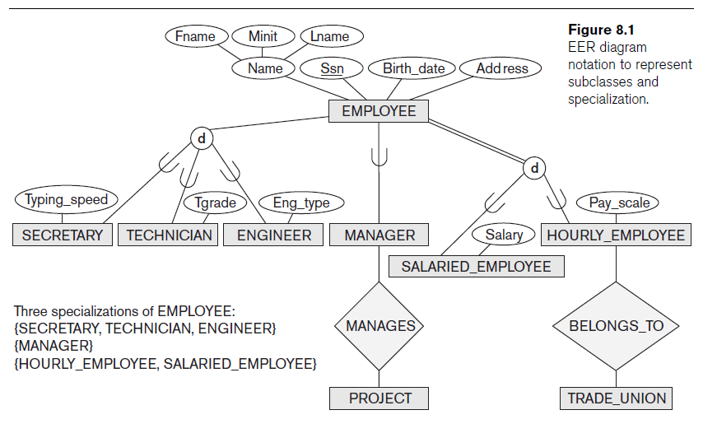

Slide 27
Subclasses and Superclasses
An entity type may have additional meaningful subgroupings of its entities
Example: EMPLOYEE may be further grouped into SECRETARY, ENGINEER, MANAGER, TECHNICIAN, SALARIED_EMPLOYEE, HOURLY_EMPLOYEE,…
  Each of these groupings is a subset of EMPLOYEE entities
  Each is called a subclass of EMPLOYEE
  EMPLOYEE is the superclass for each of these subclasses
These are called superclass/subclass relationships.
Example: EMPLOYEE/SECRETARY, EMPLOYEE/TECHNICIAN

Slide 28
Subclasses and Superclasses
These are also called IS-A relationships (SECRETARY IS-A EMPLOYEE, TECHNICIAN IS-A EMPLOYEE, …).
Note: An entity that is member of a subclass represents the same real-world entity as some member of the superclass
  The Subclass member is the same entity in a distinct specific role
  An entity cannot exist in the database merely by being a member of a subclass; it must also be a member of the superclass
  A member of the superclass can be optionally included as a member of any number of its subclasses
Example: A salaried employee who is also an engineer belongs to the two subclasses ENGINEER and SALARIED_EMPLOYEE
  It is not necessary that every entity in a superclass be a member of some subclass

Slide 29
Attribute Inheritance in Superclass / Subclass Relationships
An entity that is member of a subclass inherits all attributes of the entity as a member of the superclass
It also inherits all relationships

Slide 30
Subclass/Superclass
specialization
Surname
generalization
FirstName
PN
Name
Employee
process of
defining
classes
d
o
Commission
U
U
U
U
Salesman
Engineer
Manager
ProjectLeader
1
1
uses
writes
1
N
Car
MonthlyReport
RegNumber
ReportID
Notes:
In the database application an entity type may have different subgroupings of its entities that are meaningful and need to be represented explicitly.
E.g. EMPLOYEE entity type is grouped further into salesman, engineer, manager and project leader.
Each of these subgrouping is called subclass of EMPLOYEE entity type. EMPLOYEE entity type is called the superclass for each of these subclass.
Subclass inherits all the attributes of the entity of the superclasses, and also inherits all the relationships in which the superclass participates.
(Every entity of these subclasses) All salesman, engineers, managers and project leaders are also employees. They have PN and name.
Entities in each subclasses have their own specific properties.
Subclass may have specific attributes. They only can be applied to entities of the subclass, e.g. Only salesmans have commision. Subclass may participant specific relationship type. E.g. Salesman participants in the use relationship type.
An entity can not exist in the database only by being a member of subclass. It must be also be a member of the superclass.
Subclasses are attached by lines to a circle. The circle represents the specialization, which is connected to the superclass.
Subset symbol is from A < B. on each line indicates the direction of the super/subclass
D, specifies that the subclasses must be disjoint. That means that an entity can be a member of at most one of the subclass. E.g. An employee can be either salesman or engineer.
O specifies that the subclasses must be overlap. E.g. an employee can be both manger and project leader.
Total specialization: an entity in the superclass must be a member of at least one sublcass. Total specialization is connected to the superclass by a double line. Assume that all employees must be either engineers or sales people,
______________________________________________________
Specialization is a process of defining subclasses of an entity type:
Specialization is based on some distinguishing characteristics of superclass. e.g. The set of subclasses {salesman, engineer} is a specialization of EMPLOYEE based on the job type of each employee.
We can have several specializations of the same entity type. E.g. Antoher specilization of EMPLOYEE is based on the type of leadership.
Generalization is a reverse process of specialization– process of identifying common features among several entity types. Generalize them into a sigle superclass
Confronted with a database containing data about engineers, sales people, managers and project leaders, there are common features of these four entity types. They all are an employee of the company, have attributes, PN, name, and so on.

Slide 31
Single vs. Multiple inheritance
Surname
FirstName
PN
Name
Employee
d
o
U
U
U
U
Commission
Salesman
Engineer
Manager
ProjectLeader
U
U
Software
ProjectLeader
N
1
PID
SoftwareProject
manages
Notes:
These subclasses inherit attributes and relationships from one entity type.
There a kind of subclass inherits attributes and relationships from more than one entity types.
SoftwareProjectLeader inherits attributes and relationships from two superclasses ”Engineer” and ”ProjectLeader”.
only project leaders that are engineers are allowed to lead software projects.
Such a subclass is called shared subclass. So a shared subclass inherits attributes and relationships from multiple superclasses.

Slide 32
Specialization
Is the process of defining a set of subclasses of a superclass
The set of subclasses is based upon some distinguishing characteristics of the entities in the superclass
Example: {SECRETARY, ENGINEER, TECHNICIAN} is a specialization of EMPLOYEE based upon job type.
  May have several specializations of the same superclass
Example: Another specialization of EMPLOYEE based in method of pay is {SALARIED_EMPLOYEE, HOURLY_EMPLOYEE}.
  Superclass/subclass relationships and specialization can be diagrammatically represented in EER diagrams
  Attributes of a subclass are called specific attributes. For example, TypingSpeed of SECRETARY
  The subclass can participate in specific relationship types. For example, BELONGS_TO of HOURLY_EMPLOYEE

Slide 33
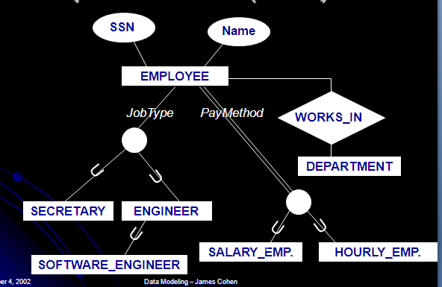

Slide 34
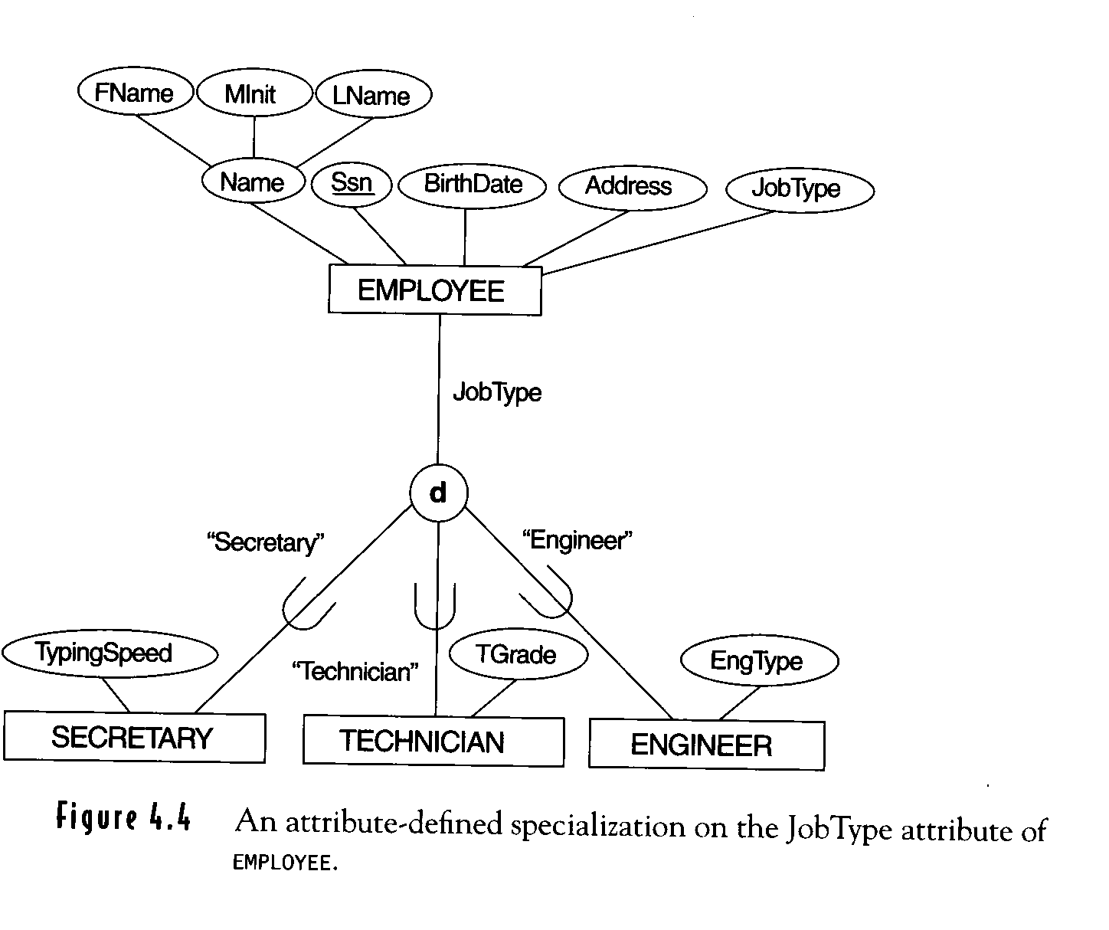

Slide 35
Model Shapes
When you have more than one subclass based on the same defining attribute (JobType), use
To show class/subclass relationships, use
  Used for relationships between entity types
To show relationship between two different entity types, use
U

Slide 36
Generalization
The reverse of the specialization process
Generalize into a single superclass ; original classes become its subclasses
Example: CAR, TRUCK generalized into VEHICLE; both CAR, TRUCK become subclasses of the superclass VEHICLE.
  We can view {CAR, TRUCK} as a specialization of VEHICLE
  Alternatively, we can view VEHICLE as a generalization of CAR and TRUCK

Slide 37
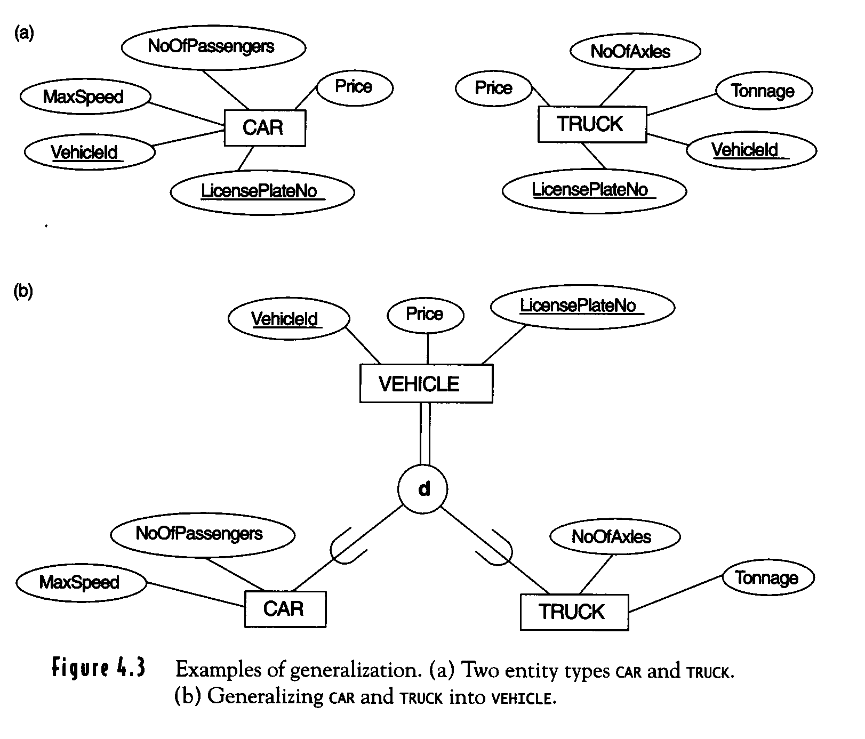

Slide 38
Constraints of Specialization and Generalization
Constraints that apply to a single specialization or a single generalization
Differences between specialization/
generalization lattices and hierarchies

Slide 39
Cont.
May be several or one subclass
Determine entity subtype:
  Predicate-defined (or condition-defined) subclasses
  Attribute-defined specialization
  User-defined

Slide 40
(cont.)
Disjointness constraint
  Specifies that the subclasses of the specialization must be disjointed (an entity can be a member of at most one of the subclasses of the specialization)
  Specified by d in EER diagram
  If not disjointed, overlap; that is the same entity may be a member of more than one subclass of the specialization
Completeness constraint
  May be total or partial
  Total specifies that every entity in the superclass must be a member of some subclass in the specialization/ generalization
  Shown in EER diagrams by a double line
  Partial allows an entity not to belong to any of the subclasses
  Shown in EER diagrams by a single line
  Note: Generalization usually is total because the superclass is derived from the subclasses.

Slide 41
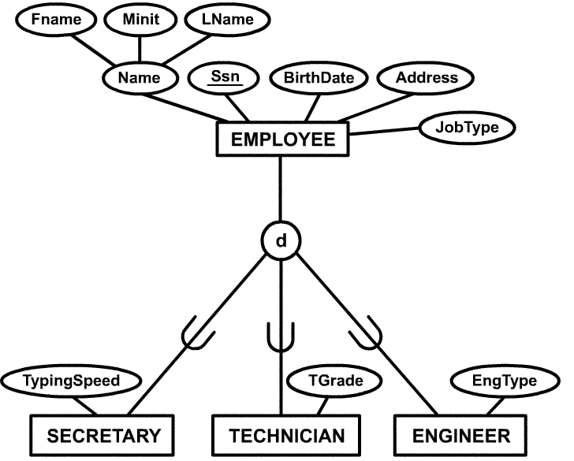
Example of disjoint partial Specialization

Slide 42
Specialization / Generalization Hierarchies, Lattices and Shared Subclasses
A subclass may itself have further subclasses specified on it
Forms a hierarchy or a lattice
Hierarchy has a constraint that every subclass has only one superclass (called single inheritance)
In a lattice, a subclass can be subclass of more than one superclass (called multiple inheritance)
In a lattice or hierarchy, a subclass inherits attributes not only of its direct superclass, but also of all its predecessor superclasses
A subclass with more than one superclass is called a shared subclass
Can have specialization hierarchies or lattices, or generalization hierarchies or lattices
In specialization, start with an entity type and then define subclasses of the entity type by successive specialization (top down conceptual refinement process)
In generalization, start with many entity types and generalize those that have common properties (bottom up conceptual synthesis process)
In practice, the combination of two processes is employed

Slide 43
Hierarchies and Lattices
Hierarchy – subclass participates in one class/subclass relationship
EMPLOYEE
SOFTWARE ENGINEER has all the attributes of an ENGINEER and EMPLOYEE
U
U
SECRETARY
ENGINEER
U
SOFTWARE ENGINEER

Slide 44
Hierarchies and Lattices
Lattice – subclass participates in more than one class/subclass relationship
ENGINEERING MANAGER (shared subclass) is a MANGER and an ENGINEER
EMPLOYEE
U
U
U
SECRETARY
ENGINEER
MANAGER
U
U
ENGINEERING MANAGER

Slide 45
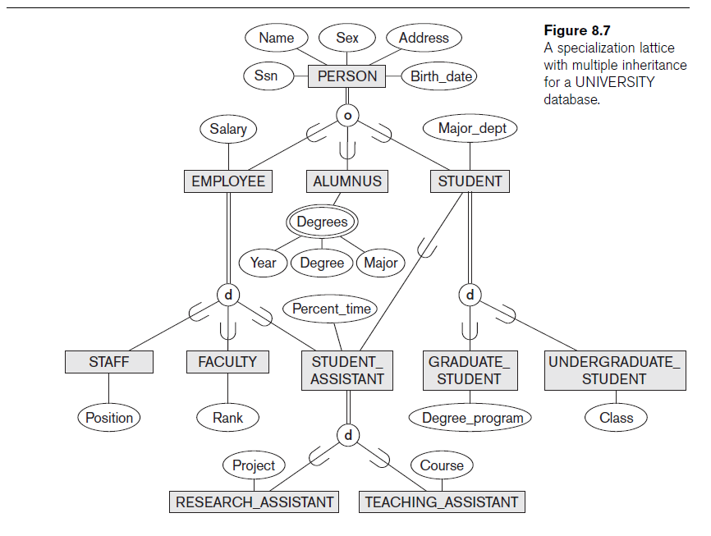

Slide 46
A Sample UNIVERSITY EER Schema, Design Choices, and Formal Definitions
The UNIVERSITY Database Example
  UNIVERSITY database
    Students and their majors
    Transcripts, and registration
    University’s course offerings

Slide 47
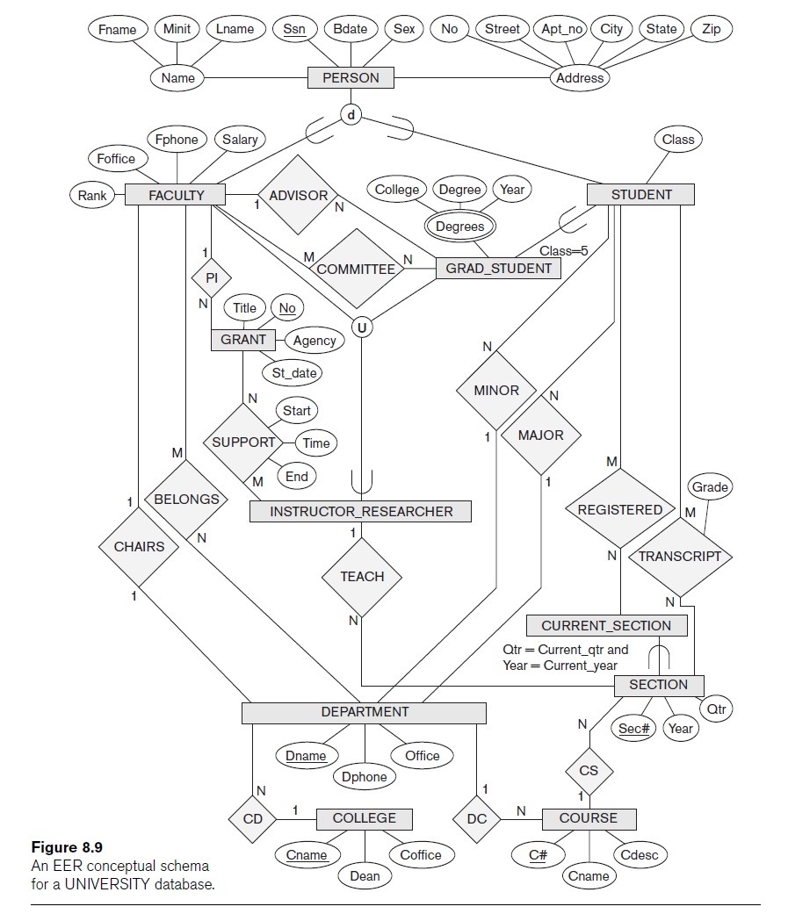

Slide 48
Example: A taxi company needs to model their activities
There are two types of employees in the company: drivers and operators. For drivers it is interesting to know the date of issue and type of the driving license, and the date of issue of the taxi driver’s certificate. For all employees it is interesting to know their personal number, address and the available phone numbers.
The company owns a number of cars. For each car there is a need to know its type, year of manufacturing, number of places in the car and date of the last service.
The company wants to have a record of car trips (körningar). A taxi may be picked on a street or ordered though an operator who assigns the order to a certain driver and a car. Departure and destination addresses together with times should also be recorded.
Notes:
No need to model the central station. Core information – car runs together with all relevant information.

Slide 49
Street
Address
PN
Phone
PostNumber
Town
Employee
TaxiCertifDate
o
U
U
DrivingLicenseDate
DrivingLicenseDate
Driver
Operator
DrivingLicenseType
1
1
DrivingLicenseType
drives
assign
N
DepTime
N
Type
DeparturePlace
Trip
YearOfManuf
RegNumber
Destination
ServiceDate
DestTime
N
made_by
1
Car
Places
ID
Notes:
Tveksamt för att modellen inte visar att en förare kan ha många körkorts(typer).
Here we have an assumption that each driver only can have one driving license. With this model we can not model driver with more than one drive licenses.
Typical exam errors:
- Forget cardinalities, primary key attributes
- Wrong subclass notation (where goes the primary key?)
- No use of total participation or weak entities

Slide 50
TaxiCertifDate
A driver may have many
driving licenses (types)
DrivingLicenseDate
Driver
DrivingLicenseType
Date
Type
Id
TaxiCertifDate
N
belongsTo
1
Körkort
belongsTo
DrivingLicense
Driver
TaxiCertifDate
Type
DrivingLicense
N
belongsTo
M
Driver
Date
Notes:
2nd case. DL types are tight to the table definition. May not be convenient if the types have to be extended by the user.
3rd case. Allows the user to extend types.

Slide 51
Formal Definitions for the EER Model Concepts
Class
  Set or collection of entities
  Includes any of the EER schema constructs of group entities
Subclass
  Class whose entities must always be a subset of the entities in another class
Specialization
  Set of subclasses that have same superclass

Slide 52
Formal Definitions for the EER Model Concepts (cont’d.)
Generalization
  Generalized entity type or superclass
Predicate-defined
  Predicate on the attributes of is used to specify which entities in C are members of S
User-defined
  Subclass that is not defined by a predicate

Slide 53


