Slide 1
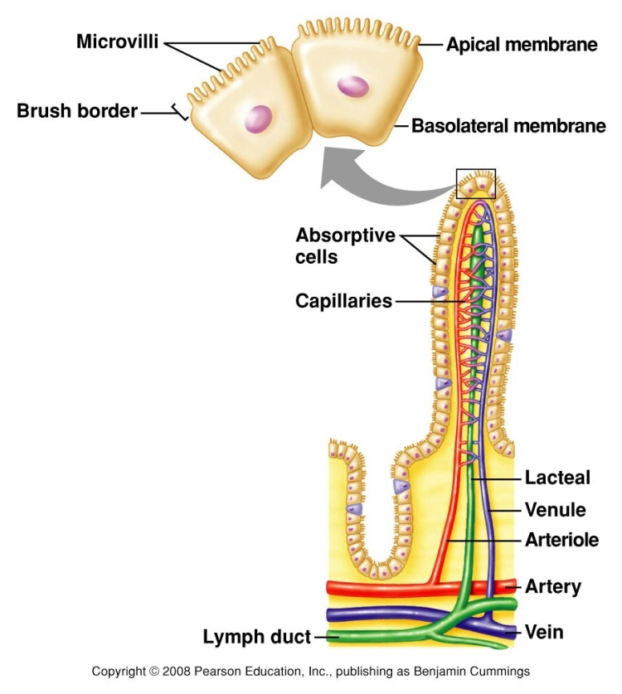
Absorption in the small intestine
• The most active region for both digestion and absorption is the small intestine
• The barrier through which materials must pass during absorption from the gut is formed by a single layer of epithelial cells on the surface of the villi, the finger-like projections.
• The area of the apical luminal surface of each epithelial cell is greatly increased by the presence of the brush-border.
• Below the villi in the mucosal membrane is a thick network of blood capillaries and small lymphatics.
• The basal side of the cell rests on a very thin basement membrane, which is close to the basement membrane of the underlying capillary.

Slide 2
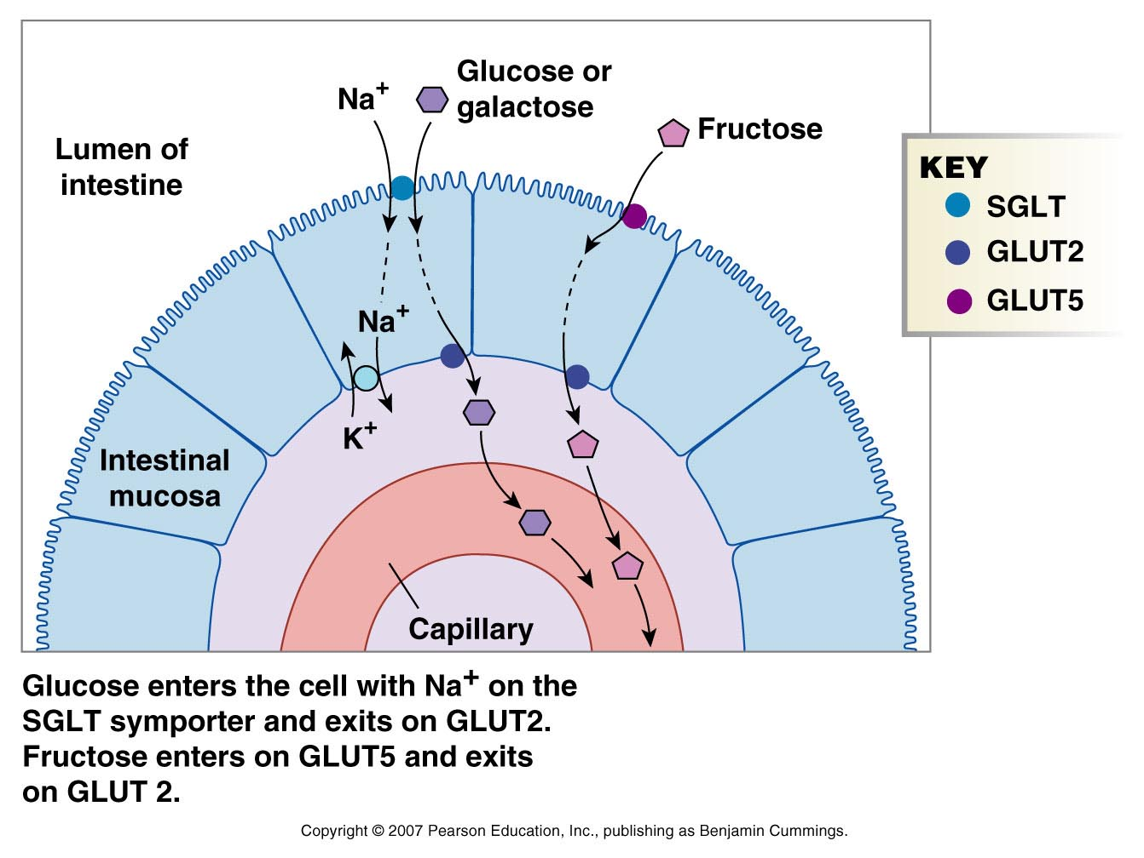
Absorption of carbohydrates in the small intestine
• Carbohydrate is absorbed as monosaccharides (mainly glucose, galactose and fructose-these) being formed from the disaccharides maltose, lactose and sucrose by enzymes on the brush-border of the intestinal villi.
• There is a specific carrier molecule for glucose and galactose; the affinity of glucose for this molecule is high, so this sugar is absorbed especially rapidly.
• One suggestion is that Na+ may modify the structure of the carrier to give it a greater affinity for glucose; then the complex (carrier, Na+ and glucose) moves in such a way that the Na+ and glucose are offloaded into the cytoplasm, and the carrier returns to the external cell surface and picks up another Na+ ion and another glucose molecule.

Slide 3
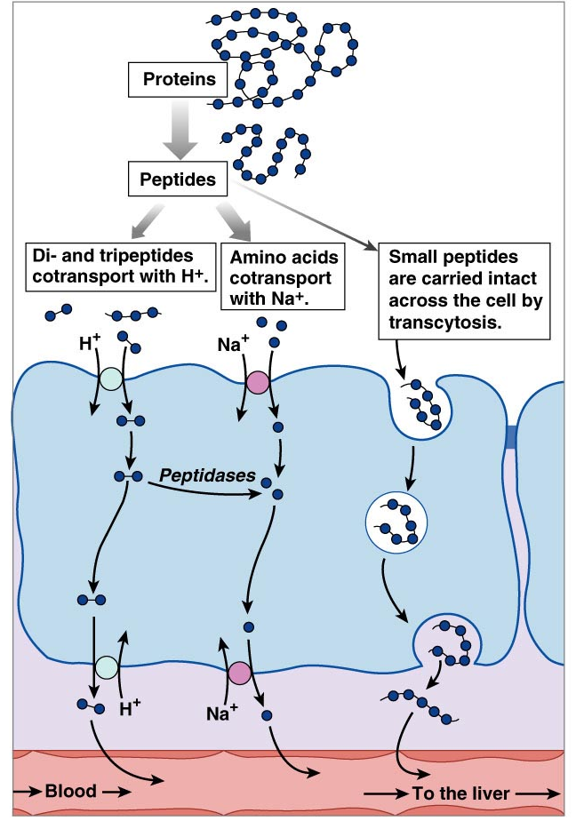
Absorption of peptides in the small intestine
• There are dipeptidases in the cells of the villi, so most of the luminal dipeptides are hydrolysed at the moment of absorption.
• There are four different carrier molecules:
One for the neutral amino acids
One for the basic amino acids
One for the dicarboxylic amino acids (glutamic and aspartic)
and the fourth for proline, hydroxyproline and glycine.
• The presence of the Na+ ion speeds the carrier-mediated movement of amino acids into the intestinal cell. The role of sodium here may be similar its role in glucose absorption.

Slide 4
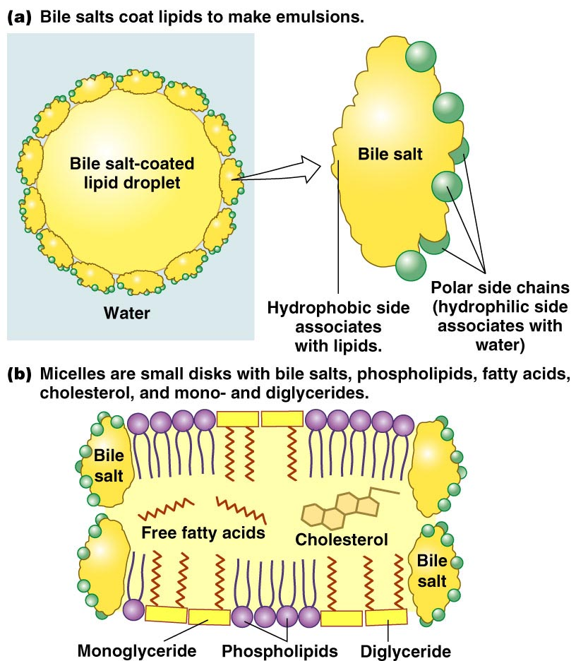
Absorption of fats in the small intestine
The role of bile salts in emulsions and micelles

Slide 5
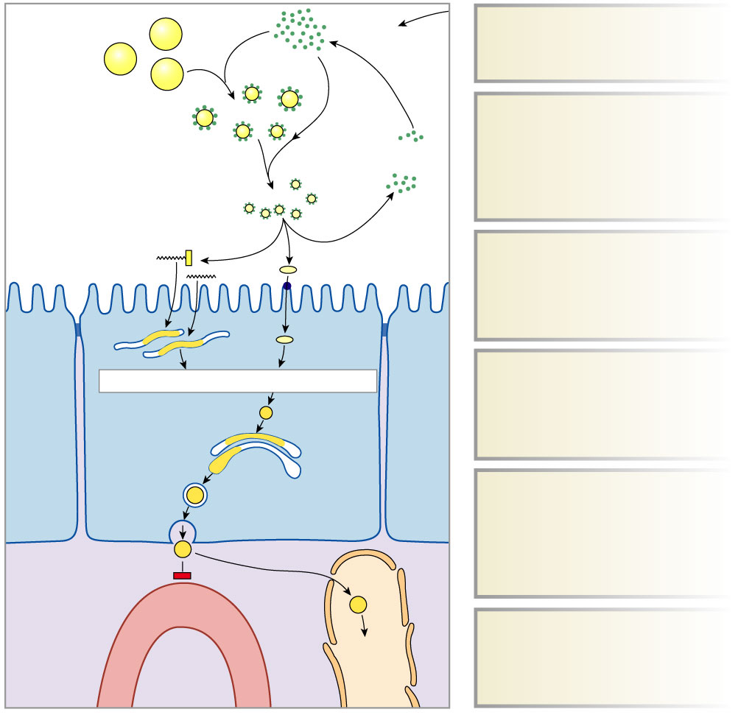
Absorption of fats in the small intestine
• Fat may be absorbed in the form of extremely small particles. These may be droplets of an emulsion of monoglyceride, free fatty acids and bile salts.
• If these particles are less than 5000 nm in diameter, they could pass down between the threads of the microvilli forming the brush-border, and enter by pinocytosis.
• Most fat absorption, however, involves the micelles.
Large fat droplets
from stomach
Bile salts
from liver
1
Bile salts from liver coat
fat droplets.
1
Emulsion
2
Pancreatic lipase and
colipase break down
fats into monoglycerides
and fatty acids stored
in micelles.
Lipase
and colipase
2
Bile salts
recycled
Lumen of
small intestine
Micelles
3a
3b
3a
Monoglycerides and
fatty acids move out of
micelles and enter cells
by diffusion.
Smooth
ER
4
Triglycerides + cholesterol + protein
3b
Cholesterol is
transported into cells
by a membrane
transporter.
Cells of
small
intestine
Chylomicron
Golgi
apparatus
4
Absorbed fats combine
with cholesterol
and proteins in the
intestinal cells to form
chylomicrons.
5
Interstitial
fluid
Capillary
Lacteal
Lymph
to
vena
cava
5
Chylomicrons are
released into the
lymphatic system.

Slide 6
Absorption in the small intestine
• Intestine absorbs vitamins and minerals
• Fat-soluble vitamins (A, D, E, K) absorbed with fats in small intestines
• Water-soluble vitamins (C, B vitamins) absorbed by mediated transport
• Minerals absorbed by active transport

Slide 7
Absorption of fats in the Jejunum-Ileum
• Nutrients will be reabsorbed along the jejunum-ileum
• Vitamin B₁₂ when complexed to intrinsic factor, secreted in the stomach, and absorbed in ileum.

