Slide 1
Chapter 10: One- and Two-Sample Tests of Hypotheses

Slide 2
Introduction
• A statistical hypothesis is a conjecture concerning (or a statement about) the population.
• For example, if θ is an unknown parameter of the population, we may be interested in testing the conjecture that $θ > θ_{0}$for some specific value $θ_{0}$.

Slide 3
• We usually test the null hypothesis: $H_{0}$: $θ =$$θ_{0}$(Null Hypothesis)
Against one of the following alternative hypotheses:

Slide 4
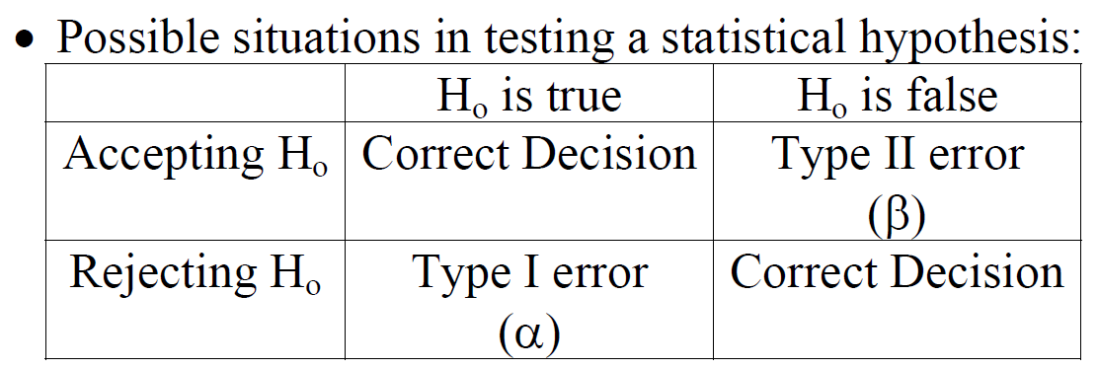

Slide 5
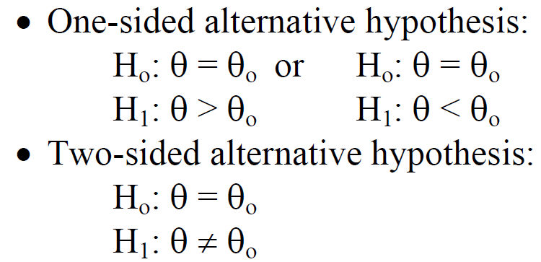
The level of significance of the test
α = P(Type I error) = P(Rejecting $H_{0}$| $H_{0}$is true)

Slide 6
The test procedure for rejecting $H_{0}$(accepting $H_{1}$) or accepting $H_{0}$(rejecting $H_{1}$) involves the following steps:
1. Determining a test statistic (T.S.)
2. Determining the significance level α
α = 0.01, 0.025, 0.05, or 0.10

Slide 7
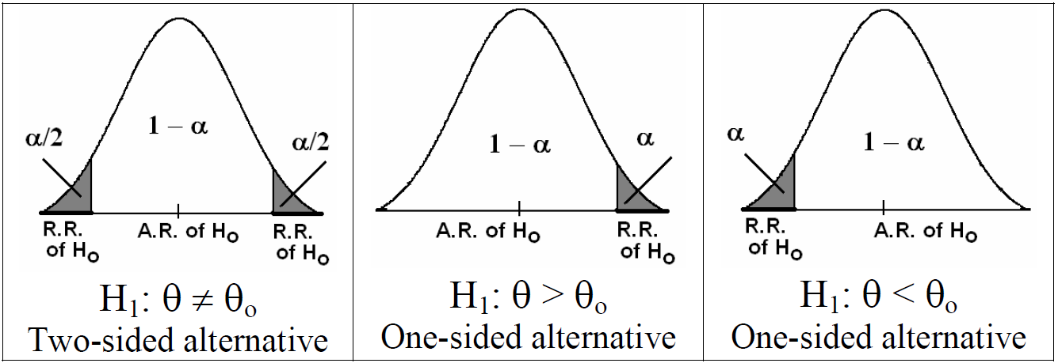
3. Determining the rejection region (R.R.) and the acceptance region (A.R.) of $H_{0}$. R.R. of $H_{0}$depends on $H_{1}$and $α$
• $H_{1}$determines the direction of the R.R. of $H_{0}$
• $α$ determines the size of the R.R. of $H_{0}$

Slide 8
4. Decision:We reject $H_{0}$(accept $H_{1}$) if the value of the T.S. falls in the R.R. of $H_{0}$, and vice versa.

Slide 9
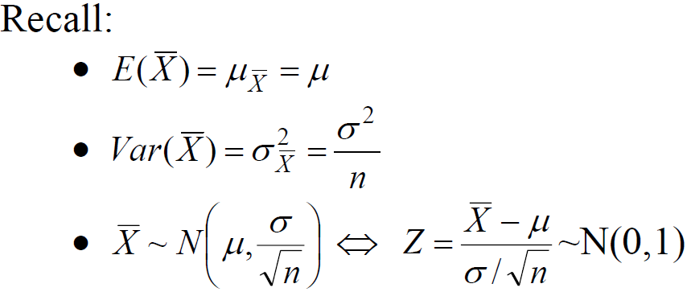
Single Sample: Tests Concerning a Single Mean (Variance Known)
Suppose that $X_{1},X_{2}$,…, $X_{n}$is a random sample of size $n$from distribution with mean $μ$ and (known) variance $σ2$.

Slide 10
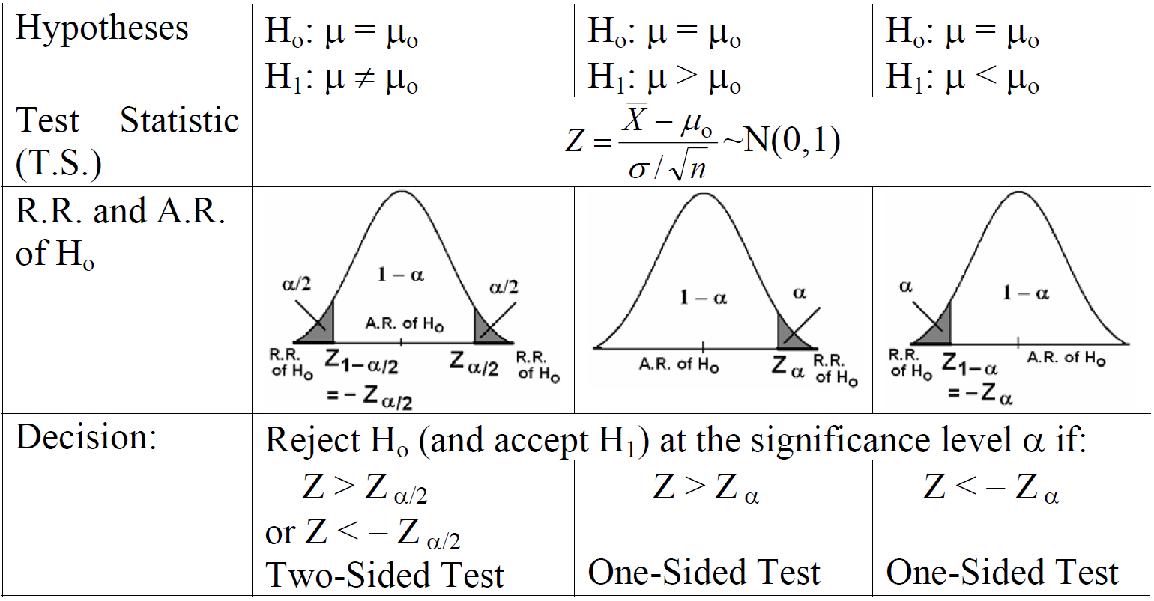
Let $μ_{0}$be a given known value.
Test Procedure

Slide 11
Example
A random sample of 100 recorded deaths in the United States during the past year showed an average of 71.8 years. Assuming a population standard deviation of 8.9 year, does this seem to indicate that the mean life span today is greater than 70 years? Use a 0.05 level of significance.

Slide 12
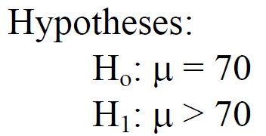
Solution:

Slide 13
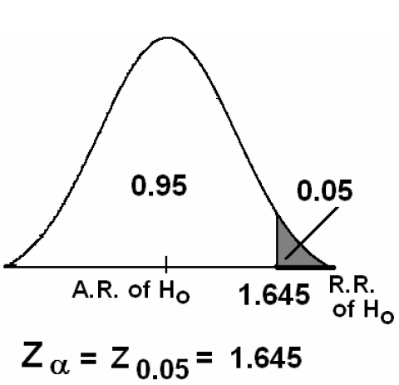

Slide 14
Example
A manufacturer of sports equipment has developed a new synthetic fishing line that he claims has a mean breaking strength of 8 kilograms with a standard deviation of 0.5 kilograms. Test the hypothesis that μ=8 kg against the alternative that μ≠8 kg if a random sample of 50 lines is tested and found to have a mean breaking strength of 7.8 kg. Use a 0.01 level of significance.

Slide 15
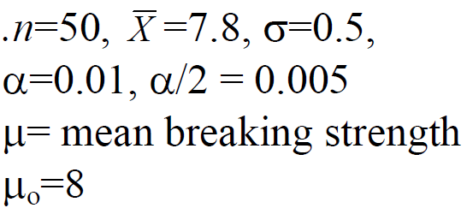
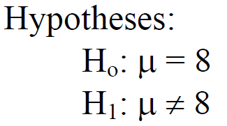
Solution:

Slide 16
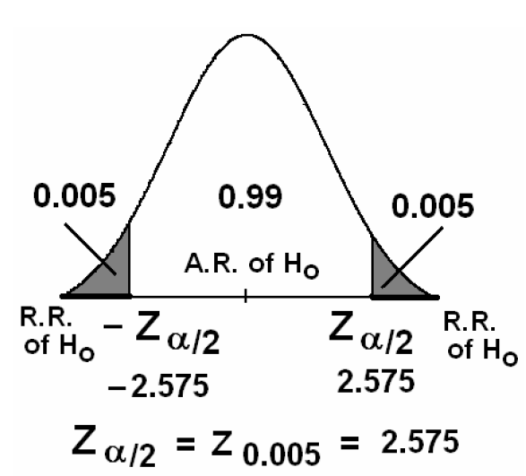

Slide 17
Decision:
Since Z= −2.83 ∈R.R., i.e.,
$Z= −2.83 < −Z_{0.005}$
we reject $H_{0}$at α=0.01 and accept $H_{1}$: μ ≠ 8. Therefore, we conclude that the claim is not correct.

Slide 18
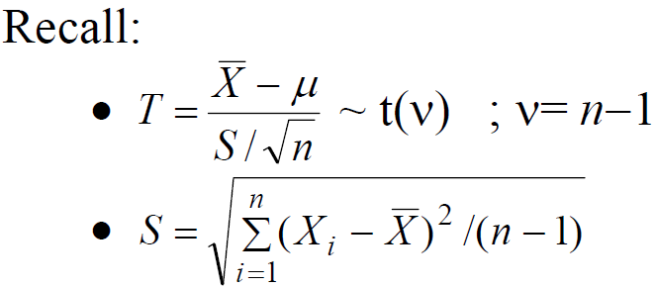
Single Sample: Tests on a Single Mean (Variance Unknown):
Suppose that $X_{1},X_{2}$,…, $X_{n}$is a random sample of size $n$from normal distribution with mean $μ$ and unknown variance $σ2$.

Slide 19
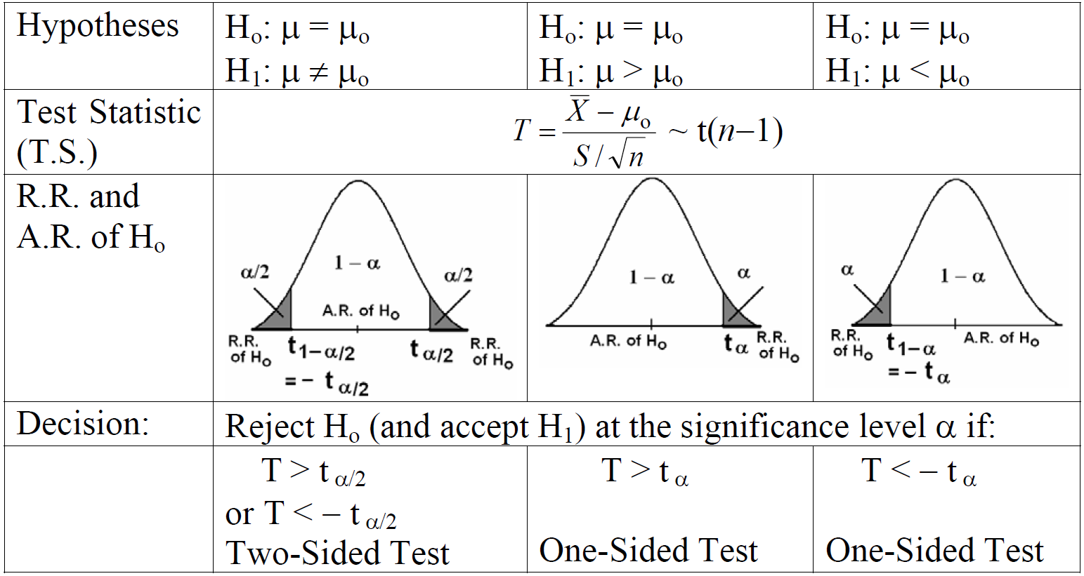
Test Procedure:

Slide 20
Example
If a random sample of 12 homes included in a planned study indicates that vacuum cleaners expend an average of 42 kilowatt-hours per year with a standard deviation of 11.9 kilowatt-hours, does this suggest at the 0.05 level of significance that the vacuum cleaners expend, on the average, less than 46 kilowatt-hours annually? Assume the population of kilowatt-hours to be normal.

Slide 21
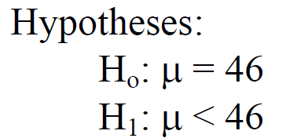
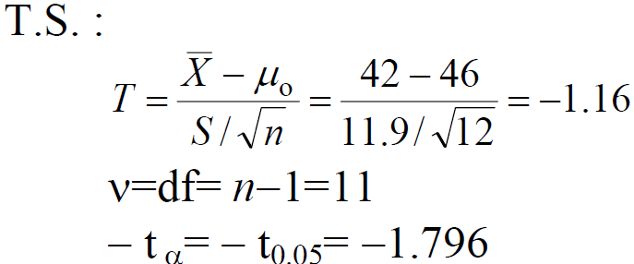
Solution:

Slide 22
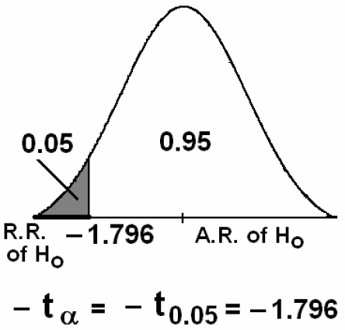

Slide 23
Decision:
Since
$$T=−1.16∉R.R. (T=−1.16∈A.R.),$$
we do not reject $H_{0}$at $α=0.05$ (i.e, accept $H_{0} : μ = 46$) and reject $H_{1} : μ < 46$.
Therefore, we conclude that $μ$ is not less than 46 kilowatt-hours.

Slide 24
Two Samples: Tests on Two Means

Slide 25
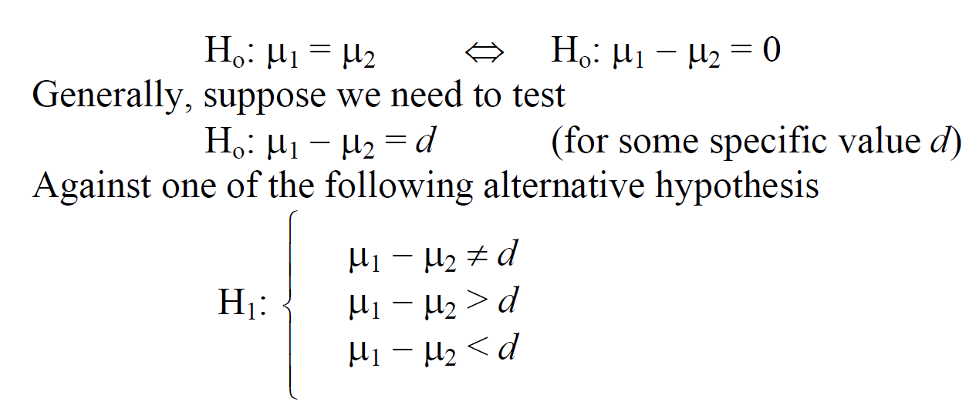
Now, suppose we need to test the null hypothesis

Slide 26
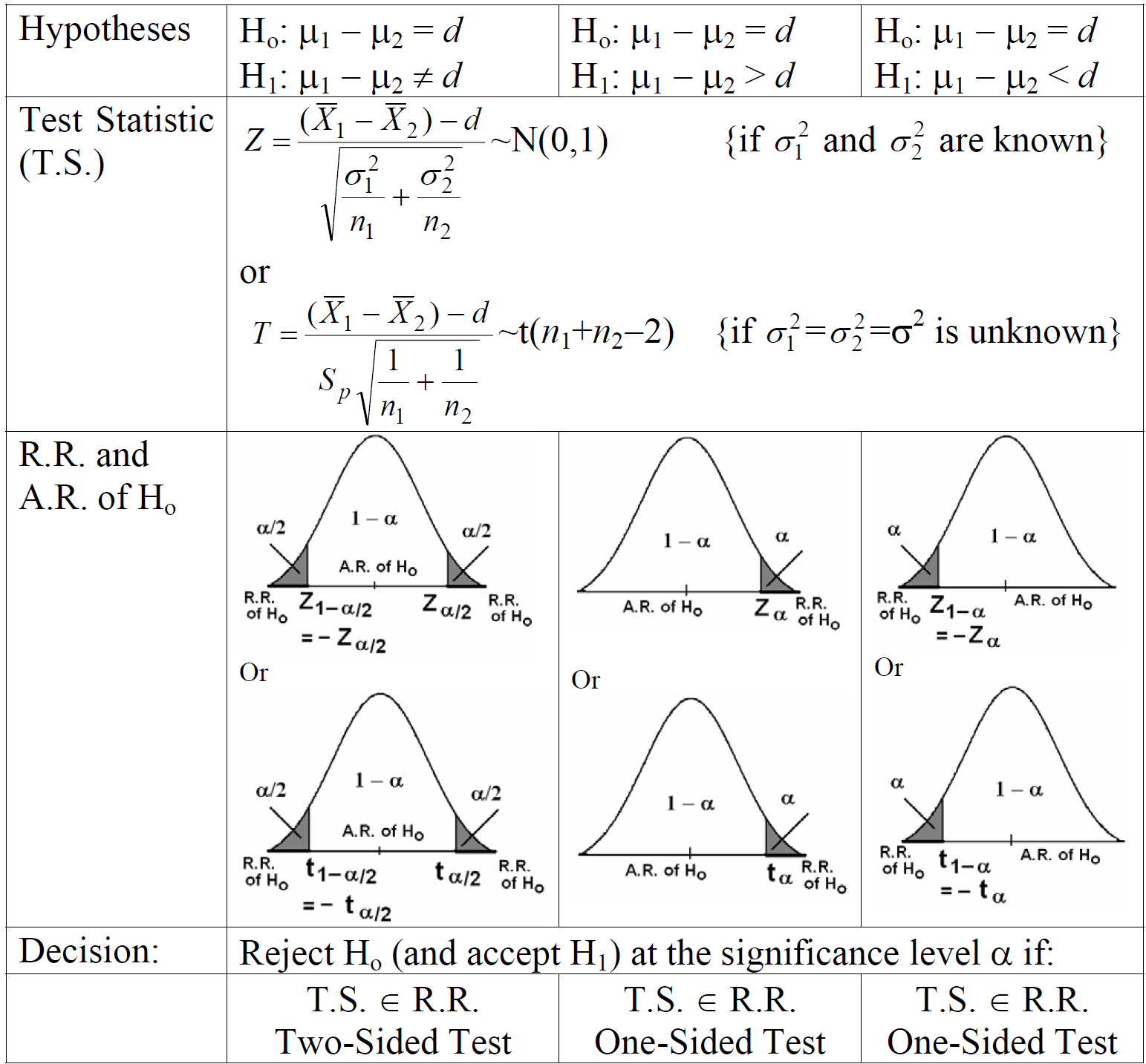

Slide 27
Example
An experiment was performed to compare the abrasive wear of two different laminated materials. Twelve pieces of material 1 were tested by exposing each piece to a machine measuring wear. Ten pieces of material 2 were similarly tested. In each case, the depth of wear was observed. The samples of material 1 gave an average wear of 85 units with a sample standard deviation of 4, while the samples of materials 2 gave an average wear of 81 and a sample standard deviation of 5. Can we conclude at the 0.05 level of significance that the mean abrasive wear of material 1 exceeds that of material 2 by more than 2 units? Assume populations to be approximately normal with equal variances.

Slide 28
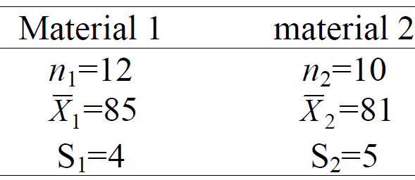
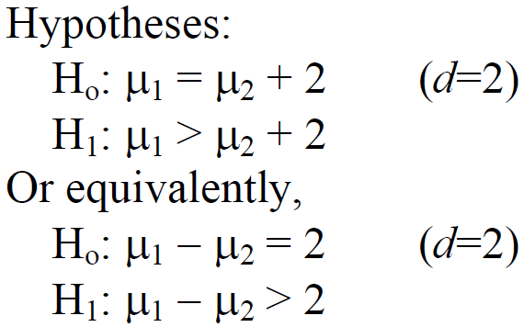
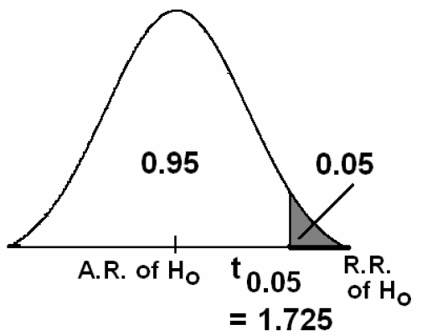
Solution:

Slide 29
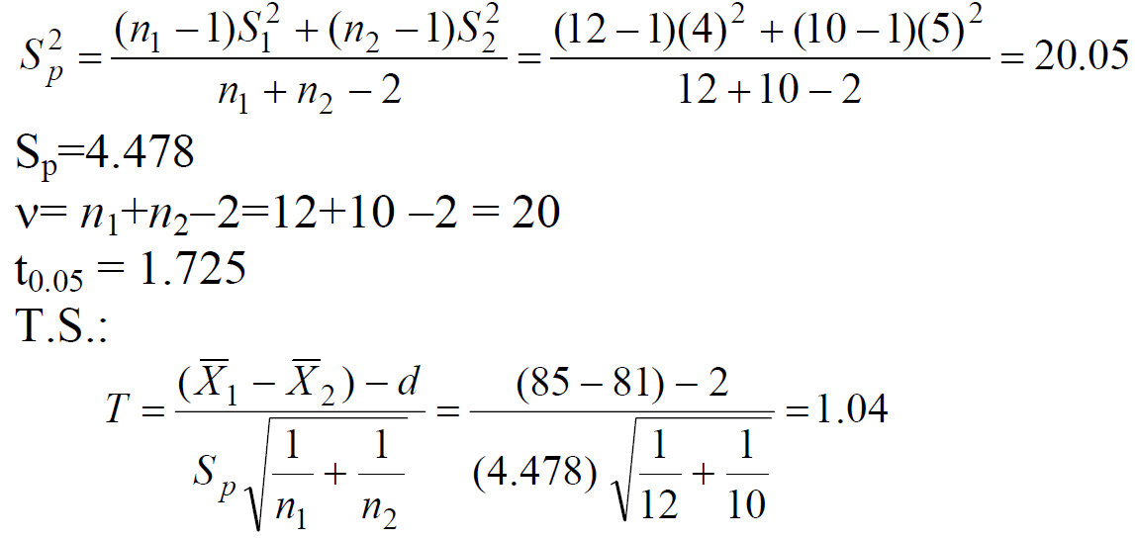

Slide 30
Decision:
Since
$T=1.04 ∈A.R. (T=1.04< t_{0.05}= 1.725)$
we accept (do not reject) $H_{0}$and reject $H_{1} :μ_{1}−μ_{2}> 2$at $α=0.05$.

Slide 31
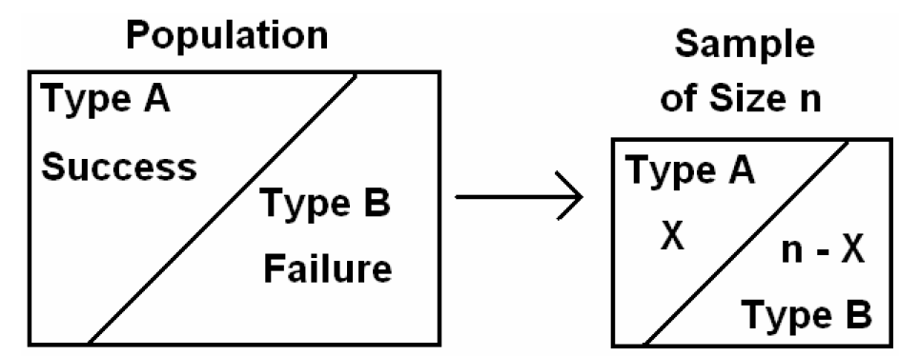
One Sample: Tests on a Single Proportion

Slide 32
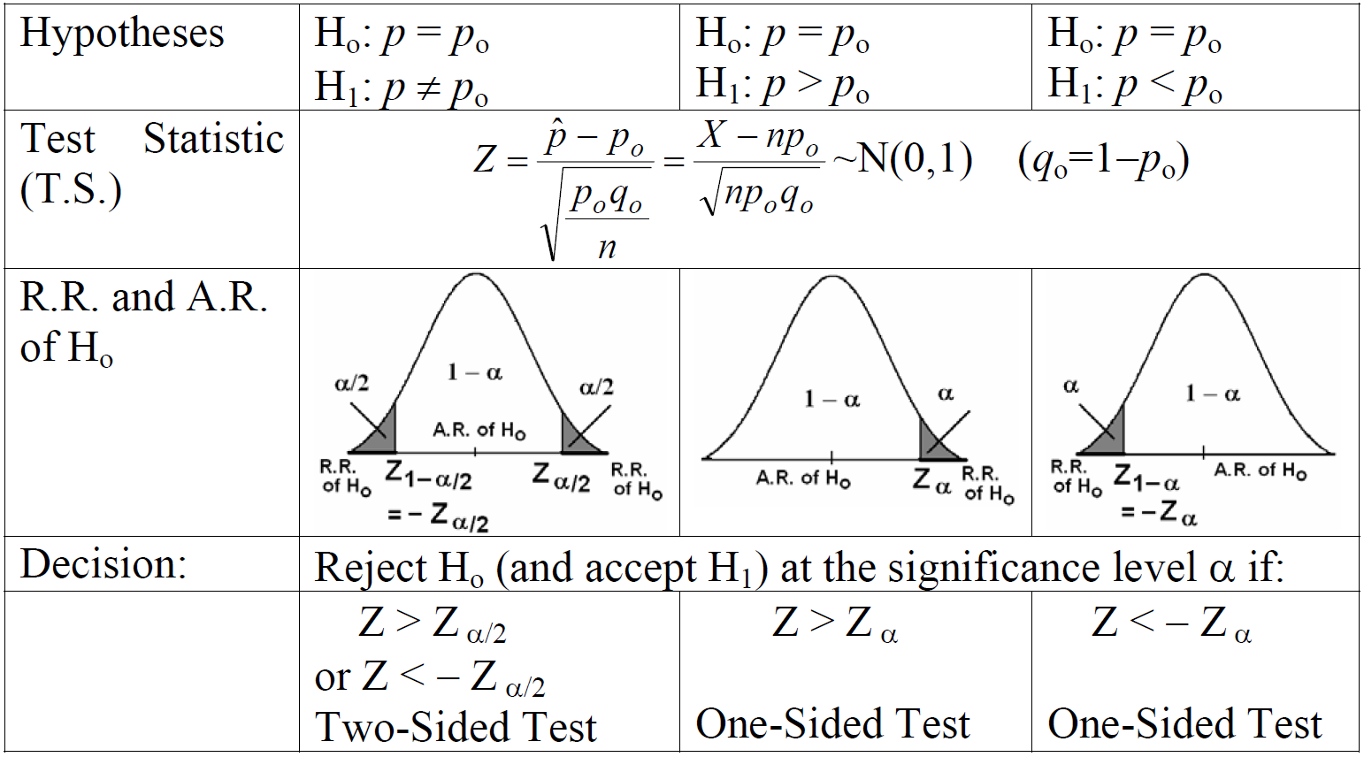

Slide 33
Example
A builder claims that heat pumps are installed in 70% of all homes being constructed today in the city of Richmond. Would you agree with this claim if a random survey of new homes in the city shows that 8 out of 15 homes had heat pumps installed? Use a 0.10 level of significance.

Slide 34
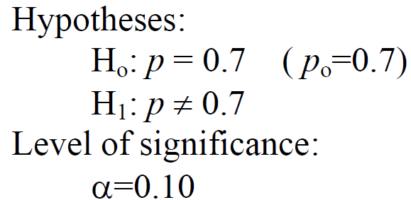
Solution:

Slide 35
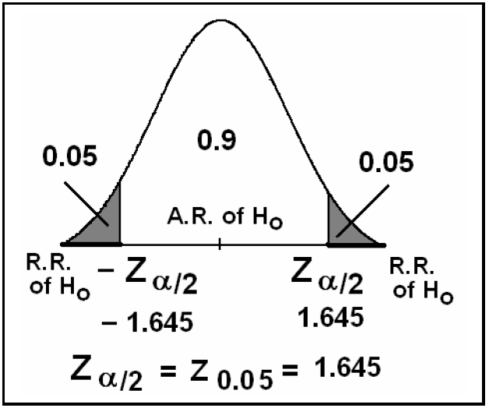

Slide 36
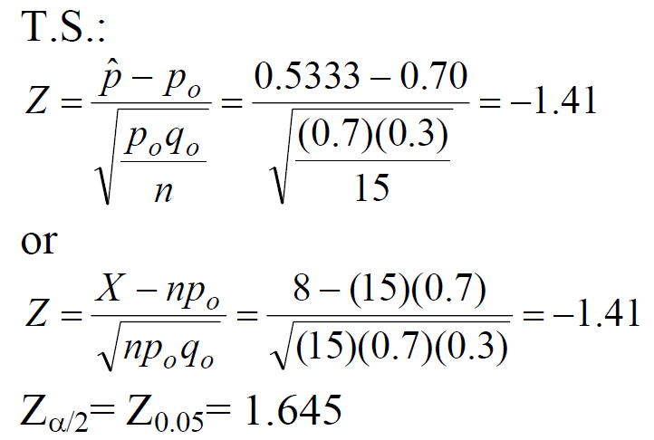

Slide 37
Decision:
Since $Z= −1.41 ∈A.R$., we accept (do not reject) $H_{0}$: $p=0.7$ and reject
$H_{1}$: $p ≠ 0.7$at $α=0.1$
Therefore, we agree with the claim.

Slide 38
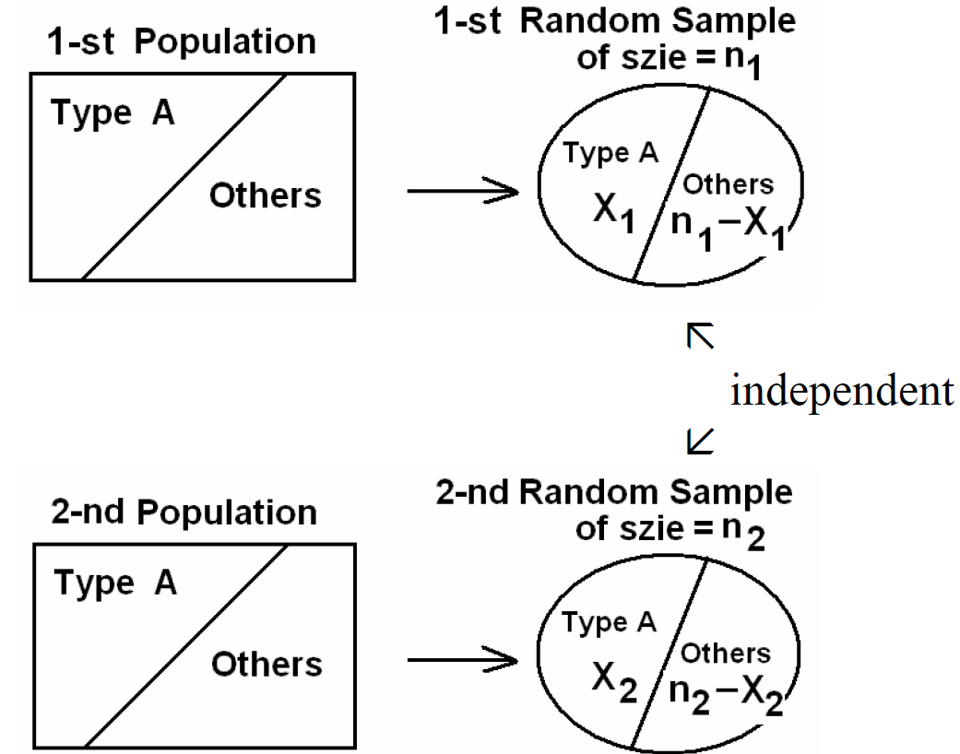
Two Samples: Tests on Two Proportions

Slide 39
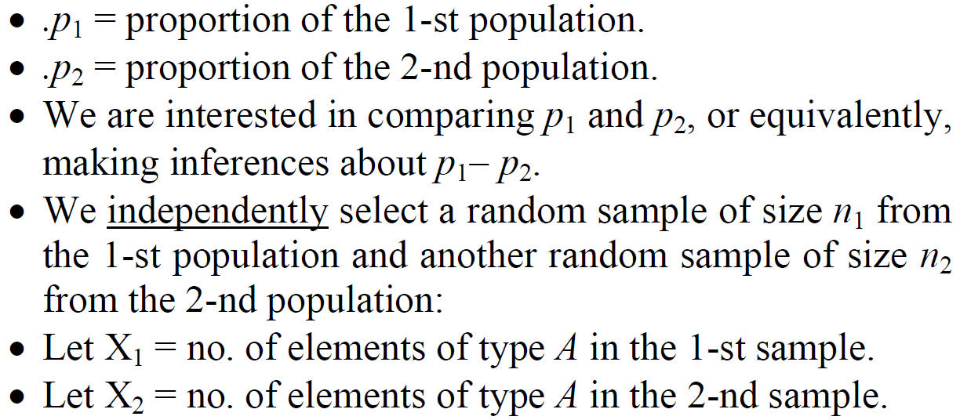
Suppose that we have two populations:

Slide 40
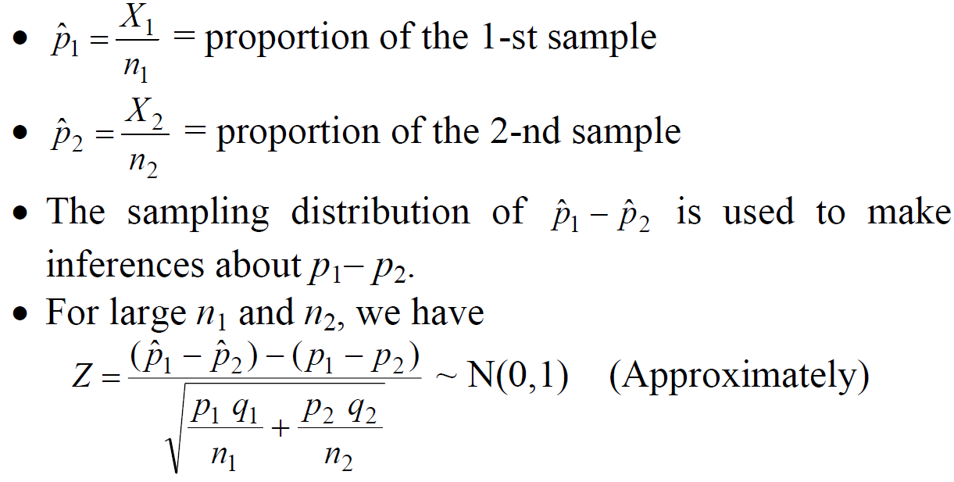

Slide 41
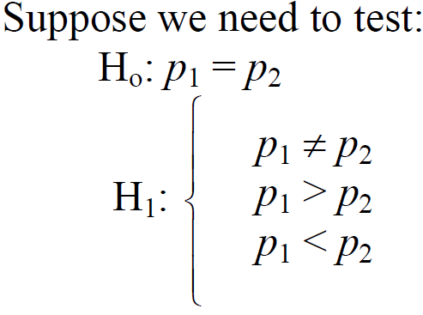
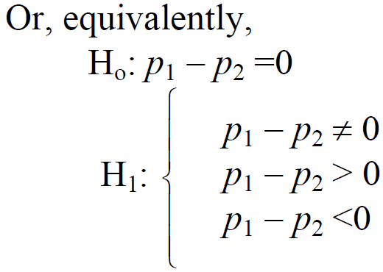
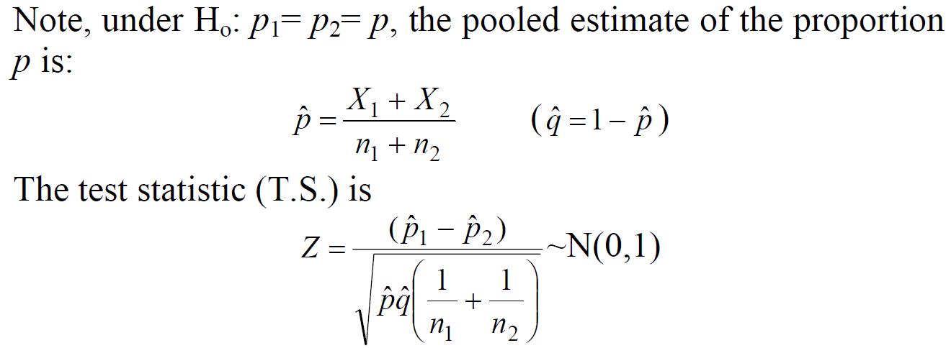

Slide 42
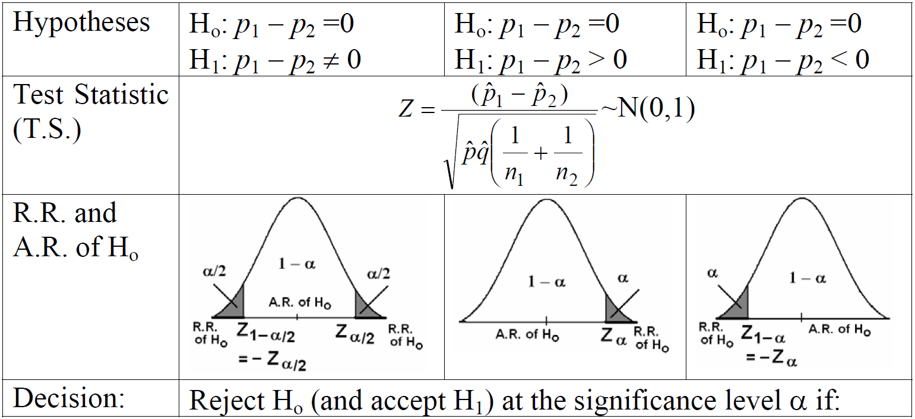

Slide 43
Example
A vote is to be taken among the residents of a town and the surrounding county to determine whether a proposed chemical plant should be constructed. The construction site is within the town limits and for this reason many voters in the county feel that the proposal will pass because of the large proportion of town voters who favor the construction. To determine if there is a significant difference in the proportion of town voters and county voters favoring the proposal, a poll is taken. If 120 of 200 town voters favor the proposal and 240 of 500 county voters favor it, would you agree that the proportion of town voters favoring the proposal is higher than the proportion of county voters? Use a 0.025 level of significance.

Slide 44
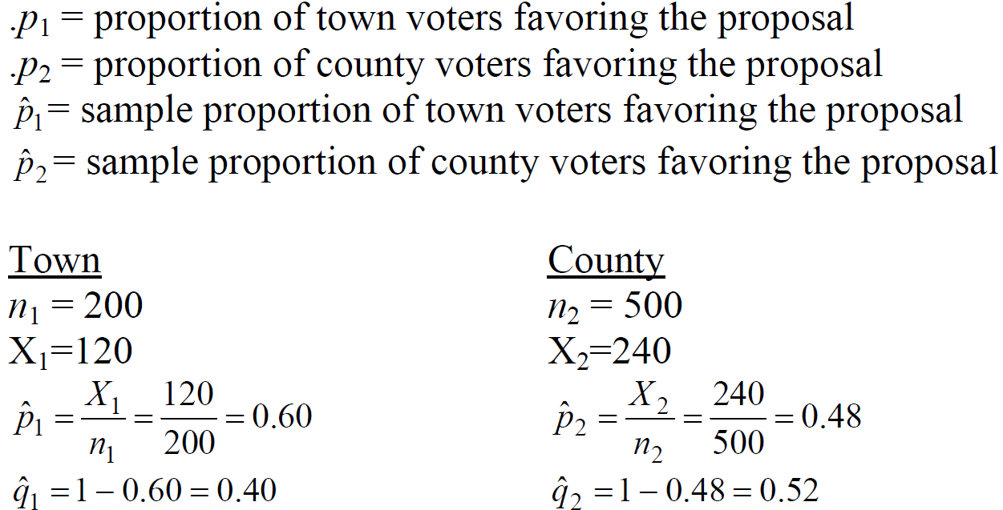
Solution:

Slide 45
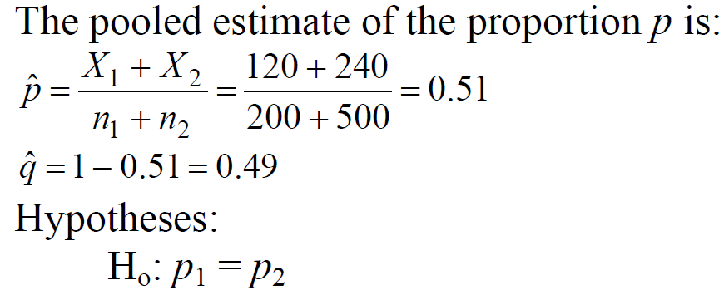
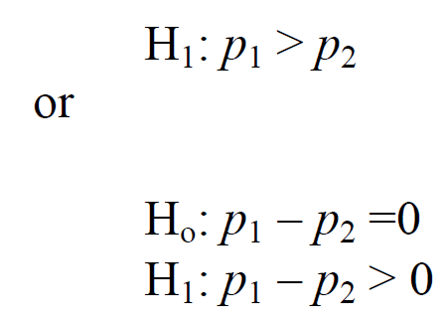

Slide 46
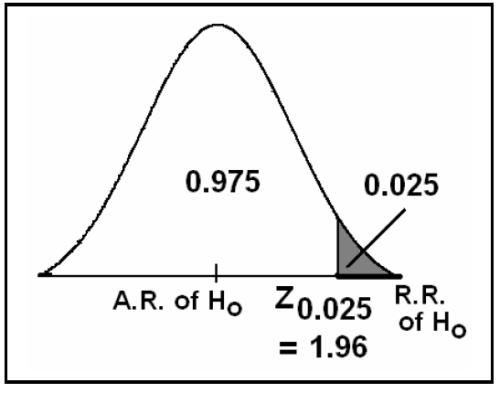
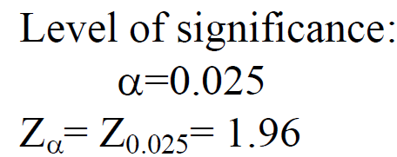

Slide 47
T.S:
Decision:

