Slide 1


Slide 2



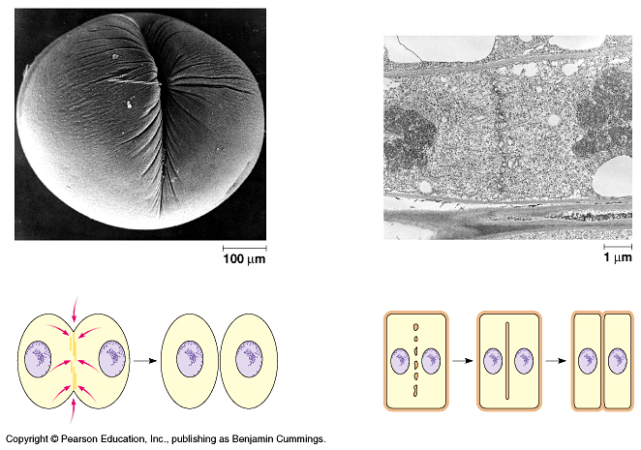
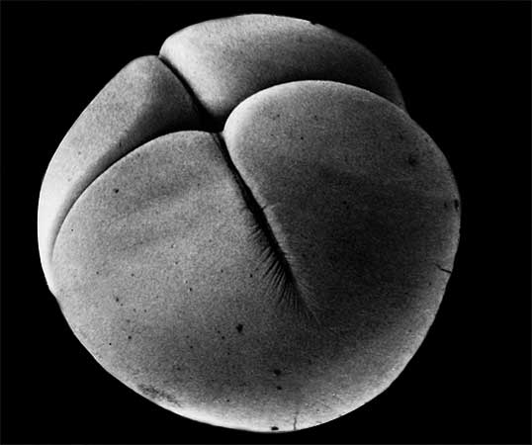
The Role of Meiosis in Sexual Life Cycles
Copyright © 2002 Pearson Education, Inc., publishing as Benjamin Cummings

Slide 3
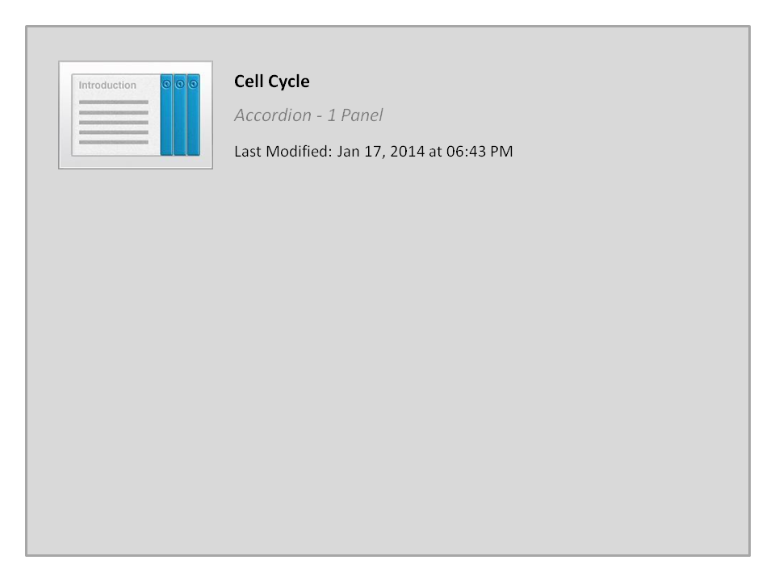
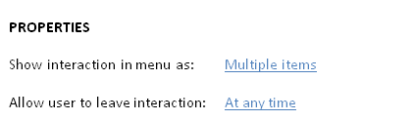


Cell Cycle

Slide 4


Fertilization and Meiosis alternate in sexual life cycles
A life cycle of an organism is the generation-to-generation sequence of stages in its reproductive history.
It starts at the conception of an organism until it produces its own offspring.
In humans, each somatic cell (all cells other than sperm or ovum) has 46 chromosomes.
These homologous chromosome pairs carry genes that control the same inherited characters.
A karyotype النمط الكروموسومي display of the 46 chromosomes shows 23 pairs of chromosomes, each pair with the same length, centromere position, and staining pattern.
Copyright © 2002 Pearson Education, Inc., publishing as Benjamin Cummings

Slide 5
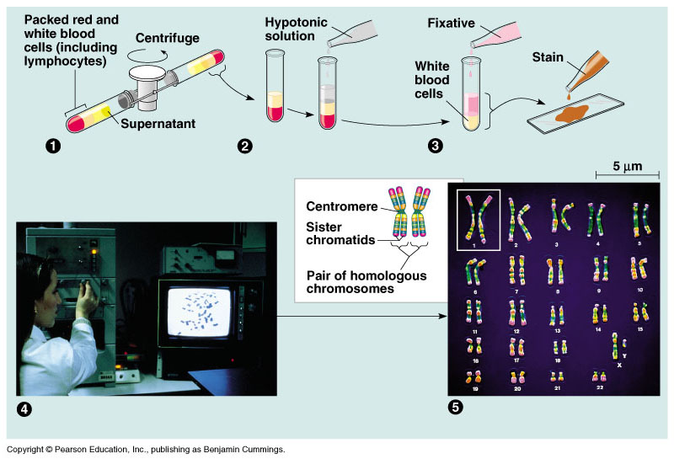
The Karyotype
It is a display of an individual’s chromosomes those are arranged according to sizes and shapes

Slide 6
Chromosomes (sex and autosomes)
An exception to the rule of homologous chromosomes is found in the sex chromosomes, the X and the Y.
The pattern of inheritance of these chromosomes determine an individual’s sex.
  Human females have a homologous pair of X chromosomes (XX).
  Human males have an X and a Y chromosome (XY).
The other 22 pairs are called autosomes.
We inherit one chromosome of each homologous pair from each parent.
  The 46 chromosomes in a somatic cell can be viewed as two sets of 23, a maternal set and a paternal set.
Sperm cells or ova (gametes) have only one set of chromosomes - 22 autosomes and an X or a Y.

Slide 7
Chromosomes (sex and autosomes)
A cell with a single chromosome set is called haploid.
  For humans, the haploid number of chromosomes is 23 (n = 23).
A haploid sperm reaches and fuses with a haploid ovum.
These cells fuse (syngamy) resulting in fertilization.
The fertilized egg (zygote) now has a diploid set of chromosomes from the maternal and paternal family lines.
The zygote and all cells with two sets of chromosomes are diploid cells 46 (2n = 46).
As an organism develops from a zygote to a sexually mature adult, the zygote’s genes are passes on to all somatic cells by mitosis.
Gametes, which develop in the gonads, are not produced by mitosis.
Instead, gametes undergo the process of meiosis in which the chromosome number is halved.

Slide 8
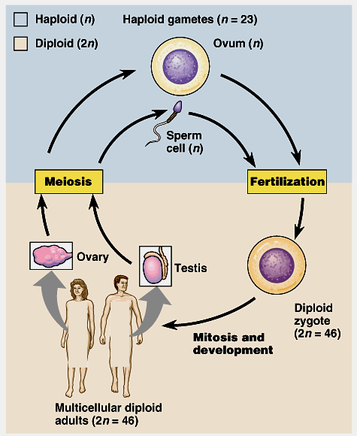
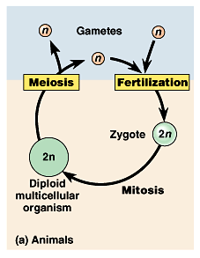
Fertilization restores the diploid condition by combining two haploid sets of chromosomes.
Fertilization and meiosis alternate in sexual life cycles.
  Gametes, produced by meiosis, are the only haploid cells.
  Gametes undergo no divisions themselves, but fuse to form a diploid zygote that divides by mitosis to produce a multicellular organism

Slide 9
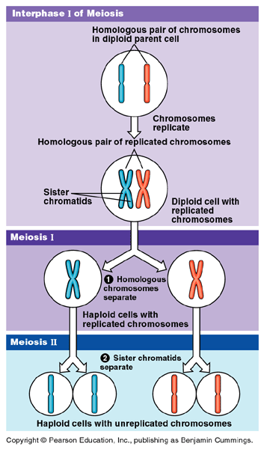
Meiosis (Reduction Division)
Reduces chromosome number from diploid to haploid :
Many steps of meiosis resemble steps in mitosis.
Both are preceded by the replication of chromosomes.
However, in meiosis, chromosomes replicate once followed by two consecutive cell divisions, meiosis I and meiosis II, which results in four daughter cells.
Each final daughter cell has only half chromosomes number (haploid).
Meiosis reduces chromosome number by copying the chromosomes once, but dividing twice.
  The first division (meiosis I) separates homologous chromosomes.
  The second (meiosis II) separates sister chromatids.

Slide 10
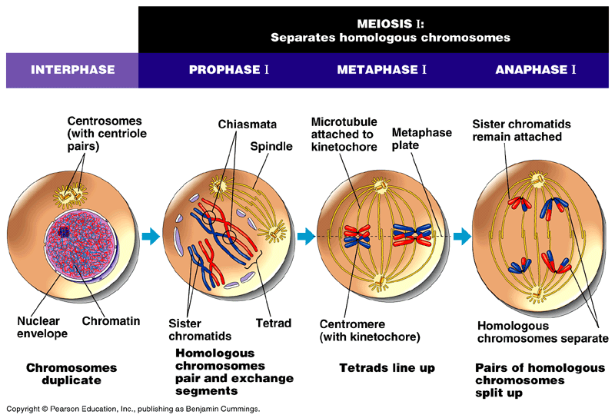
Meiosis (Reduction Division)
A)- Meiosis I:
1)- interphase the chromosomes are replicated to form sister chromatids.
2)- Prophase I, the chromosomes condense and homologous chromosomes pair up to form tetrads.
Homologous chromosomes attached together (synapsis).
  Chromatids of homologous chromosomes are crossed (at chiasmata) and segments of the chromosomes are exchanged (Crossing Over).

Slide 11
Meiosis (Reduction Division)
3)- Metaphase I, the tetrads are all arranged at the metaphase plate.
  Microtubules from one pole are attached to the kinetochore of one chromosome of each tetrad, while those from the other pole are attached to the other.
4)- Anaphase I,
the homologous chromosomes separate and are pulled toward opposite poles.

Slide 12
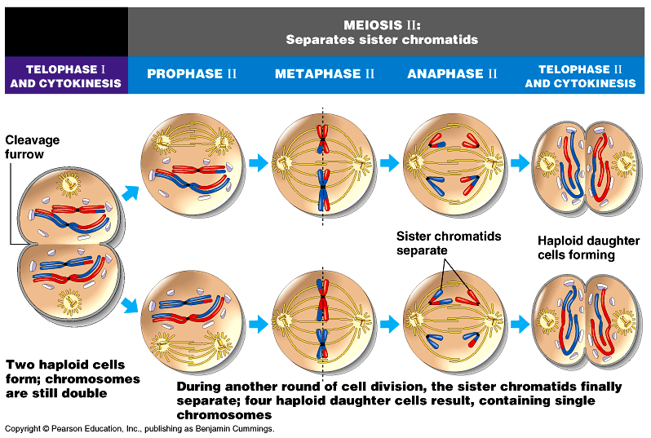
Meiosis (Reduction Division)
5)- Telophase I, movement of homologous chromosomes continues until there is a haploid set at each pole.
  Each chromosome consists of linked sister chromatids.
Cytokinesis follows

Slide 13
B)- Meiosis II
Prophase II, a spindle apparatus forms, attaches to kinetochores of each sister chromatids, and moves them around.
2)- Metaphase II, the sister chromatids are arranged at the metaphase plate.
3)- Anaphase II, the centromeres of sister chromatids separate and the separate sisters chromatids travel toward opposite poles.

Slide 14
Meiosis (Reduction Division)
4)- Telophase II, separated sister chromatids arrive at opposite poles.
  Nuclei are formed around the chromatids.
Cytokinesis separates the cytoplasm.
At the end of meiosis, there are four haploid daughter cells.

Slide 15
Meiosis Division (Reduction Division)
Meiosis: Summary
Occurs in two steps
A)- Meiosis I
B)- Meiosis II
- Separate homologous
chromosomes.
- Results in 2 cells with replicated chromosomes.
- No further replication of
chromosomes.
Occurs in the newly resulting
cells from Meiosis I.
(4 haploid cells)
It occurs mainly in sex gonads to form Gametes (sperms and ova)
Each of the resulting cells has half number of chromosomes of the original cell (23 in human). Thus, it is called Reduction Division

Slide 16
Crossing over
Chiasma
Recombinant Chromosomes

Slide 17
Crossing over
Occurs during prophase I.
The two homologous chromosomes joint together very closely.
Two non-sister chromatids of the homologous chromosomes are crossed over at a chiasma point and exchange corresponding segments.
The resulting chromosomes are called “recombinant chromosomes”.
It is important in genetic variation in sexual life cycle.

Slide 18
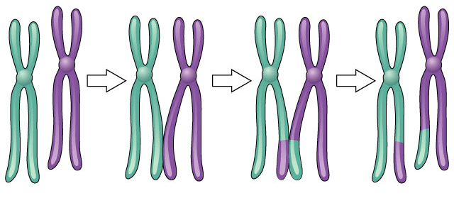
Crossing over
3 steps
  cross over
  breakage of DNA parts
  re-fusing of DNA parts
New combinations of traits
Notes:
Sexual reproduction is advantageous to species that benefit from genetic variability. However, since evolution occurs because of changes in an individual's DNA, crossing over and chromosome segregation is likely to result in progeny that are less well-adapted than their parents. On the other hand, asexual reproduction ensures the production of progeny as fit as the parent since they are identical to the parent. Remember the adage, “if it's not broken, don't fix it.” There are several hypotheses regarding the evolution of sexual reproduction. One is associated with repairing double-stranded DNA breaks induced by radiation or chemicals. The contagion hypothesis suggests that sex arose from infection by mobile genetic elements. The Red Queen hypothesis theorizes that sex is needed to store certain recessive alleles in case they are needed in the future. Along similar lines, eukaryotic cells build up large numbers of harmful mutations. Sex, as explained by Miller's rachet hypothesis, may simply be a way to reduce these mutations. The “whole truth” is likely a combination of these factors. Regardless of how and why, the great diversity of vertebrates and higher plants and their ability to adapt to the highly varied habitats is indeed a result of their sexual reproduction.

Slide 19
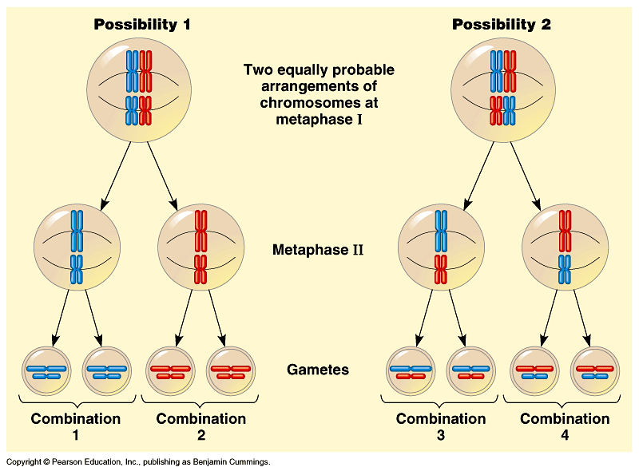
Sexual life cycles produce genetic variation among offspring
Three mechanisms contribute to genetic variation:
  independent assortment
  crossing over
  random fertilization
1)- Independent assortment: of chromosomes contributes to genetic variability due to the random orientation of tetrads at the metaphase plate.
  There is a fifty-fifty chance that a particular daughter cell of meiosis I will get the maternal chromosome of a
  certain homologous
  pair and a fifty-fifty
  chance that it will
  receive the paternal
  chromosome.

Slide 20
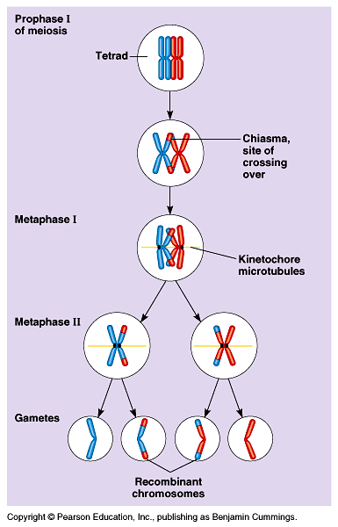
Independent assortment alone would find each individual chromosome in a gamete that would be exclusively maternal or paternal in origin.
3)- Crossing over:
Homologous portions of two non-sister chromatids exchange places, producing recombinant chromosomes which combine genes inherited from each parent.
2- The random fertilization: it adds to the genetic variation arising from meiosis.
Any sperm can fuse with any egg.

Slide 21
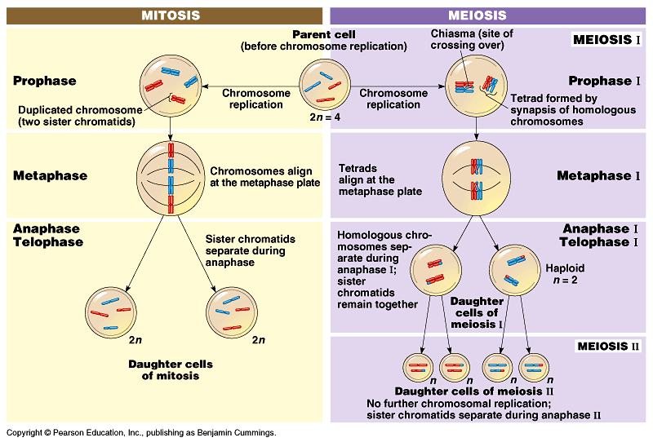
Mitosis produces two identical daughter cells, but meiosis produces 4 very different cells.

Slide 22
Comparison between Mitosis and Meiosis
The chromosome number is reduced by half in meiosis, but not in mitosis.
  Mitosis produces daughter cells that are genetically identical to the parent and to each other.
  Meiosis produces cells that differ from the parent and each other.
Three events, unique to meiosis, occur during the first division cycle.
1. During prophase I, homologous chromosomes pair up in a process called synapsis.
  Later in prophase I, the joined homologous chromosomes are visible as a tetrad.
  At X-shaped regions called chiasmata, sections of nonsister chromatids are exchanged.
  Chiasmata is the physical manifestation of crossing over, a form of genetic rearrangement.

Slide 23
Comparison between Mitosis and Meiosis
2. At metaphase I homologous pairs of chromosomes, not individual chromosomes are aligned along the metaphase plate.
    In humans, you would see 23 tetrads.
3. At anaphase I, it is homologous chromosomes, not sister chromatids, that separate and are carried to opposite poles of the cell.
  Sister chromatids remain attached at the centromere until anaphase II.
The processes during the second meiotic division are virtually identical to those of mitosis.

Slide 24
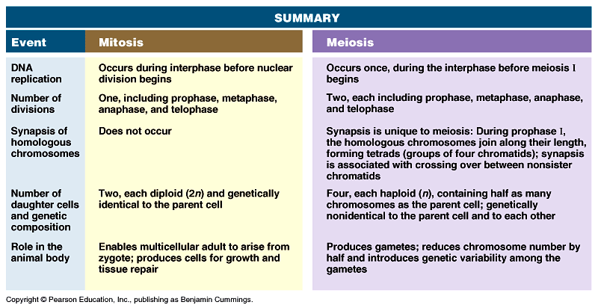
Comparison between Mitosis and meiosis

Slide 25
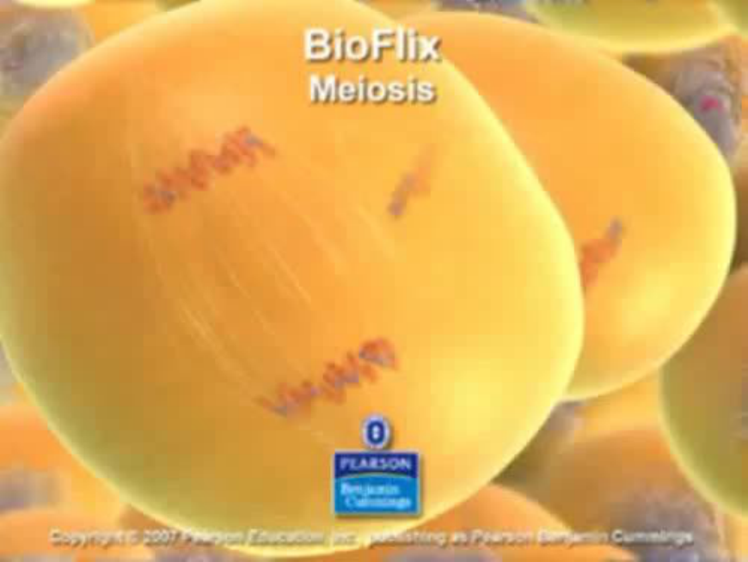
Meiosis

Slide 26
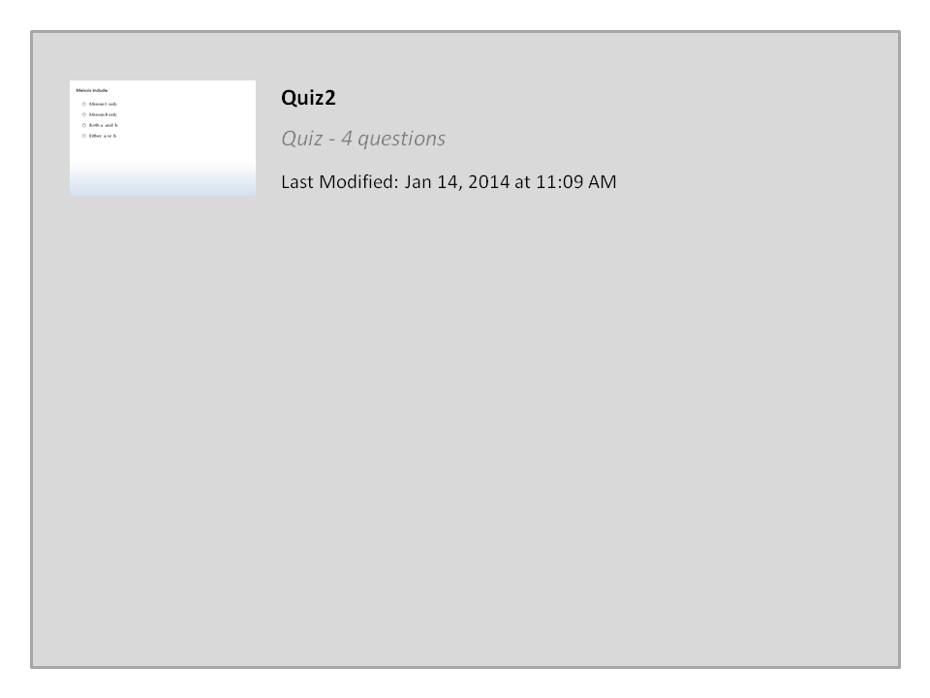


Quiz2

Slide 27




College of Science,
Zoology Department
General Animal Biology
(Zoo-145)
Prof. Ashraf M. Ahmed
aalii@ksu.edu.sa

