Slide 1
Ch3: A word and its parts: roots, afﬁxes and their shape
ENGT 243
Morphology & Syntax

Slide 2
Ch3: A word and its parts: roots, afﬁxes and their shape
In this chapter we will focus on
Section 3.1 Morphology &The smaller parts of words, generally called morphemes.
Sections 3.2 and 3.3 the two important distinctions between different kinds of morpheme.
Section 3.4 we will consider ways in which a morpheme can vary in shape.

Slide 3
3.1 Taking words apart
What is Morphology?
The area of grammar concerned with the structure of words and with relationships between words involving the morphemes that compose them.
from the Greek word morphe ‘form, shape’
Morphemes are the minimal units of morphology

Slide 4
3.1 Taking words apart
Characteristics of morphemes
To allow the meanings of some complex words to be predictable, morphemes must
1. be identiﬁable from one word to another
and
2. contribute in some way to the meaning of the whole word.

Slide 5
3.1 Taking Words Parts
consider the words
Attack
Stack
Tackle
Taxi
These all contain a syllable pronounced like the word tack
So it may seem natural to link characteristic 1. tightly to 2., making the identiﬁcation of morphemes dependent on their meaning.

Slide 6
3.1 Taking Words Parts
Point 1: Morphemes are not merely the smallest units of grammatical structure but also the smallest meaningful units.
This view is widespread precisely because it ﬁts many complex words like helpfulness, which is divisible into the morphemes
help, -ful (identiﬁable also in cheerful and doleful, for example)
and -ness (identiﬁable also in happiness and sadness).

Slide 7
3.1 Taking Words Parts
It seems reasonable to say that the meaning of helpfulness is entirely determined by the meanings of the morphemes that they contain.
The meaning of a word such as readable is clearly related to the normal meanings or functions of read and -able.

Slide 8
3.1 Taking Words Parts
Point 2: although morphemes are the parts out of which words are composed, they do not have to be of any particular length.
Some relatively long words, such as catamaran and knickerbocker, may consist of just one morpheme.
On the other hand, a single-syllable word, such as tenths, may contain as many as three morphemes (ten, -th, -s).

Slide 9
3.2 Kinds of morpheme: bound versus free
What is the core of the word helpfulness?
Help
Then we add –ful
Then we add -ness

Slide 10
3.2 Kinds of morpheme: bound versus free
Two reason why “help” is the core of the word “helpfulness”:
help supplies the most precise and concrete element in its meaning, shared by a family of related words like helper, helpless, helplessness and unhelpful.
help can stand on its own – that is, only help can, in an appropriate context, constitute an utterance by itself. That is clearly not true of -ness, nor is it true of -ful.

Slide 11
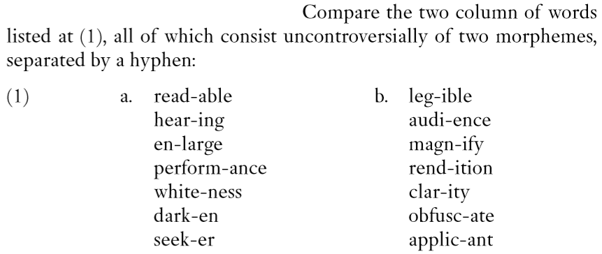
3.2 Kinds of morpheme: bound versus free
Free Morphemes can stand on their own
Bound Morphemes cant.
Lllll

Slide 12
3.2 Kinds of morpheme: bound versus free
Is it possible for a bound morpheme to be so limited in its distribution that it occurs in just one complex word?
(1) the morpheme leg- ‘read’ in legible
it is found in only one other word, illegible
(2) morphemes cran-, huckle- and gorm- in cranberry, huckleberry and gormless.
So the answer is YES

Slide 13
3.2 Kinds of morpheme: bound versus free
Is it possible for a bound morpheme to be so limited in its distribution that it occurs in just one complex word?
Also, CRANBERRY MORPHEMES
Cranberry and huckleberry are compounds whose second element is clearly the free morpheme berry, occurring in several other compounds such as strawberry, blackberry and blueberry;
however, cran- and huckle- occur nowhere outside these compounds.

Slide 14
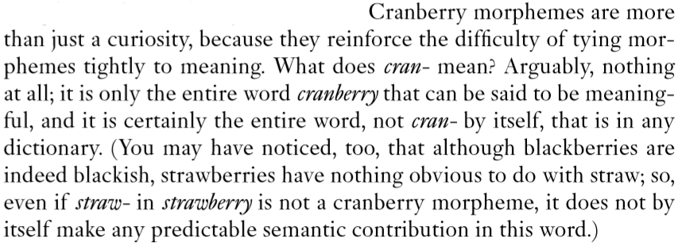
3.2 Kinds of morpheme: bound versus free

Slide 15
3.3 Kinds of morpheme: root, afﬁx, combining form
The root of a complex word is usually free.
The non-root morphemes:
those that precede the root (like en- in enlarge) are called preﬁxes.
those that follow it are called sufﬁxes (like -ance in performance.
An umbrella term for preﬁxes and sufﬁxes (broadly speaking, for all morphemes that are not roots) is afﬁx.
Only root morphemes can be free.
Afﬁxes are necessarily bound.

Slide 16
3.3 Kinds of morpheme: root, afﬁx, combining form
If afﬁxes are always bound, do not ‘bound morpheme’ and ‘afﬁx’ mean essentially the same thing?
If roots are usually free, do we really need both the terms ‘root’ and ‘free morpheme’?
Afﬁxes are indeed always bound, but it is not the case that roots are always free.

Slide 17
3.2 Kinds of morpheme: bound versus free
Free Morphemes can stand on their own
Bound Morphemes cant.
Lllll

Slide 18
3.3 Kinds of morpheme: root, afﬁx, combining form
ALL the words in (1b) have roots that are bound.
Because the root is bound, it is harder to identify and isolate as a morpheme.
A free root is easier to be identified.

Slide 19
3.3 Kinds of morpheme: root, afﬁx, combining form
However, for most of the examples in (1b) it is possible to ﬁnd other words in which the same roots appear,
such as audible, auditory and audition alongside audience.
A cranberry morpheme can be thought of as a bound root that occurs in only one word.

Slide 20
3.3 Kinds of morpheme: root, afﬁx, combining form
Two Types of Words
1- Single free root
2- Single bound root
Is it the case, then, that a word can contain no more than one root? Certainly no
such words are very common; they are COMPOUNDS.

Slide 21
3.3 Kinds of morpheme: root, afﬁx, combining form
COMPOUNDS
Complex word containing two or more free roots
Examples are bookcase, motorbike, penknife, truck-driver.
COMBINING FORMS
(2) Complex word containing two or more bound roots
Examples are electrolysis, microscopy, microcosm,
They are not nearly so common as ordinary compounds. They are scientific.
(3) Other words which, like cranberry, contain one bound and one free root are microﬁlm, electrometer

Slide 22
3.3 Kinds of morpheme: root, afﬁx, combining form
COMBINING FORMS
all technical terms of scientiﬁc vocabulary, coined self-consciously out of non-English elements, mostly from Latin and Greek.
Combining forms ‘acquired their freedom’
Photograph ‘photo’ must now be classiﬁed as a free morpheme.
micro- and macro- (as in at a micro level or on a macro scale) and retro-, as applied to music or fashion.

Slide 23
3.4 Morphemes and their allomorphs
An allomorph is a variety of a single morpheme.
The English plural morpheme has 3 allomorphs:
/әz/… as in busses
/z/… as in twigs
/s/… as in cats
The allomorph is conditioned by the phonetic or sound environment of the word…

Slide 24
Allomorphs of English Plural
/әz/ | /s/ | /z/
Bushes | Cats | Pens
Judges | Tips | Dogs
Buses | Books | Cars
1. [əz] occurs on nouns ending in s, z, š, z, č, j.
[s] occurs following all other voiceless sounds
[z] occurs following all other voiced sounds
The allomorphs of English plural are: [әz] [s] [z]

Slide 25
when the preceding sound is a sibilant (the kind of ‘hissing’ or ‘hushing’ sound heard at the end of horse, rose, bush, church and judge), the [әz] allomorph occurs.
otherwise, when the preceding sound is voiceless, i.e. produced with no vibration of the vocal folds in the larynx (as in cat, rock, cup or cliff ), the [s] allomorph occurs.
otherwise (i.e. after a vowel or a voiced consonant, as in dog or day), the [z] allomorph occurs.

Slide 26
Allomorphs of English Past Tense
/t/ | /d/ | /әd/
Stopped | Grabbed | Wanted
Talked | Begged | Waited
Kissed | Buzzed | Demanded
1. [əd] occurs on nouns ending in t, and d.
[t] occurs following all other voiceless sounds
[d] occurs following all other voiced sounds
The allomorphs of English plural are: [әd] [t] [d]

Slide 27
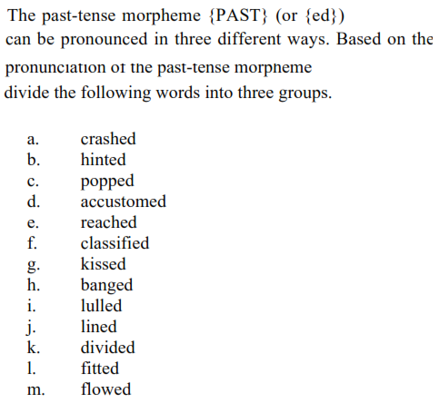

Slide 28
Allomorphy
Allomorphy is a morphological matter at all. But that is not quite correct.
E.g., Lie
Its plural form is lies, with [z] –ends in a vowel sound.
But this is not because either [s] or [əz] would be unpronounceable here, or would break some rule of English phonology.
If we experiment by replacing the [z] of lies with [s], we get an actual word (lice, the plural of louse),

Slide 29
Allomorphy
Phonology may inﬂuence the choice of allomorphs of a morpheme. (+V, -V, etc.)
E.g. laugh, cliff, ﬁfe and oaf [s]
both end in the same voiceless consonant.
But what about wife and loaf ?
They end in the same voiceless consonant as laugh and cliff;
yet their plurals are not *wifes and *loafs but wives and loaves.
knives, lives, hooves,
They use their voiced allomorph

Slide 30
Allomorphy
Grammar or vocabulary may inﬂuence the choice of allomorphs of a morpheme, too.
My wife’s job
[s]
wife, knife and the rest DO NOT USE THEIR VOICED ALLOMORPH (wive- etc.) before the ‘apostrophe s’ morpheme that indicates possession
except plural -s – wives and loaves.
knives, lives, hooves,
So the allomorphy here is determined both
lexically (it is restricted to certain nouns only)
grammatically (it occurs before the plural sufﬁx -s but not before other morphemes).

Slide 31
3.5 Identifying morphemes independently of meaning
The preﬁx re- and its possible allomorphs.
Added to verbs (again) rewrite, reread, repaint, revisit.
represented phonetically as [ri] as in see
The same preﬁx re- occurs in
revive, return, restore, revise, reverse,
pronounced with a so-called ‘reduced vowel’, [rI] or [rə].
The ,meaning is ‘again’ or ‘backward movement’: revive means ‘bring back to life’, return means ‘come back’ or ‘give back’, restore means ‘bring back to a former condition’,
It may therefore seem natural to treat [ri] and [rə] as allomorphs of the same morpheme re-.

Slide 32
3.5 Identifying morphemes independently of meaning
I turned the steaks on the barbecue a minute ago, and I’ll re-turn them soon.
Are ‘return’ and ‘re-turn’ the same? Discuss.

Slide 33
3.5 Identifying morphemes independently of meaning
There are some roots with which both[ri] and [rə] can occur, yielding different meanings:
The meanings of restore and return are distinct from those for re-store ‘store again’ and re-turn ‘turn again’. How?
The [ri] preﬁx can be added to almost any verb, with the consistent meaning ‘again’ re-store and re-turn
the [rə] preﬁx is lexically much more restricted as well as harder to pin down semantically restore and return

Slide 34
3.5 Identifying morphemes independently of meaning
The two prefixes pronounced [ri] and [rə] belong to distinct morphemes in modern English.
Their phonetic and semantic similarities are historical
(being due to their having the same historical source in that part of English vocabulary that has been borrowed from Latin via French.)

Slide 35
3.5 Identifying morphemes independently of meaning
Another Conclusion
One might consider rejecting the analysis of revive, return, restore, revise and reverse
as consisting of a prefix plus a root.
instead treat them as monomorphemic.
This has unwelcome consequences too
→

Slide 36
3.5 Identifying morphemes independently of meaning
If revive and revise are single morphemes,
that leads us to say that they have no parts in common (except phonologically) with
survive and supervise.
But that is unwelcome,
because it will stop us from recognizing
sur- and super- as morphemes that recur in
surpass and superimpose.
p.24

Slide 37
3.5 Identifying morphemes independently of meaning
If we stick to the view that individual morphemes must be meaningful, then all these words must be treated as monomorphemic;
because no consistent meaning can be identified in modern English for any of the purported morphemes that they contain.

Slide 38
3.5 Identifying morphemes independently of meaning
Revolve → Revolution
Devolve → Devolution
Involve → Involvement not Involution
The meaning of conduce has nothing to do with that of conduction.
The noun that seems most closely related to involve is not involution (another rarity) but involvement.
Prefixes and roots that they comprise such complex words are identifiable without reference to meaning.

