Slide 1


Slide 2



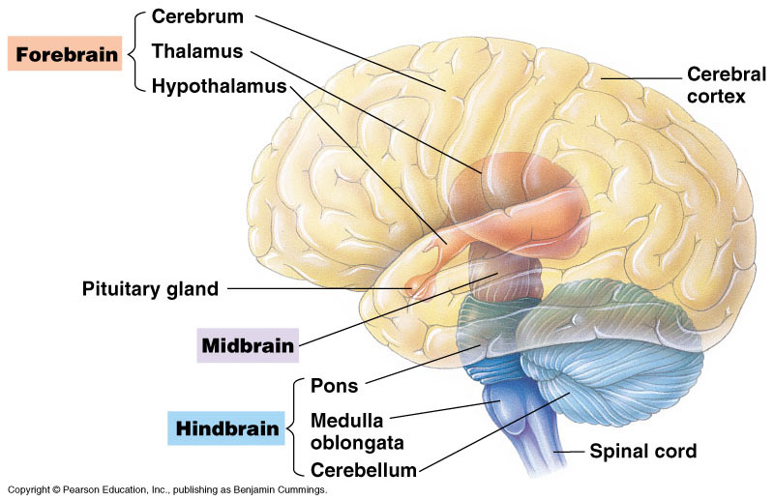
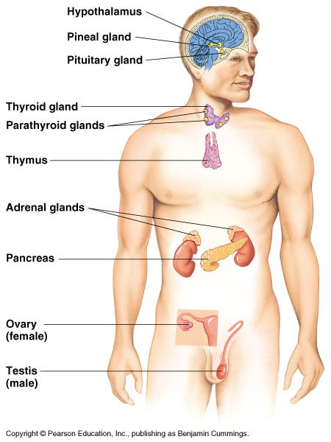
CHEMICAL SIGNALS IN ANIMALS
Copyright © 2002 Pearson Education, Inc., publishing as Benjamin Cummings

Slide 3
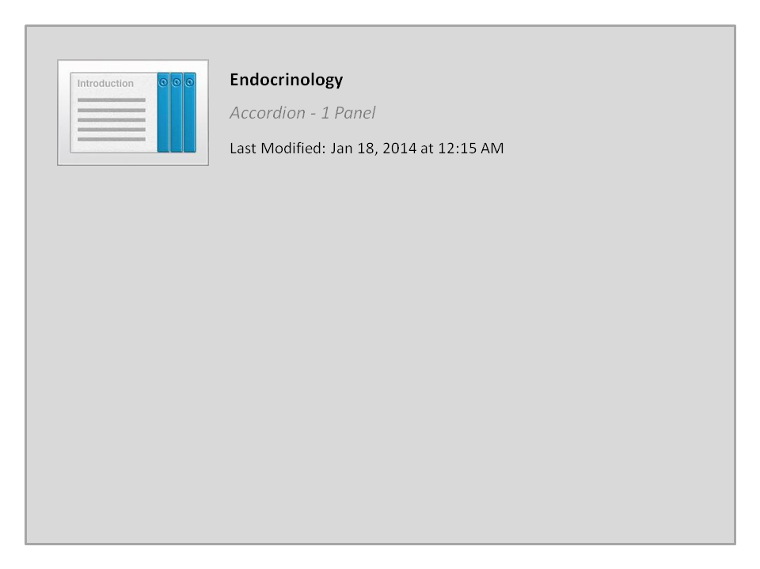
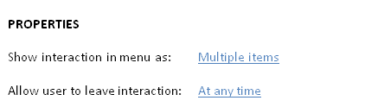


Endocrinology

Slide 4


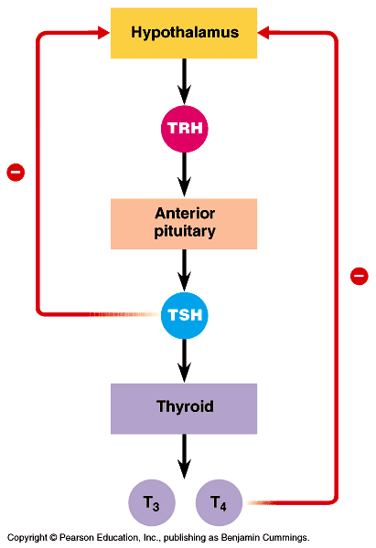
3. Thyroid gland: its hormones help in development, bioenergetics, and homeostasis ثبات البيئة الفسيولوﭽـية الداخلية
The thyroid gland of mammals consists of two lobes located on the ventral surface of the trachea. It contains 4 small Parathyroid glands. It plays role in maintaining normal blood pressure, heart rate and digestion ..etc.
Thyroid glands secretes 3 hormones:
  Tri-iodothyronine [(T₃), 3 I atoms]: amino acid derivative.
  Thyroxine [(T₄), 4 I atoms]: amino acid derivative.
  Stimulates and maintain metabolic processes.
  Secretion is regulated by TSH hormones.
Thyroid releasing H.
Thyroid stimulating H.
Copyright © 2002 Pearson Education, Inc., publishing as Benjamin Cummings

Slide 5

Calcitonin: a peptide.
  Lowers blood Ca²⁺ levels.
  Its secretion regulated by calcium in blood.
Hyperthyroidism:
It is the excessive secretion of thyroid hormones causes:
  high body temperature, sweating, weight loss, Irritability, high blood pressure.
Hypothyroidism:
It is an insufficient قليل amount of thyroid hormonesbecause deficiency of I in human diet (causes Goiter).
  Infants: cretinism. دمامة
  Adults: weight gain, lethargy الخمول, cold intolerance.
  Goiter تضخم الغدة: often is associated with iodine deficiency نقص.

Slide 6
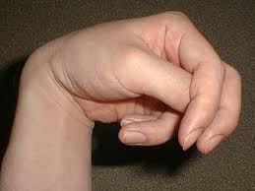
4- Parathyroid gland:
Secretes Parathyroid hormone (PTH): it is a peptide
PTH is secreted by The four parathyroid glands which are embedded in the surface of the thyroid gland. It functions as:
  Raises blood Ca²⁺ levels.
  Secretion is regulated by calcium in the blood.
  Causes osteoclasts فقد الكالسيوم to break down bone, releasing Ca²⁺ into the blood.
  Stimulates the kidneys to reabsorb تعيد إمتصاص Ca²⁺.
  Stimulates kidneys to convert vitamin D to its active form, which stimulate intestine to absorb Ca²⁺.
  PTH and calcitonin are antagonistic متضادين hormones. Thus PTH and calcitonin regulate blood calcium level (important role in homeostasis).
Hypoparathyroidism (tetany):
It is a lack of PTH which causes:
      Ca²⁺ levels in the blood drop.
      Convulsive تشنج contractions of the skeletal muscles.

Slide 7
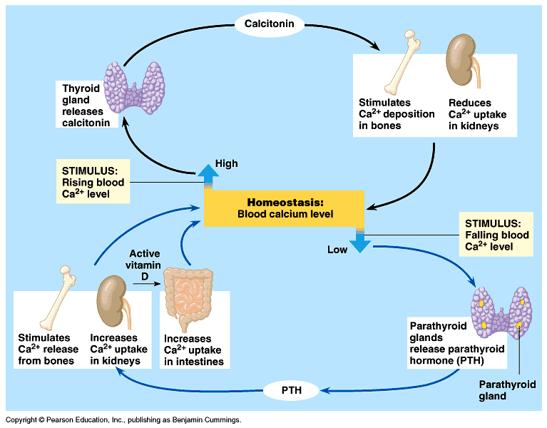
Hormonal control of calcium homeostasis in mammals blood

Slide 8
5. Pancreas:
The endocrine tissues of the pancreas secrete insulin and glucagon, antagonistic hormones that regulate blood glucose
The pancreas has both endocrine and exocrine functions.
  Exocrine function: secretion of bicarbonate ions and digestive enzymes.
  Endocrine function: insulin and glucagon are secreted by beta and alpha cells of islets of Langerhans جيوب لانجرانز.
  Insulin: a protein secreted by beta cells.
    Lowers blood glucose levels.
      Stimulates all body cells (except brain cells) to take up glucose.
      Slows glycogenolysis يبطىء تحلل الجليكوجين (a source of glucose).
      Inhibits gluconeogenesis يوقف تكوين الجلوكوز.
    Secretion is regulated by glucose in blood (negative feedback).
  Hypoinsulinism: diabetes mellitus نقص الإنسولين.
    Hereditary factors عامل وراثى and play a role in its development.
    High blood sugar levels – sugar is excreted in the urine.
    Symptoms: excessive urination كثرة التبول and excessive thirst العطش.

Slide 9
Pancreas
  Type I diabetes mellitus (insulin-dependent diabetes).
    Autoimmune disorder.
    Usually appears in childhood الطفولة.
    Treatment: insulin injections.
  Type II diabetes mellitus (non-insulin-dependent diabetes).
    Usually due to target cells having a decreased responsiveness to insulin قلة الإستجابة للإنسولين.
    Usually occurs after age 40 – risk increases with age.
    Accounts for over 90% of diabetes cases.
  Glucagon: a protein secreted by alpha cells.
    Raises blood glucose levels.
      Stimulates glycogenolysis تحلل الجليكوجين in the liver and skeletal muscle to produce glucose.
      Secretion is regulated by glucose in blood (negative feedback).

Slide 10
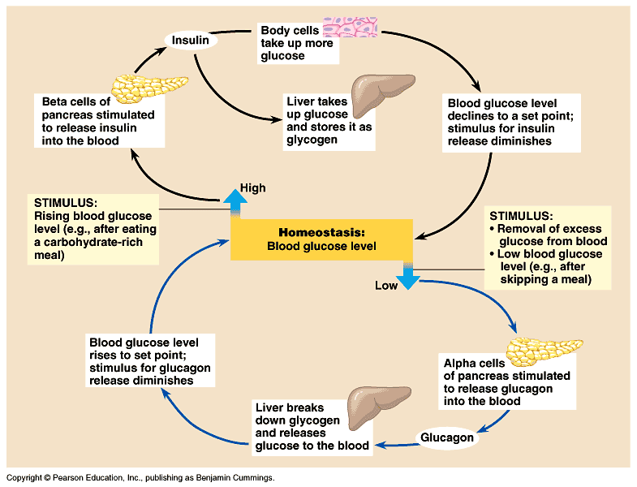
Hormonal control of glucose homeostasis in mammals blood

Slide 11
6. The adrenal gland: helps the body to manage stress
The adrenal glands are located adjacent to the kidneys.
  The adrenal cortex القشرة is the outer portion.
  The adrenal medulla is the inner portion.
I- Adrenal medulla المركز.
  Developmentally and functionally related to the nervous system.
  It produces the following hormones (in response to stress):
  Epinephrine (adrenaline هرمون القلب).
  Norepinephrine (noradrenaline).
  They are amino acid derivatives (synthesized from tyrosine) and function as:
    Raises blood glucose level and blood fatty acid level.
    Increases heart rate and stroke volume and dilates bronchioles.
    Shunts blood away from skin, digestive organs, and kidneys, and increases blood flow to heart, brain, and skeletal muscle.

Slide 12
II- Adrenal cortex: reacts to stress.
  Secretion of corticosteroids (a family of steroid hormones) is regulated by the nervous system in response to stress for example:
  Glucocorticoids.
    Raises blood glucose level.
    Secretion is regulated by ACTH (Adrenocorticotropic hormone).
    Abnormally high doses are administered as medication to suppress the inflammation response.
  Mineralocorticoids (example: aldosterone, which affects salt and water balance).
    Promotes re-absorption of Na⁺ and excretion of K⁺ in kidneys.
    Their secretion regulated by K⁺ in blood.
  C) Sex hormones.
    Androgens are secreted by the adrenal cortex may account for the female sex drive.
    The adrenal cortex also secretes small amounts of estrogens and progesterone.

Slide 13
7. Tests & 8. ovaries:
Gonadal steroids regulate growth, development, reproductive cycle, and sexual behavior
Testes hormones:
  Testosterone): steroids.
    Supports sperm formation.
    Promote development and maintenance of male sex characteristics.
    Secretion is regulated by FSH and LH.
Ovaries hormones:
  Estrogens: steroids.
    Stimulate uterine lining growth.
    Promote development and maintenance of female sex characteristics.
    Secretion is regulated by FSH and LH.
  Progesterone: steroids.
    Promotes uterine lining growth.
    Secretion is regulated by FSH and LH.

Slide 14
9- Thymus gland:
Secretes Thymosin: a peptide.
It stimulates T lymphocytes.
Protein hormones affect target cells via receptors on the membrane protein
Steroid hormones enter the target cells and trigger protein synthesis via receptors in the nucleus.

Slide 15
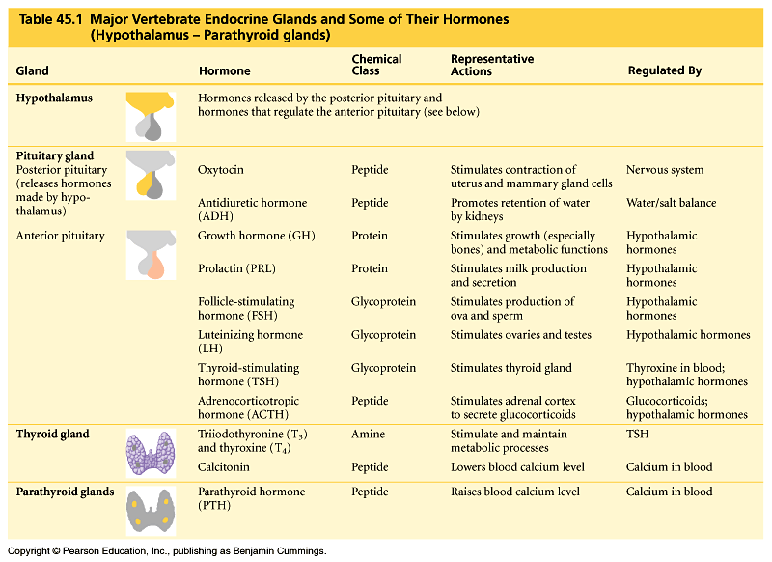
Page 961

Slide 16
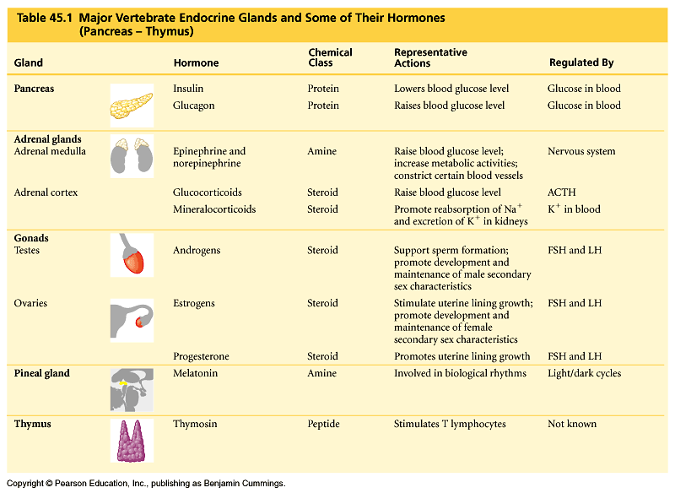
Table 45.1 (continued)

Slide 17

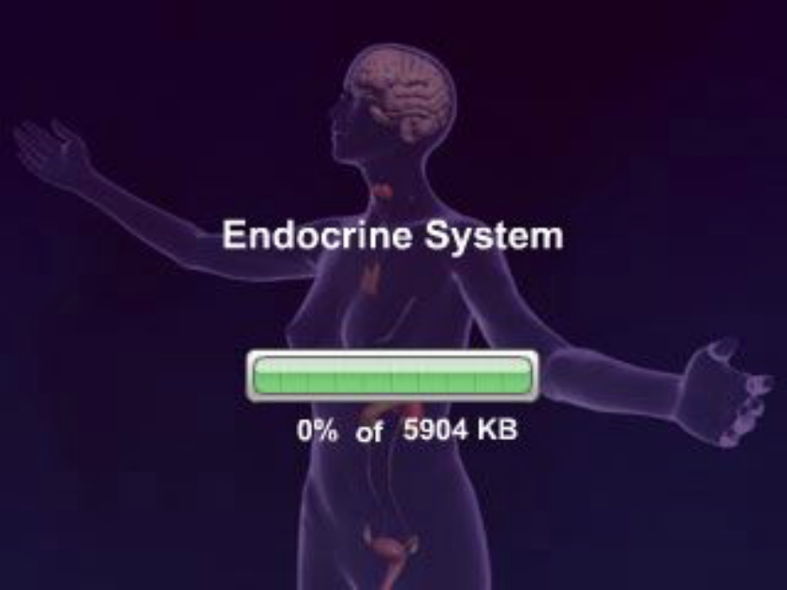
The Vertebrate Endocrine System

Slide 18
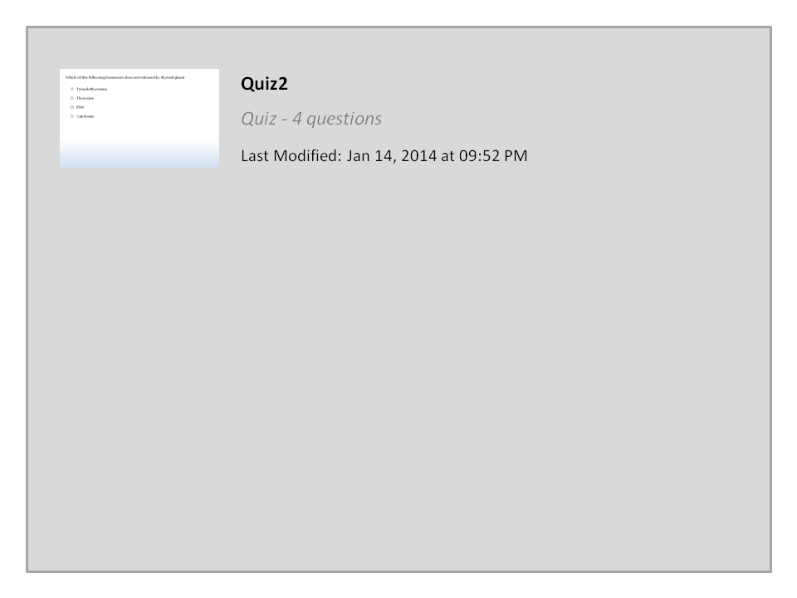


Quiz2

Slide 19




College of Science,
Zoology Department
General Animal Biology
(Zoo-145)
Prof. Ashraf M. Ahmed
aalii@ksu.edu.sa

