Slide 1
Lecture 2: Wireless Sensor Networks: A Survey
By Maysoon Al Duwais

Slide 2
Outline
Terminologies
What is WSN?
WSN Components
Sensor Node
Functions
Type
Example
Wireless Sensor Networks Applications
WSN Characteristics
WSN Advantages & disadvantages
Factors Influencing Sensor Network Design
Sensor Networks Communication Architecture
Sensor Network Protocols
Sensor Networks Operating Systems
Sensor Networks Simulators
Conclusion

Slide 3
Terminologies
sensor
A transducer
converts physical phenomenon e.g. heat, light, motion, vibration, and sound into electrical signals
sensor node
basic unit in sensor network
contains on-board sensors, processor, memory, transceiver, and power supply
sensor network
consists of a large number of sensor nodes
nodes deployed either inside or very close to the sensed phenomenon

Slide 4
What is WSN?
A wireless sensor network (WSN) is a wireless network that consists of distributed sensor nodes that monitor specific physical or environmental events or phenomena, such as temperature, sound, vibration, pressure, or motion, at different locations. The first development of WSN was first motivated by military purposes in order to do battlefield surveillance. Nowadays, new technologies have reduced the size, cost and power of these sensor nodes besides the development of wireless interfaces making the WSN one of the hottest topics of wireless communication.

Slide 5
WSN Components
There are four basic components in any WSN:
(1) a group of distributed sensor nodes.
(2) an interconnecting wireless network
(3) a gathering-information base station(Sink)
(4) a set of computing devices at the base station (or beyond) to interpret and analyze the received data from the nodes
Note: sometimes the computing is done through the network itself

Slide 6
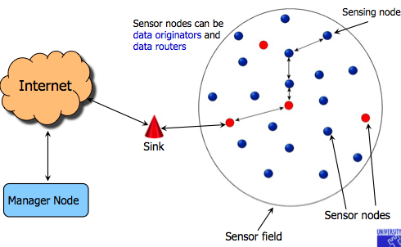
WSN Components

Slide 7
Sensor Node
Sensor nodes,
Low-cost and low-power devices used to accumulate the desired data and forward it to the base station.
A sensor node is composed of:
Sensing unit
Radio transceiver or other wireless communications device
Microcontroller / Processing Unit.
Energy source, usually a battery,
some sensor nodes have an additional memory component
Location Finding System (optional)
Power Generator (optional)
Mobilizer (optional)

Slide 8
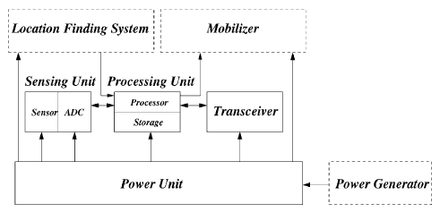
Sensor Node

Slide 9
Sensor Node Functions
Functionality of sensor nodes lies behind the ability of the node to either being the source of the data (i.e. senses the event) then transmits it.
or just being a pure transceiver that receives data from other sources then forwards it to other nodes in order to reach the base station.
Functionality depends on the network architecture

Slide 10
Sensor Node Types
The size of a single sensor node can vary from shoebox-sized nodes to the size of a dust.
The cost of sensor nodes is similarly variable, ranging from hundreds of dollars to a few cents, depending on:
the size of the sensor network
the complexity of individual sensor nodes.
The different types of sensors
Seismic, thermal, visual, infrared

Slide 11
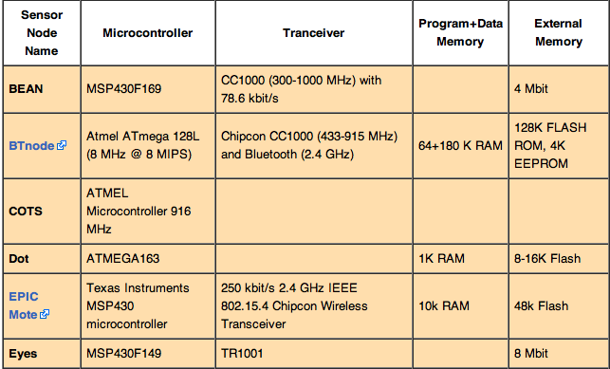
Sensor Nodes Examples

Slide 12
Wireless Sensor Networks Applications
Monitoring friendly forces, equipment, and ammunition
Battlefield surveillance
Reconnaissance of opposing forces and terrain
Targeting
Battle damage assessment
Nuclear, biological, and chemical attack detection

Slide 13
Wireless Sensor Networks Applications
Forest fire detection
Bio-complexity mapping of environment
Flood detection
Precision Agriculture
Air and water pollution

Slide 14
Wireless Sensor Networks Applications
Health Care Applications
Telemonitoring of human physiological data
Tracking and monitoring doctors and patients inside a hospital
Drug administration in hospitals

Slide 15
Wireless Sensor Networks Applications
Home and Office Applications
Home and office automation
Smart environment

Slide 16
Wireless Sensor Networks Applications
Automotive Applications
Reduces wiring effects
Measurements in chambers and rotating parts
Remote technical inspections
Conditions monitoring e.g. at a bearing

Slide 17
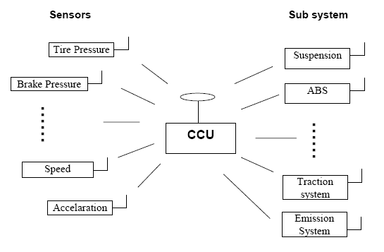
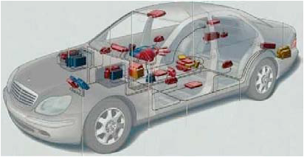
Wireless Sensor Networks Applications
Automotive Applications

Slide 18
Wireless Sensor Networks Applications
Other Commercial Applications
Environmental control in office buildings (estimated energy savings $55 billion per year!)
Interactive museums
Detecting and monitoring car thefts
Managing inventory control
Vehicle tracking and detection

Slide 19
WSN Characteristics
Power consumption constraints for nodes using batteries or energy harvesting
Chance to cope with node failures (Fault Tolerance/Recovery)
Mobility of nodes
Heterogeneity of nodes
Scalability to large scale of deployment
Capability to cope with harsh environmental conditions
Simplicity of use
More use of broadcast communications instead of point-to-point
Nodes do not have a global ID such as an IP number

Slide 20
WSN Advantages
Network setups can be carried out without fixed infrastructure.
Suitable for the non-reachable places such as over the sea, mountains, rural areas or deep forests.
Flexible if there is a random situation when additional workstation is needed.
It avoids plenty of wiring.
It is scalable, might accommodate new devices at any time.
It can be accessed by using a centralized monitor.
20

Slide 21
WSN Disadvantages
Less secure because hackers can enter the access point and obtain all the information.
Lower speed compared to wired networks.
More complicated to configure compared to a wired network.
Easily troubled by surroundings (walls, microwave, large distances due to signal attenuation, etc).
It is easy for hackers to hack it we couldn’t control propagation of waves.
Comparatively low speed of communication.
Still Costly (most importantly).

Slide 22
Factors Influencing WSN Design
Fault tolerance
Scalability
Production costs
Hardware constraints
Sensor network topology
Environment
Transmission media
Power Consumption
Sensing
Communication
Data processing

Slide 23
WSN Operations
Two important operations in a sensor networks
Data dissemination : the propagation of data/queries throughout the network
Data gathering : the collection of observed data from the individual sensor nodes to a sink

Slide 24
Data Dissemination
Data dissemination: is the process by which queries or data are routed in the sensor network.
The data collected by sensor nodes has to be communicated to the node which is interested in the data.
The node that generates data is called source.
the information to be reported is called an event.
A node which interested in an event is called sink.
Data dissemination consist of a two-step process: interest propagation and data propagation.
Interest propagation: for every event that a sink is interested in, it broadcasts its interest to is neighbor, and across the network.
Data dissemination: When an event is detected, it is reported to the interested nodes (sink).
24

Slide 25
Flooding
Each node which receives a packet (queries/data) broadcasts it until the packet reaches the destination node.
Disadvantages :
Implosion :
Happens when duplicate messages sent to the same node.
Occurs when a node receives copies of the same messages from many of its neighbors.
Overlap :
the same event may be sensed by more than one node due to overlapping regions of coverage.
This results in their neighbors receiving duplicate reports of the same event.
Resource blindness : the flooding protocol does not consider the available energy at the nodes and results in many redundant transmissions. Hence, it reduces the network lifetime.
25

Slide 26
Gossiping
Modified version of flooding
The nodes do not broadcast a packet, but send it to a randomly selected neighbor.
Avoid the problem of implosion
It takes a long time for message to propagate throughout the network.
It does not guarantee that all nodes of network will receive the message.
26

Slide 27
Data Gathering
The objective of the data gathering problem is to transmit the sensed data from each sensor node to a BS.
The goal of algorithm which implement data gathering is
maximize the lifetime of network
Minimum energy should be consumed
The transmission occur with minimum delay
27

Slide 28
Sensor Network Architecture
The two basic kinds of sensor network architecture
Layered Architecture
Clustered Architecture
28

Slide 29
Layered Architecture
A layered architecture has a single powerful base station (BS), and the layers of sensor nodes around it corresponds to the nodes that have the same distance to the BS.
The BS acts an access point to a wired network, and small nodes form a wireless backbone to provide wireless connectivity.
The advantage of a layered architecture is that each node is involved only in short-distance, low-power transmissions to nodes of the neighboring layers.
29

Slide 30
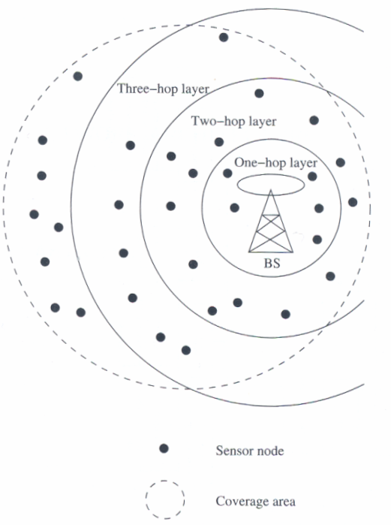
Layered architecture
30

Slide 31
Unified Network Protocol Framework (UNPF)
UNPF is a set of protocols for complete implementation of a layered architecture for sensor networks
UNPF integrates three operations in its protocol structure:
Network initialization and maintenance
MAC protocol
Routing protocol
31

Slide 32
Clustered Architecture
A clustered architecture organizes the sensor nodes into clusters, each governed by a cluster-head.
The nodes in each cluster are involved in message exchanges with their cluster-heads, and these heads send message to a BS.
Clustered architecture is useful for sensor networks because of its inherent suitability for data fusion.
The data gathered by all member of the cluster can be fused at the cluster-head, and only the resulting information needs to be communicated to the BS.
The cluster formation and election of cluster-heads must be an autonomous, distributed process.
32

Slide 33
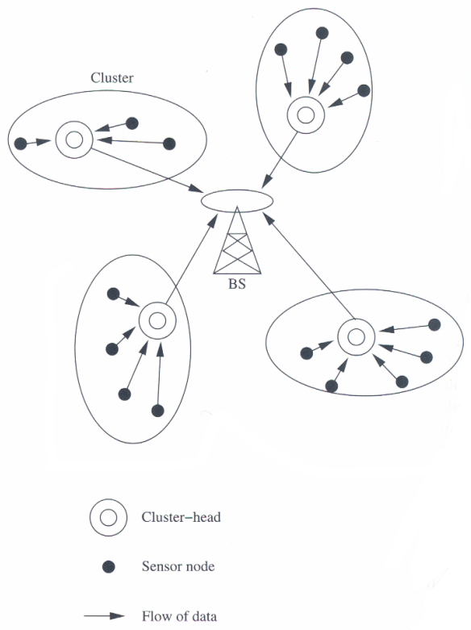
Clustered architecture
33

Slide 34
Low-Energy Adaptive Clustering Hierarchy (LEACH)
LEACH is a clustering-based protocol that minimizes energy waste in sensor networks.
The operation of LEACH is spilt into two phases : setup and steady.
Setup phase:
Cluster heads are selected.
The cluster-heads advertise their selection to all nodes.
All nodes choose their nearest cluster-head by signal strength.
The cluster-heads then assign a schedule for their cluster members.
Steady phase:
Data transmission takes place based on the schedule.
The cluster-heads perform data aggregation/fusion.
After a certain period of time in the steady phase, cluster-heads are selected again through the setup phase.
34

Slide 35
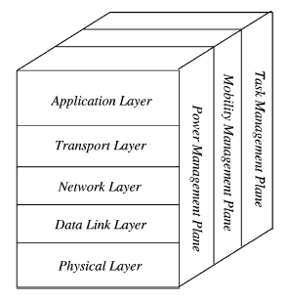
WSN Protocol Stack

Slide 36
WSN Operating Systems
TinyOS
Contiki
MANTIS
BTnut
SOS
Nano-RK

Slide 37
TinyOS
Event-driven programming model instead of multithreading
TinyOS and its programs written in nesC
Main (includes Scheduler)
Application (User Components)
Actuating
Sensing
Communication
Communication
Hardware Abstractions

Slide 38
TinyOS Charactersitics
Small memory footprint
non-preemptable FIFO task scheduling
Power Efficient
Puts microcontroller to sleep
Puts radio to sleep
Concurrency-Intensive Operations
Event-driven architecture
Efficient Interrupts and event handling
No Real-time guarantees

Slide 39
WSN Simulators
NS-2
GloMoSim
OPNET
SensorSim
J-Sim
OMNeT++
Sidh
SENS

Slide 40
WSN Emulators
TOSSIM
ATEMU
Avrora
EmStar

Slide 41
References
I. F. Akyildiz, W. Su, Y. Sankarasubramaniam, and E. Cayirci, “Wireless Sensor Networks: A Survey”, Elsevier Computer Networks, volume 38, Issue 4, pp. 393-422, March 2002.
Dr. Victor Leung, Lecture Slides on “Wireless Sensor Networks”, University of British Columbia, Canada
D. Curren, “A Survey of Simulation in Sensor Networks”
Wikipedia, [Available Online] http://en.wikipedia.org/wiki/Wireless_Sensor_Networks
Fahad Al-Jabarti & Khaled Al-Omar “A Survey on Wireless Sensor Networks (WSN)”
Arslan Munir “Wireless Sensor Networks: A Survey”, University of Florida
Dr. Chenyang Lu Slides on “Berkeley Motes and TinyOS”, Washington University in St. Louis, USA
J. Hill and D. Culler, “A Wireless Embedded Sensor Architecture for System-Level Optimization”, Technical Report, U.C. Berkeley, 2001.
X. Su, B.S. Prabhu, and R. Gadh, “RFID based General Wireless Sensor Interface”, Technical Report, UCLA, 2003.

