Slide 1
Bio-molecules
Lecture 2

Slide 2
What is Life Made of?
Everything is made up of atoms.
Living organisms are made up of cells.
Cells are made up of atoms.

Slide 3
Bio-molecules
1- Structure of Water
2- Organic molecules

Slide 4
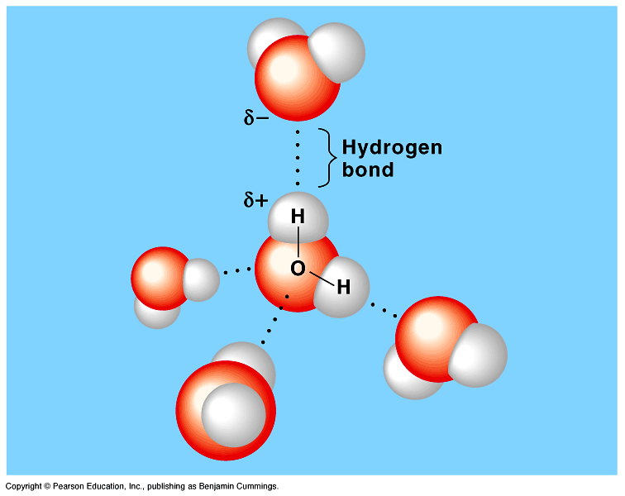
Water
Life exists on Earth because of the abundant liquid water.
Water has been referred to as the universal solvent (capable of dissolving a varity of substances).
Aqueous solutions: are solutions that have materials dissolved in water)
So, it has slightly positive and a slightly negative sides.

Slide 5
Types of solutions
Hydrophilic ( water loving)(Glucose):
Is any substance that has an affinity for water.
Hydrophobic (water fearing) (Lipid):
Is the substances that have no affinity for water. Because they have non-ionic and non-polar covalent bonds.
Thus, water molecules cannot form hydrogen bonds with these molecules.
Amphipathic (Phospholipid):
Has end with affinity for water and the other end with no affinity for water
Cell membrane is Amphipathic consisting of two fatty acid (hydrophobic) and phosphate (hydrophilic) head group.

Slide 6
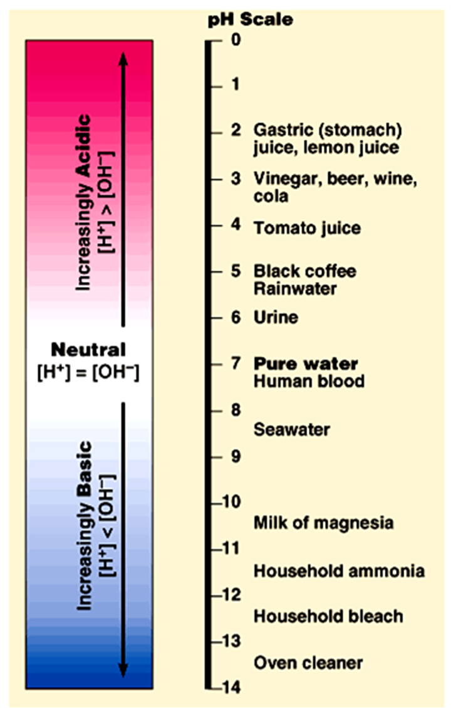
Organisms are sensitive to changes in pH (potential Hydrogen)
The acid:
Is a substance that increases the hydrogen ion (H⁺) concentration in a solution.
When hydrochloric acid is added to water, hydrogen ions dissociate from chloride ions:
HCl H⁺ + Cl⁻
Addition of an acid makes a solution more acidic.
The base:
Is any substance that reduces the hydrogen ion concentration in a solution.
Some bases reduce H⁺ directly by accepting hydrogen ions.
Other bases reduce H⁺ indirectly by releasing OH⁻ that combines with H⁺ to
form water.
NaOH → Na⁺ + OH⁻ OH⁻ + H⁺ → H₂O
Solutions with more OH⁻ than H⁺ are basic solutions.

Slide 7
Organic molecules
4 main molecules involved in life
Carbohydrates
Lipids
Proteins
Nucleic Acids

Slide 8
(Carbohydrates, Lipids, Proteins and nucleic acids)
Mono-mer
Di-mer
Poly-mer
Polymer is a long molecule consists of a chain of similar building molecules (monomers) covalently bounded together.
Polymer can be built up by linking its monomers by dehydration (removing H₂O).
Polymer can be broken down to its monomers by hydrolysis (adding H₂O).

Slide 9
Macromolecule | Monomer
Carbohydrates. | Monosaccharide (sugar).
Lipids. | Fatty acid and glycerol.
Proteins. | Amino acids.
Nucleic acids. | Nucleotides.

Slide 10
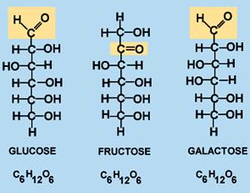
Carbohydrates
Made of: carbon, hydrogen, and oxygen atoms
Job: provide living things with energy
Examples: sugars and starches (corn, rice, potato, bread)

Slide 11
Polysaccharides
Consisted of hundreds -thousands of monosaccharides.
They are two types:
1- Storage: Provide sugar for cell by hydrolysis as Starch (in plants) and Glycogen (in animals).
2- Structural: Serve as building materials for the organism.
as Cellulose in plants (cell wall) and Chitin in the cuticle (Skin) of insects

Slide 12
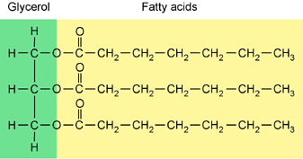
Lipids
Made of: long chains of carbon and hydrogen atoms (with some oxygen).
Job: store energy.
Examples: fats and oils (butter, olive oil)

Slide 13
A) Saturated Fats
There is no double bonds between the carbons. All C are linked with H.
Thus, it is saturated with H.
Most animal fats are saturated.
They are solid at room temperature.
Saturated fats-rich diet results in Atherosclerosis.
B) Unsaturated Fats
These double bonds are formed by the removal of H atoms.
Most vegetable fats (oils) and fish fats are unsaturated.
They are liquid at room temperature.
They can be synthetically converted to saturated (solid) by adding H (Hydrogenation).

Slide 14
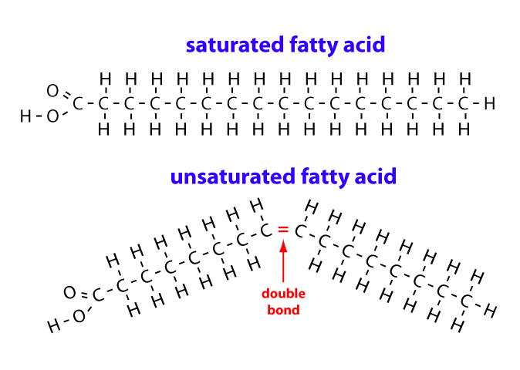

Slide 15
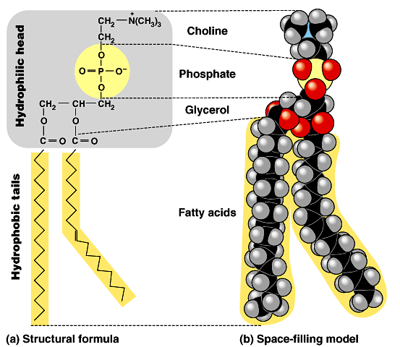
Phospholipids
Phospholipids have two fatty acids attached to glycerol and a phosphate group at the third position.
The phosphate group carries a negative charge.
The fatty acid tails are hydrophobic, but the phosphate group and its attachments form a hydrophilic head.
Thus, it is amphipathic

Slide 16
Proteins
Made of: Nitrogen, Carbon, Hydrogen, and other atoms
Job: Many different jobs in our bodies include structural support, storage, transport of other substances, intercellular signaling, movement, and defense against microbes.
Examples: enzymes, muscles

Slide 17
Nucleic Acids
Nucleic acids are consisted of nucleotides.
Nucleotides contain three parts:
Nitrogenous bases (Adenine, guanine, cytosine, thymine and uracil)
Phosphate group.
Five carbon sugar.
Job: Store genetic information
Examples: DNA, RNA

