Slide 1
Mathematical induction
Mathematical induction is one of the techniques which can be used to prove variety of mathematical statements which are formulated in terms of n, where n is positive integer.
The principle of mathematical induction
Let P(n) be a given statement involving the natural number n such that
Prove that the statement is true for n = 1, i.e., P(1) is true (or true for any fixed natural number)
Assume that truth of P(k) , for any integer k ≥ 1.
prove that the statement P(k+1) is true.
(i.e, truth of P(k) implies the truth of P(k + 1). Then P(n) is true for all natural numbers n).■

Slide 2
Example 1: $1+3+5+…+\left(2n−1\right)$=$n^{2}$
Solution: Let the given statement P(n) be defined as
P(n) :𝟏+𝟑+𝟓+…+(𝟐𝒏−𝟏)=$n^{2}$, for $n∈N$.
(i) Note that P(1) is true, since P(1):1=$1^{2}$.
(ii) Assume that P(k) is true for some$k∈N$, i.e.,
P(k): $1+3+5+…+\left(2k−1\right)=k^{2}.$
(iii) Now, to prove that P(k + 1) is true, we have
1 + 3 + 5 + ... + (2k – 1) + (2(k + 1)-1)=$k^{2}+$(2k + 1)
=$k^{2}$+2k + 1
=${(k+1)}^{2}$
Thus, P(k + 1) is true, whenever P(k) is true. ■

Slide 3
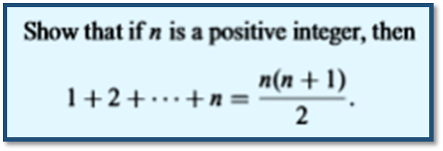
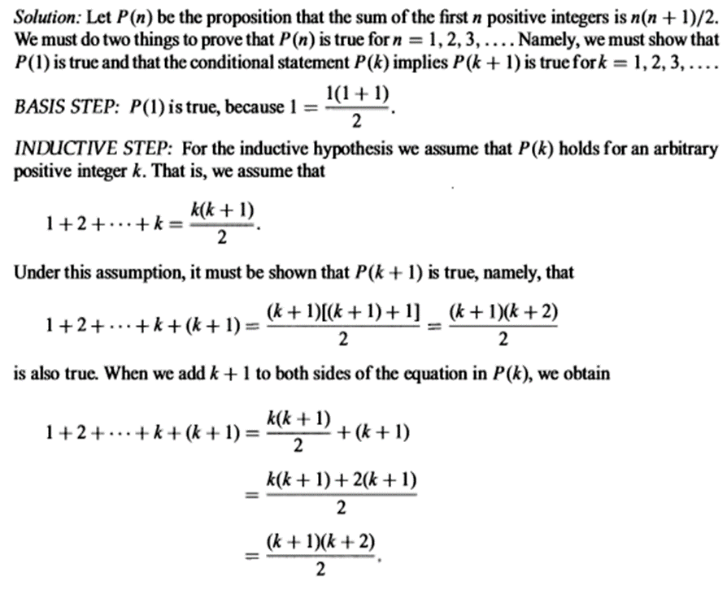
Example 2:

Slide 4
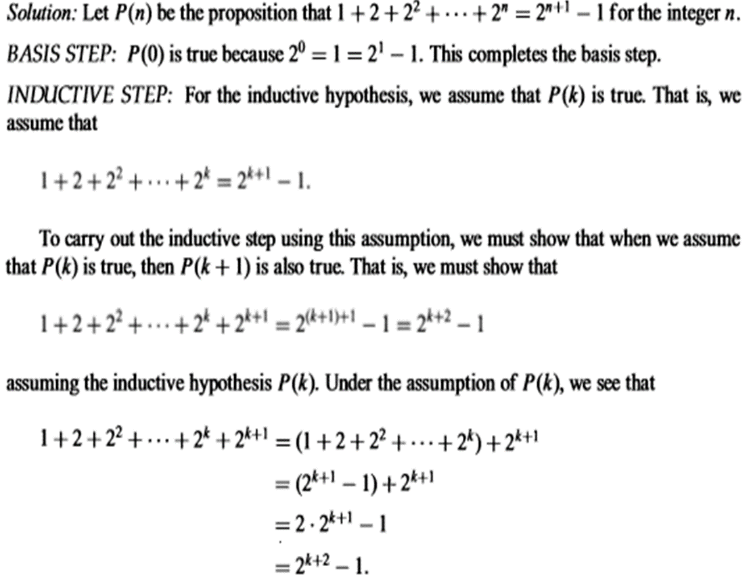
Example 3:

Slide 5
Example 4: For $n∈N,$ it follows that $2^{n}≤2^{n+1}−2^{n−1}−1$
Proof. We will prove this with mathematical induction.
If n = 1, this statement is $2^{1}≤2^{1+1}−2^{1−1}−1$ which simplifies to
$2≤4−1−1.$ which is obviously true.
Suppose $k≥1, 2^{k}≤2^{k+1}−2^{k−1}−1$is true.
We need to show that $2^{k+1}≤2^{\left(k+1\right)+1}−2^{(k+1)−1}−1.$
$$2^{k}≤2^{k+1}−2^{k−1}−1$$
$2\left(2^{k}\right)≤2\left(2^{k+1}−2^{(k+1)−1}−1\right)$ (multiply both sides by 2)
$$2^{k+1}≤2^{k+2}−2^{\left(k+1\right)−1}−2$$
$2^{k+1}≤2^{k+2}−2^{\left(k+1\right)−1}−2+1$ (add 1 to the bigger side)
$$2^{k+1}≤2^{\left(k+1\right)+1}−2^{\left(k+1\right)−1}−1$$
It follows by induction that $2^{n}≤2^{n+1}−2^{n−1}−1$ for each $n∈N.$ ■

Slide 6

Homework:
Prove that by induction:
$1^{2}+2^{2}+…+n^{2}=\frac{1}{6}n\left(n+1\right)\left(2n+1\right), for any n≥1.$
$n!≤n^{n},$for any integer $n≥1.$
$8|3^{2n}−1,$ for any integer $n≥0$

