Slide 1
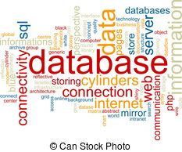
Chapter 2
Database Environment

Slide 2
Objectives
Purpose of three-level database architecture.
Contents of external, conceptual, and internal levels.
Purpose of external/conceptual and conceptual/internal mappings.
Meaning of logical and physical data independence.
Distinction between DDL and DML.
A classification of data models.
Purpose/importance of conceptual modeling.
Typical functions and services a DBMS should provide.
Function and importance of system catalog.

Slide 3
the three-level architecture
An early standard terminology and general architecture for database systems produced in 1971 by Data Base Task Group (DBTG)and Conference on Data Systems and Languages (CODASYL, 1971).
The DBTG recognized the need for a two-level approach with a system view called the schema and user views called subschemas.

Slide 4
the three-level architecture
In 1975, The American National Standards Institute (ANSI)Standards Planning and Requirements Committee (SPARC), ANSI/SPARC produced a similar terminology and recognized the need for a three-level approach with a system catalog:
External Level
Conceptual Level
Internal Level

Slide 5
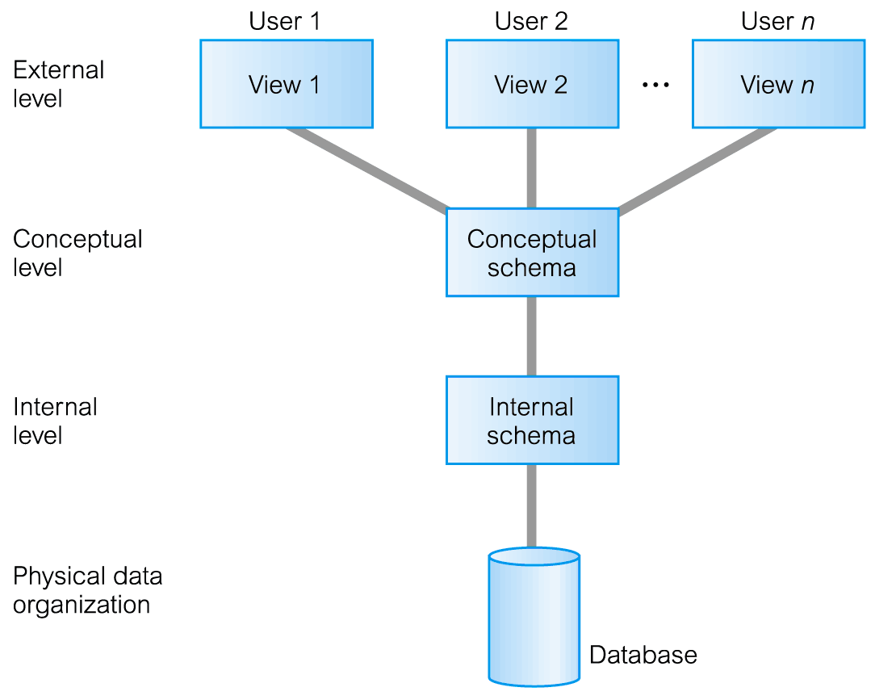
the three-level architecture

Slide 6
The objective of the three-level architecture
Each user should be able to access the same data, but have a different customized view of the data.
Users should not have to deal directly with physical database storage details.
The DBA should be able to change the database storage structures without affecting the users’ views.

Slide 7
The objective of the three-level architecture
The internal structure of the database should be unaffected by changes to the physical aspects of storage, such as the changeover to a new storage device.
The DBA should be able to change the conceptual structure of the database without affecting all users.

Slide 8
the three-level architecture
External Level
Users’ view of the database.
Describes that part of database that is relevant to a particular user.
Conceptual Level
Community view of the database.
Describes what data is stored in database and relationships among the data.

Slide 9
the three-level architecture
Internal Level
Physical representation of the database on the computer.
Describes how the data is stored in the database.

Slide 10
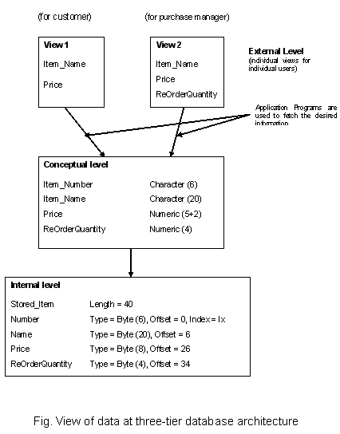
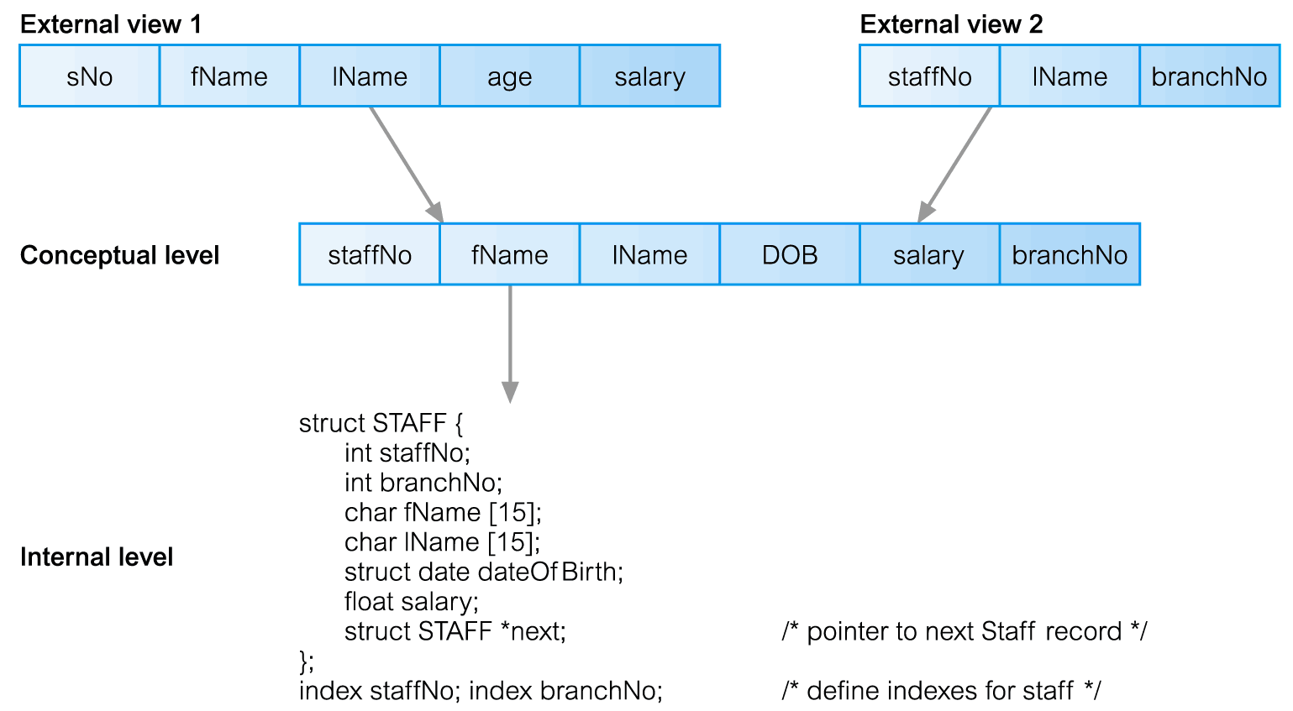
Differences between Three Levels of ANSI-SPARC Architecture

Slide 11
Schema and Instances
Schema: is the description of the DB . It rarely changes.
Instance: is the actual content of the DB at a particular point in time. Data is actual “instance” of DB, changes rapidly.
The concepts of Schema & instances to types &values in programming languages.

Slide 12
Mapping
Mapping : is the process of transforming requests and results between the internal , Conceptual & external levels.
Two type of mapping:
External / conceptual mapping
Conceptual / internal mapping.

Slide 13
Data Independence
A major objective for the three-level architecture is to provide data independence, which means that upper levels are unaffected by changes to lower levels.
There are two kinds of data independence:
Logical independence: immunity of the external schemas to changes in the conceptual schema;
Physical independence: immunity of the conceptual schema to changes in the internal schema.

Slide 14
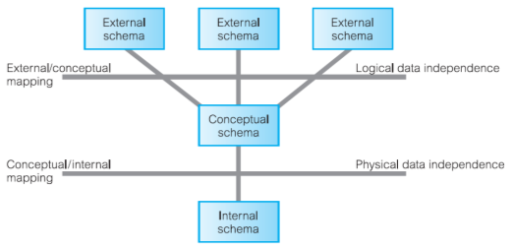
Data Independence

Slide 15
Data Independence
Logical Data Independence
Refers to immunity of external schemas to changes in conceptual schema.
Conceptual schema changes (e.g. addition/removal of entities).
Should not require changes to external schema or rewrites of application programs.

Slide 16
Data Independence
Physical Data Independence
Refers to immunity of conceptual schema to changes in the internal schema.
Internal schema changes (e.g. using different file organizations, storage structures/devices).
Should not require change to conceptual or external schemas.

Slide 17
Database Languages
A data sublanguage consists of two parts: a Data Definition Language (DDL) and a Data Manipulation Language (DML).
The DDL is used to specify the database schema.
The DML is used to both read and update the database.
Database languages are called data sublanguages because they do not include constructs for all computing needs (conditional or iterative statement) .
Many DBMSs have a facility for embedding the sublanguage in a high-level programming language such as COBOL, ‘C’, C++, Java, or Visual Basic.

Slide 18
Data Definition Language (DDL)
A language that allows the DBA or user to describe and name the entities, attributes, and relationships required for the application, together with any associated integrity and security constraints.
The DDL is used to define a schema or to modify an existing one. It cannot be used to manipulate data.
The result of the compilation of the DDL statements is a set of tables stored in special files collectively called the system catalog.

Slide 19
Data Definition Language (DDL)
The system catalog integrates the metadata, that is data that describes objects in the database and makes it easier for those objects to be accessed or manipulated.
The metadata contains definitions of records, data items, and other objects that are of interest to users or are required by the DBMS.
In practice, there is one comprehensive DDL that allows specification of at least the external and conceptual schemas.

Slide 20
Data Manipulation Language (DML)
A language that provides a set of operations to support the basic data manipulation operations on the data held in the database.
Data manipulation operations usually include the following:
Insertion of new data into the database;
Modification of data stored in the database;
Retrieval of data contained in the database;
Deletion of data from the database.
Data manipulation applies to the external, conceptual, and internal levels.

Slide 21
Data Manipulation Language (DML)
The part of a DML that involves data retrieval is called a query language.
The term ‘query’ is therefore reserved to denote a retrieval statement expressed in a query language.
There are two types of DML: procedural and non-procedural
Procedural DMLs: allows the user to tell the system what data is needed and exactly how to retrieve the data.
Non-procedural DMLs: allows the user to state what data is needed rather than how it is to be retrieved.

Slide 22
Data Manipulation Language (DML)
The DBMS translates a DML statement into one or more procedures that manipulate the required sets of records.
Non-procedural languages are also called declarative languages.
Relational DBMSs usually include some form of non-procedural language for data manipulation, typically SQL (Structured Query Language)or QBE (Query-By-Example).
Non-procedural DMLs are normally easier to learn and use than procedural DMLs.

Slide 23
Fourth-Generation Languages (4GLs)
4GL is non-procedural language that allow user to defines what is to be done, not how.
The user does not define the steps that a program needs to perform a task, but instead defines parameters for the tools that use them to generate an application program.

Slide 24
Fourth-Generation Languages (4GLs)
4GL encompass:
Presentation languages, such as query languages and report generators;
Specialty languages, such as spreadsheets and database languages;
Application generators that define, insert, update, and retrieve data from the database to build applications;
Very high-level languages that are used to generate application code.

Slide 25
Data model
Schema is written using a data definition language and is written in the data definition language of a particular DBMS.
The type of this language is too low level to describe the data requirements of an organization in a way that is readily understandable by a variety of users.
The require for a higher-level description of the schema: that is, a data model.
Data model: An integrated collection of concepts for describing and manipulating data, relationships between data, and constraints on the data in an organization.

Slide 26
Data model
A data model can be thought of as comprising three components:
A structural part, consisting of a set of rules according to which databases can be constructed;
A manipulative part, defining the types of operation that are allowed on the data;
A set of integrity constraints, which ensures that the data is accurate.

Slide 27
Data model
Purpose: to represent data in an understandable way.
Categories of data models include:
Object-based
Record-based
Physical.
1st & 2nd categories: used to describe data at the conceptual and external levels
3rd categories: used to describe data at the internal level.

Slide 28
Object-Based Data Models
Object-based data models use concepts such as entities, attributes, and relationships.
An entity is a distinct object (a person, place, thing, concept, event) in the organization that is to be represented in the database.
An attribute is a property that describes some aspect of the object that we wish to record
A relationship is an association between entities.

Slide 29
Object-Based Data Models
Some of the more common types of object-based data model are:
Entity-Relationship (ER)
Semantic
Functional
Object-oriented

Slide 30
record-based model
In a record-based model, the database consists of a number of fixed-format records, possibly of differing types.
Each record type defines a fixed number of fields, typically of a fixed length.
There are three principal types of record-based logical data model:
Relational data model
Network data model
Hierarchical data model.

Slide 31
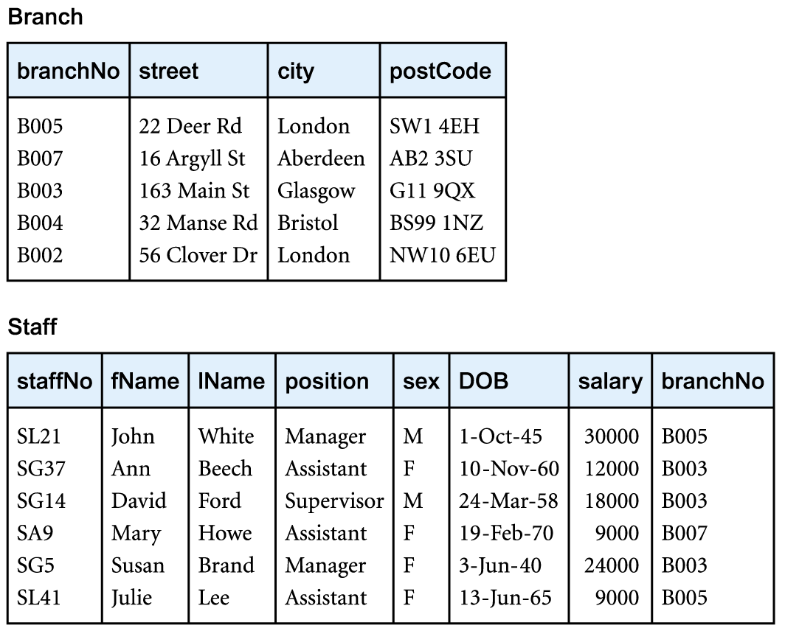
Relational Data Model

Slide 32
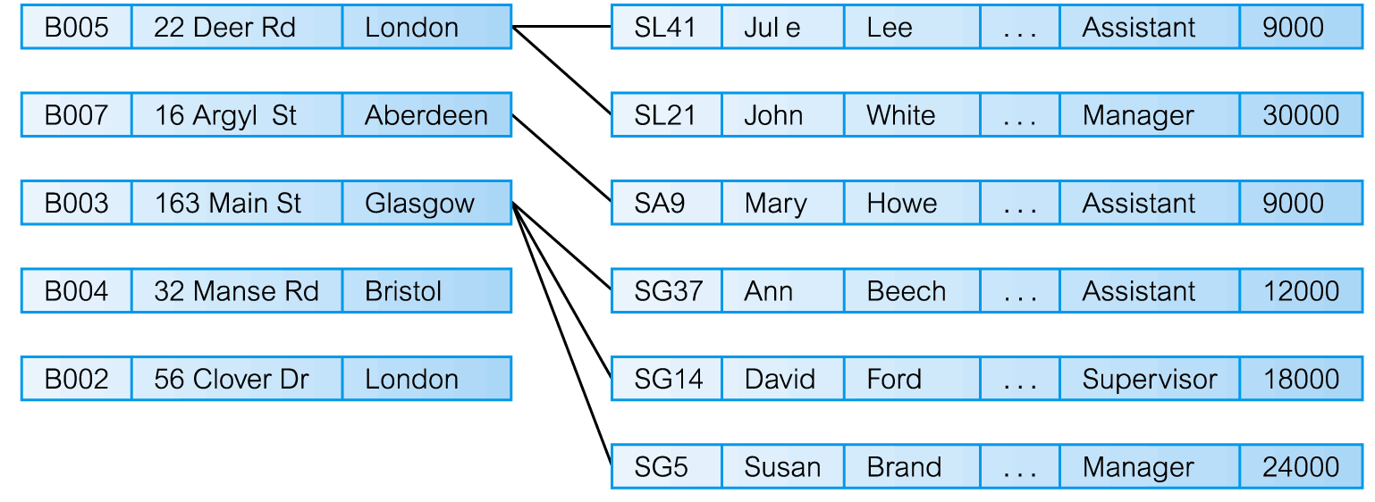
Network Data Model

Slide 33
Hierarchical Data Model

Slide 34
Physical data models
Physical data models describe how data is stored in the computer, representing information such as record structures, record orderings, and access paths.
There are not as many physical data models as logical data models, the most common ones being the unifying model and the frame memory.

Slide 35
Conceptual Modeling
From an examination of the three-level architecture, we see that the conceptual schema is the ‘heart’ of the database.
It supports all the external views and is, in turn, supported by the internal schema.
The internal schema is merely the physical implementation of the conceptual schema.
The conceptual schema should be a complete and accurate representation of the data requirements of the enterprise.

Slide 36
Conceptual Modeling
Conceptual modeling, or conceptual database design, is the process of constructing a model of the information use in an enterprise that is independent of implementation details. (conceptual data model).

Slide 37
Functions of a DBMS
Data Storage, Retrieval, and Update.
A User-Accessible Catalog.
Transaction Support.
Concurrency Control Services.
Recovery Services.
Authorization Services.
Support for Data Communication.
Integrity Services.
Services to Promote Data Independence.
Utility Services.

Slide 38
Functions of a DBMS
Data storage, retrieval, and update
A DBMS must furnish users with the ability to store, retrieve, and update data in the database.
2. A user-accessible catalog
A DBMS must furnish a catalog in which descriptions of data items are stored and which is accessible to users.

Slide 39
Functions of a DBMS
3. Transaction support
A DBMS must furnish a mechanism that will ensure either that all the updates corresponding to a given transaction are made or that none of them is made.
4. Concurrency control services
A DBMS must furnish a mechanism to ensure that the database is updated correctly when multiple users are updating the database concurrently

Slide 40
Functions of a DBMS
5. Recovery services
A DBMS must furnish a mechanism for recovering the database in the event that the database is damaged in any way
6. Authorization services
A DBMS must furnish a mechanism to ensure that only authorized users can access the database

Slide 41
Functions of a DBMS
7. Support for data communication
A DBMS must be capable of integrating with communication software
8. Integrity services
A DBMS must furnish a means to ensure that both the data in the database and changes to the data follow certain rules.

Slide 42
Functions of a DBMS
9. Services to promote data independence
A DBMS must include facilities to support the independence of programs from the actual structure of the database.
10. Utility services
A DBMS should provide a set of utility services.

