Slide 1
What is Life Made of?
Lecture 2: Bio-molecules
Everything is made up of atoms.
Living things are made up of cells.
Cells are made up of atoms.

Slide 2
Bio-molecules
Structure of Water
Organic molecules
Carbohydrates
Lipids
Proteins
Nucleic acids

Slide 3
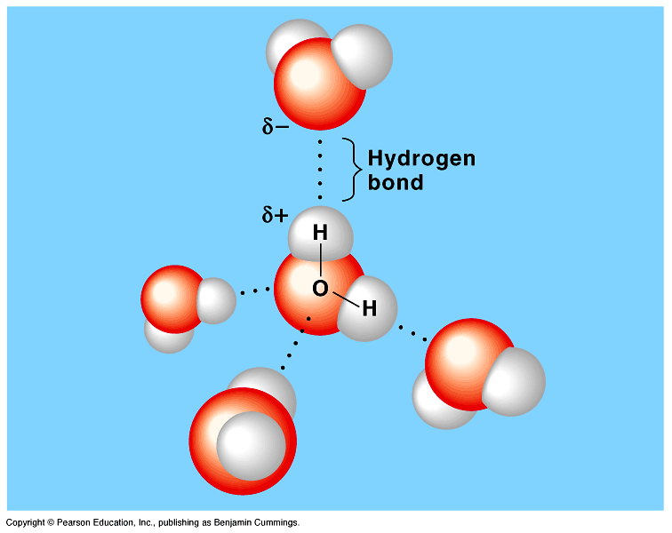
I- Water
Life exists on Earth because of the abundant liquid water.
Water has been referred to as the universal solvent.
Aqueous solutions: are solutions that have materials dissolved in water)
So, it has slightly positive and a slightly negative sides.

Slide 4
Types of solutions
Hydrophilic (Glucose):
Is any substance that has an affinity for water>
Hydrophobic (Lipid):
Is the substances that have no affinity for water. Because they have non-ionic and non-polar covalent bonds.
Thus, water molecules cannot form hydrogen bonds with these molecules.
Amphipathic (Phospholipid):
Has end with affinity for water and the other end with no affinity for water
The Hydrophobic molecules are the major components of cell membranes.
Notes:
Components but not ingredients

Slide 5
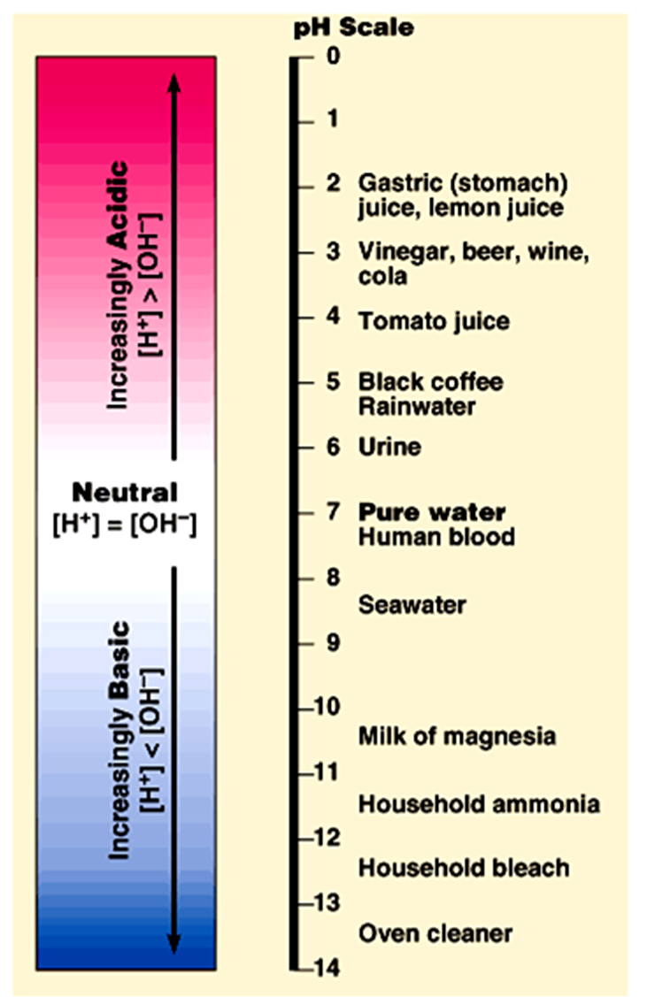
Organisms are sensitive to changes in pH
The acid:
Is a substance that increases the hydrogen ion (H⁺) concentration in a solution.
When hydrochloric acid is added to water, hydrogen ions dissociate from chloride ions:
HCl H⁺ + Cl⁻
Addition of an acid makes a solution more acidic.
The base:
Is any substance that reduces the hydrogen ion concentration in a solution.
Some bases reduce H⁺ directly by accepting hydrogen ions.
Other bases reduce H⁺ indirectly by releasing OH⁻ that combines with H⁺ to form water.
NaOH → Na⁺ + OH⁻ OH⁻ + H⁺ → H₂O
Solutions with more OH⁻ than H⁺ are basic solutions.

Slide 6
2. Biomolecules
4 main molecules involved in life
Carbohydrates
Lipids
Proteins
Nucleic Acids

Slide 7
(Carbohydrates, Lipids, Proteins and nucleic acids)
Mono-mer
Di-mer
Poly-mer
أحادى
ثنائى
عديد
Polymer is a long molecule consists of a chain of similar building molecules (monomers) covalently bounded together.
Polymer can be built up by linking its monomers by dehydration (removing H₂O).
Polymer can be broken down to its monomers by hydrolysis (adding H₂O).

Slide 8
Monomers
Macromolecule
Carbohydrates
Lipids
Proteins
Nucleic acids
Monomer
Monosaccharide (sugar)
Hydrocarbon chains
Amino acids
Nucleotides

Slide 9
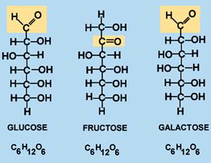
Carbohydrates
Made of: carbon, hydrogen, and oxygen atoms
Function: provide living things with energy
Examples: sugars and starches (corn, rice, potato, wheat)
Notes:
Function but not job
Wheat but not bread

Slide 10
Polysaccharides
Consist of few hundreds to few thousands of monosaccharides.
They are two types:
1- Storage Provide sugar for cell by hydrolysis.
as Starch (in plants) and Glycogen (in animals)
2- Structural Serve as building materials for the organism.
as Cellulose in plants (cell wall) and Chitin in the cuticle of insects
Notes:
Consist but not Consisted

Slide 11
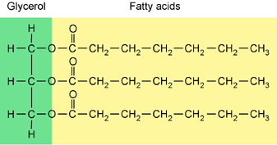
Lipids
Made of: long chains of carbon and hydrogen atoms (with some oxygen).
Function: store energy, repel water
Examples: fats and oils (butter, cheese, oil)

Slide 12
A)- Saturated Fats
The Fatty acid components are saturated (there is no double bonds between the carbons. All C are linked with H.
Thus, it is saturated with H.
Most animal fats are saturated.
They are solid at room temperature.
* Saturated fats-rich diet results in Atherosclerosis.
B)- Un-saturated Fats
These double bonds are formed by the removal of H atoms.
Most vegetable fats (oils) and fish fats are unsaturated.
* They are liquid at room temperature.
They can be synthetically converted to saturated (solid) by adding H (Hydrogenation).

Slide 13
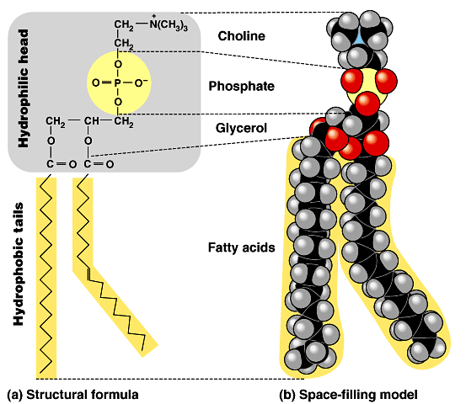
Phospholipids Are major components of cell membranes
Phospholipids have two fatty acids attached to glycerol and a phosphate group at the third position.
The phosphate group carries a negative charge.
The fatty acid tails are hydrophobic, but the phosphate group and its attachments form a hydrophilic head.
Thus, it is amphipathic

Slide 14
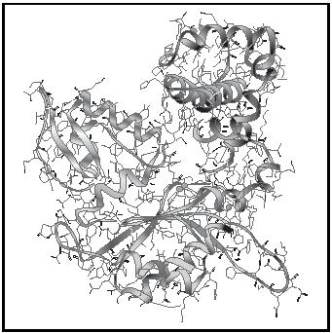
Proteins
Made of: Nitrogen, Carbon, Hydrogen, and other atoms
Function: Many different jobs in our bodies include structural support, storage, transport of other substances, intercellular signaling, movement, and defense against microbes.
Examples: enzymes, muscles, hair

Slide 15
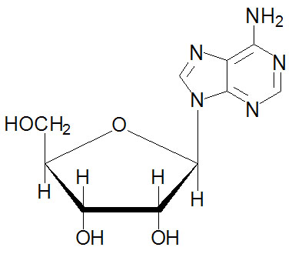
Nucleic Acids
Made of: Phosphorous, Carbon, Nitrogen, Oxygen, and Hydrogen atoms
Function: Store genetic information
Examples: DNA, RNA

