Slide 1
Lecture3: Voice over IP (VoIP)
by
Kiran Kumar Devaram
Varsha Mahadevan
Shashidhar Rampally

Slide 2
What’s VoIP?
VoIP is the ability to make telephone calls and send faxes over IP-based data networks with a suitable quality of service and superior cost/benefit.

Slide 3
Motivations for VoIP
Demand for Multimedia communication
Demand for integration of Voice and Data networks
Cost Reduction in long distance telephone calls

Slide 4
How to VoIP?
Compression to less than 32Kbps
Transfers through Routers, LAN Switches etc, using their Protocols

Slide 5
Voice To/From IP
Analog
Voice
CODEC: Analog to Digital
Compress
Create Voice Datagram
Add Header
(RTP, UDP, IP, etc)
Digital

Slide 6
Voice To/From IP
Digital
Process Header
Re-sequence and
Buffer Delay
Decompress
CODEC: Digital to Analog
Analog
Voice

Slide 7
Configuration Options
Telephone-to-Telephone

Slide 8
PC-to-PC

Slide 9
Telephone-to-PC

Slide 10
Main Issues
Quality of Voice
Interoperability
Security
Integration with Public Switched Telephone Network(PSTN)
Scalability

Slide 11
VoIP Standards
ITU
H.323
IETF
Session Initiation Protocol (SIP)
Media Gateway Control (Megaco)
Signal Transport (SigTran)

Slide 12
ISO Reference Model and VoIP Standards
ISO Protocol layer
Protocols and standards
Presentation
Codecs / Applications
Session
H.323 / SIP / MGCP
Transport
RTP / TCP / UDP
Network
IP
Link
FR, ATM, Ethernet, PPP, HDLC, etc.

Slide 13
H.323 Entities
Terminals
Gateways
Gatekeepers
Multi-point Control Units (MCU)

Slide 14
Terminal
Endpoint on a LAN
Supports real-time, 2-way communications with another H.323 entity
Must support:
Voice - audio codecs
Signaling and setup
Optional support:
Video
Data

Slide 15
Gateway
Interface between the LAN and the circuit switched network
Translates communication procedures and formats between networks
Call setup and clearing
Compression and packetization of voice
Example: IP/PSTN gateway

Slide 16
Gatekeeper
Optional (e.g., Netmeeting does not use gatekeepers), but must perform certain functions if present
Manage a zone (a collection of H.323 devices)
Usually one gatekeeper per zone; alternate gatekeeper might exist for backup and load balancing
Typically a software application, implemented on a PC, but can be integrated in a gateway or terminal

Slide 17
Multi-point Control Unit (MCU)
Endpoint that supports conferences between 3 or more endpoints
Can be stand-alone device (e.g., PC) or integrated into a gateway, gatekeeper or terminal
Typically consists of multi-point controller (MC) and multi-point processor (MP)
MC - handles control and signaling for conference support
MP - receives streams from endpoints, processes them, and returns them to the endpoints in the conference

Slide 18
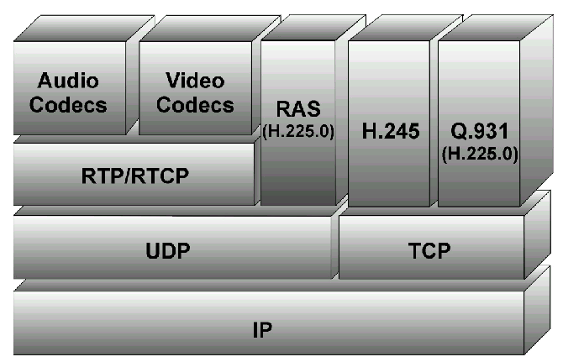
H.323 Protocol Stack
Transfer of real-time media (audio and video)
Registration
Control and Signaling

Slide 19
VoIP Origination side
Analog voice is sent from telephone set to local office.
Local switch converts analog signal to PCM and transmits 64kbps bit stream to the gateway.
Gateway receives 64kbps bit stream and does the following
Compress speech
Convert speech samples to datagrams
Transmit speech datagram over IP network
VoIP Termination side
VoIP gateway receives speech datagrams
Convert Speech datagram to PCM speech.
Transmit 64Kbps PCM speech to Local switch
Local switch converts PCM to analog voice and sends it to telephone set

Slide 20
H.323 Call Stages
Discovery and Registration(RAS) – Who am I
Call Setup(RAS/H.225/Q.931) – Whom I want to call
Call Negotiation (H.245) – These are our capabilities
Media Channel Setup(H.245) – Let’s open audio channel
Media Transport( RTP/RTCP) – Send audio datagrams
Call termination (H.245/H.225/RAS) – We are done

Slide 21
Simple VoIP Call
Caller Number : 785-537-2736
Called Number : 410-944-511
ITSP Number : 1-888-745-2654
Gateway
Local Loop
Trunk
785-537-2736
1-888-745-2654
Local Switch
Caller dials ITSP toll free number : 1-888-745-2654
Caller gets connected to VoIP gateway of ITSP

Slide 22
Simple VoIP Call
Gatekeeper
LRQ
ARQ
LCF
ACF
Gateway
785-537-2736
1-888-745-2654
Local Switch
What is the IP address of the destination gateway for 410-944-2511?-LRQ
The IP address of the destination gateway is 154.23.78.345. – LCF
May I call the IP address? ARQ
You may use XX Kbps bandwidth - ACF

Slide 23
Simple VoIP Call
Gatekeeper
Connect H.225/Q.931/H.245
Gateway
785-537-2736
1-888-745-2654
Destination Gateway
Local Switch
The setup message consists of
Originator gateway IP address (129.130.10.123) Destination Gateway IP address (154.23.78.345)
Caller-number (785-537-2736) Called-number (410-944-2511)
H.245 request: OpenLogicalChannelForAudio

Slide 24
Simple VoIP Call
Gatekeeper
Gateway
ACF
ARQ
785-537-2736
Destination Gateway
1-888-745-2654
Local Switch
Destination gateway makes a request to the gatekeeper to accept the call from the originator
May I call the originator gateway IP address? ARQ
Yes,You may use XX Kbps bandwidth - ACF

Slide 25
Simple VoIP Call
Gatekeeper
Connect H.225/Q.931/H.245
Gateway
785-537-2736
1-888-745-2654
Destination Gateway
Local Switch
Destination gateway sends a connect confirm message.

Slide 26
Simple VoIP Call
Gatekeeper
Local Switch
Local Switch
Gateway
Gateway
Destination Gateway establishes PSTN connection with PSTN circuit switch and H.245 audio channel
Caller will hear the ringer tone generated by the destination switch

Slide 27
SIP: Session Initiation Protocol
IETF’s Signaling Protocol for real time calls and confernces over IP networks.
Integrated heavily w/ Internet technologies such as web (http), email & messaging services, and directory services (LDAP, DNS)
Location Independent and hence opted for Mobile Networks
SIP is complimentary to MGCP
SIP Provides Session Control
SGCP/MGCP Provides Device Control

Slide 28
SIP Architecture
Client/Server in Nature
Major Entities
User Agent
Proxy Server
Redirect Server
SIP Registrar

Slide 29
SIP Entities
User Agents
User Agent Client (UAC)
User Agent Server (UAS)
Network Servers

Slide 30
SIP Proxy Operation
SIP Proxy Server
3. Proxy server looks up phone number or URL to registered called party, SIP server then sends invitation to called party
2. When user picks up phone and dials destination phone number or URL, request is sent to the proxy server
4. Called Client is informed of incoming call by an invitation from proxy server
SIP Client
Caller
SIP Client
Callee
5. SIP Clients open RTP session between themselves when the called user picks up the phone
1. SIP Clients registers with SIP servers at login or at boot up

Slide 31
SIP Redirect Operation
3. Redirect server looks up phone number or URL to registered called party, SIP server then sends the address back to the call originator
SIP Redirect server
2. When user picks up phone and dials destination phone number or URL, request is sent to the redirect server
4. Call originator sends invitation to destination
5. Called client is informed of incoming call by invitation message (Phone ring)
SIP Client
Caller
SIP Client
Callee
6.SIP Clients open RTP session between themselves when the called user picks up the phone
1. SIP Clients registers with SIP servers at login or at boot up

Slide 32
H.323 vs SIP
 | H.323 | SIP
Philosophy | Designed for multimedia communication over different types of networks | Designed to session b/w two points
Reliability | Designed to handle failure of network entities | No defined procedures for handling device failure
Message Encoding | Encodes in compact binary format | Encodes in ASCII text format. Hence easy to debug and process
Addressing | Flexible addressing scheme using URLs and E.164 numbers | Understands only URLs style addresses
Architecture | Monolithic | Modular

Slide 33
QoS Issues
Delay | One way latency for high quality voice must not be greater than 150ms. Delay greater than 50ms leads to echo and talker overlap.
Jitter | Variation in inter-packet arrival time. The solution to this problem is to introduce jitter buffers.
Packet Loss | Loss in excess of 5-10% causes significant degradation in voice quality.
Re-ordering | Packets may arrive out of order and this leads to garbled speech.

Slide 34
Billing Issues
Time-based | Metered by flow duration, time-of-day, time-of-week
Destination, distance, carrier-based | Rated by called and calling station ids associated with the sequence of stages used to support the call
QoS based | Rated by established service parameters such as priority, selected QoS and latency.

Slide 35
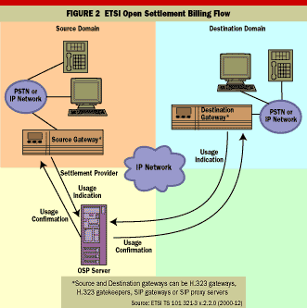
OSP way of billing

Slide 36
Cost Considerations
 | Cisco 1750 Modular Access Router | Ericsson WebSwitch 100 Phone Gateway P4 | Multi-Tech Multi VOIP MVP400 | Nortel Passport 4430 Multi service Access Switch
Price | $2,695 | $1,091 | $2,999 | $3,200
Product type | Router | Gateway | Gateway | Router
Phone ports | Up to 6 | 4 | 4 | Up to 6
H.323 support | Yes | Optional (with external gateway) | Yes | No

Slide 37
References
http://www.protocols.com/papers/voip.htm
http://www.networkmagazine.com/encyclopedia/search?term=IPtelephony
ftp://ftp.netlab.ohio-state.edu/pub/jain/courses/cis788-99/voip_protocols/index.html
http://members.tripod.com/taegon/voip/current_problems.htm
http://www.itpapers.com/techguide/voiceip.pdf
http://www.zdnet.com/products/stories/reviews/0,4161,2626792,00.html

