Slide 1
Lecture 4: Internet of Things
By D. Najla Al-Nabhan

Slide 2
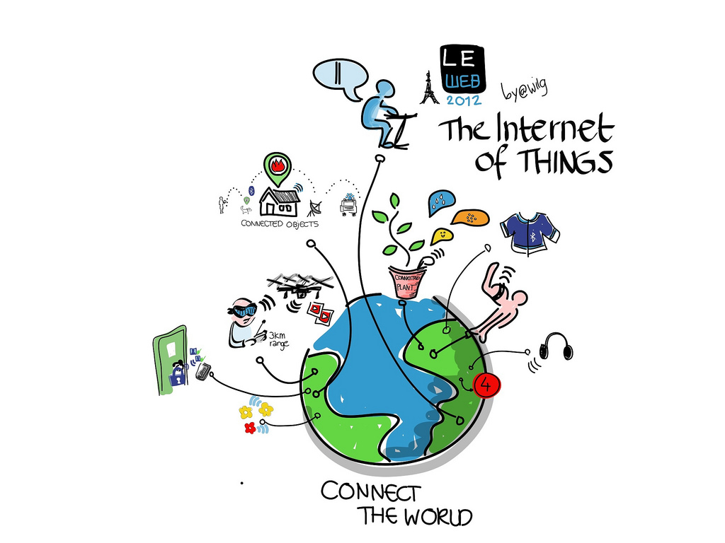
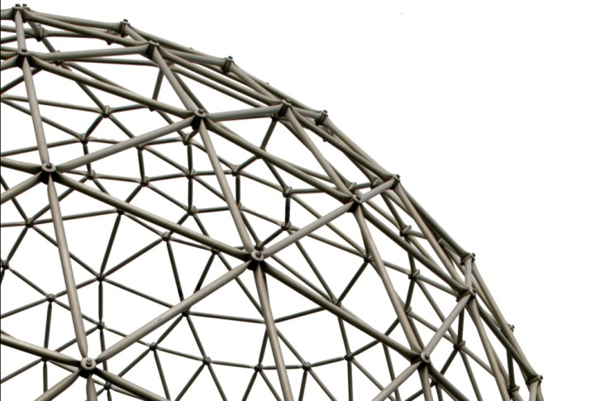
Internet of Things
Notes:
2

Slide 3
Lecture Aims
The main aim of this lecture is to introduce the fundamental concepts of the Internet of Things and its applications and architecture models;
Introduction to the technologies and mechanisms for sensing, actuation, processing and cyber-physical data communication.
Discussing semantic technologies, service oriented solutions and networking technologies that enable the integration of Internet of Things data and services into the cyber world (i.e. the Internet and the Web).
To develop practical skills that can be transferred into a real-world environment.

Slide 4
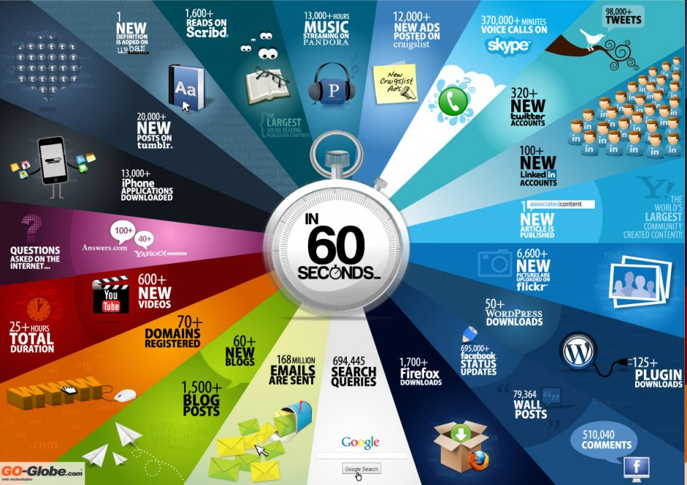

Slide 5
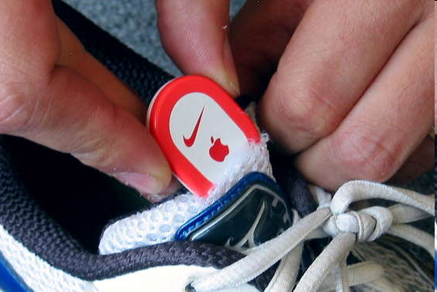
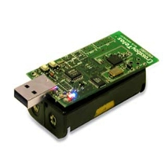
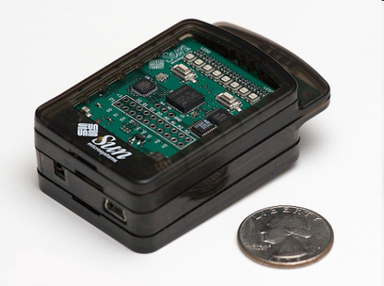
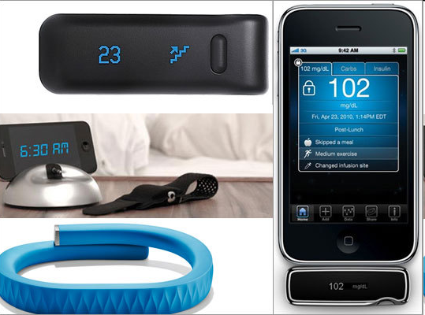
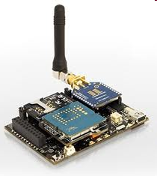
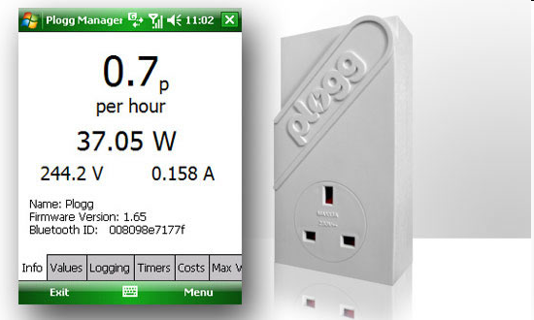
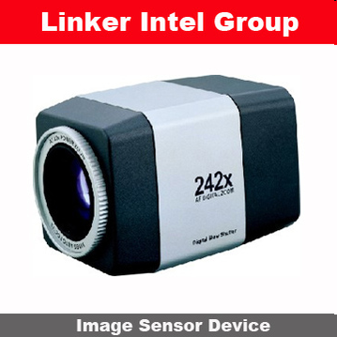
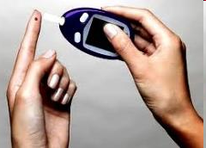
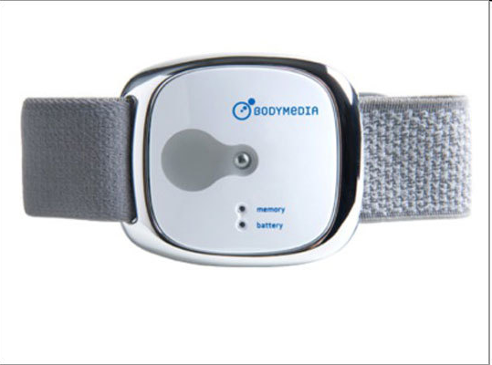
Sensor devices are becoming widely available
- Programmable devices
- Off-the-shelf gadgets/tools

Slide 6
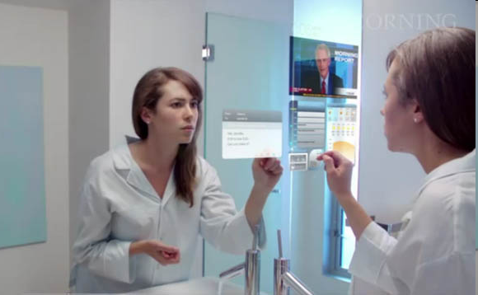
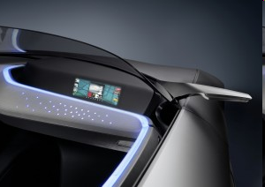
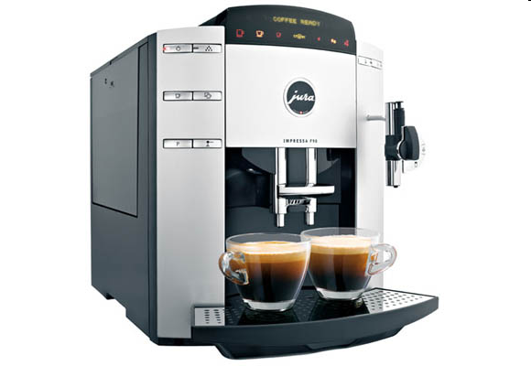
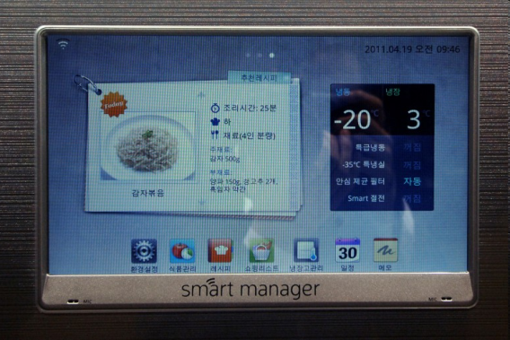
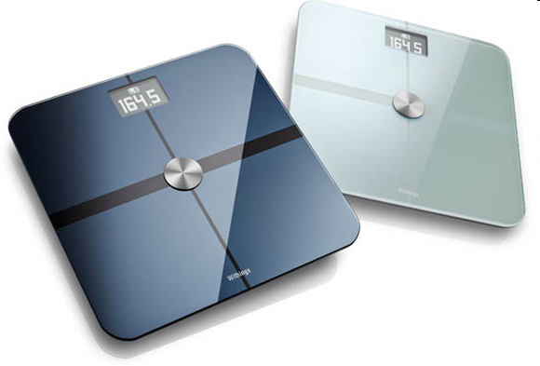
More “Things” are being connected
Home/daily-life devices
Business and
Public infrastructure
Health-care
…

Slide 7




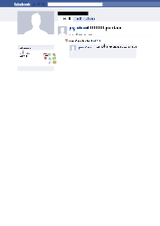
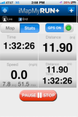
People Connecting to Things
ECG sensor
Internet
Motion sensor
Motion sensor
Motion sensor

Slide 8
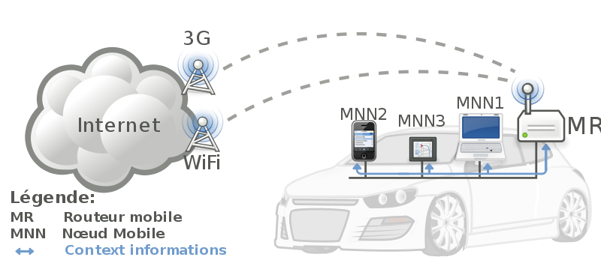


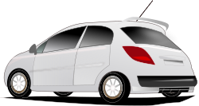
Things Connecting to Things
- Complex and heterogeneous
resources and networks

Slide 9







Wireless Sensor Networks (WSN)
End-user
Core network
e.g. Internet
Gateway
Sink
node
Gateway
Computer services
The networks typically run Low Power Devices
Consist of one or more sensors, could be different type of sensors (or actuators)

Slide 10
How are the networks changing?
Extensions
  More nodes, more connections, IPv6, 6LowPan,...
  Any TIME, Any PLACE + Any THING
  M2M, IoT
    Billions of interconnected devices,
    Everybody connected.
Expansions
  Broadband
Enhancements
  Smart networks
  Data-centric and content-oriented networking
  Context-aware (autonomous) systems

Slide 11
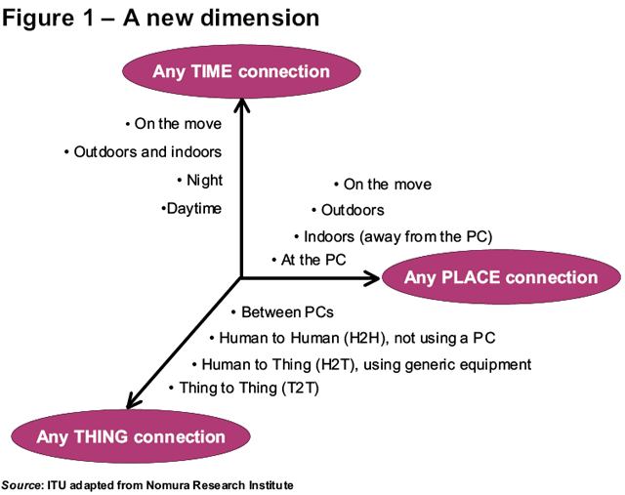
Future Networks
11
11

Slide 12
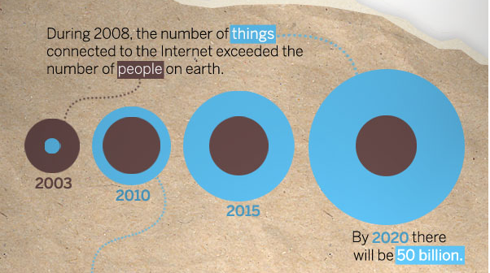
“Thing” connected to the internet
Image Courtesy: : CISCO
12

Slide 13
What does Internet of Things (IoT) mean?
Extending the current Internet and providing connection, communication, and inter-networking between devices and physical objects, or "Things," is a growing trend that is often referred to as the Internet of Things.
“The technologies and solutions that enable integration of real world data and services into the current information networking technologies are often described under the umbrella term of the Internet of Things (IoT)”

Slide 14
Internet of Things Module
Image courtesy: Wilgengebroed

Slide 15
Why should I learn about IoT?
Business trend
Emerging technologies
Growing IoT Services and Application

Slide 16
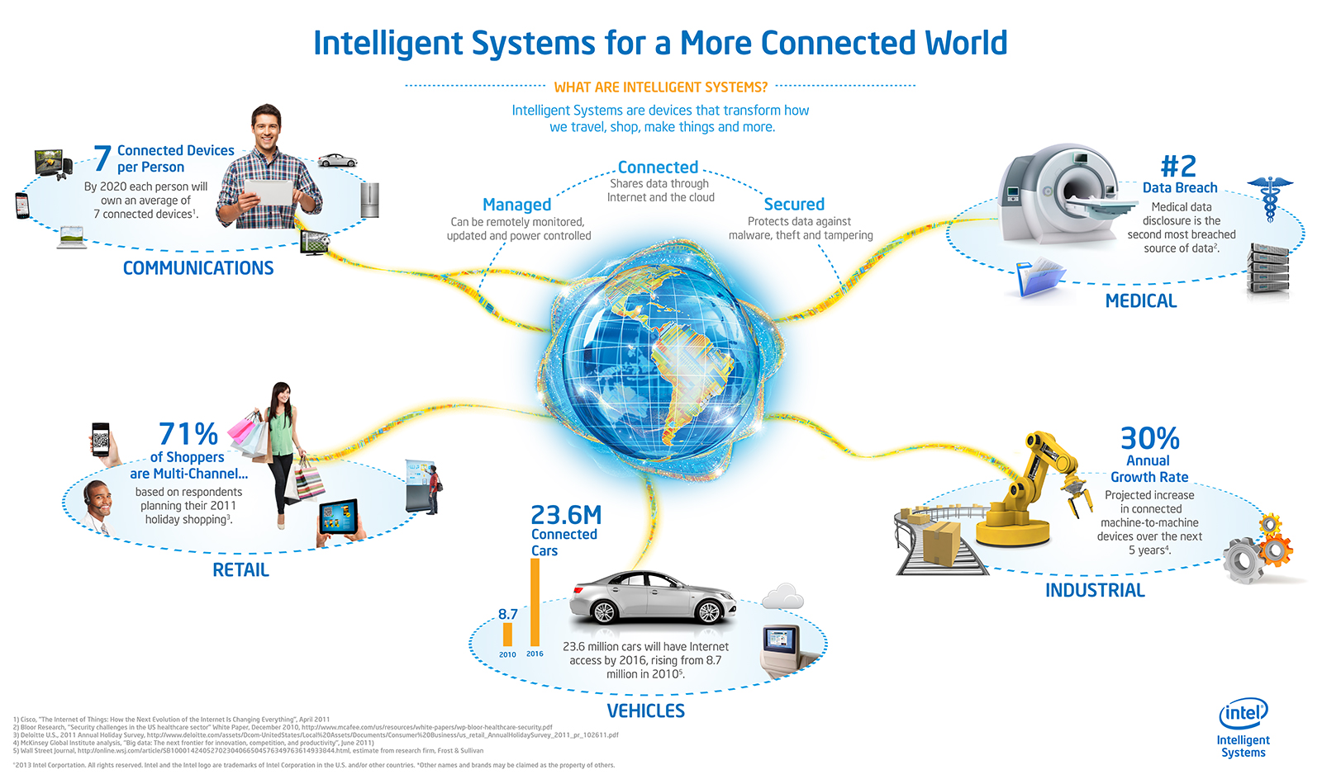
Opportunities
Source: http://blog.trentonsystems.com/internet-of-things-crosses-business-personal-boundaries/

Slide 17
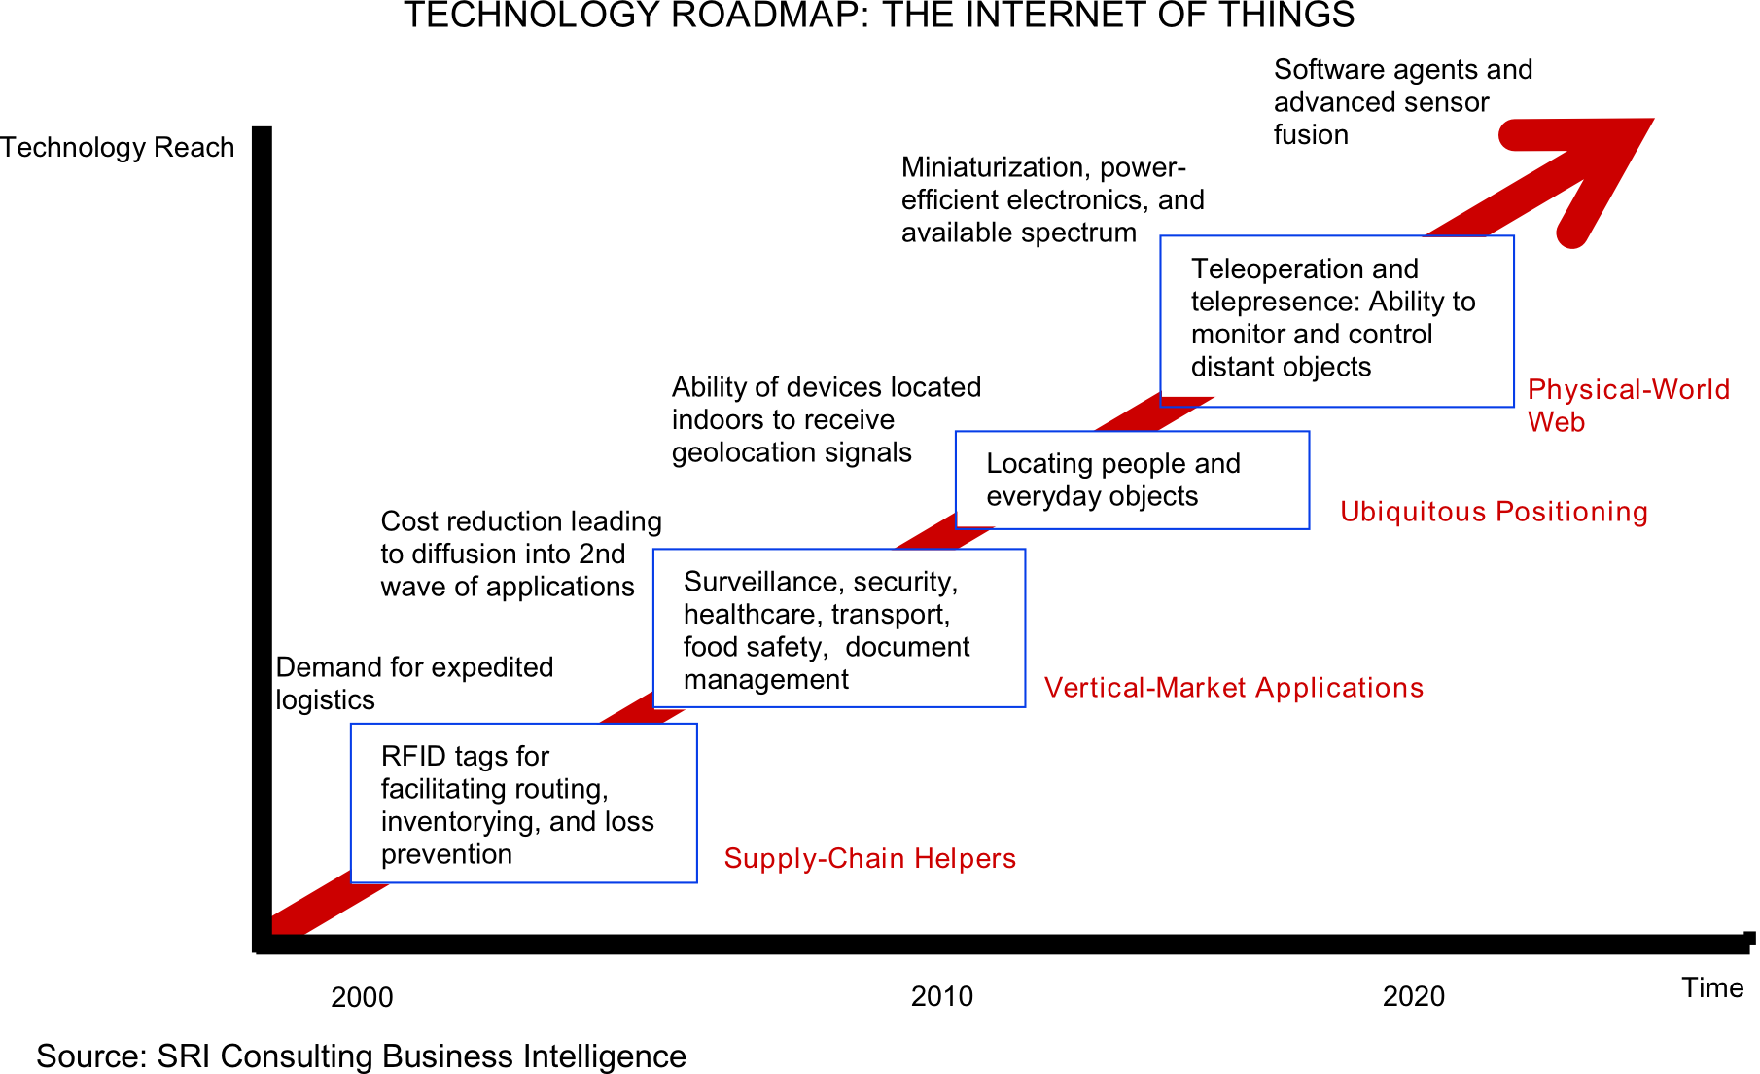
Technology trend

Slide 18
Market growth
“According to a study conducted by Frost & Sullivan in 2011, the global RFID market of $3 billion to $4 billion (in 2009) will grow by twelve percent per year through 2016 and reach a volume of approximately $6.5 billion to almost $9 billion.”
80 percent of all households in the European Union are expected to have intelligent power meters by 2020.
A building’s energy management can then be monitored and administered remotely via a smartphone or a PC. Market experts predict that this global market, which represented $5.3 billion in 2010.
In February 2012 the Chinese government therefore decided to set up a fund of approximately $775 million to support this field in the next five years. It will grow to $11 billion by 2015.
  This sector is expected to grow to $116 billion by 2015, according to a report published by the Xinhua News Agency in late 2010.
Source: Siemens, http://www.siemens.com/innovation/apps/pof_microsite/_pof-fall-2012/_html_en/facts-and-forecasts-growth-market-of-the-future.html

Slide 19
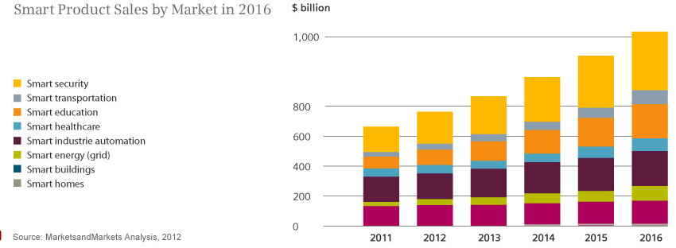
Smart product sales
Source: Siemens, http://www.siemens.com/innovation/apps/pof_microsite/_pof-fall-2012/_html_en/facts-and-forecasts-growth-market-of-the-future.html

Slide 20
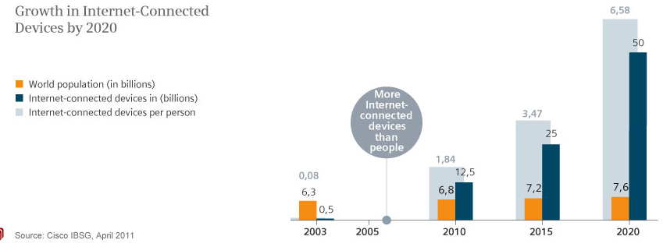
Internet Connected devices
Source: Siemens, http://www.siemens.com/innovation/apps/pof_microsite/_pof-fall-2012/_html_en/facts-and-forecasts-growth-market-of-the-future.html

Slide 21
Global Data Generation
Everyday around 20 quintillion (10^18) bytes of data are produced (Source: http://www-01.ibm.com/software/data/bigdata/).
- This data includes textual content (unstructured, semi-structured, structured) to multimedia content (images, video and audio), on a variety of platforms (enterprise, social media, and sensors).

Slide 22
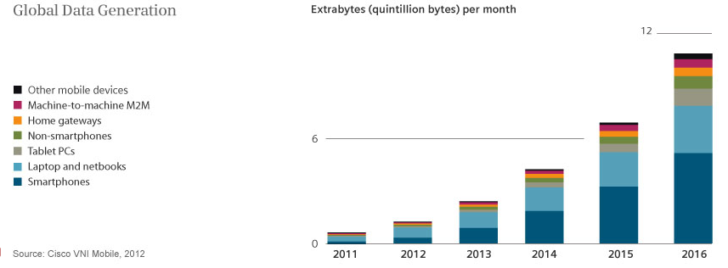
Data Generation

Slide 23
Reading Assignment!
from the following web page; choose one of the Internet of Things application and summarize into points.
http://postscapes.com/internet-of-things-examples/

Slide 24
Reference
  Thanks to professors P.Barnaghi and Dr Chuan H Foh
  http://personal.ee.surrey.ac.uk/Personal/P.Barnaghi/teaching/
  http://surrylearn.surrey.ac.uk
  https://www.youtube.com/watch?v=luwIF96LRRE

