Slide 1
Lecture 4: Mobile Computing
By D. Najla Al-Nabhan

Slide 2
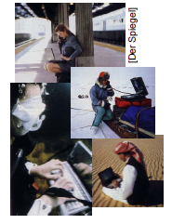
Overview
What is it?
Who needs it?
History
Future

Slide 3
A computer in 2014?
Advances in technology
– More computing power in smaller devices
– Flat, lightweight displays with low power consumption
– New user interfaces due to small dimensions
– More bandwidth (per second? per space?)
– Multiple wireless techniques
Technology in the background of mobile computing
– Device location awareness: computers adapt to their environment
– User location awareness: computers recognize the location of the user and react appropriately (call forwarding, service allocation)
• “Computers” evolve
– Small, cheap, portable, replaceable
– Integration or disintegration?

Slide 4
What is Mobile Computing?
Aspects of mobility
User mobility: users communicate “anytime, anywhere, with anyone”
(example: read/write email on web browser)
Device portability: devices can be connected anytime, anywhere to the network

Slide 5
What is Mobile Computing?
• The demand for mobile communication creates the need for integration of wireless networks and existing fixed networks, such as
– Local area networks
– Wide area networks
– Internet: Mobile IP extension of the Internet protocol IP

Slide 6
Application Scenarios
• Vehicles
• Smart mobile phone
• Invisible computing
• Wearable computing
• Intelligent house or office
• Meeting room/conference
• Taxi/Police/Fire squad fleet
• Service worker
• Disaster relief and Disaster alarm
• Games
• Military / Security
What is important?

Slide 7
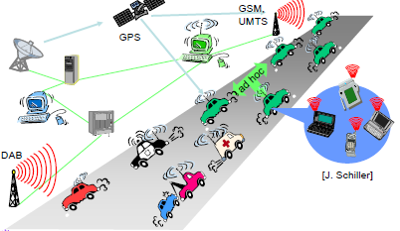
Vehicles

Slide 8
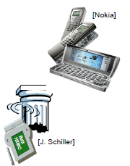
Smart mobile phone
• Mobile phones get smarter
• Converge with PDA?
• Voice calls, video calls
• Email or instant messaging
• Play games
• Up-to-date localized information
Map
Finding Services
( Ask: Find the next Pizzeria, answer: “Hey, we have great Pizza!”)
• Stock/weather/sports info
• Ticketing

Slide 9
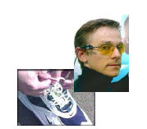
Invisible/ubiquitous/pervasive and wearable computing
• Tiny embedded “computers”
• Everywhere
Notes:
An invisible computing scenario
Alice begins the day with a cup of coffee and her personalized newspaper. When her carpool arrives, she switches to reading the news on her handheld display, where she notices an advertisement for a new 3-D digital camera. It looks like something that would interest Bob, so Alice asks her address book to place the call.
Bob's home entertainment system softens the volume of his custom music file as his phone rings. Alice begins telling Bob about the camera, and forwards him a copy of the advertisement which pops up on his home display. Bob is sold on the product, and after hanging up with her, he asks his electronic shopping agent to check his favorite photography stores for the lowest price and make the purchase.
When the camera arrives, Bob snaps some photos of his neighbor's collection of antique. After reviewing the photo album generated automatically by a web-based service, Bob directs a copy of his favorite image to the art display in his foyer. He also sends a pointer to the photo album to Alice and instructs his scheduling agent to set up a lunch date so that he can thank her for the suggestion.
Elements of the scenario
Large number of task-specific devices
Seamless communication between peers and Internet
Many services available
Secure

Slide 10
Intelligent Office and Intelligent House
• Bluetooth replaces cables
• Plug and play, without the “plug”
• Again: Find the local printer
• House recognizes resident
• House regulates temperature according to person in a room
• Home without cables looks better
• LAN in historic buildings

Slide 11
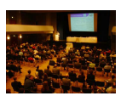
Meeting room or Conference
• Share data instantly
• Send a message to someone else in the room
• Secretly vote on controversial issue
• Find person with similar interests
• Broadcast last minute changes
• Ad-Hoc Network

Slide 12
Taxi / Police / Fire squad / Service fleet
• Connect
• Control
• Communicate
Service Worker Example..

Slide 13
Disaster relief
• After earthquake, tsunami, volcano, etc:
• You cannot rely on infrastructure but you need to
orchestrate disaster relief
• Early transmission of patient
data to hospital
• Satellite
• Ad-Hoc network

Slide 14
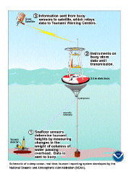
Disaster alarm
• With sensors you might be able to alarm early
• Example: Tsunami
• Example: Cooling room
• Or simpler: Weather station
•Satellite
• Ad-Hoc network

Slide 15
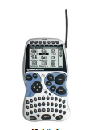
Games
• Nintendo Gameboy [Advance]: Industry standard mobile game station
• Connectable to other Gameboys
• Can be used as game pad for Nintendo GameCube

Slide 16
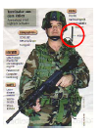
Military / Security
• From a technology standpoint this is similar to disaster relief
• “US army is the best costumer”

Slide 17
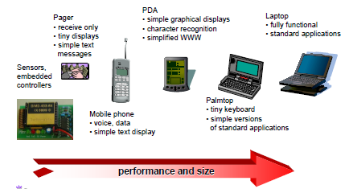
Mobile devices

Slide 18
Effect of Device Portability: Challenges
• Energy consumption
– limited computing power, low quality displays, small disks
– Limited memory (no moving parts)
– Radio transmission has a high energy consumption
– CPU: power consumption
Limited user interfaces
– compromise between size of fingers and portability
– integration of character/voice recognition, abstract symbols
• Loss of data
– higher probability (e.g., defects, theft)

Slide 19
Wireless networks in comparison to fixed networks
Wireless networks has :
• Higher loss-rates due to interference
• Restrictive regulations of frequencies
• Low transmission rates
. Higher delays, more jitter
• Lower security, simpler active attacking
• Always shared medium

Slide 20
Lecture 5: Mobile Computing Part-II
By D. Najla Al-Nabhan

Slide 21
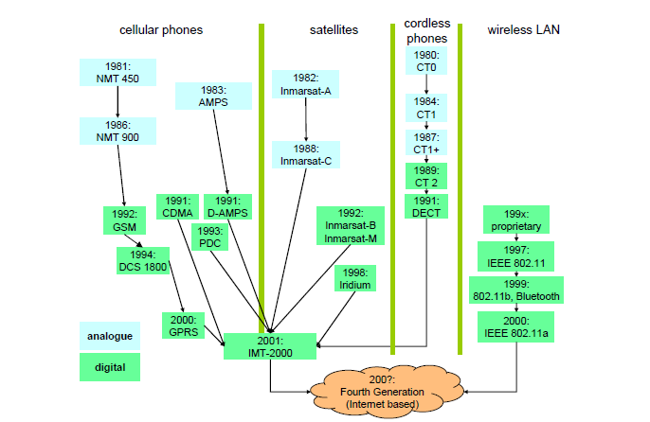
History of Wireless Technologies Development (1980-200?)

Slide 22
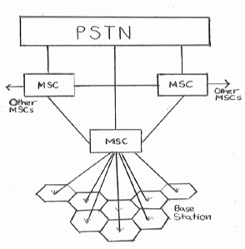
EXISTING CELLULAR NETWORK ARCHITECTURE
A cellular network consists of mobile units linked together to switching equipment, which interconnect the different parts of the network and allow access to the fixed Public Switched Telephone Network (PSTN).
It's incorporated in a number of transceivers called Base Stations (BS).
Every BS is located at a strategically selected place and covers a given area or cell - hence the name cellular communications.
A number of adjacent cells grouped together form an area and the corresponding BSs communicate through a so called Mobile Switching Centre (MSC).

Slide 23
EXISTING CELLULAR NETWORK ARCHITECTURE
The MSC is the heart of a cellular radio system.
MSC is responsible for
routing, or switching, calls from the originator to the destination.
managing the cell,
for set-up, routing control and termination of the call,
for management of inter-MSC hand over and supplementary services,
and for collecting charging and accounting information.
The MSC may be connected to other MSCs or to the PSTN.

Slide 24
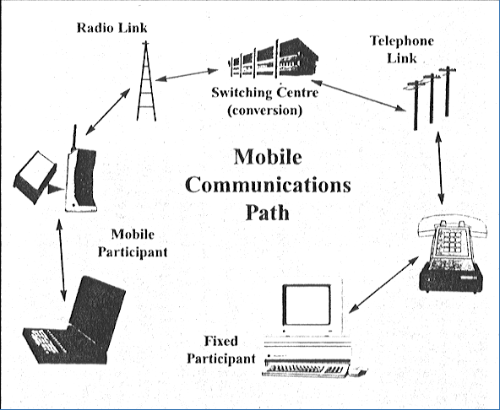
Mobile communication overview
Each cell has a number of channels associated with it.
When a Mobile Station (MS) becomes 'active' it registers with the nearest BS.
The corresponding MSC stores the information about that MS and its position.
This information is used to direct incoming calls to the MS.
If during a call the MS moves to an adjacent cell then a change of frequency will necessarily occur - since adjacent cells never use the same channels. This procedure is called hand over and is the key to Mobile communications.

Slide 25
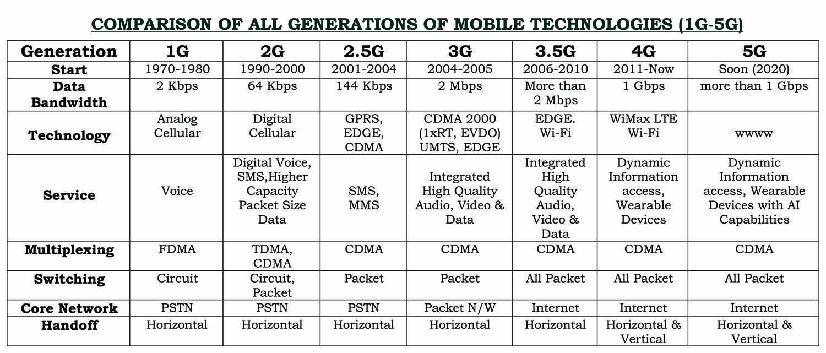
History of Wireless Technologies Development (1980-200?)

Slide 26
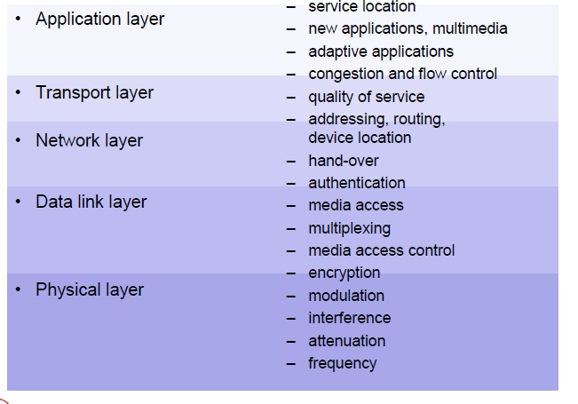
Networking Approaches in mobile Computing

Slide 27
The Future
With the emphasis increasingly on compact, small mobile computers, it may also be possible to have all the practicality of a mobile computer in the size of a hand held organizer or even smaller.
With the rapid technological advancements in Artificial Intelligence, Integrated Circuitry and increases in Computer Processor speeds, the future of mobile computing looks increasingly exciting.
Use of Artificial Intelligence may allow mobile units to be the ultimate in personal secretaries,
which can receive emails and paging messages, understand what they are about, and change the individuals personal schedule according to the message.
The working lifestyle will change, with the majority of people working from home, rather than commuting. This may be beneficial to the environment as less transportation will be utilized.

Slide 28
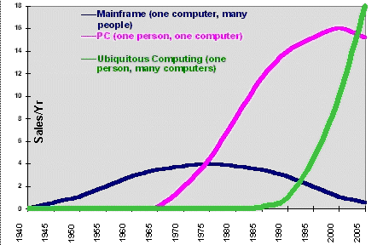
The Future
As shown in the figure, trends are very much towards ubiquitous or mobile computing.
Interactive television, Video Image Compression, mobility in the home, ie. home shopping etc.➔this mobility may be pushed to extreme.
The future of Mobile Computing is very promising indeed, although technology may go too far, causing big changes to society.

