Slide 1
1. The nucleus: Contains the cell’s genetic library المكتبة (المحتوى) الـجيني
Lecture 4: The Cell organelles
The nucleus contains most of the genes in an eukaryotic cell.
The nucleus is separated from the cytoplasm by a double membrane غشاء مزدوج called nuclear membrane.
The nuclear membrane contains pores ثقوب that allow large macromolecules and particles to pass through.
The nuclear membrane helps to maintain the shape of the nucleus.

Slide 2
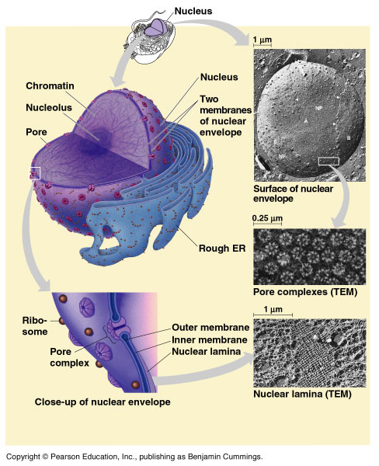

Slide 3
The nucleus contains “chromatin fiber” الخيوط الكروماتينية which is the DNA associated with proteins.
When the cell prepares to divide, the chromatin fibers coil up تلتف to be seen as “chromosomes”.
Each eukaryotic species has a characteristic number of chromosomes رقم مُمَيـٍز من الكروموسومات.
A typical human cell has 46 chromosomes, but sex cells (eggs and sperm) have only 23 chromosomes.
The nucleus directs protein synthesis by synthesizing messenger RNA (mRNA).
The mRNA travels to the cytoplasm and combines with ribosomes to translate its genetic message into the primary structure of a specific protein.
Nucleolus is a dark region involved in production of ribosomes.

Slide 4
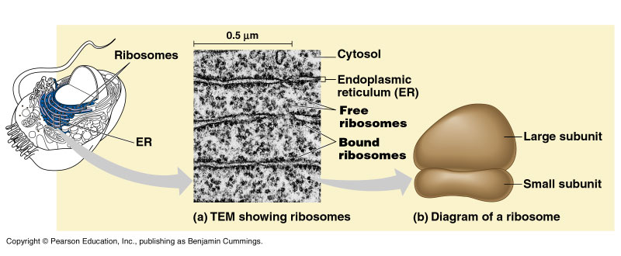
2. Ribosomes: build the cell’s proteins
Ribosomes contain rRNA and protein.
A ribosome is composed of two subunits وحدتين that combine تتحد to carry out protein synthesis بناء البروتين.

Slide 5
In the nucleolus, ribosomal RNA (rRNA) is synthesized and assembled with proteins from the cytoplasm to form ribosomal subunits.
The subunits pass from the nuclear pores to the cytoplasm where they combine to form ribosomes.
Cell types that synthesize large quantities of proteins (e.g., pancreas) have large numbers of ribosomes.
Types of Ribosomes:
Free ribosomes ريبوسومات حرة are suspended معلّق in the cytosol and synthesize proteins that function within the cytosol.
Bound ribosomes ريبوسومات مرتبطةare attached to ملتصق بـ the outside of the endoplasmic reticulum.
These synthesize proteins that are either included into membranes or for secretion إفرازoutside the cell.

Slide 6
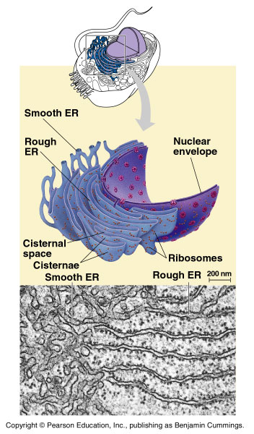
3. The endoplasmic reticulum (ER):
The ER includes membranous tubules
There are two types of ER that differ in structure and function.
Smooth ER looks smoothناعمة because it lacks ribosomes.
Rough ER looks rough خشنة because ribosomes (bound ribosomes) are attached to its outside.

Slide 7
1- The smooth ER: الشبكة الإندوبلازمية الناعمة
It is rich in enzymes and plays a role in metabolic processes.
Its enzymes synthesize lipids دهون (oils, phospholipids, and steroids) including the sex hormones الهرمونات الجنسية.
Extensive توجد بكثرة in the liver, it helps detoxify إبطال الأثر السام drugs المخدرات and poisons السموم
2- The rough ER: الشبكة الإندوبلازمية الخشنة
It is especially abundant متوفرة in those cells that secrete proteins as it contains ribosomes.
These secretory proteins are packaged in transport vesicles that carry them to their next stage.

Slide 8
4- Golgi apparatus: جهاز جولجي
Many transport vesicles حويصلات النقل from the ER travel to the Golgi apparatus for modification تعديلof their contents.
The Golgi function is manufacturing تصنيع, warehousing تخزين, sorting فرز, and shipping نقل materials to outside the cell.
The Golgi apparatus is especially extensive in cells specialized for secretion الإفراز.
The Golgi also manufactures pectin البكتينand polysaccharides.

Slide 9
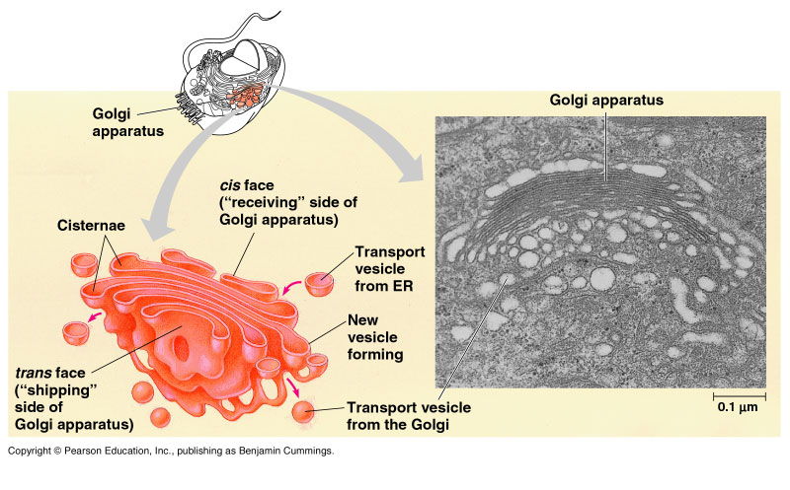

Slide 10
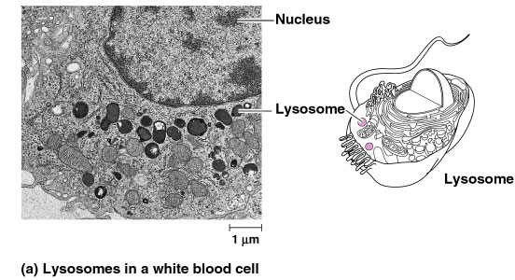
5- Lysosomes: الأجسام المحللة
The lysosome is a membrane-bounded sac كيسof enzymes that digests macromolecules (large molecules).

Slide 11
Lysosomal enzymes:
Lysosomal enzymes work best at pH = 5 (acidic).
They are synthesized by rough ER and then transferred to تنقل إلى the Golgi then to lysosomes.
Functions of Lysosomal enzymes:
They hydrolyze يحللproteins, fats, polysaccharides, and nucleic acids.
Can destroy the cell by autodigestion (autophagy) الهضم الذاتى.
Can fuse with food vacuoles الفجوة الغذائية to digest food, (when a food item is brought into the cell by phagocytosis).
Can also fuse with another organelle or part of the cytoplasm. This process of autophagy called recycling which renews the cell.

Slide 12
6- Vacuoles: الفجوات
Vesicles and vacuoles are membrane-bound sacs أكياس ذات أغشية with diverse functions.
Types of vacuoles:
Food vacuoles فجوة غذائية: from phagocytosis البلعمة, fuse with lysosomes.
Contractile vacuolesفجوة منقبضة : are found in freshwater Protists الطلائعيات , pump excess water out of the cell.
Central vacuoles فجوة مركزي: are found in many mature plant cells.

Slide 13
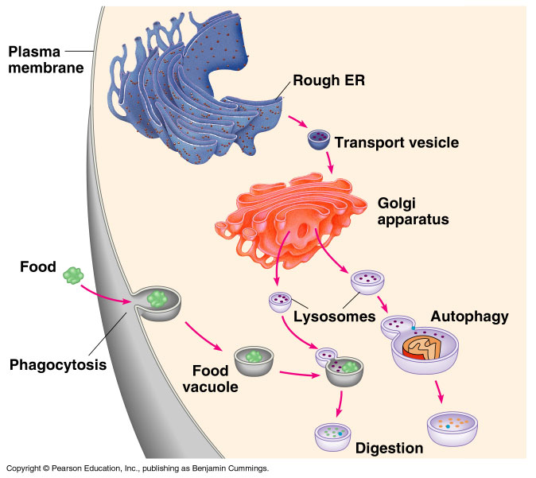

Slide 14
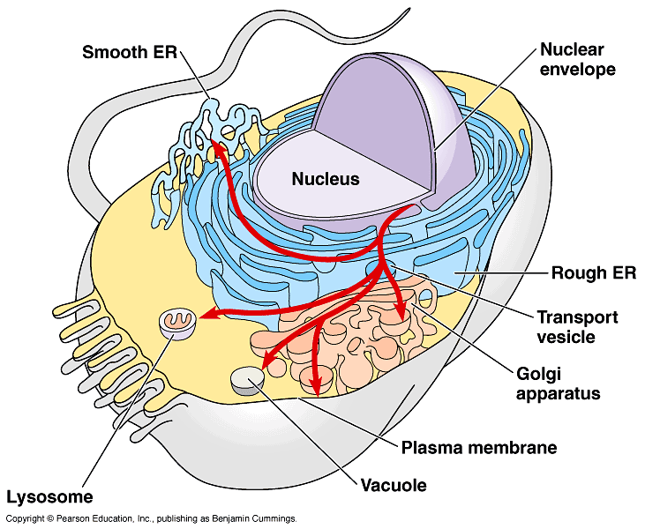
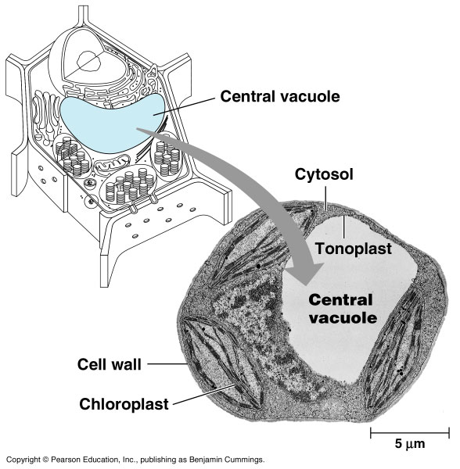
خلية نباتية
الفجوة المركزية
خلية حيوانية

