Slide 1
3.8 Matrices

Slide 2
Matrix
DEFINITION 1
A matrix is a rectangular array of numbers.
A matrix with m rows and n columns is called an m x n matrix.
The size of an mxn matrix is mxn
The plural of matrix is matrices.
A square matrix is a matrix with the same number of rows and columns

Slide 3
Example 1
The matrix size is…………………

Slide 4
A Column Matrix & Raw Matrix
A matrix with only one column is called a column matrix.
Example:
It is a 3x1 column matrix
A matrix with only one raw is called a
raw matrix.
Example:
It is a 1x3 column matrix

Slide 5
Main Diagonal
The shaded entries (a)₁₁ , (a)₂₂ , …., (a)_{nn} are said to be on the main diagonal of A.

Slide 6
Example:
(a)₁₁ = , (a)₁₂ =
(a)₂₁ = , (a)₂₂ =
(a)₃₁ = , (a)₃₂ =

Slide 7
Equality of Tow Matrices
Definition
Two matrices are defined to be equal if
They have the same size and
Their corresponding entries are equal.

Slide 8
Example:
Consider the matrices
Is A=B , B = C , A = C.

Slide 9
Matrix Operations
Addition and Subtraction.
Scalar Multiples.
Multiplying Matrices.

Slide 10
Addition and Subtraction of matrices
DEFINITION 3
If A and B are matrices of the same size, then the sum A+B is the matrix obtained by adding the entries of B to the corresponding entries of A, and
The difference A-B is the matrix obtained by subtracting the entries of B from the corresponding entries of A.
Matrices of different sizes cannot be added or subtracted.

Slide 11
EXAMPLE 2
Consider the matrices
Find: A+B , A-B , A+C, B+C, A-C, and B-C

Slide 12
Scalar Multiples.
DEFINITION 3
If A is any matrix and c is any scalar, then the product cA is the matrix obtained by multiplying each entry of the matrix A by c.
The matrix cA is said to be a scalar multiple ofA.
In matrix notation,
If A =[a_{ij}], then cA =c[a_{ij}], = [ca_{ij}].

Slide 13
Example:
For the matrices
Find: 2A , - B , (1 ⁄3)C

Slide 14
Multiplying Matrices.
DEFINITION 4
Let A be an m x k matrix and B be a k x n matrix. The product of A and B, denoted by AB, is
the m x n matrix with its (i,j)th entry equal to the sum of the products of the corresponding
elements from the ith row of A and the jth column of B.
In other words, if AB = [c_{ij}] then c_{ij} = a_{1j} b_{1j} + a_{i2}b_{2i} + . . . + a_{ik}b_{ki}.

Slide 15
Determining Whether a product Is Defined
Suppose that A, B, and C are matrices with the following sizes:
A B C
3x4 4x7 7x3
Then
AB is defined and is a 3x7 matrix;
BC is defined and is a 4x3 matrix;
CA is defined and is a 7x4 matrix.
The products AC, CB, and BA are all undefined.

Slide 16
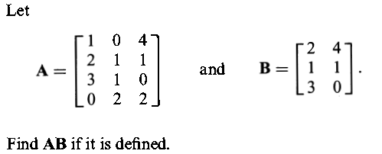
EXAMPLE 3

Slide 17
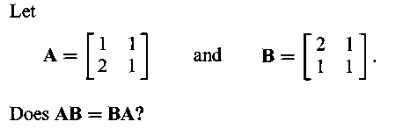
Coution!
AB≠BA
EXAMPLE 4

Slide 18
The Identity Matrices

Slide 19
The Zero Matrices
Definition
A matrix whose entries are all zero is called a zero matrix.
We will denote a zero matrix by 0 unless it is important to specify its size, in which case we will denote the mxn zero matrix by 0_{mxn} .
Examples:

Slide 20
Remark
If A and 0 are matrices of the same sizes, then
A+0= 0+A= A & A-0 = 0-A = A
If A and 0 are matrices of a different sizes, then
A+0 , 0+A, A-0 & 0-A are not defined.

Slide 21
Transpose of Matrix
DEFINITION 6
If A is any mxn matrix, then the transpose of A, denoted by A^{T} , is defined to be the nxm matrix that results by interchanging rows and columns of matrix A; that is; the first column of A^{T} is the first row of A, and the second column of A^{T} is the column row of A, and so forth.

Slide 22
Example:
The following are some examples of matrices and their transposes.

Slide 23
The Trace of a Matrix
Definition
If A is a square matrix, then the trace of A, denoted by tr(A), is defined to be the sum of the entries on the main diagonal of A. The trace of A is undefined if A is not a square matrix.

Slide 24
Example:
The following are example of matrices and their traces:

Slide 25
Singular, nonsingular, and Inverse Matrices
Definition
If A is a square matrix, and if a matrix B of the same size can be found such that AB=BA=I, then A is said to be invertible or nonsingular, and B is called an inverse of A.
If no such matrix B can be found, then A is said to be singular.

Slide 26
Example:
Let
Then
Thus, A and B are invertible and each is an inverse of the other.

Slide 27
Calculating the Inverse of a 2x2 Matrix
Theorem
The matrix
is invertible if and only if ad-bc≠0, in which case the inverse is giving by the formula

Slide 28
Example:
In each part, determine whether the matrix is invertible. If so, find its inverse.
Solution:
The determination of A is
det(A)=
(b) det(A)=

Slide 29
Homework
Page 254
1(a,b,c,d,e)
2(a,b,c,d)
3(a,b,c)
20(a)
Page 35
1(a,b,c,d,e,f,g,h)
2(a,b,c,d,e,f,g,h)
3(a,b,c,d,e,h,i,j,k)
17
Page 49
1(a,d)
3(c)
4
5
12
14
18 (c).

