Slide 1
Lecture 6: Cloud Computing
By D. Najla Al-Nabhan

Slide 2

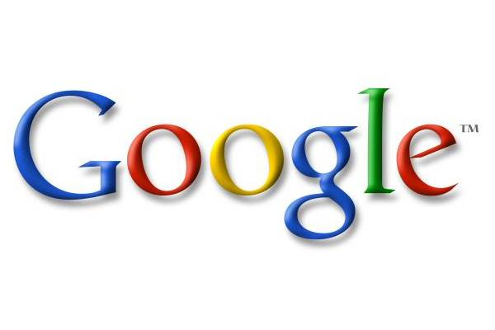



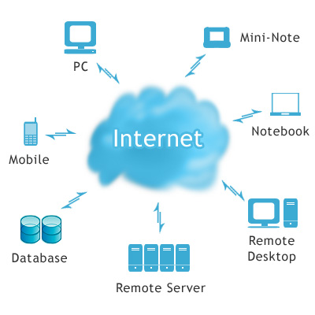
Cloud Computing

Slide 3
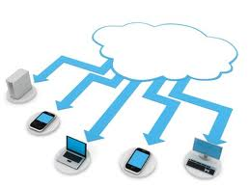
Americans Don’t Understand Cloud Computing
In a recent survey, just 22% of Americans understood the concept of “the cloud”
There is still a wide gap between the perceptions and realities of cloud computing
http://mashable.com/2012/08/29/clueless-cloud/

Slide 4
Agenda
THE WHAT: Understanding Cloud Computing
THE WHY: Appreciating Cloud Computing
THE HOW: Applying Cloud Computing

Slide 5
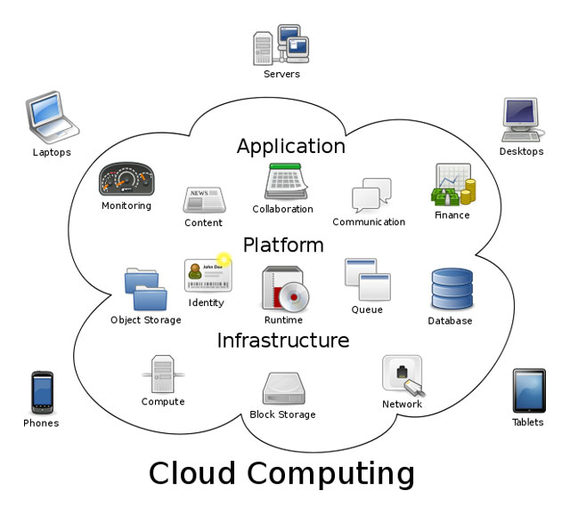
Literal & Visual Definition
“The practice of using a network of remote servers hosted on the Internet to store, manage, and process data, rather than a local server or a personal computer”
http://www.us-cert.gov/reading_room/USCERT-CloudComputingHuthCebula.pdf
http://www.blippitt.com/2010-new-oxford-american-dictionary-new-words/

Slide 6
Data, Internet, and the Cloud
Instead of storing data on individual physical machines, data is stored on the Internet
Cloud can be Public, Private, Community, or Hybrid
Data
Internet
The Cloud
Notes:
Customers can access the cloud from anywhere as long as they have access to an Internet connection
Public - accessed by any subscriber with an internet connection - Gmail
Private - established for specific group or organization and limits access to just that group, in house – US Marines
Community - shared among two or more organizations that have similar cloud requirements - government orgs?
Hybrid - mix of at least two types of cloud
Example: email - not stored on your physical computer - you use your web browser to access it, can access it from anywhere with a connection

Slide 7
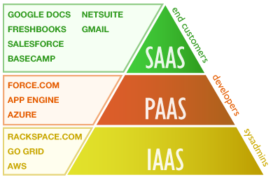
Types of Cloud Computing
Software as a Service (SaaS)
  Access to resources and applications
Platform as a Service (PaaS)
  Access to development and operational components
Infrastructure as a Service (IaaS)
  Completely outsources needed storage and resources
http://www.ladenterprizes.com/pdf/CloudComputing.pdf
Notes:
SaaS - Google's Gmail, instant messaging from AOL, Yahoo, and Google
Info provided through a Web Browser, not a "locally-installed" application, most common – can ensure that all ocations are using the correct application software version and, therefore, the format of the info being recorded and conveyed is accurate
PaaS - Google Maps, Salesforce.com’s Force.com (Because there are no servers or software to buy or manage, you can focus solely on building apps that include built-in social and mobile functionality, business processes, reporting, and search.)
Can run existing applications or develop new ones without worrying about maintaining operating systems, server hardware, load balancing or computing capacity - GROWTH
IaaS - Amazon.com ( EC2 allows users to rent virtual computers on which to run their own computer applications. ), IBM
Delivers utility computing capability on demand that customers can configure and manage, can build their own cloud-enabled applications
Go from least to most secure, subscriber gains more control over what they can do within the space of the cloud

Slide 8
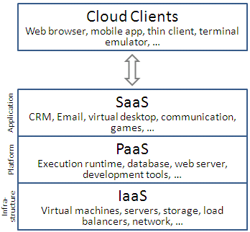
Types of Cloud Computing
Notes:
SaaS - Google's Gmail, instant messaging from AOL, Yahoo, and Google
Info provided through a Web Browser, not a "locally-installed" application, most common – can ensure that all ocations are using the correct application software version and, therefore, the format of the info being recorded and conveyed is accurate
PaaS - Google Maps, Salesforce.com’s Force.com (Because there are no servers or software to buy or manage, you can focus solely on building apps that include built-in social and mobile functionality, business processes, reporting, and search.)
Can run existing applications or develop new ones without worrying about maintaining operating systems, server hardware, load balancing or computing capacity - GROWTH
IaaS - Amazon.com ( EC2 allows users to rent virtual computers on which to run their own computer applications. ), IBM
Delivers utility computing capability on demand that customers can configure and manage, can build their own cloud-enabled applications
Go from least to most secure, subscriber gains more control over what they can do within the space of the cloud

Slide 9
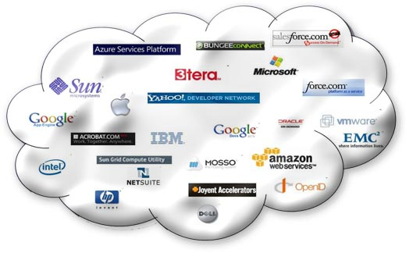
The WHY: Why are so many companies moving to the cloud?

Slide 10
Benefits of Cloud Computing
Availability
Access data anywhere, anytime through standard internet connection
Cost reductions
Pay as you go model
Mobility
Savings on maintenance, repairs, and upgrades
Connecting employees, partners, and suppliers globally
Can access data and application from various devices
Scalability
Users have access to resources that scale quickly based on their demand
http://www.businessweek.com/magazine/toc/09_24/B4135cloud_computing.htm
http://www.sei.cmu.edu/library/assets/whitepapers/Cloudcomputingbasics.pdf

Slide 11

Putting the Cloud to Work: FAA
Increased cost efficiency
Provisioning speed
Scalability
http://www.fastcompany.com/1843699/air-traffic-cloud

Slide 12

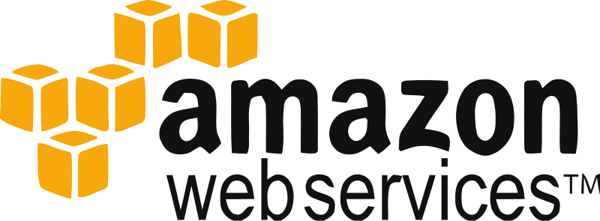

Putting the Cloud to Work:Examples
http://www.tubechop.com/watch/526959
IHG: 9 hotel brands, 660,000 rooms, 153 Million guests a year
Believer in major cloud vendors:
  Amazon Web Services
  Salesforce CRM
Operating their own private cloud:
  “Camelot” supported by cloud services from HP & Verizon
  Runs IHG’s: Revenue Mgmt System, Loyalty program, promotions
http://www.informationweek.com/hardware/data-centers/4-companies-getting-real-results-from-cl/229000706

Slide 13
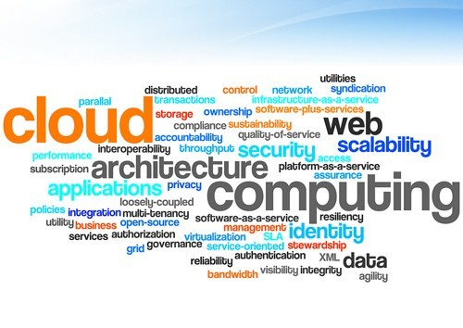
The How: Addressing Risks and Implementing a Strategy

Slide 14
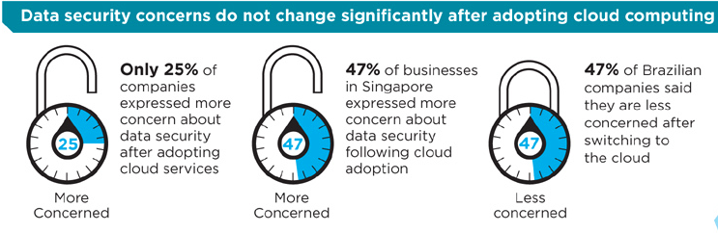
Issues with Cloud Computing:
Security and Privacy
Does the cloud back up your data?
Is your data always safe?
Can you conduct business abroad?
Who is given access to your data?
Who else is on your server?

Slide 15
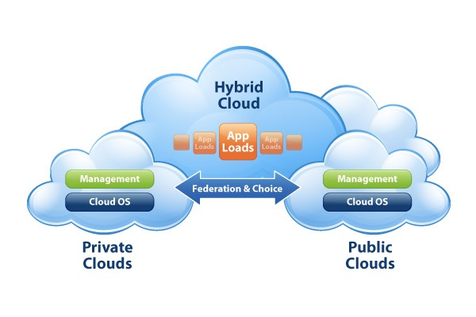
Issues with Cloud Computing: Security and Privacy Solutions
Triage, Secure, and Back Up
Authentication & Authorization
“Private Cloud” vs. “Public Cloud”
Hybrid Approach

Slide 16

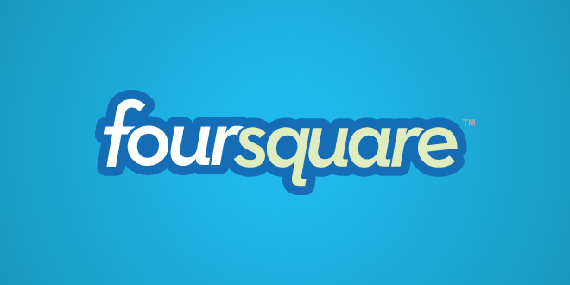

Issues with Cloud Computing: Reliability
Prevention & Strategic Response
  Choice of server
  Think ahead
  Hybrid Approach

Slide 17
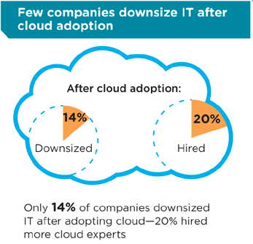
Issues with Cloud Computing: Downsizing Workforces?
Increasing need for cloud experts and third-party companies
Increase in workforce leads to increase in efficiency

Slide 18
Final Remarks
Understanding cloud computing will allow you to understand both the risks and the rewards
“Companies that don’t understand the risk just shouldn’t use cloud computing, the potential for a security threats or a compliance violation can be high”

Slide 19
https://www.youtube.com/watch?v=IJUhfcKqdS0
Homework :
  Answer all questions in slide 14
  Find 4 examples for cloud systems.

